Slide 1

UNIT I
LINUX : The Operating System

Slide 2
Linux – The Operating System
Linux is a freely distributed operating system that
Manages computer hardware resources (hard disk, I/O devices, Memory etc)
Provides common services for efficient execution to various application software.

Slide 3
Unix
The development began in 1960’s under the name Multics.
First Version was created in Bell Labs in 1969 by Ken Thompson and Dennis Ritchie, and it was named Unics.
Unix was entirely written in C language.
In 1980’s, AT&T Bell Labs implemented commercial license on Unix distribution and the first version System V was commercialized.

Slide 4
Unix
The &University of California, Berkeley, continued the development of its own version of Unix, called BSD (Berkely Software Distribution).
Through 1980’s and 90’s, many companis commercialized and licensed their own versions of Unix.
In early 1990’s, AT&T sold all their rights including its further development to Novell.
In 1995, Novell sold all their rights including its further development to SCO (Santa Cruz Operation).
In 2005, Sun Microsystems released the majority of its code with Open Solaris
BSD continued its development and released free version of unix, called FreeBSD.

Slide 5

History Of Linux
The name "Linux" comes from the Linux kernel, originally written in 1991 by Linus Torvalds.
In April 1991, Linus Torvalds, a 21-year-old student at the University of Helsinki, Finland started working on some simple ideas for an operating system and developed his own kernel.

Slide 6

The GNU Project
It was released for free on the Internet and generated the largest software-development phenomena of all time.
Because of GNU software, created by the Free Software Foundation, Linux has many utilities to offer.
The GNU Project is a free software, mass collaboration project, announced on September 27, 1983, by Richard Stallman at MIT(USA).
The FSF is developing a new kernel called
HURD to replace the Linux kernel in GNU
systems.

Slide 7
Introduction to Linux
Introduction to Linux
The Kernel version 1.0 was released in 1994 and today the most recent stable version is 2.6.9
Developed under the GNU General Public License, the source code for Linux is freely available to everyone.
Linux can be installed on a wide variety of computer hardware, ranging
from mobile phones, tablet computers and video game consoles, android
powered devices to mainframes and Supercomputers.
Linux is a leading server operating system, and runs the 10 fastest
supercomputers in the world.
Linux lack in games applications

Slide 8
Linux Distributions
Most popular and user friendly:
Ubuntu
Linux Mint
Fedora
Mandriva
Open SuSE
Simple and easy (first time choice):
Lycoris
Xandros
Linspire

Slide 9
Linux Distributions
Natural, stable and secure :
Slackware
Red Hat
Debian
Run-from-CD solution
Knoppix
CentOS

Slide 10
Unix Distributions
HP – UX
Solaris
IBM AIX
Mac OS
IRIX
Apple OS X

Slide 11
Features of Linux
Multi user and Multi tasking
Multi processor
Multi threading
Highly customizable
Secure
Freely distributed and Open source
Stable
Network Friendlinesss

Slide 12
Features of Linux
Flexible
Compatible
Fast and easy installation
Hierarchical file system
Supports various common file systems
Supports many networking protocols like TCP, IP, IPv6, AX.25, X.25, DDP(Appletalk), etc.

Slide 13
UNIX/Linux : Common Features
Support multiple, simultaneously logged in users
Hierarchical file system,
Support for running processes in foreground or background mode
Written in C
Windows manager (KDE, Gnome)
Various office applications such as OpenOfice
Shells like ksh, csh, bash.
Development tools like perl, python, C/C++ compiler etc
Back up and recovery tools
Notes:
13

Slide 14
UNIX/Linux : Differences
Linux is just a kernel
License and cost
Security firewall software
System start up scripts
HP – UX : /sbin/init.d
AIX : /etx/rc.d/init.d
Linux : /etc/init.d
User friendly
Types of users
File system support

Slide 15
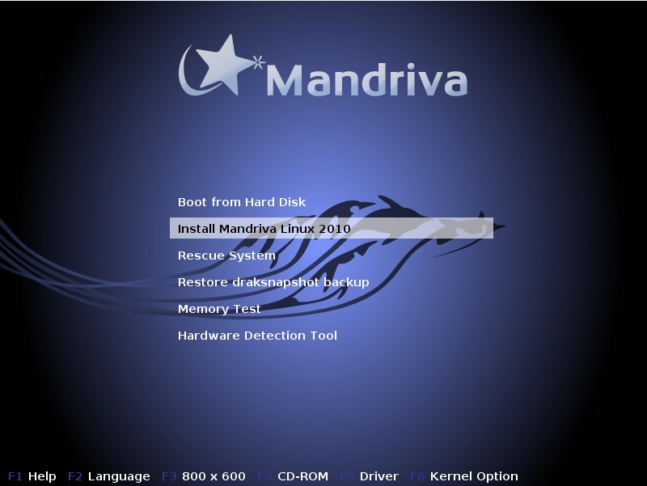
Installation of Mandriva Linux 2010 Steps

Slide 16
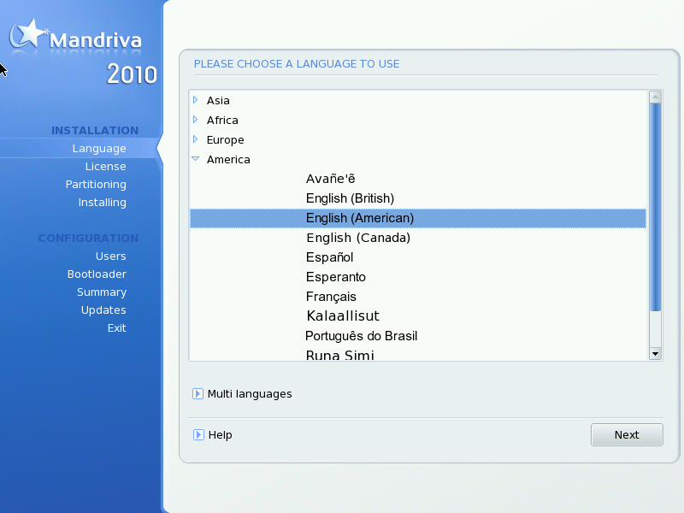
Choosing your Language

Slide 17
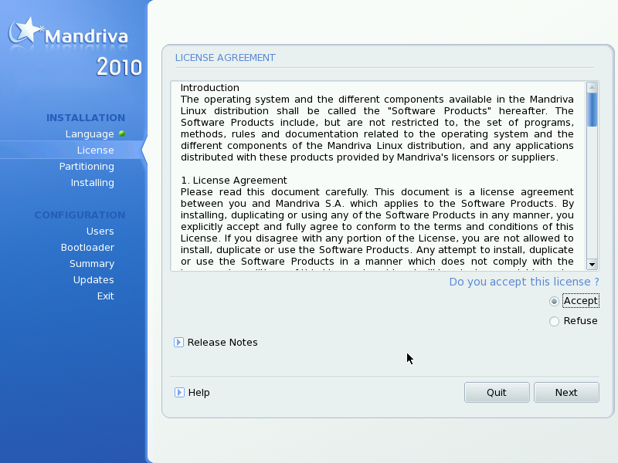
License Terms of the Distribution

Slide 18
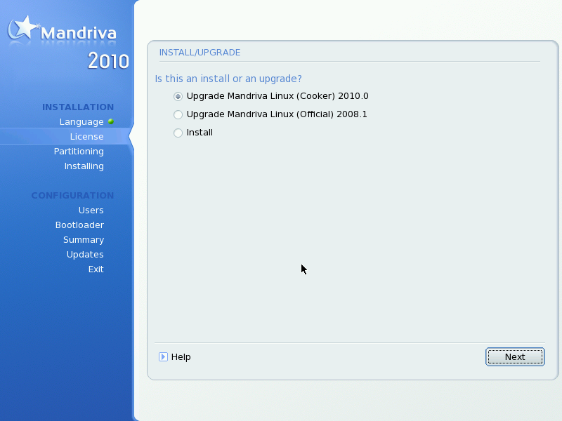
Installation Class

Slide 19
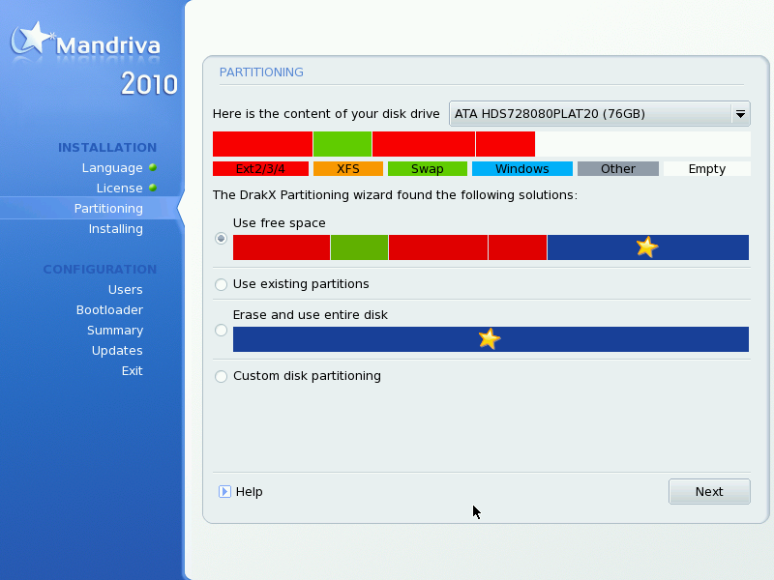
Where to Install Mandriva on your Hard Disk

Slide 20
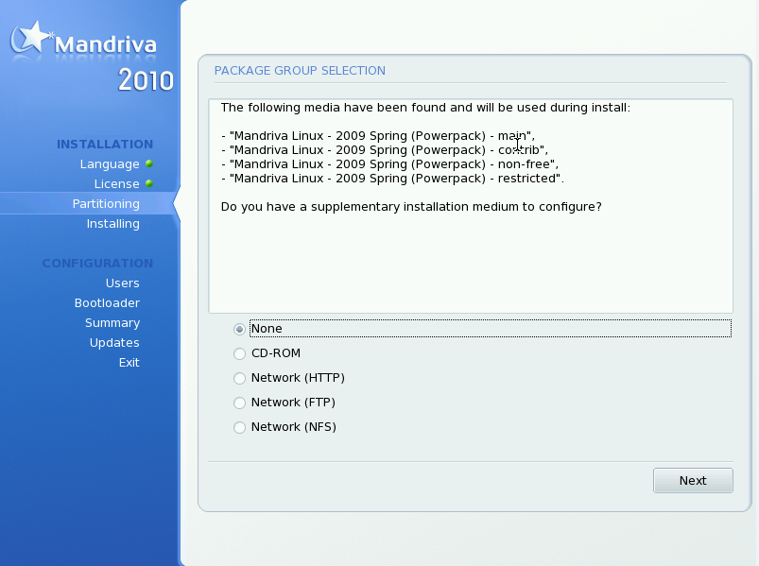
Package Selection

Slide 21
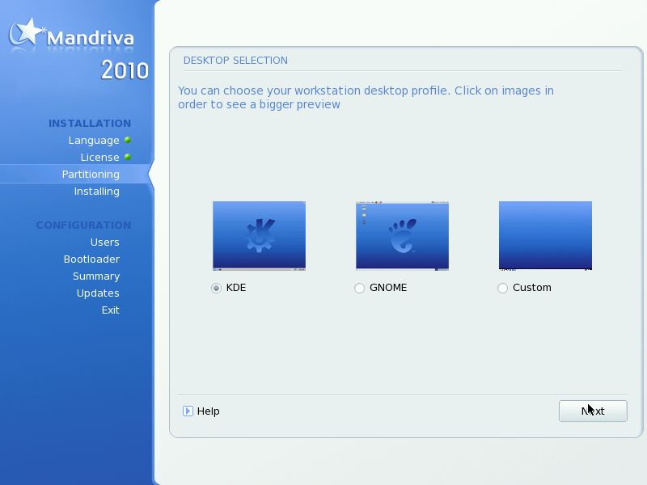
Choosing a Graphical Environment

Slide 22
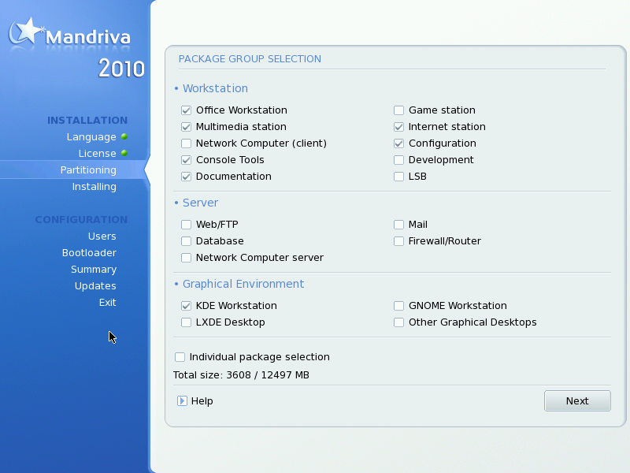
Choosing Package Groups to Install

Slide 23
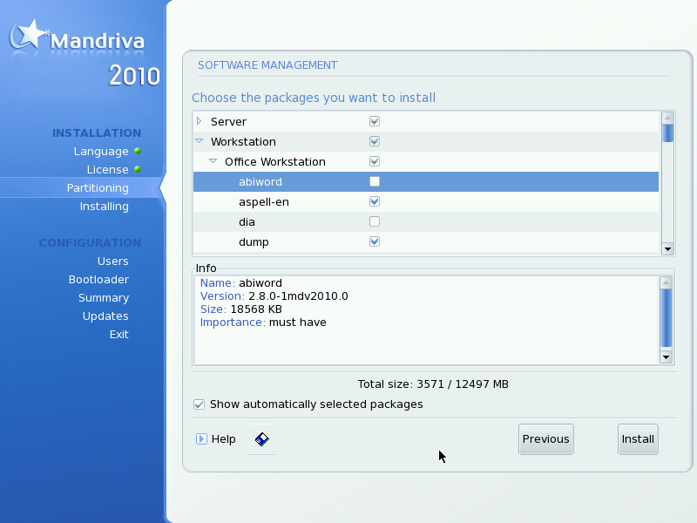
Choosing Individual Packages to Install

Slide 24
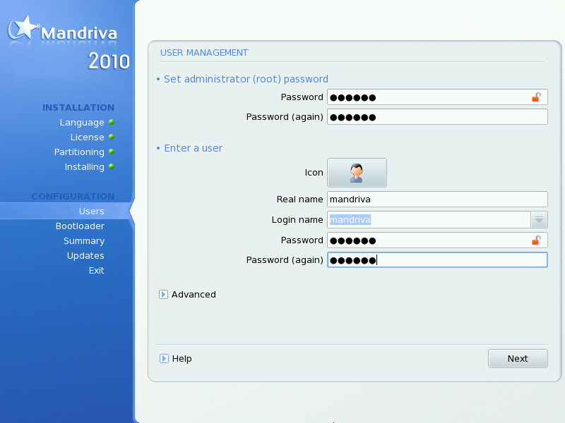
User Management

Slide 25
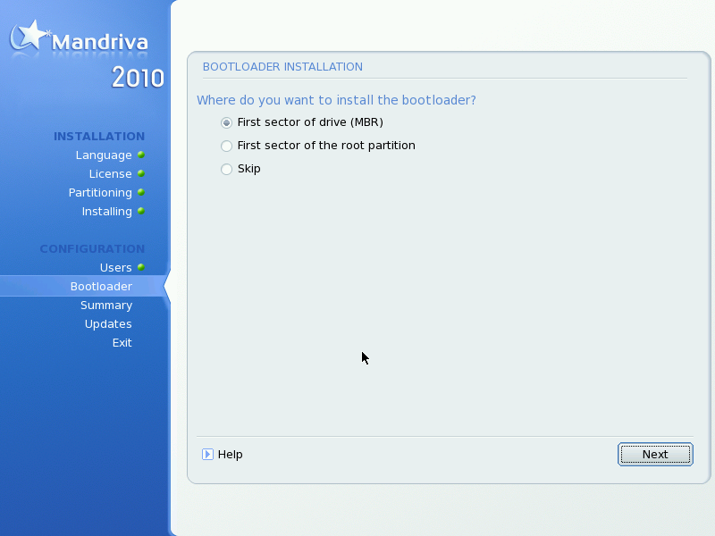
Installing a Bootloader

Slide 26
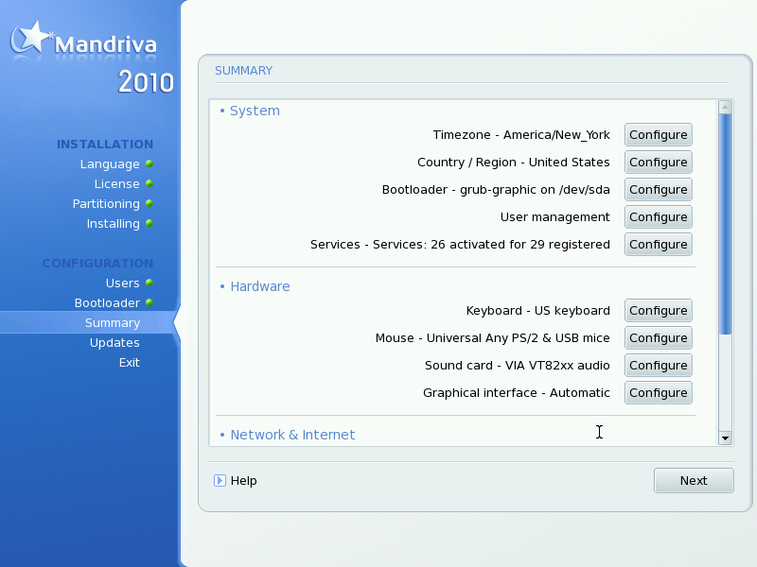
Checking Miscellaneous Parameters

Slide 27
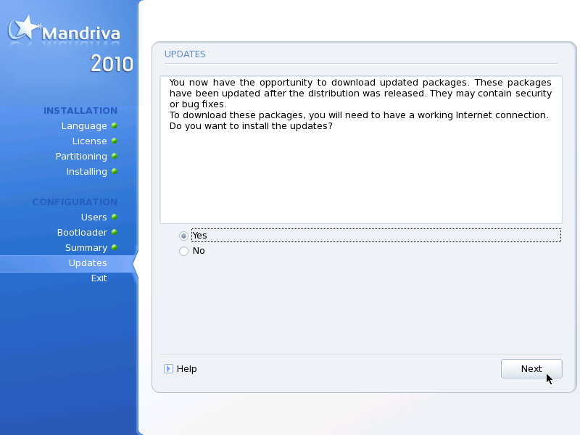
Installing Updates from the Internet

Slide 28
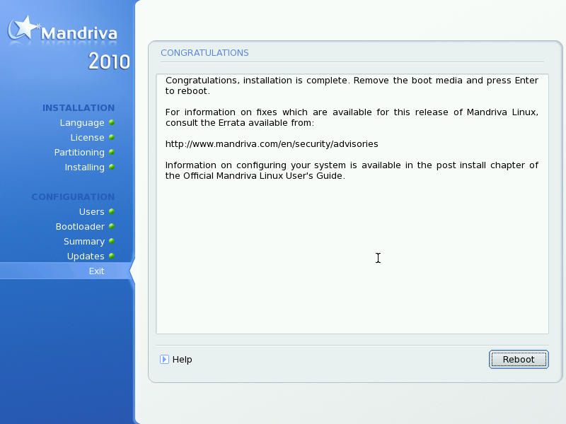
It's All Done!

Slide 29
Linux Architecture: Overview
Kernel
H/W
O/S Services
User Applications

Slide 30
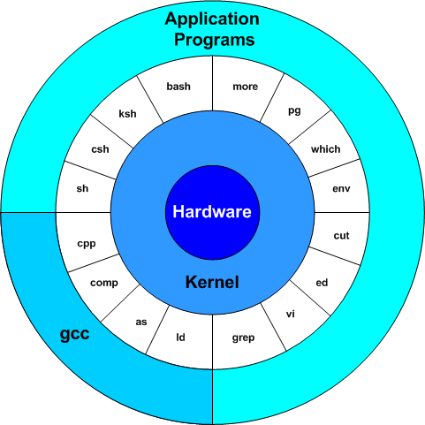
Linux Architecture

Slide 31
Linux Architecture
System Softwares
User
Process
User
Utility
Compilers
System Libraries
Kernel
Kernel Modules
Hard
ware
CPU
RAM
I/O

Slide 32
Linux OS Components
Linux Operating System has primarily 3 major components:
Kernel – consists of various modules and it directly interacts with the underlying hardware.
System Libraries – are the special functions or programs using which application programs or system utilities accesses kernel’s features
System utility – programs that are responsible to do specialized, individual level tasks.

Slide 33
Kernel mode vs User mode
Kernel component code executes in a special privileged mode called kernel mode with full access to all resources of the computer.
User programs and other system programs work in user mode which has no access to system hardware and kernel code.

Slide 34
Applications & User-Space
User applications
Execute in User-Space
Can access a subset of machine’s available resources
Are unable to make a direct access to hardware.
Communicate with the kernel via system calls
Use predefined libraries that rely on System Call Interface to instruct the kernel to carry out tasks on their behalf.

Slide 35
Linux Booting Process
Booting is a bootstrapping process that starts operating systems when the user turns on a computer system
The stages in the Linux Booting process are as follows:
1. System Start Up
2. BIOS (Basic Input Output)
3. MBR (Master Boot Record) - Boot loader Stage 1
4. GRUB (Grand Unified Boot loader) - Boot Loader Stage 2
5. Kernel
6. Init
7. Run level

Slide 36
System startup
How computer startup?
When you power on your system, the power is supplied to SMPS and to all the devices connected to the machine.
The CPU starts running its sequence of operations stored in its memory.
The first instruction it will run is to pass control to BIOS to do the POST.

Slide 37
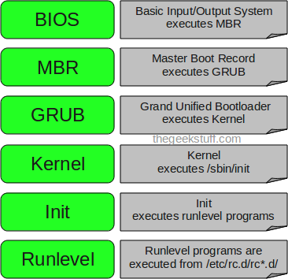
How Linux boot?

Slide 38
BIOS
The BIOS takes care of Following:
POST (Power On Self Test) checks for the availability of hardware.
Selecting first Boot device – It detects the bootable device such as CD, Floppy or Hard disk.
It searches, loads and executes the boot loader program stage1 (MBR).
Control is given to this program. Once the boot loader program is detected and loaded into the memory, BIOS gives the control to it.

Slide 39
MBR (Master Boot Record)
The MBR is a 512-byte sector, located in the first sector on the disk .
MBR is a location on disk which have details about
1. Primary Boot Loader Code (446 bytes)
2. Partition Table (64 bytes)
3. Magic number (2 bytes)
It loads second stage boot loader (GRUB).
GRUB is loaded from first sector of first partition.

Slide 40
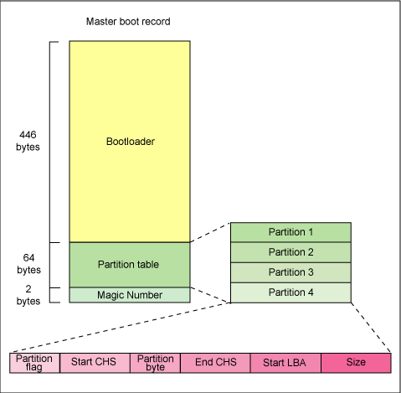
MBR (Master Boot Record)

Slide 41
GRUB
GRUB stands for GRand Unified Bootloader.
If you have multiple kernel images installed on your system, you can choose which one to be executed.
It loads the default kernel image into the memory as specified in the grub configuration file.
Grub configuration file is /boot/grub/grub.conf.
GRUB has the knowledge of the filesystem (the older Linux loader LILO didn’t understand filesystem).
It passes the control to the kernel.

Slide 42
Kernel
It mounts the root file system as specified in the “root=” in
grub.conf .
Kernel initializes and configures the computer’s memory and
configures the various hardware attached to the system.
initrd (Initial RAM disk) is booted and mounts as the
temporary root File system that allows the kernel to fully boot
without having to mount any physical disks.
After the kernel is booted, the initrd file system is unmounted
and real root file system is mounted.
Kernel executes the /sbin/init program.

Slide 43
Init
Init is the first program to be executed by the Linux kernel and therefore has always the Pid of 1.
It is considered as the parent process of all the processes that run under Linux.
The first process it runs is the script /etc/rc.d/rc.sysinit.
Then it runs /etc/inittab to identify the default run level.
Then the init command sets the the source function library /etc/rc.d/init.d/functions for the system which configures how to start, kill and determine the Pid of the program.
For each run level, there is specific rc directory. For eg : etc/rc.d/rc5.d for run level 5.

Slide 44
Run Levels
Following are the available run levels
1 – Single user mode
2 – Multiuser, without NFS
3 – Full multiuser mode
4 – unused
5 – X11
6 – reboot

Slide 45
Shutting Down
command > /sbin/shutdown
Two most common uses are:
/sbin/shutdown -h now
/sbin/shutdown -r now
After shutting everything down, the -h option will halt the machine, and the -r option will reboot.
Non-root users can use the reboot and halt commands to shut down the system while in runlevels 1 through 5.

Slide 46
Shutdown: Warning
When Linux system is shutdown
File systems are unmounted,
User processes (if anybody is still logged in) are killed
Daemons( back ground process) are shut down.
When that is done, init prints out a message that you can power down the machine.

Slide 47
Shell Startup
When an interactive login shell starts, it automatically executes one or more pre-defined files.
Different shells execute different files: listed in corresponding documentation
The Bourne shell (/bin/sh) and its derivatives execute
/etc/profile:
.profile in the user's home directory:

Slide 48
Linux File System
A file system is a mean to organize data expected to be retained after a program terminates and
Manage the available space on the device which contained it.
File systems organize files into logical hierarchical structures with directories, soft links and so on held in blocks on physical devices. Devices that can contain file systems are known as block devices.
It is the task of each block device driver to map a request to read a particular block of its device into terms meaningful to its device; the particular track, sector and cylinder of its hard disk where the block is kept

Slide 49
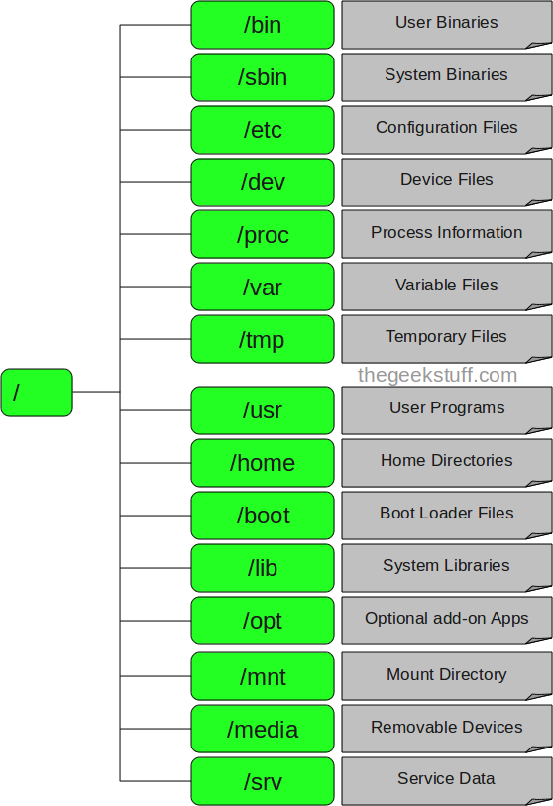
Linux File System (Cont.)

Slide 50
Linux File System (Cont.)
The MINIX file system was used as Linux first file
system.
Minix file system was mostly free of bugs, but used16-bit
offsets internally and thus had a maximum size Limit of
only 64 MB
There was also a filename length limit of 14 characters
Because of these limitations, work begin on a replacement
native file system for Linux.

Slide 51
Linux File System (Cont.)
The extended file system (ext), was released in April 1992 as
the first file system using the API.
The ext file system solved the two major problems in the
Minix file system (maximum partition size and filename
length limitation to 14 characters)
It allowed 2 gigabytes of data and filenames of up to 255
characters.
But it still had problems: there was no support of separate
timestamp for file access, inode modification, and data
modification

Slide 52
Linux File System (Cont.)
Directory | Content
/bin | Common programs, shared by the system, the system administrator and the users.
/boot | The startup files and the kernel
/dev | Contains references to all the CPU peripheral hardware, which are represented as files with special properties.
/etc | Most important system configuration files are in /etc, this directory contains data similar to those in the Control Panel in Windows
/home | Home directories of the common users.
/init.d | Information for booting. Do not remove!
/lib | Library files, includes files for all kinds of programs needed by the system and the users.
/lost+found | Every partition has a lost+found in its upper directory. Files that were saved during failures are here.
/misc | For miscellaneous purposes.

Slide 53
Linux File System (Cont.)
/mnt | Standard mount point for external file systems, e.g. a CD-ROM
/net | Standard mount point for entire remote file systems
/opt | Typically contains extra and third party software.
/proc | A virtual file system containing information about system resources.
/root | The administrative user's home directory.
/sbin | Programs for use by the system and the system administrator.
/tmp | Temporary space for use by the system, cleaned upon reboot.
/usr | Programs, libraries, documentation etc. for all user-related programs.
/var | Storage for all variable files and temporary files created by users, such as log files, the mail queue, the print spooler area, space for temporary storage of files downloaded from the Internet.

Slide 54
ext2FS: Added Features
Ext2 stands for second extended file system
Was introduced in 1993
Developed by Remy Card
It does not have journaling feature
Maximum individual file size can be from 16 GB to 2 TB
Overall file system size can be from 2 TB to 32 TB
Allows the administrator to choose the logical block size when creating the file system.
Implements fast symbolic links.
Does not use any data block on the file system.
The target name is not stored in a data block but in the inode itself.
Can save some disk space (no data block needs to be allocated)
Speeds up link operations (there is no need to read a data block when accessing such a link).
As the space available in the inode is limited so not every link can be implemented as a fast symbolic link.

Slide 55
The ext2 Inode
Mode
Owner Info
Size
Timestamps
data
Direct Blocks
data
data
Indirect blocks
data
Double Indirect
data
Triple Indirect
data
data

Slide 56
Inode
A data structure that describes each file in the file system
Maintains file attributes and the blocks that the data within a file occupies.
Every file is described by a single inode
Each inode has a single unique number identifying it.
The inodes for the file system are all kept together in inode tables.
Directories are simply special files (themselves described by inodes) which contain pointers to the inodes of their directory entries.

Slide 57
Directory Entries
A directory file is a list of directory entries, each one containing the following information:
inode
The inode for this directory entry.
This is an index into the array of inodes held in the Inode Table of the Block Group.
name length
The length of this directory entry in bytes,
name
The name of this directory entry.

Slide 58
ext3FS
ext3 support the same features as ext2, but also includes Journaling.
Was developed in 2001 by Stephen Tweedie
A log of file system actions is maintained
Max individual file size can be from 16 GB to 2 TB
Overall ext3 file system size can be from 2 TB to 32 TB.
A directory can contain upto 32,000 sub directories
Three types of journaling is allowed:
Journal
Ordered
Writeback

Slide 59
Journaling
A Journaling file system is a file system that maintains a special file called a journal that is used to repair any inconsistencies that occur as the result of an improper shutdown of a computer.
Journaling file systems write meta data (i.e., data about files and directories) into the journal that is flushed to the HDD before each command returns.
In the event of a system crash, a given set of updates may have either been fully committed to the file system (i.e., written to the HDD)

Slide 60
Journal (Cont.)
Journal mode requires that an ext3 file system write every change to a file system twice - once to the journal, and then again to the file system itself.
This can reduce the overall performance of your file system,
This mode most beloved by users, because it minimizes the chances of losing changes to your files since both metadata and data updates are recorded in the ext3 journal and can be replayed when a system reboots.

Slide 61
Ordered
Using the "ordered" mode, only file system metadata changes are logged, which reduces redundancy between writing to the file system and to the journal and is therefore faster.
Though the changes to file data are not logged, they must be done before associated file system metadata changes are made by the ext3 journaling daemon, which can slightly reduce the performance of your system.
However, using this journaling mode guarantees that files in the file system will never be out of sync with any related changes to file system metadata.

Slide 62
Write Back
Write back mode is faster than the other two ext3 journaling modes because it only logs changes to file system metadata and does not wait for associated changes to file data to be written before updating things like file size and directory information.
Because updates to file data are done asynchronously to journaled changes to file system metadata, files in the file system may exhibit metadata inconsistencies such as owning data blocks to which updated data was not yet written when the system went down

Slide 63
ext4 Features
Was introduced in 2008
Support huge individual file size i.e. from 16 GB t 16 TB
Overall file system size can be upto 1 EB.
Directory can contain a max of 64,000 subdirectories.
Use of checksums in the journal to improve reliability
Has the option to turn off the journal feature
Measures timestamps in nanoseconds

Slide 64
Mounting a File System
A mechanism of making a file system available for use.
It includes checking that the device being mounted contains a valid file system.
In Linux, all storage devices are mounted in the same namespace and thus are a part (nodes) of a single directory tree.
A flag is set in the in-memory copy of the inode where mounting is done, to remember the mount-status of the directory.

Slide 65
Mounting File Systems
Automatic mounting
The entries in /etc/fstab are used to mount file systems automatically.
Data contained:
Device name
Mount point
File-system type
Options
Dump code: backup required 0/1
File System check code: fsck required 0/1
Manual mounting
Use the mount command
mount –t <filesystemtype> <device> <mountpoint>

Slide 66
LINUX COMMANDS
File Management and Viewing
File system Mangement
Help, Job and Process Management
Network Management
System Management
User Management
Printing and Programming
Document Preparation
Miscellaneous
Notes:
66
66

Slide 67
Command Structure
Command <Options> <Arguments>
Multiple commands separated by ; can be executed one after the other
Notes:
67
67

Slide 68
Commonly Used Commands
ls – displays the list of directories and files
Eg : $ ls
$ ls –l displays a line of info of each file
$ ls –l <filename> displays the info of specific file
$ ls –a displays hidden files also
$ ls –f to display / before directory name
$ ls –r to display all subdirectories

Slide 69
Commonly Used Commands (Cont.)
history - displays the history of commands or the actions that took place. By default history stores 500 actions but you can set the new size as:
$ HISTSIZE = 10
HISTSIZE is a shell variable that stores the length of the history.
Using history command
$ history
$ ! Also refers to history
$ ! 54 will execute a command whose sequence no is 54.

Slide 70
Commonly Used Commands (Cont.)
WILD CARDS
* is used for matching multiple characters
Eg : $ ls *t
? Is used for matching single character
Eg : $ ls ???day
[ ] is used to match a range of characters
Eg : $ ls doc[1-5]
$ ls doc[A-D]

Slide 71
Wild Card Matching
Allows you to use meta characters to match characters based upon a certain pattern
“searches” for files or directories in a given directory
Several wildcard matching techniques
Match any character
Match a single character
Match one of several characters

Slide 72
Wild Card Matching (Cont.)
To match any character, use the asterisk symbol (*)
Example to list all files in the current directory with an extension of .dat, regardless of filename:
ls *.dat
Example to move all files, regardless of filename, with an extension of .dat, to .bkp:
mv *.dat *.bkp

Slide 73
Wild Card Matching (Cont.)
To match a single character, use the question mark symbol (?)
Example to copy files, with three characters in the filename and an extension of .dat ,to .old:
cp ???.dat ???.old
Example to take a long listing of files, with a two character extension:
ls -l file.??

Slide 74
Wild Card Matching (Cont.)
To match one of several characters, surround what you want to match with square brackets
List files beginning with uppercase A, B or C and ending in .txt:
ls -l [ABC]*.txt
You can use ^ to invert selection
ls -l [^ABC]*.txt
Lists names not starting with A, B or C
List all files beginning with either “S” or “s”, followed by “pain” with .txt as the extension
ls [Ss]pain.txt

Slide 75
Few Basic Commands
cat (for concatenate) command is used to display the contents of a file. Used without arguments it takes input from standard input <Ctrl d> is used to terminate input.
cat [filename(s)] cat > [filename] Data can be appended to a file using >
cd Used to change directories

Slide 76
Copying Files
cp The cp (copy) command is used to copy a file. cp [filename1] [filename2]
Eg $ cp *.c mydir
$ cp *.[oc] mydir
-i use this option to check before overwriting
-r to copy entire directory structure to new location

Slide 77
Few more basic commands
mkdir : used to create directories
More: The more command is used to display data one screen full at a time. More [filename]
mv moves a file from one directory to another or simply changes filenames. The command takes filename and pathnames as source names and a filename or exiting directory as target names.
mv [source-file] [target-file]
This command is also used for renaming files
Eg $ mv file1 file2
This will create file2 at the same location and deletes the file1

Slide 78
Few more basic commands (Cont.)
ps Gives information about all the active processes.
pwd (print working directory) displays the current directory.
rm The rm (remove) command is used to delete files from a directory. A number of files may be deleted simultaneously. A file(s) once deleted cannot be retrieved. rm [filename 1] [filename 2]…
wc The wc command can be used to count the number of lines, words and characters in a fine.
wc [filename(s)]

Slide 79
Few more basic commands (Cont.)
Cal : Print the calendar of month for any year
Who : List of users log in
Who am I : Details about yourself
Tput clear : Clear the screen
Ps : View all the process
Wc : Print no of line ,word and character in a file
Pipe : Feed output of one command to another
Echo : Display the text or value of a variable on screen
Tty : Knowing your terminal
Stty : Display the characteristic of your terminal
Uname : Print the running OS

Slide 80
Few more basic commands (Cont.)
Printf : Variant of echo
bc : Used as a calculator
Pwd : Checking your current Directory
Cd : To change the current Directory
Mkdir : To make the directory
Rmdir : To remove the directory
Cat : To display the contents of file
Cat : To Create the File
Cp : To copying the file
Rm : To remove the file
Mv : Used for rename a file and move a group of files to a
directory

Slide 81
Few more basic commands (Cont.)
File : Display the type of file
Od : Displaying data in octal
Cmp : Comparing two file(Identical or not)
Comm : What is common
Diff : Converting one file into another

Slide 82
Redirection - Concepts
Redirection directs flow from one place to another
You redirect input or output from their normal default location
Standard input (stdin) is the default location for input which is the keyboard
Standard output (stdout) is the default location for output which is the display screen
Standard error (stderr) is the default location for errors

Slide 83
Redirection File - Concepts
A file descriptor is a number that is used to reference a file
Standard input has a file descriptor of 0
Standard output has a file descriptor of 1
Standard error has a file descriptor of 2
Linux treats all devices as files
Devices are stored in /dev
Standard input is /dev/stdin
Standard output is /dev/stdout
Standard error is /dev/stderr

Slide 84
Input Redirection
Redirecting standard input causes a program to read from a file instead of the keyboard
The symbol for redirecting standard input is the less than symbol <
The general form is:
command < filename
Example:
sort < unsorted.dat

Slide 85
Output Redirection
Redirecting standard output causes a program to read to a file instead of the screen
The symbol for redirecting standard input is the greater than symbol >
The general form is:
command > filename
Example:
ls > ls.txt
Use of > creates a new file and destroys contents of an existing file

Slide 86
Output Redirection - Example
The symbol for redirecting standard output and appending to a file is >>
The general form is:
command >> filename
Example:
ls >> allLs.txt
Use of >> appends and keeps the previous contents of the file intact

Slide 87
Error Redirection
You can redirect standard error to a file
Redirect standard error to keep the results of a file’s error
The general form is:
command 2> filename
Example:
rm file4.txt 2> rmlist.err

Slide 88
Pipes
An important early development in Unix was the invention of "pipes," a way to pass the output of one tool to the input of another.
eg. $ who | wc −l
By combining these two tools, giving the wc command the output of who, you can build a new command to list the number of users currently on the system
Notes:
88
88

Slide 89
Managing Users
The command can be used in order to
Create a new user
Set the default set of attributes for new user
Get the default set of attributes for new user
While adding a user, the values in
/etc/login.defs are made
Default settings made by useradd itself are used for deciding attributes of a new user
New values provided on command line override the defaults

Slide 90
Add a user
useradd - Adding a new user
Options:
-d home directory
-s starting program (shell)
-p password
-g (primary group assigned to the users)
-G (Other groups the user belongs to)
-m (Create the user's home directory

Slide 91
Modify a user
usermod - Modifying existing user
Options:
-d home directory
-s starting program (shell)
-p password
-g (primary group assigned to the users)
-G (Other groups the user belongs to)
Example: To add the group 'others' to the user roger
usermod -Gothers roger

Slide 92
Delete a user
userdel - Deleting a user
Options:
-r (remove home directory)
Example: To remove the user 'roger' and his home directory
userdel -r roger

Slide 93
Attributes: User Creation
The following data can be provided while creating a new user with seradd
Comment (c)
Home Directory (d)
Account Expiration date (e) (YYYY-MM-DD)
Inactive days (f) number of days after password expiry to disable the account
0: Immediate Disable
-1: Don't disable
Group
g: Initial login group of user
G: List of other groups of which user is a member

Slide 94
Attributes: User Creation
User directory is to be created (m) or not (M)
Password (p)
Login Shell (s)
User ID (u)
Don't create a user private group (n)
Create a system account (r)
Used for special services
UID lower than UID_MIN
Login doesn't expire
No home directory created by default (m for forcing)
User's login shell (s)
UID of the user (u) if it has to be specified explicitly

Slide 95
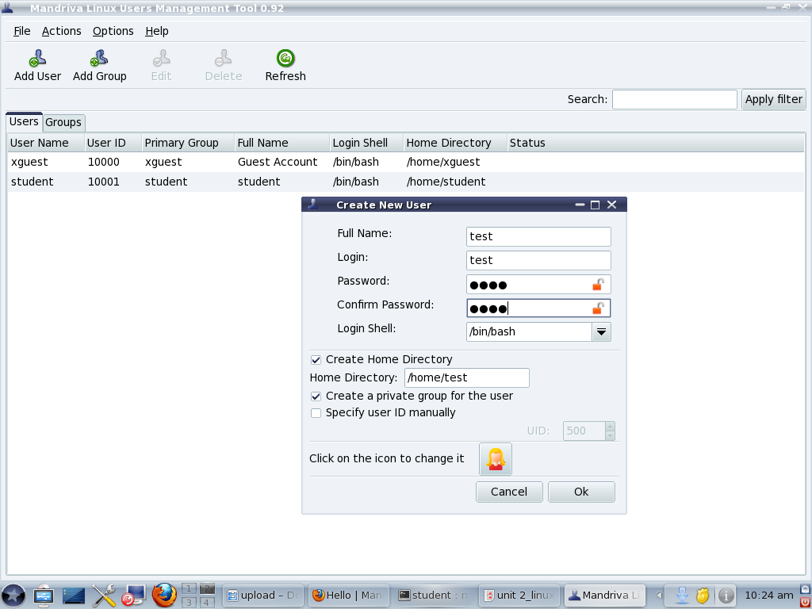
Add a user through GUI
Use user drake command in run

Slide 96
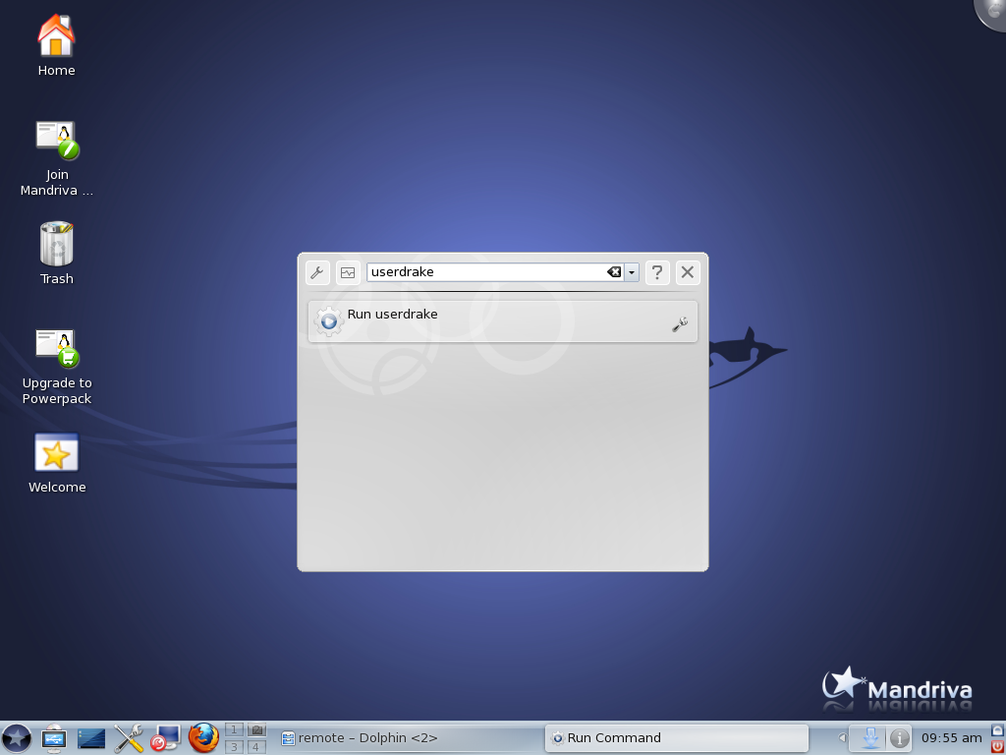
Open run and put command userdrake

Slide 97
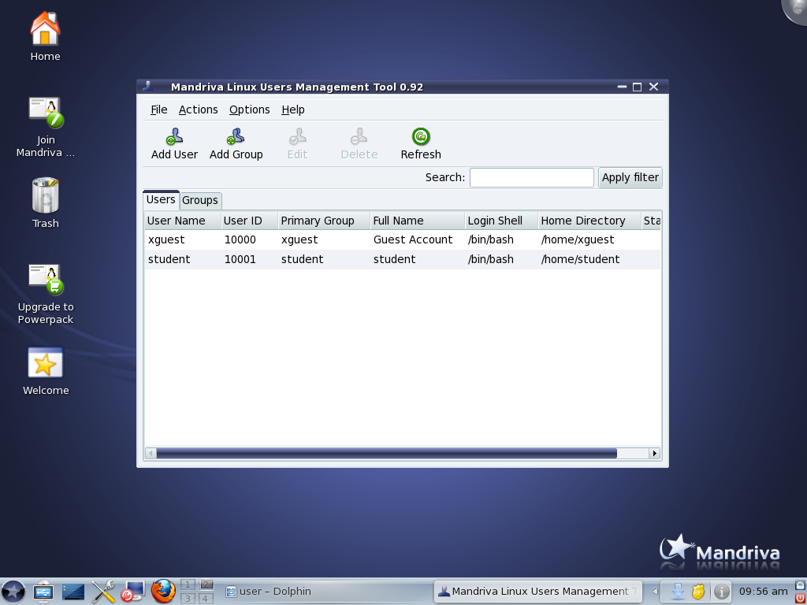
Add a user through GUI

Slide 98
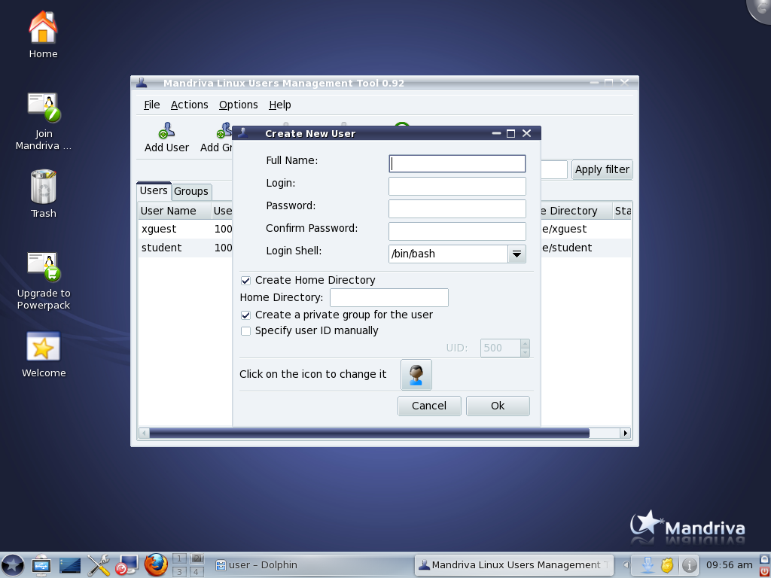
Fill the Detail of a User

Slide 99
System Management Commands
Runtime level management
exit Terminates the shell.
halt Stop the system.
init Process control initialization. (init 3)
logout Log the user off the system.
poweroff Brings the system down.
reboot Reboot the system.
runlevel List the current and previous runlevel.
Notes:
99
99

Slide 100
System Management Commands (Cont.)
su Single user login. (su -)
useradd Create a new user or update default new user information. (useradd –g <group> -s <shell> -c <comment> –d <home directory> <username>
userdel Delete a user account and related files. (userdel <user name>)
usermod Modify a user account.
users Print the user names of users currently logged in.
wall Send a message to everybody's terminal. (wall “text message”)
who Display the users logged in.
Who am i Print effective user id.
Notes:
100
100

Slide 101
System Management Commands (Cont.)
System Time
cal Calendar. (cal, cal 2005)
date Print or set the system date and time. (date, date MMDDhhmm[[CC]YY][.ss])
Notes:
101
101

Slide 102
Short Questions
Describe the salient features of the file system in Linux.
How does unix provide file protection.
What are the two linux boot loaders ? Which one is legacy boot loader ?
Why might we want to store LILO or GRUB in a linux partition instead of master booth record.
Explain the booting process in Linux?
What is the relation between Unix and Linux ?
Notes:
102

Slide 103
Long Questions
Explain different function of Linux architecture. Also explain its architecture?
What is security features in Linux explain ?
Briefly describes four reasons why linux would not be a viable choice for a business operating system ?
How would our approach to a linux installation be different if we are offering a product or service.
Notes:
103

