Slide 1

CoffyCup
A Premium Coffee Brand Website
Project -1 (BCA0505)
Under the Guidance of:
Presented By: Apoorv Batham
Dr. Shefali Parihar

Slide 2

INTRODUCTION
CoffyCup is a coffee brand website designed to showcase a variety of - coffee products such as Brewed Coffee and Ready-to-Drink Coffee.
The website allows users to:
Browse and explore coffee products.
This is a coffee brand showcase website. not a complete e-commerce system.
Place Order using the “Order Now” option.
Pure Taste Pure Beans
- The main focus of the project is to provide an coffee themed, environmental and engaging UI/UX and make the website simple and user-friendly.

Slide 3
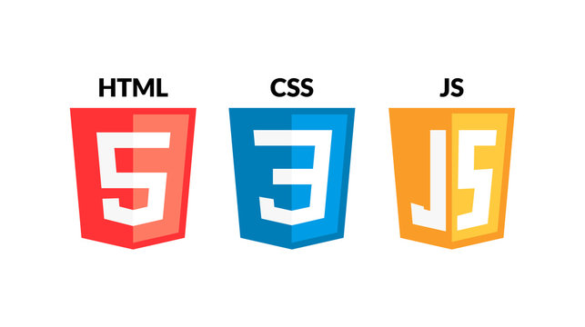



Tools & Technologies Used
💻 Frontend:
• HTML5
• CSS3
• JavaScript
⚙️ Backend:
• Python
🗄️ Database:
• MySql
🛠️Development Tools:
• Notepad++

Slide 4
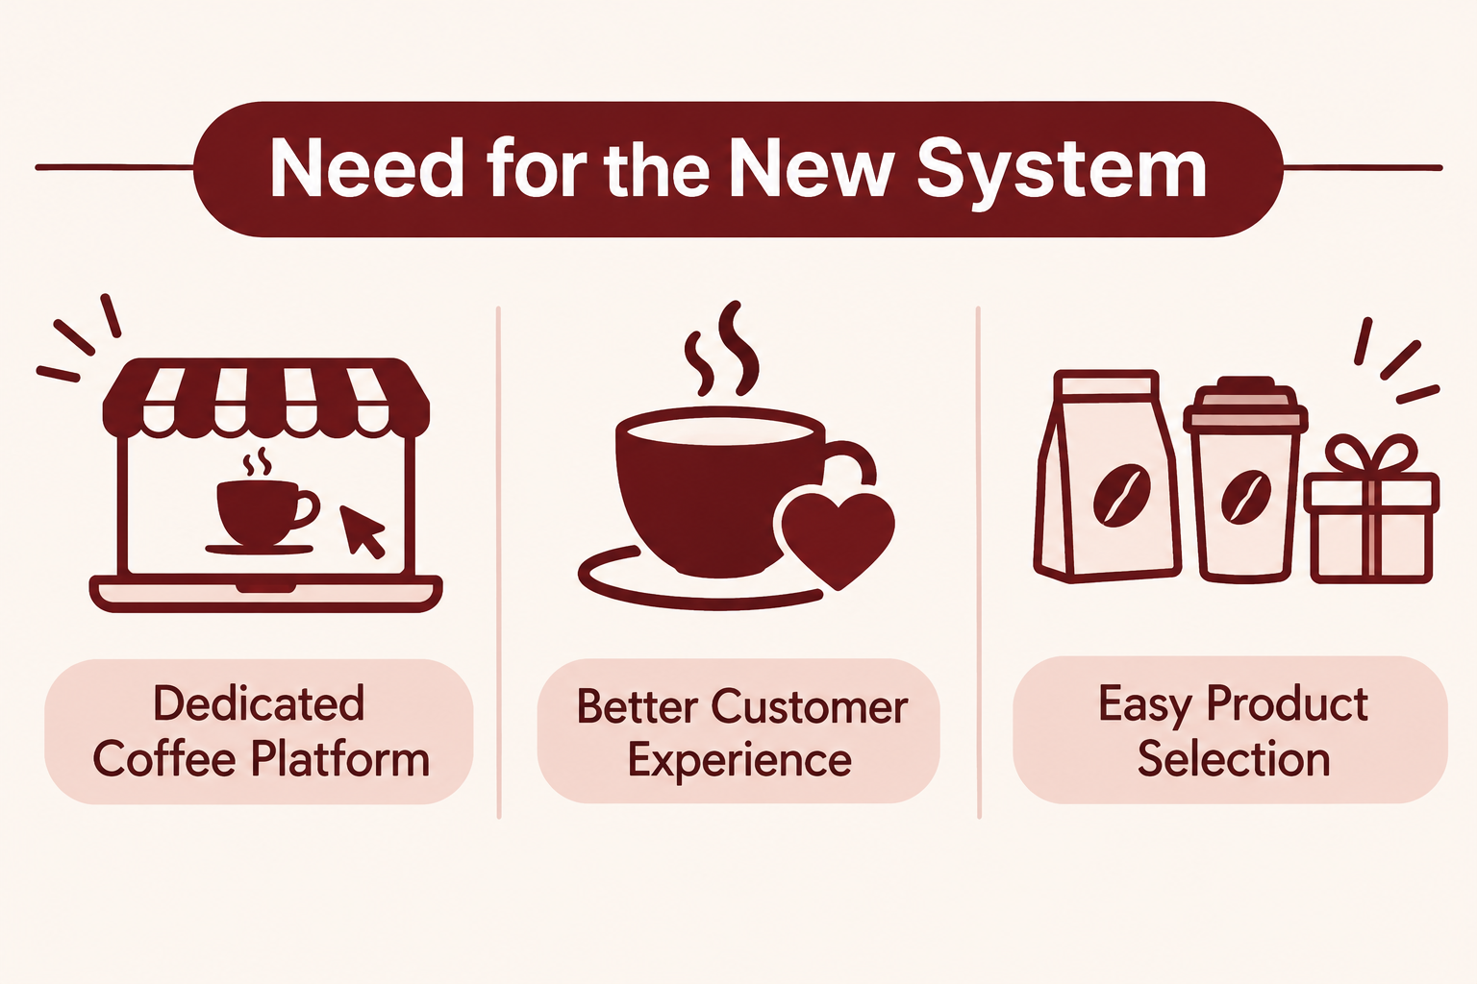
Need for the New System
Dedicated Coffee Platform: A single platform to explore coffee blends, ready-to-drink beverages, and gifting hampers.
Better Customer Experience: To create an attractive coffee-themed experience that connects coffee with emotions, special moments, and memories.
Easy Product Selection: A carefully selected range of products to help customers choose without confusion.

Slide 5
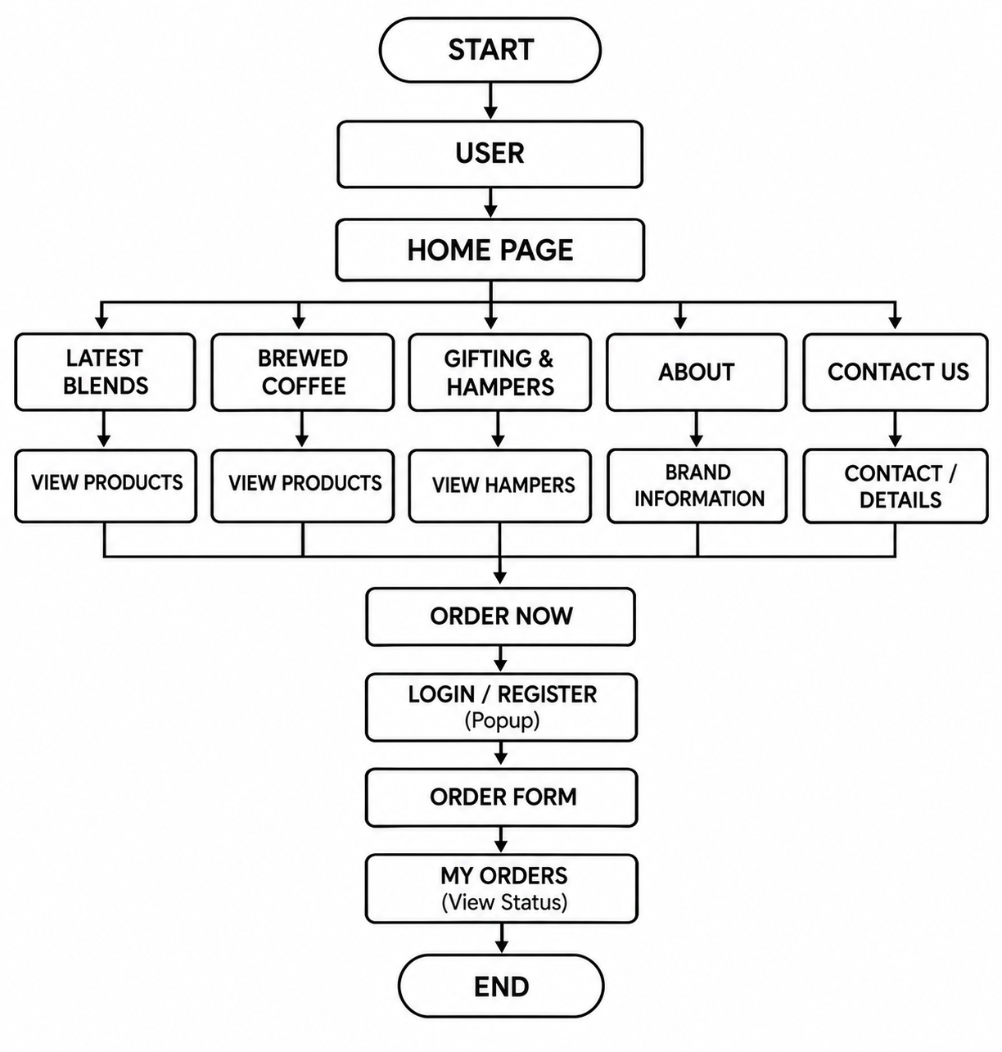
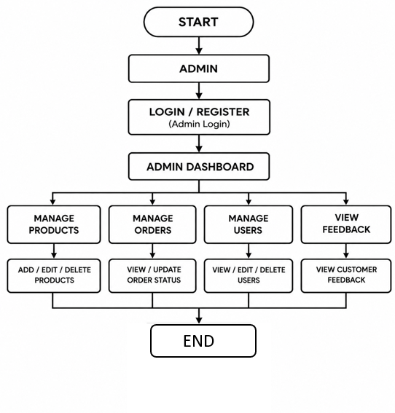
System Flow Diagram
User
Admin

Slide 6
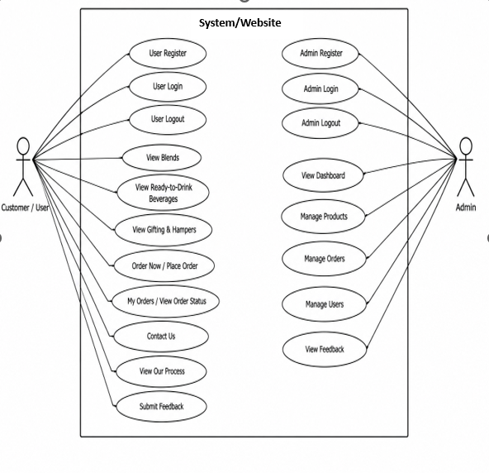
UML - Diagrams
1. Use Case Diagram:

Slide 7
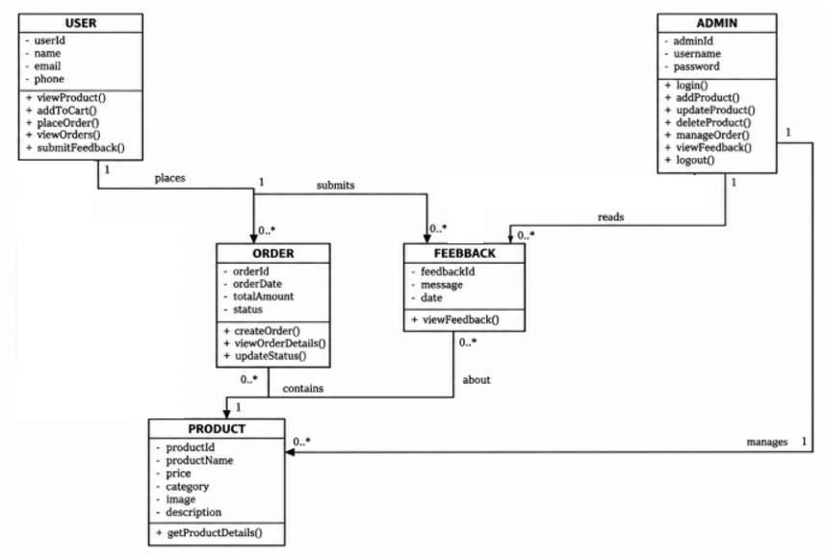
2. Class Diagram:

Slide 8
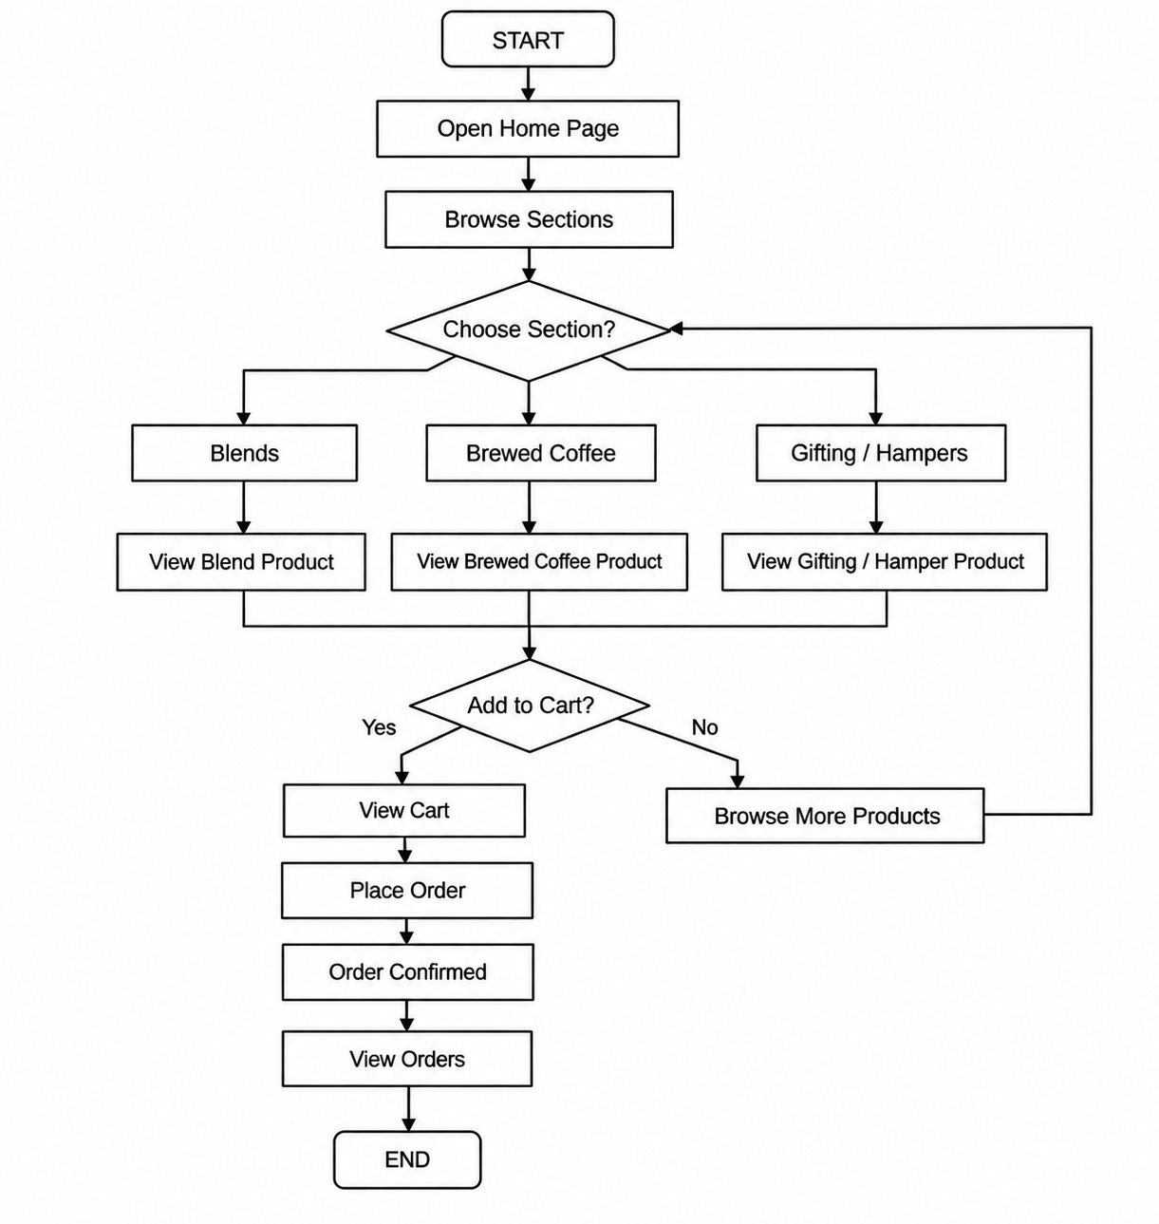
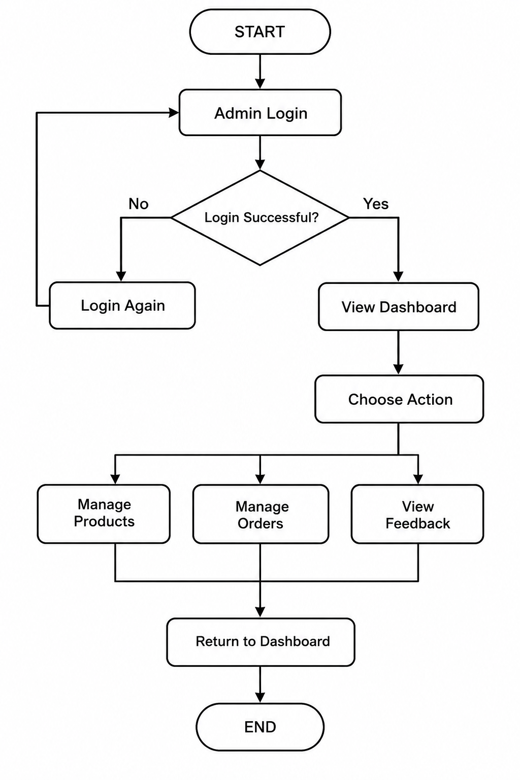
3. Activity Diagram:
User
Admin

Slide 9
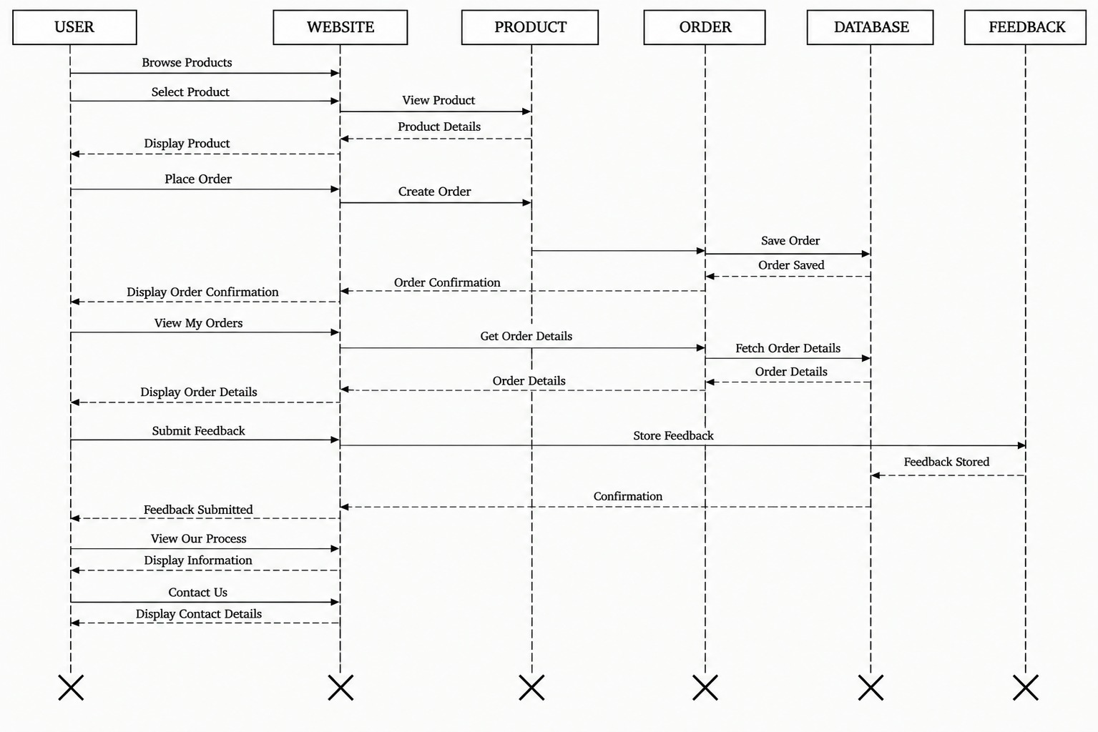
4. Sequence Diagram:
Get

Slide 10
List of Database Tables
Master Tables:
admins
users
Products
Transaction Tables:
orders
feedback

Slide 11
Data Dictionary
1. MasterTable(User):
Field Name | Data Type | Description | P.K. | F.K. | Not Null
id | INT(11) | Unique user ID | Yes | No | Yes
name | VARCHAR(100) | Name of the registered customer | No | No | Yes
email | VARCHAR(150) | Email address of the customer | No | No | Yes
phone | VARCHAR(20) | Customer's phone number | No | No | No
password_hash | VARCHAR(255) | Stores the hashed user password | No | No | Yes
created_at | TIMESTAMP | Date and time when the user account was created | No | No | No

Slide 12
2. MasterTable(Admin):
Field Name | Data Type | Description | P.K. | F.K. | Not Null
id | INT(11) | Unique admin ID | Yes | No | Yes
username | VARCHAR(100) | Admin username | No | No | Yes
password_hash | VARCHAR(255) | Hashed admin password | No | No | Yes
created_at | TIMESTAMP | Account creation date and time | No | No | Yes

Slide 13
3. MasterTable(Products):
Field Name | Data Type | Description | P.K. | F.K. | Not Null
id | INT(11) | Unique product ID | Yes | No | Yes
name | VARCHAR(150) | Name of the coffee product | No | No | Yes
cat | VARCHAR(100) | Product category | No | No | Yes
price | DECIMAL(10,2) | Price of the product | No | No | Yes
img | VARCHAR(500) | Path of the product image | No | No | No
description | TEXT | Description of the product | No | No | No
sold | INT(11) | Number of units sold | No | No | Yes
created_at | TIMESTAMP | Date and time when the product was added | No | No | No

Slide 14
4. TransactionTable(Orders):
Field Name | Data Type | Description | P.K. | F.K.
id | INT(11) | Unique order ID | Yes | No
user_id | INT(11) | ID of the customer who placed the order | No | Yes
name | VARCHAR(100) | Customer's name | No | No
phone | VARCHAR(20) | Customer's phone number | No | No
email | VARCHAR(150) | Customer's email address | No | No
addr | TEXT | Customer's delivery address | No | No
city | VARCHAR(100) | Delivery city | No | No
pincode | VARCHAR(15) | Delivery PIN code | No | No
prod | VARCHAR(150) | Name of the ordered product | No | No
product_id | INT(11) | ID of the ordered product | No | Yes
qty | INT(11) | Quantity of the product ordered | No | No
total | DECIMAL(10,2) | Total order amount | No | No
payment_method | VARCHAR(50) | Selected payment method | No | No
status | VARCHAR(30) | Current order status | No | No
created_at | TIMESTAMP | Date and time when the order was placed | No | No

Slide 15
5. TransactionTable(Feedback):
Field Name | Data Type | Description | P.K.
id | INT(11) | Unique feedback ID | Yes
user_id | INT(11) | ID of the user who submitted feedback | No
name | VARCHAR(100) | Name of the customer | No
email | VARCHAR(150) | Customer's email address | No
msg | TEXT | Feedback message submitted by the customer | No
created_at | TIMESTAMP | Date and time when feedback was submitted | No
rating | TINYINT(4) | Rating given by the customer | No

Slide 16
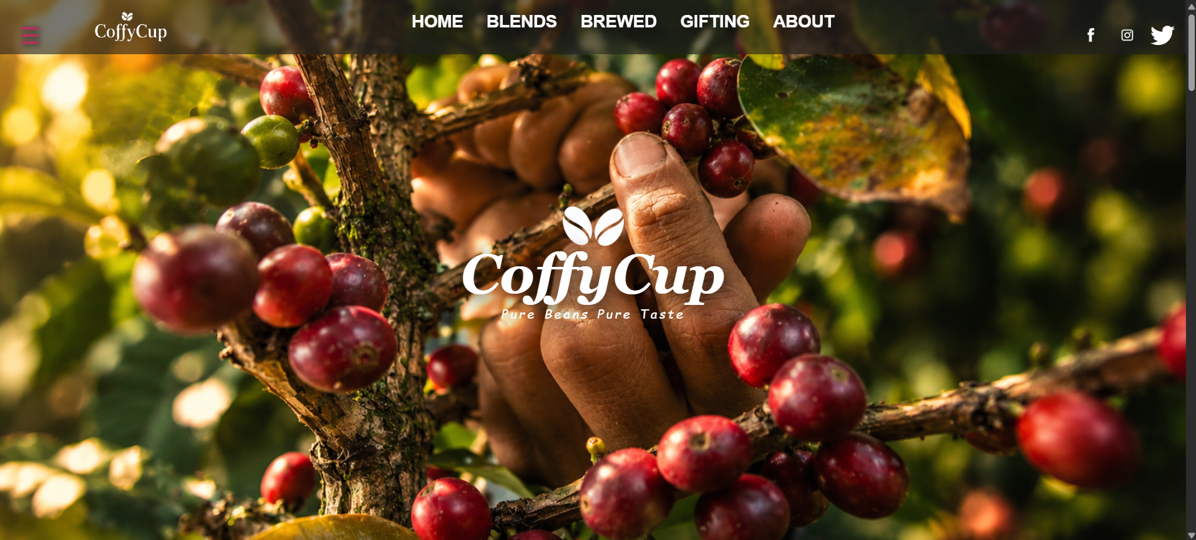
User Interface
1. Home Page:

Slide 17
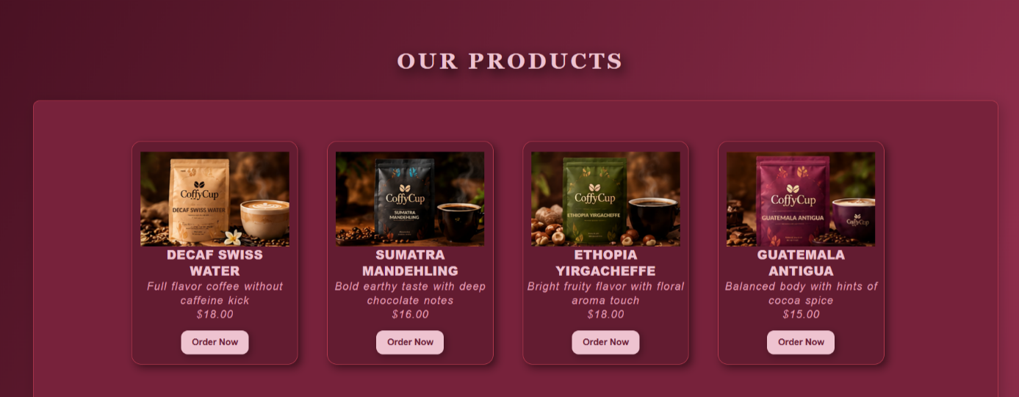
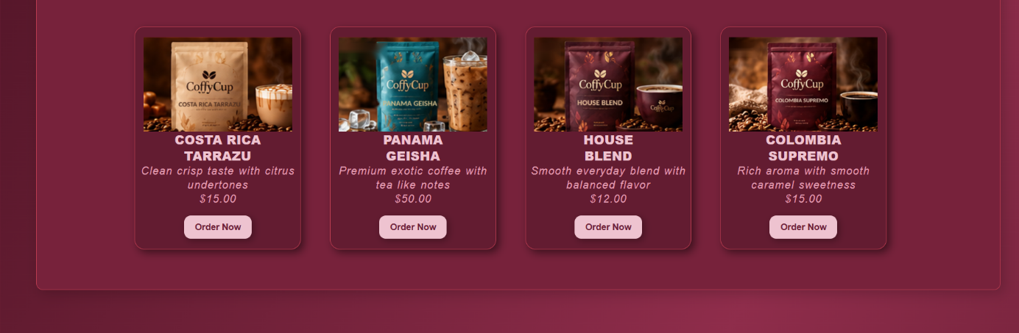
2.Product Section:
2.1 Brewed Coffee:

Slide 18
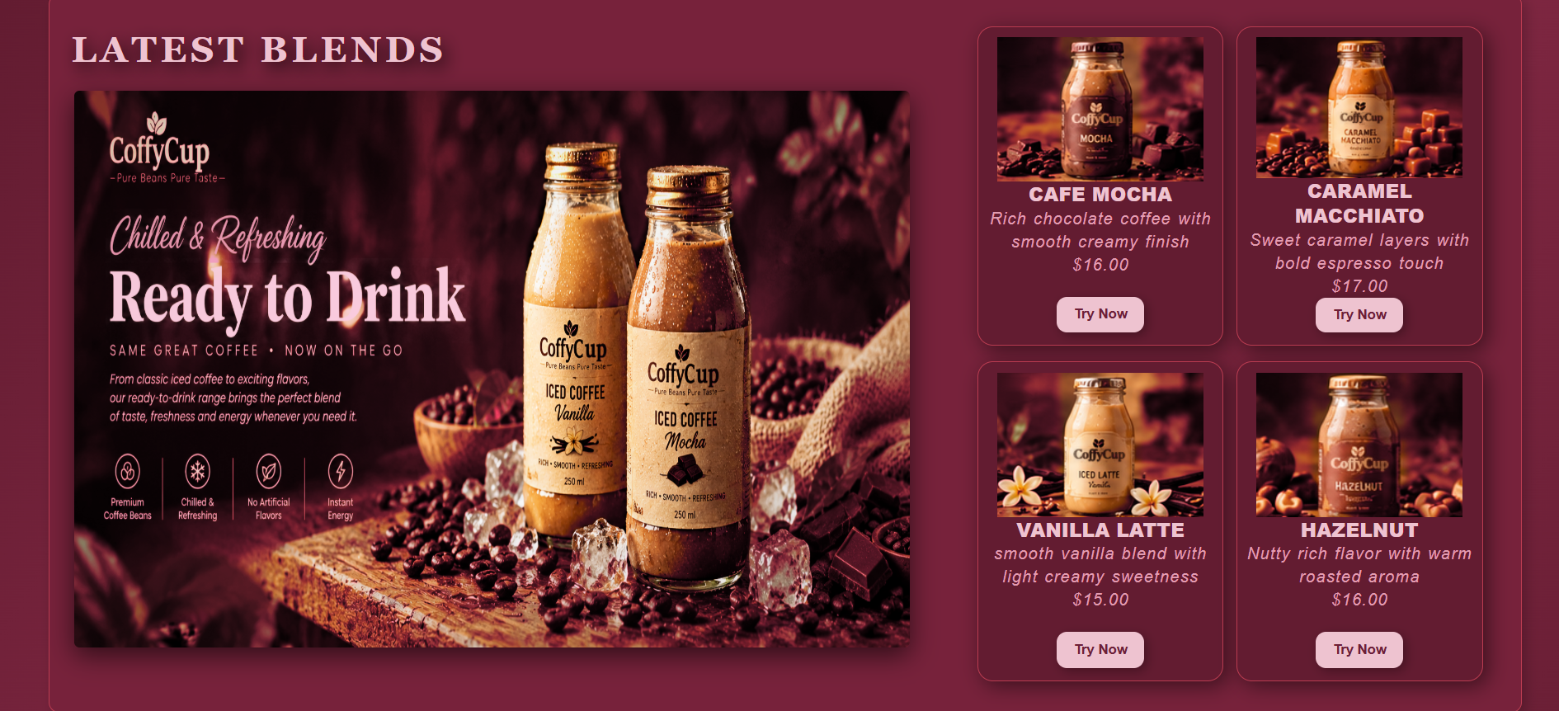
2.2 Ready-to-Drink Beverages:

Slide 19
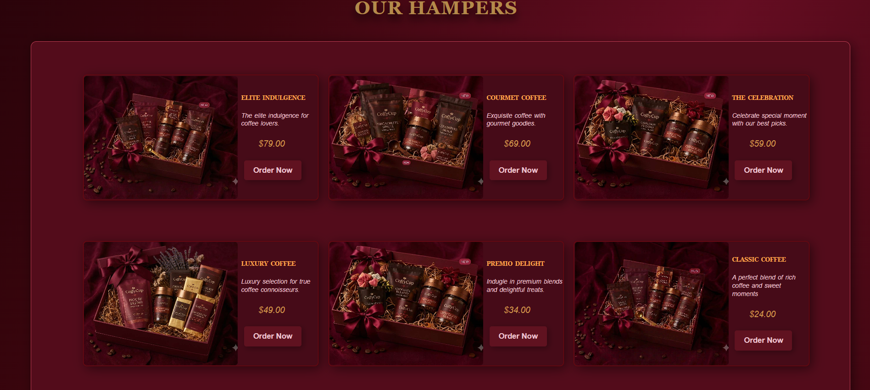
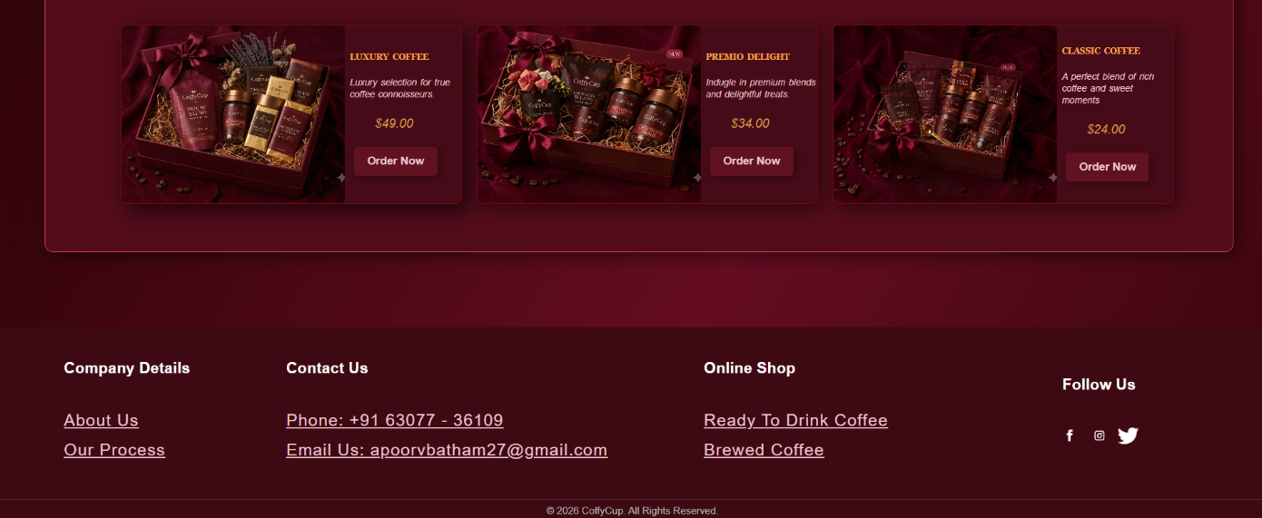
2.3 Gifting:

Slide 20
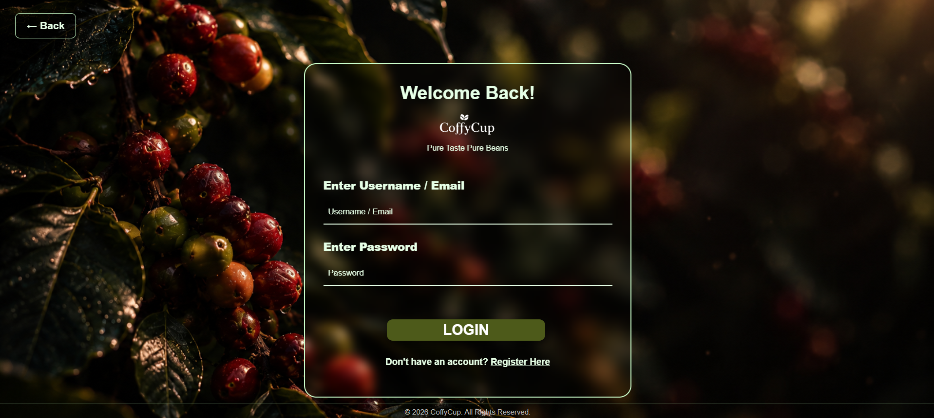
3. Authentication:
3.1 Login:

Slide 21
3.1 Register:

Slide 22
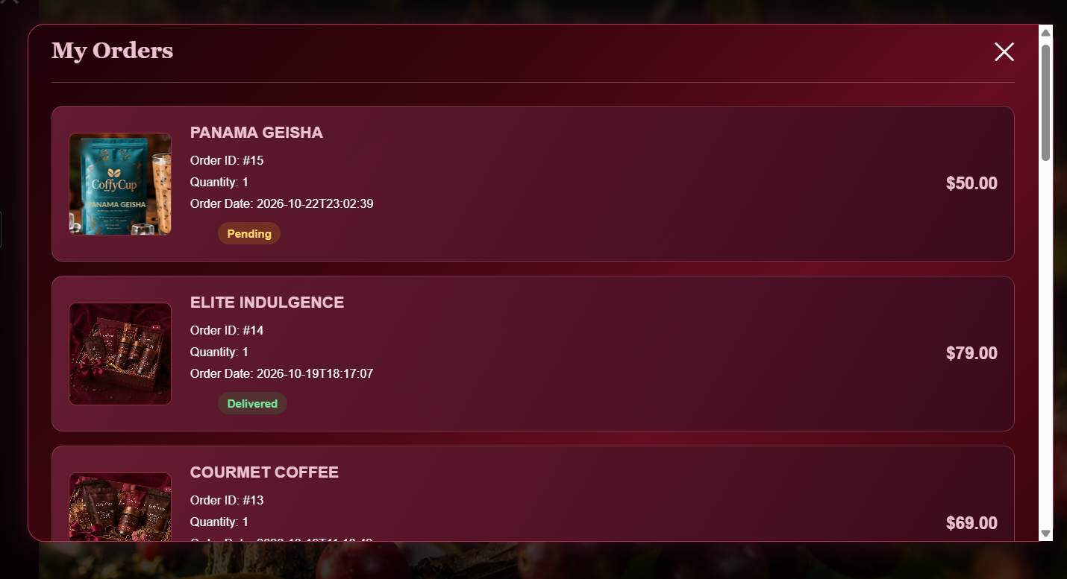
4. My Orders:

Slide 23
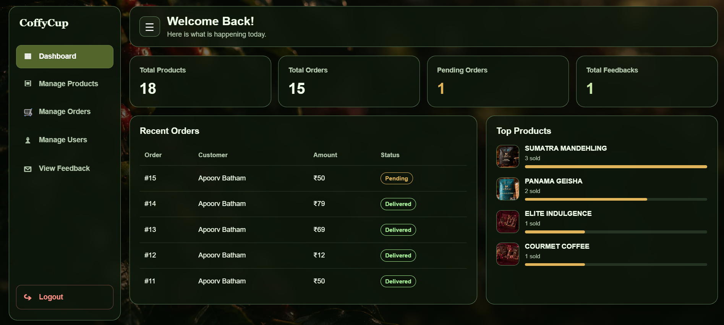
5. Admin Dashboard:

Slide 24
Test case & Test Plan
Test Case(User):
No. | Test Case | Expected Result | Status
1 | User Registration | User account created successfully. | Pass
2 | Login Validation | Valid login accepted; invalid login shows an error. | Pass
3 | Blank Field Validation | Required fields are validated. | Pass
4 | Product Selection | Selected product appears in the order form. | Pending
5 | Order Form Validation | Valid details accepted; empty fields show validation. | Pass
6 | Order Placement | Order saved successfully. | Pass
7 | View My Orders | User's placed orders are displayed. | Pass

Slide 25
Test Case(Admin):
No. | Test Case | Expected Result | Status
1 | User Registration | User account created successfully. | Pass
2 | Login Validation | Valid login accepted; invalid login shows an error. | Pass
3 | Blank Field Validation | Required fields are validated. | Pass
4 | Product Selection | Selected product appears in the order form. | Pending
5 | Order Form Validation | Valid details accepted; empty fields show validation. | Pass
6 | Order Placement | Order saved successfully. | Pass
7 | View My Orders | User's placed orders are displayed. | Pass

Slide 26
Test Plan:
No. | Testing Area | Test Plan
1 | User Registration | Check registration fields and validation messages.
2 | User Login | Verify valid and invalid login credentials.
3 | Product Selection | Check whether the selected product appears in the order form.
4 | Order Placement | Verify order form validation and successful order submission.
5 | My Orders | Check whether users can view their placed orders.
6 | Admin Login | Verify admin login and dashboard access.
7 | Product Management | Check the display and management of products.
8 | Order Management | Verify that admin can view customer orders and their details.
9 | Feedback | Check whether submitted customer feedback is visible to admin.

Slide 27
Future Enhancement
Online Payment: Integration of UPI and debit/credit card payment options.
Order Tracking: Allow customers to check their order status.
Product Reviews and Ratings: Enable users to rate and review coffee products.
Email Notifications: Send order confirmations and status updates through email.
Mobile-Friendly Design: Improve usability on mobile phones and tablets.
Wishlist: Allow users to save their favourite coffee products for future reference.

Slide 28
Bibliography
YouTube – Used for learning web development concepts and understanding project implementation.
ChatGPT (OpenAI) – Used for programming assistance, debugging, and understanding technical concepts.
Gemini (Google) – Used for generating images for the website.
W3Schools HTML Color Picker – Used for selecting and exploring suitable colours for the website design.
https://www.w3schools.com/colors/colors_picker.asp
Google Chrome Extensions – Used for additional support during website design and development.
Blue Tokai Coffee Roasters – Referred to for coffee product presentation and website design inspiration.
https://bluetokaicoffee.com/
Sleepy Owl Coffee – Referred to for website layout, product presentation, and design inspiration.
https://sleepyowl.co/

Slide 29
Thank You

