Slide 1
Gaming from Pixels: Building Control Networks using Deep Reinforcement Learning
Presentation
Team 5
Apoorve Dave
Nivedita Prasad
Saurabh Gupta

Slide 2
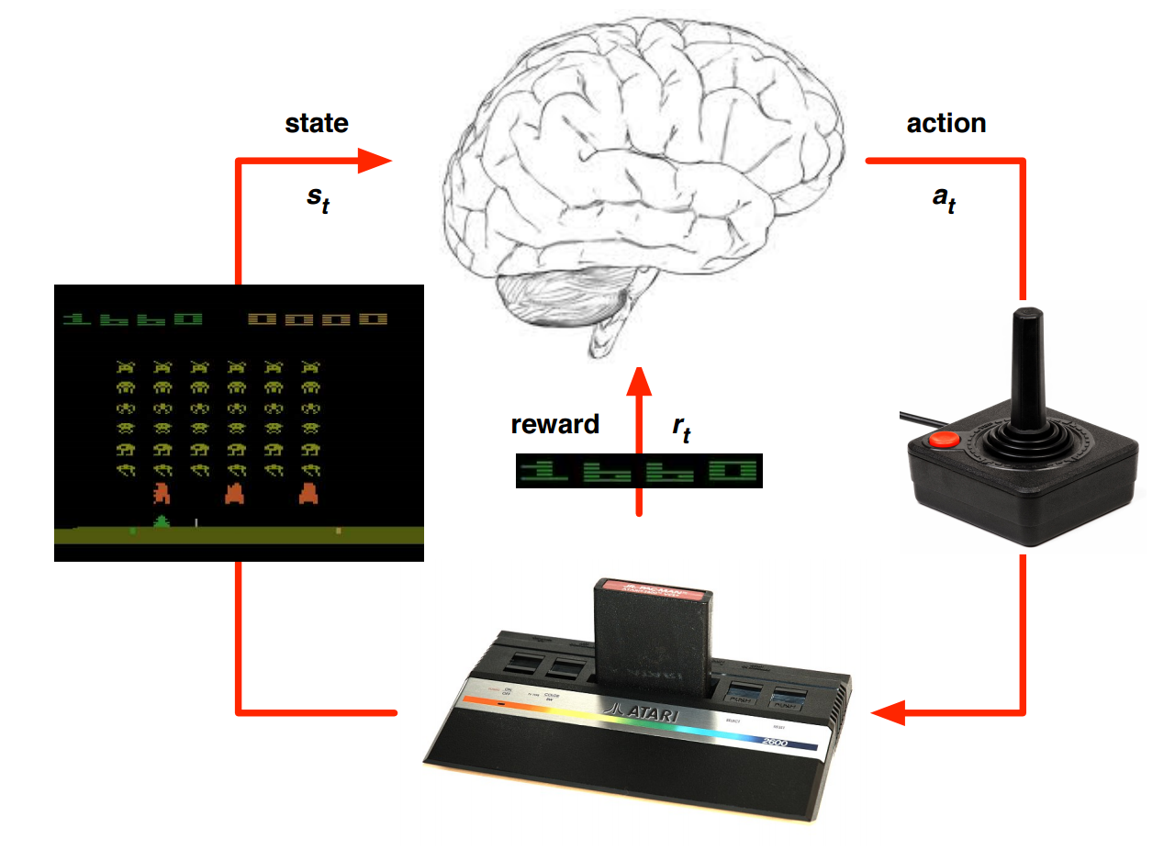
Atari gaming from Pixels!
Notes:
In this project, we apply a deep reinforcement learning model (recently developed by DeepMind) to learn optimal control patters from visual inputs to play Atari games. The brain shown here is basically a function approximator, in this case a neural network. It takes pixels from Atari games as input, and it outputs an optimal action that can be sent to Atari. Depedning on the action, the game returns a reward i.e. change in score and its state changes. Our goal is to develop an agent that maximizes the rewards or game score.

Slide 3
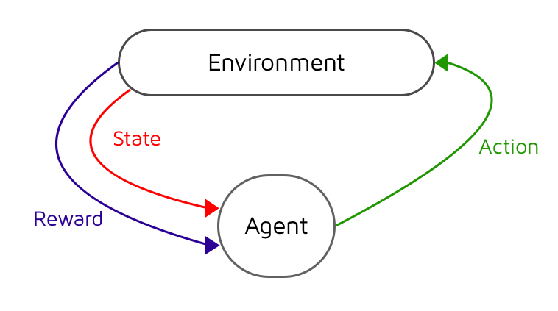
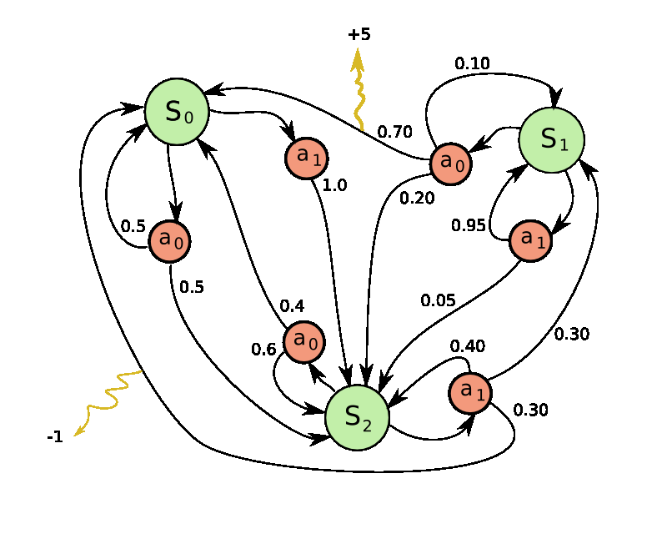
Reinforcement Learning
Learning to act through trial and error
An agent interacts with an environment and learns by maximizing a scalar reward signal.
No models, labels, demonstrations, or any other human-provided supervision signal.
Markov Decision Process
The set of states and actions, together with rules for transitioning from one state to another, make up a Markov decision process.
One episode of this process (e.g. one game) forms a finite sequence of states, actions and rewards:
s₀, a₀, r₀, s₁, a₁, r₁, s₂, …… s_{n}
Notes:
Before I dive into the details of our model, let me talk a bit about reinforcement learning. In reinforcement learning, we have an AI agent that can perform actions on environment which causes a change in state and the environment returns a reward. The aim of this agent is to maximize the sum of rewards that it will keep on getting from the environment.
The set of states and actions along with transition rules are called Markov decision processes or MDPs. We can represent an episode of a game as : s0, a0, r0 and so on.

Slide 4
Q-learning
To solve a reinforcement learning problem, we define a function Q(s, a) representing the maximum discounted future reward when we perform action a in state s, and continue optimally from that point on.
If the optimal Q function is known for state s’, then we can write the optimal Q function at preceding state s as:
Why Deep-Q learning?
It is very challenging to store the Q-value for every possible state-action pair and iteratively update this table as the agent explores its environment.
Let Deep Neural nets approximate the Q function to learn to act from high-dimensional sensory inputs!
Notes:
To model a reinforcement learning algorithm, we define a Q function that represents the max discounted future reward the agent gets if it performs action a in state s. This function can also be represented in this form, which is also known as Bellman eqn.
SO, why do we want to use neural nets here? If we think in terms of Atari games, with each pixel the state of game changes. So, it will be very challenging to explore and store all possible values of state-action pairs in a table. Instead, we can approximate the q function using a neural network.

Slide 5
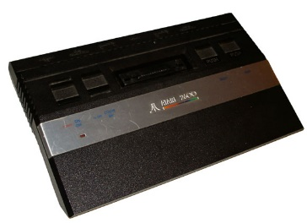
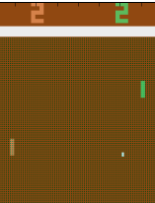
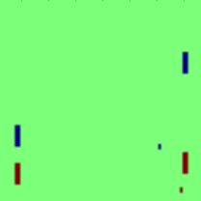
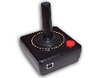
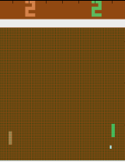
First attempt: Pong-V1
Atari (Simulator)
Previous frame
.
.
.
.
.
Up
Difference
Down
Current frame
Notes:
This is a very simple model which we developed to play pong. We take last 2 frames from the Atari simlulator and subtract them to capture the motion of ball. And we feed this to a feed-forward neural network. So, this network has 200 hidden units with relu activations and has 2 linear outputs, which give the Q values of 2 possible actions – up and down. So, in each iteration, we take the action with max Q value and send it to Atari to continue the loop. I will discuss the loss function in later slides.

Slide 6
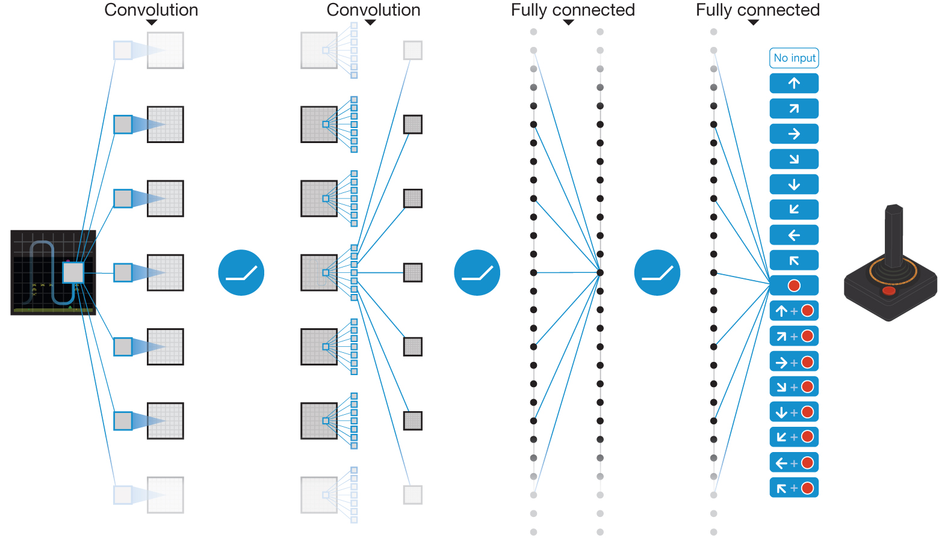
DQN Architecture(DeepMind)
End-to-end learning of values Q(s,a) from pixels s
Input state s is stack of raw pixels from last 4 frames
Output is Q(s, a) for 18 joystick/button positions
Reward is change in score for that step
Network architecture and hyper-parameters fixed across all games [Mnih et al.]
Notes:
Besides creating our own model without using any convolutional layers, we replicated the results of deepmind using their dqn network. The input to this network is a volume of last 4 frames. There are 3 convolutional layers followed by 2 fully connected layers. The last layer has 18 units corresponding to each action possible in Atari. This network was designed in a way so that it can be used to train on any Atari game.

Slide 7
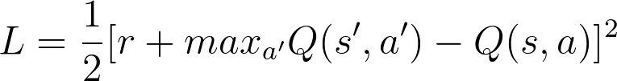
Is just plugging in ConvNets enough? (Tricks of Trade)
DQN with Experience Replay
Successive samples are correlated. To remove correlations, build data-set from agent’s own experience
Take action at according to Epsilon-greedy policy
Store transition (s_{t}, a_{t},r_{t+1},s_{t+1}) in replay memory D
Sample random mini-batch of transitions (s, a, r, s’) from D
Optimize MSE between Q-network and Q-learning targets. Loss function:
Notes:
Now that we have discussed the model architecture, how do we actually do the training? We cannot use successive samples to train as they are highly correlated. Instead, we frst build a replay memory of these quadruples (st, at, rt+1, st+1). We then randomly sample mini-batches from this replay memory and backprop into the network using SGD.
The loss function minimizes the MSE between Q value outputted by the network and the expected q value derived using bellman eqn.

Slide 8
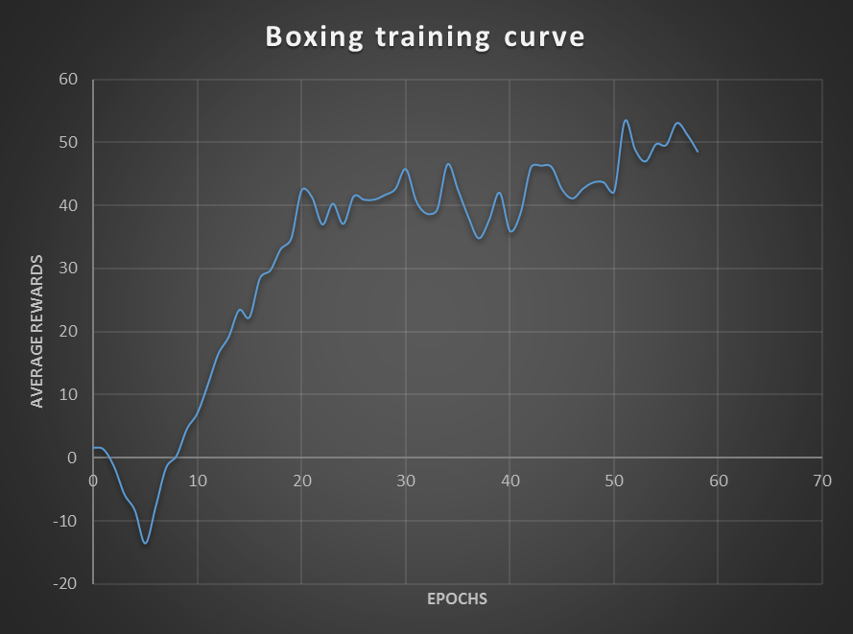
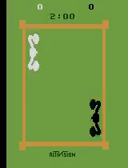
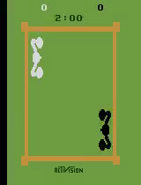
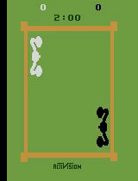
Model training curves | Boxing
Our agent
Computer
Final score: 25 | 46
Final score: 67 | 66
Final score: 99 | 16
Notes:
So, this graph shows the training curve of boxing. Average rewards here are the final scores that the agent gets wehn the game ends. So, by looking at these 3 videos, you can get an idea of the strategies learnt by the AI agents. As it gains more experience, it learns how to pin its opponent against the ring and keeps on jabbing him to get very high rewards.

Slide 9
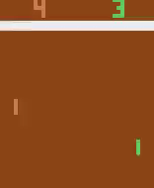
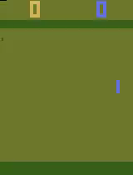
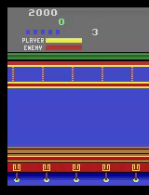
Pong-V1/V2, Boxing, Kung-Fu demo
Computer
Our agent
Computer
Our agent
Pong-V1 (Multilayer perceptron)
Pong-V2 (with DQN)
Our agent
Computer
Boxing (with DQN)
KungFu (with DQN)
Notes:
Here, we show the demos of all the games that we trained the deep q learning model on. PongV1 is our simple model without any convolutional layers that learns to play almost as well as the computer but it is not as good as the deep learning model. KungFu is a game that requires more exploration and it looks like the network didn’t get to learn it that well.

Slide 10
Our Atari Agent vs Human
Average gameplay scores
Game | Random Play* | Human* | DQN | Multi-layer Perceptron
Boxing | 0.1 | 4.3 | 41.2 ± 11.4
Pong | -20.7 | 9.3 | 11.8 ± 2.1 | 3.8 ± 1.4
Kung-Fu Master | 258.5 | 22736 | 14129 ± 3234
* V Mnih et al. Nature 518, 529-533 (2015) doi:10.1038/nature14236
Notes:
So,finally in this slide, we compare our agent’s performance with human performance. The average scores of random play and human were taken from DeepMind’s nature paper. So, in boxing and pong, the trained agent can play much better than humans, however for kung fu its performance is not that good. That’s mainly because we couldn’t train it for enough time.

Slide 11
Thank You!
Questions?

Slide 12
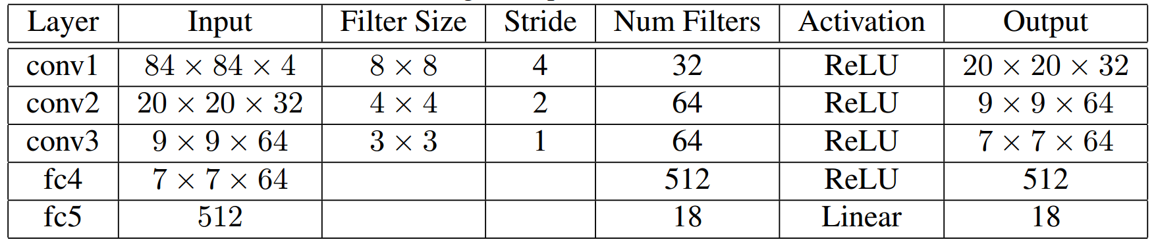
Appendix | DQN architecture

Slide 13
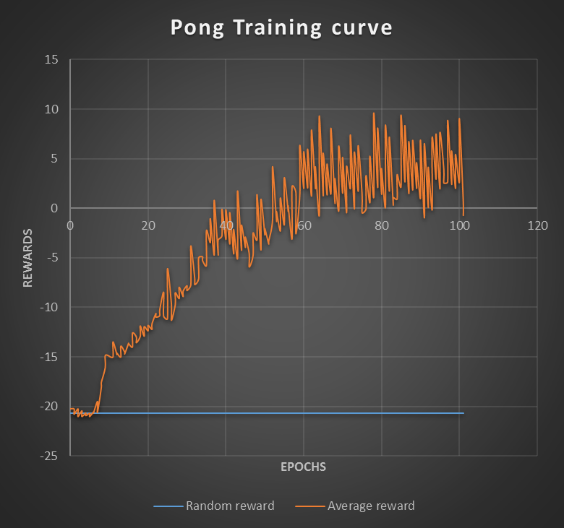
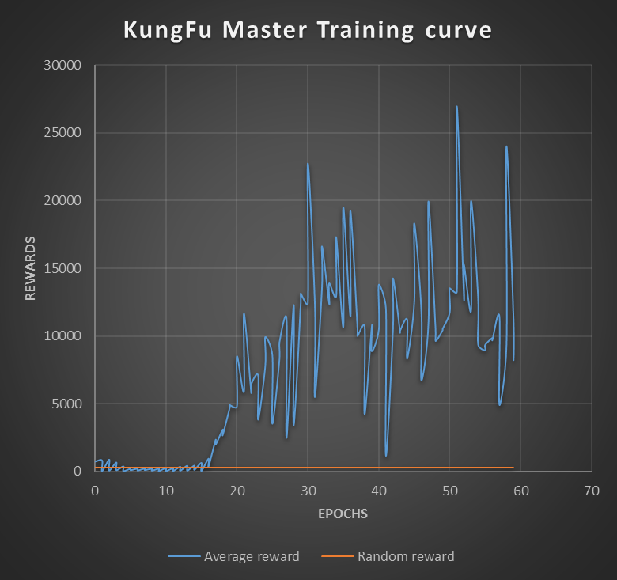
Model training curves | Pong and KungFu

Slide 14
Extra
Rewards Clipping
DQN clips the rewards to [−1, +1]
This prevents Q-values from becoming too large
Ensures gradients are well-conditioned
Problem: Can’t tell difference between small and large rewards

