Slide 1

YouTube dataset
Team lex
APOORVE GUPTA
ARAVIND PERICHIAPPAN
PRATYUSH MISHRA

Slide 2
ABOUT
Introduction
Welcome! We explore some of the interesting simple numbers of trending YouTube videos from mid-November 2017 until January 2018. In total, we have an estimated 50,000 records to evaluate--So, let's get started!
Importing Modules and Data
We initially import our information and tools for this analysis. There a couple of comments to this initial process:
1. Data was provided by Kaggle User Mitchell J. in several files, but we went through the data-cleaning process.
2. We have also created a Descriptive Statistic function using python for this dataset.

Slide 3
INTRODUCTION
We observe trending YouTube videos from November 2017 to December 2018 for selected countries. The countries available for the scope of this analysis were
1. Canada (CA)
2. Great Britain (GB)
3. Germany (DE)
4. France (FR)
5. United States (USA)
During this time period, there area total of 15982124093 views.
In this observation, we can identify an increase in Youtube views from the beginning of December to mid December.

Slide 4
DATA CLEANING
Imports
import pandas as pd
import pprint
import string
import matplotlib.pyplot as plt
from datetime import datetime as dt
import visual_descriptiveStats as viz_personal
We locally import the YouTube datasets using Pandas. Thereafter, we utilize Pprint at some point to easily visualize and identify output.
The regions of the YouTube video information are the following:
1) Canada
2)United States of America
3)Great Britain
4)France
5)Germany

Slide 5
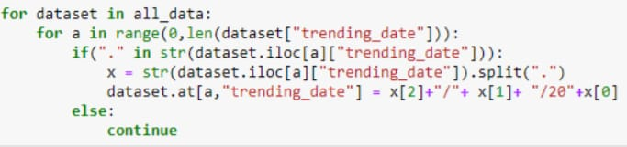
Formatting Trend Date Feature
Firstly, we format the "trending_date" feature from having dots as its delimiters, to "slash" delimiters.
For example, 1.1.17 will now be 1/1/17.

Slide 6
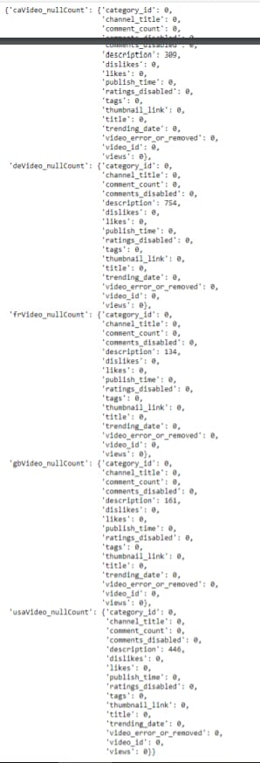
Identifying NULL Values
We identify that the Description feature for every dataset contains a lack of information, or just non-entered information. In regards to Semantic Analysis, having no description is vital.
However, there are two things to think about for the concern of this information
1. The total amount of non-entered values isn't significant enough to cause a concern for validating them or more.
2. If we look at the following Channel Users and Titles of the videos for every country, we observe that these videos are from non-influencers such as fan-made creations, commentators, or others.

Slide 7
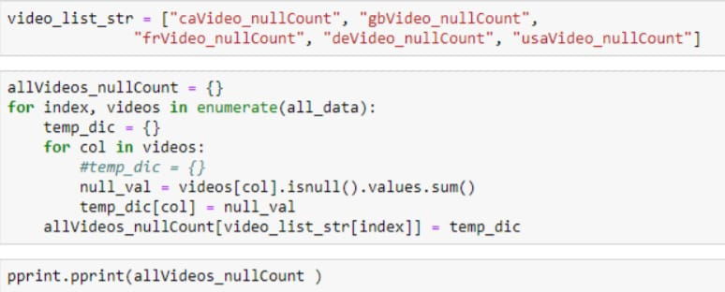
Therefore, we delete the the rows that contain a lack of information in the description feature.

Slide 8
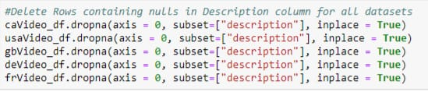
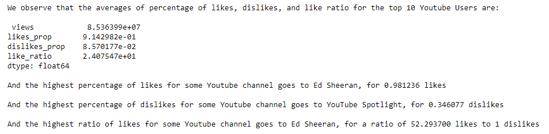
Drop Information
Here, we drop any null values that exist in each dataset. As seen from before, the following are the number of missing "Description value.

Slide 9
Preliminary Thoughts
Question 1) From the list of trending videos that occurred from November 2017-January 2018,
what are the top 10 trending:
1. YouTube videos
2. Categories
3. YouTube Channels
based on user view counts.
Question 2)
From the top videos, categories, and YouTube channels, what countries dominate those spaces?
Question 3)
Lastly, for these topics, what were the most disliked, liked, and ratio of likes?
From this analysis, we can distinguish what types of topics trending during the winter, and some of their characteristics.

Slide 10
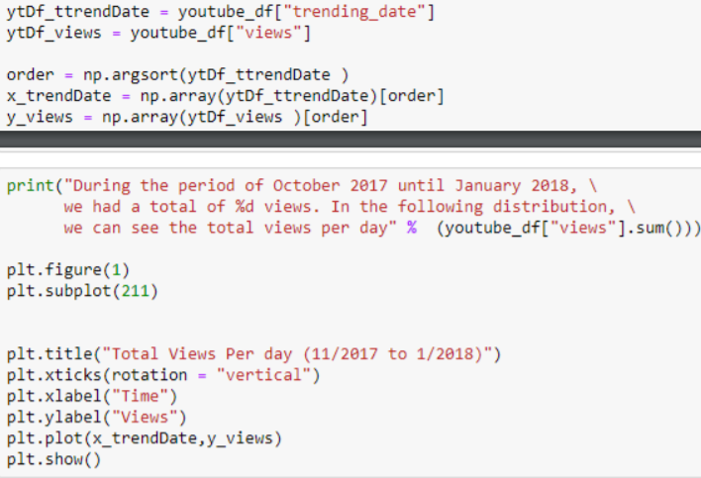
Analysis
The following visualization identifies the total views per day between 11/2017 and 01/2018.

Slide 11
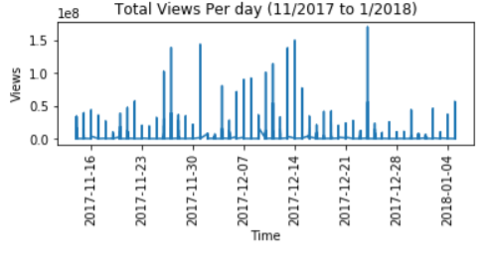
During the period of October 2017 until January 2018, we had a total of 15982124093 views. In the following distribution, we can see the total views per day:

Slide 12
Top 10 from Channels, Videos, and Categories
We now identify the top 10 viewed trending channels, videos, and categories from November 2017-January 2018.
From identifying these ranks for each feature, we identify the countries that took the most interest for such feature. (E.g. For YouTube Highlights in several countries, we see that some country China viewed it more than any other country)
We'll proceed through these rankings by YouTube
1. Users (Channel Titles)
2. Videos (Titles)
3. Categories

Slide 13

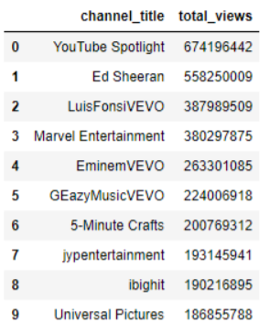
We'll proceed through these rankings by
1. Users (Channel Titles)
2. Videos (Titles)
3. Categories

Slide 14

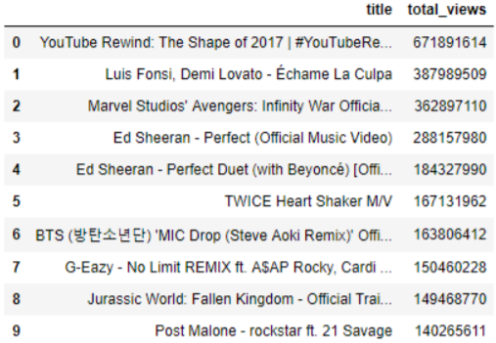
Top 10 Youtube Videos

Slide 15

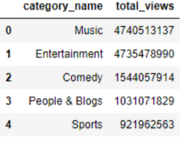
Top 5 Categories
For this time period, Music was the top category. Moreover, Ed Sheeran rocked the trending topics within both his channel and videos, especially in Great Britain.
We can identify this because in the latter part of our analysis, we identified what Channels, Videos, and Categories were popular in likes, dislikes, and their ratio.

Slide 16
Channels and their Likes:
And the highest percentage of likes for a Youtube channel goes to Ed Sheeran, for 0.981236 likes
And the highest percentage of dislikes for a Youtube channel goes to YouTube Spotlight, for 0.346077 dislikes
And the highest ratio of likes for a Youtube channel goes to Ed Sheeran, for a ratio of 52.293700 likes to 1 dislikes
Videos and their Likes:
And the highest percentage of likes for a Youtube Video goes to Ed Sheeran - Perfect (Official Music Video), for 0.981236 dislikes
And the highest percentage of dislikes for a Youtube Video goes to YouTube Rewind: The Shape of 2017 | #YouTubeRewind, for 0.346077 dislikes
And the highest ratio of likes for a Youtube Video goes to Ed Sheeran - Perfect (Official Music Video), for a ratio of 52.293700 likes to 1 dislikes
Categories and their Likes:
And the highest percentage of likes for a Youtube Video goes to Comedy, for 0.970048 likes
And the highest percentage of dislikes for a Youtube Video is Entertainment, for 0.346077 dislikes
And the highest ratio of likes for a Youtube Category is Comedy, for a ratio of 32.387098 likes to 1 dislikes

Slide 17
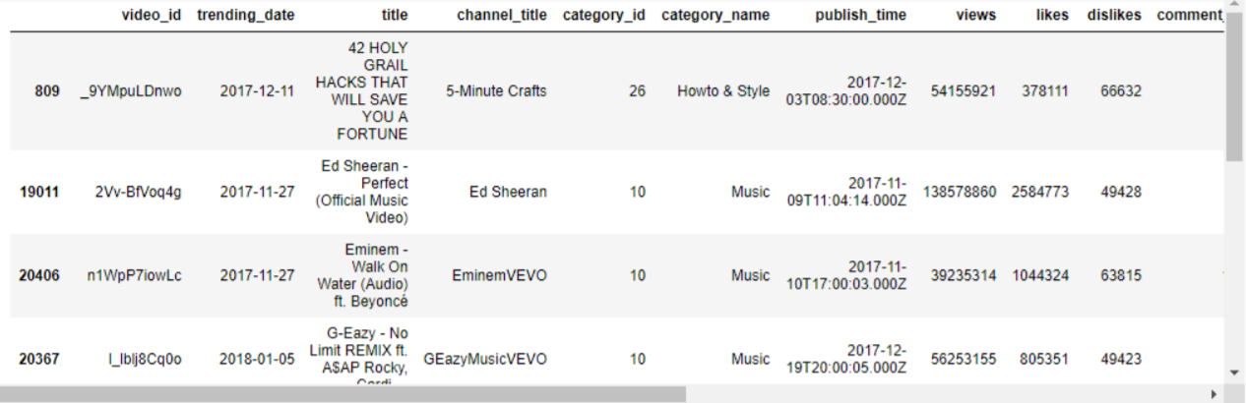
Countries that Dominate the Top 10 Users (Channel Titles)

Slide 18
You Like It?
We now evaluate the percentage of total likes and total dislikes, and the ratio of these two.
Moreover, what can we conclude is the most liked and disliked for our top channels, videos, and categories?

Slide 19
Most Liked, Disliked, and Ratio of Likes for Top Youtube Channels

Slide 20
INSPECTION
We first evaluate the type of features we have for our datasets. Moreover, we identify a few characteristics of the information!
Characteristics
(['video_id', 'trending_date', 'title', 'channel_title', 'category_id', 'publish_time', 'tags', 'views', 'likes', 'dislikes', 'comment_count', 'thumbnail_link', 'comments_disabled', 'ratings_disabled', 'video_error_or_removed', 'description'], dtype='object')

Slide 21
Count of Rows and Features
We observe discrepancies between the amount of rows for each dataframe. Since these datasets are much alike from each other, we would like to concatenate the information into one dataset, with their Country of origin being another feature, for future analysis.
The filesize should be an estimated total of the sum of all dataset's rows. This total would be SUM{ 10592 + 10600 + 10593 + 10594 + 10597 }= 52976 rows.
Total of rows and features for Canada:, (10592, 16)
Total of rows and features for USA:, (10600, 16)
Total of rows and features for Great Britain:, (10593, 16)
Total of rows and features for France:, (10594, 16)
Total of rows and features for Germany:, (10597, 16)

Slide 22
Descriptive Statistics and Thoughts
Visualizing Mean and Median for Quantitative Datatypes
From the dataframe_stats function we have created, particularly for this analysis, we get the following:

Slide 23
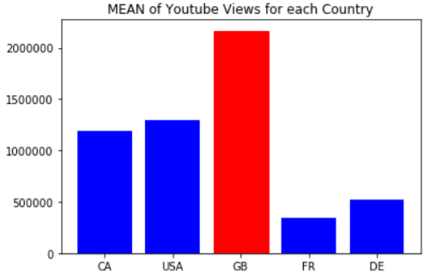
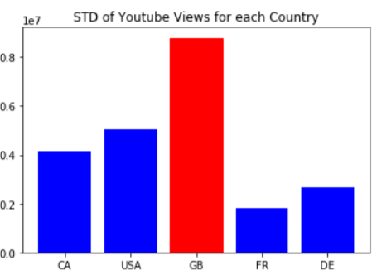
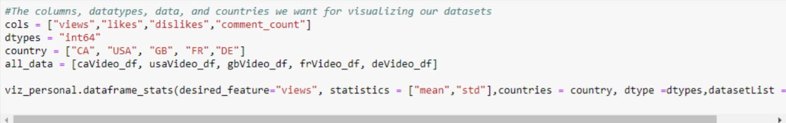
YouTube Views

Slide 24
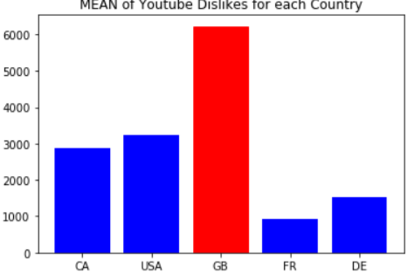
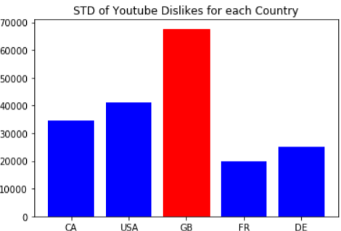
Dislikes

Slide 25
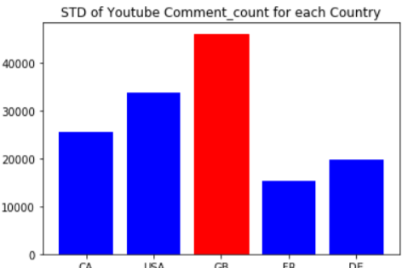
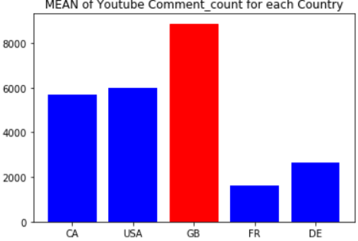
Comments Count
From our observations, we observe that both the mean and standard deviation of Great Britain (GB) are larger than that of any other country.
If we look into some of the videos in our upcoming analysis, separate document, we could identify why this situation occurs.
Even if the total data sizes for each dataset are relatively the same, GB had had more Dislikes, Comments, Likes, and other cases.

Slide 26
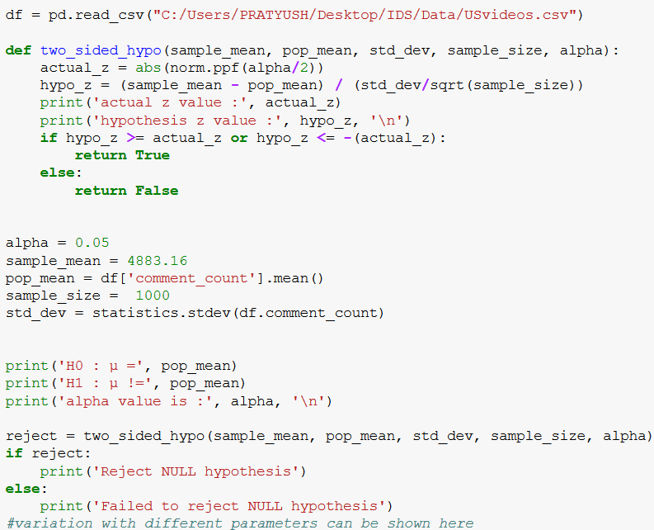
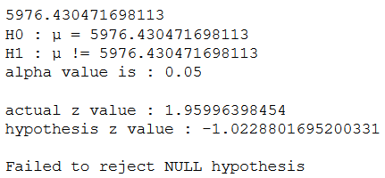
Hypothesis Testing
Two-Sided Hypothesis
Testing

Slide 27
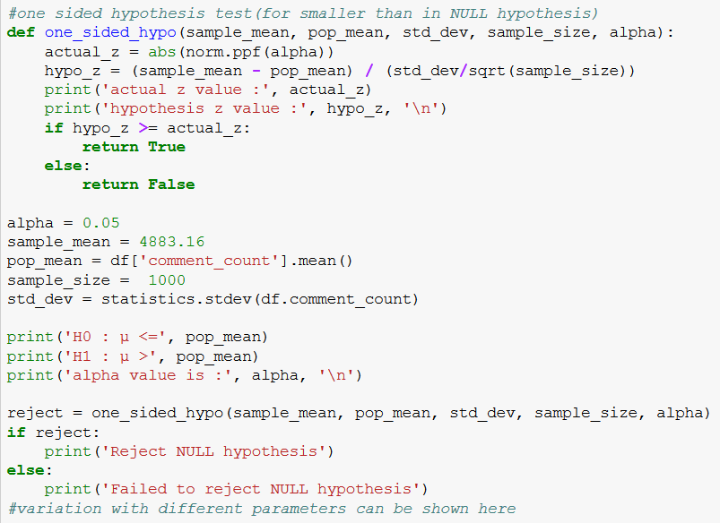
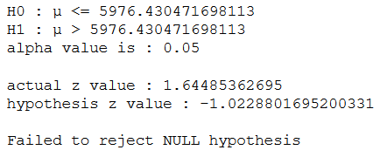
One-Sided Hypothesis
Testing

Slide 28
THANK YOU

