Slide 1
Current State – Solution Architecture (High Level Design)
Data Sources
employee_attrition.csv
acme_hr_policy.txt
Data Loader and Pandas
Policy Document
Analytics Pipeline - attrition_analytics.py
HR Assistant Pipeline - hr_assistant.py
Feature Engineering & EDA
Chunking and Embedding
Random Forest Model
FAISS Vector Store – Local Cache
Attrition Risk Score
RAG Query – LLM
Web Application – app.py
Streamlit Frontend

Slide 2












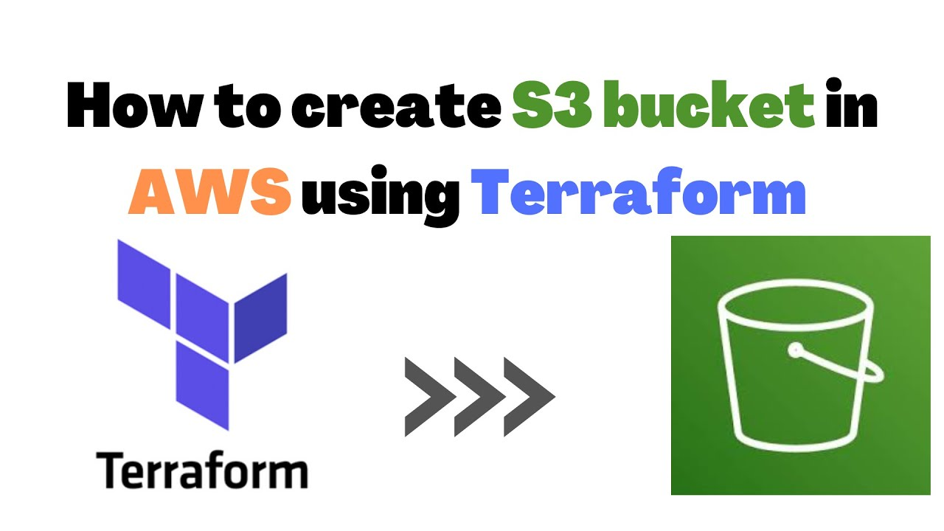




CI/ CD Pipeline
Cloud Deployed – Solution Architecture (High Level Design)
Application Layer
Developer Push Code
Application Load Balancer
Code Pipeline – Github Actions
End User
Build Docker Image
AWS Fargate - Orchestrator
User – Secure Web Access
Amazon ECR – Container Registry
HR Assistant Service
Attrition Analytics Service
Data and Storage Layer
Infrastructure
AWS S3 – Data Lake/ Data Source Files
AWS Opensearch – Vector Database
VPC & Security Groups
AWS RDS – Metadata/ User Session

