Slide 1
<Customer Name> S/4HANA Conversion
Custom Code Analysis - Summary
For additional cutouts, follow the step-by-step instructions on how to find cutout images in the SAP Media Library.
<name>, SAP
August 11, 2026

Slide 2
Custom Code - Adaptation Process
Preparation phase
Realization phase
Custom code preparation
System Conversion / Upgrade
Custom code preparation
Post conversion / upgrade activities
Application specific follow-up activities
Custom code assessment
SPDD
SPAU
HANA Code Adaptation
S4 HANA remediation
Modification Log
Custom Code Scope :
SPDD / SPAU
HANA Code Adaptation and S4 HANA Remediation
SPDD – Mandatory data dictionary adjustments
SPAU – Mandatory repository adjustments
HANA database specific custom code adjustments
S4 HANA application-level changes custom code adjustments

Slide 3
Custom Code Object – S/4HANA Simplification Category
Syntactically incompatible change of existing functionality
No impact to the business functionality
Changes required to accommodate data model or interface changes
Extension of field length of material master from 18 to 40 characters
Example: MSEG, BSEG, etc.
Semantically incompatible change of existing functionality
Functionality has been changed/simplified in standard database tables.
Example: VBRK, VBRP, SKA1, SKB1, etc.
Non-Strategic Function
Functionality will continue to work as is
Subject to compatibility scope
Example: Switch to API or Fiori
Custom code should be verified/corrected to work as per the changed function
Functionality not available : equivalent function on roadmap
Deprecated or unavailable components used in custom code, might have equivalents in future release of S/4 HANA
Detailed assessment needed
Functionality not available: Functional equivalent available
Deprecated or unavailable components used in custom code, equivalent functions available.
Detailed assessment needed
Functionality not available: No functional equivalent
Deprecated or unavailable components used in custom code
Detailed assessment needed

Slide 4
Custom Code Object Count - Statistics as reported by ATC scans for S/4HANA 2025
Unique Object Count ( ) - Segregation per Object Type

Slide 5
Custom Code Object Count - Statistics as reported by ATC scans for S/4HANA 2025
Unique Object Count
Segregation as per Remediation Category
Remediation Scope
Optional Scope (no fix required)
Out of scope
Remediation Scope - The custom code object can be remediated as per the changes in S/4HANA 2025, thus ensuring the required functionality is met - (SAP’s Scope)
Pre-Existing Issue - Custom code object which are having pre-existing issues (as in the current ECC system) - (Customer’s Scope)
Clone - Custom code objects which are classified as Clone Objects (copied using Standard SAP Objects) - (Customer’s Scope)
Fit Gap - Custom code objects which involve some deprecated functionalities, and needs further review in the system, or with the functional / business team - (Customer’s Scope)
Optional Remediation - The custom code object needs no changes and will work as is in the S/4HANA 2025 system. All the impacts from these objects are optional impacts, which can be ignored - (Optional Scope, can be ignored. Remediation will account for additional efforts)

Slide 6
Custom Code Impacts - Statistics as reported by ATC scans for S/4HANA 2025
ATC Impacts (lines of code) - Segregation as per Impact Category
Total Impacts reported by ATC Report : 1419 impacts
Pre-existing Error Impact : 98 impacts
  Impacts reported from the custom code objects which either have:-
    Pre-existing syntax error, or
    Inconsistent statements (which if executed will result in short dump)
HCA Impact (HANA Code Adaptation) : 169 impacts
  Result of the change to HANA DB
  Have no functional impact
  Are of a technical nature
  In many cases can be performed ahead of the conversion
  Quick Fixes widely available
S/4HANA Impact : 1152 impacts
  Result of change of the business suite from ECC to S/4HANA
  The Simplification Database is a database table in the SAP S/4HANA system that contains all simplification items that refer to SAP objects simplified in SAP S/4HANA. Each simplification item describes changed or removed SAP objects and refers to a dedicated SAP Note that describes the impact of the change and how the related custom code can be adapted.
Third party objects : 0 impacts
Objects from external namespaces: /ORS/*, /PROMENTA/* are impacted

Slide 7
Custom Code Impacts - Statistics as reported by ATC scans for S/4HANA 2025
Break-up for HCA Impacts ( )
Break-up for S/4HANA Impacts ( )
Remediation Scope
Optional Scope (no fix required)
Out of scope

Slide 8
Summary Scope - For Custom Code Activities
Activity | Category | Count
Mandatory Conversion Activities (in objects)
SPDD Adjustments |  | Objects
SPAU Adjustments |  | Objects
Post Conversion - Custom Code Remediation Scope (in impacts i.e., lines of code)
HANA Code Adaptation (HCA) | Mandatory Impacts | impacts
 | Optional Impacts | * Impacts
S/4HANA Remediation | Technically Remediable | impacts
 | False Positive | impacts
 | Optional - Can be ignored | * impacts
* No remediation required for Optional HCA and S/4HANA impacts. These items are not in scope,.

Slide 9
S/4HANA Conversion / Upgrade / HANA Migration
    Scope
    Mandatory Code Adjustments
    Mandatory conversion/upgrade activities - adjustments during SPDD, SPAU & SPAU_ENH phase
    Remediation of mandatory HANA Code adaptions impacts as per ATC findings on check variant *S4HANA_READINESS_2025 / FUNCTIONAL_DB
    Remediation of technically remediable S/4HANA impacts as per the ATC findings on check variant *S4HANA_READINESS_2025 / FUNCTIONAL_DB
    Other Activities
    *Delta mandatory code adjustments in subsequent system ( SPDD – upto 100 objects ( bucketed ) , SPAU – upto 100 objects ( bucketed ) , HCA - upto 250 impacts (mandatory only – bucketed ) , S4 – upto 250 impacts ( technically remediable only – bucketed )
    Development support to address issues that directly arise from the execution of mandatory code adjustments.
    Pre-Requisite
    An external NW7.52 system (or higher) should be available in the customer’s landscape in order to host an ATC scan based on check variant *S4HANA_READINESS_2025 / FUNCTIONAL_DB as part of prepare phase (before start of conversion) to validate custom code remediation scope
    *Custom code objects used actively in productive system (at least for a span of 6 months covering all critical processes )
    Assumptions
    The current scope and efforts for mandatory code adjustments are based on relevant extracts available from the customer system. Any deviations from the baselined scope will be managed through a change request.
    The customer is responsible for ensuring version correctness in the system provided for custom code activities. Mandatory code adjustments will be executed on the active version of the objects available in the designated system.
    Objects impacted during mandatory code adjustments that fall within third-party vendor namespaces (e.g., <namespace>) are expected to be reviewed and adjusted by the respective vendors. The customer is responsible for coordinating with these vendors to complete the necessary activities.
    Any adjustments required due to dual maintenance or retrofit processes fall under the responsibility of the customer and are not included in the scope of mandatory code adjustments.
    All relevant impacts related to HANA code adaptations and S/4 HANA will be addressed using *Quick Fix and / or in-house automation tools & accelerators.
    Documentation for remediated custom code will be generated using in-house automation toolset in a standardized format.
    Mandatory code adjustment activities are scoped for one system only. All remediated objects will be transported to subsequent systems.
    The development support does not extend in resolving pre-existing errors or bugs in custom code that are unrelated to the upgrade or remediation activities.
    SAP Queries, Infoset Queries, and ABAP Queries identified as impacted through ATC analysis are recommended for redevelopment by the customer. The scope, feasibility, and approach for such redevelopment will be discussed and finalized during the project execution phase. Any development support required to facilitate this effort may be undertaken through a Change Request.
    Any layout changes related to Adobe Forms / Smart Forms / Scripts Form are not included in the baseline scope. The effort will be estimated based on customer requirements and will be addressed separately via a Change Request.
    Effort estimates have been prepared based on the assumption that SAP J4D capabilities are available. If J4D capabilities are not available, the estimates will need to be reassessed and recalculated.
    *Any new fit gap development work required to replicate functionality not supported in S/4HANA is excluded from the current scope and may be addressed separately via a Change Request.
    *Effort related to Customer-Vendor Integration (CVI) within the custom code track is not included in the baseline scope. This effort will be assessed during the execution phase, based on the customer’s specific requirements, and can be covered through a separate Change Request.
    Exclusions
    Any activities not defined as in scope are deemed out of scope, including, but not limited to the following exclusions:
    Any adjustments to custom code objects clones of standard SAP objects , as identified through the SAP clone finder scan results.
    Any custom code modifications, configuration updates (in FILE t-code), or enhancements required due to changes in application server file paths resulting from an operating system change are explicitly deemed out of scope for this engagement.
    ATC impact category “Optional” or performance optimizations , including those related to variants FUNCTIONAL_DB_ADDITION or PERFORMANCE_DB variants in existing custom code.
    Any Screen variants / Transaction variants that are not carried forward by upgrade tool.
    Objects in package $TMP ( temporary or local objects ) or third party packages or objects with pre-existing syntax errors are excluded from all adjustment activities.
    * To be validated as per the scope of the opportunity

Slide 10
Fit Gap | Custom Code
What s Fit Gap? Functionalities that are not available in S/4HANA require business and functional input to determine the appropriate course of action, including: Whether a process redesign is required Whether custom development or an enhancement is needed Whether the identified gap is a false positive During the Explore phase, each identified gap is reviewed in detail to understand its business impact and validate the requirement. Based on this assessment, the appropriate action is determined—whether to adopt standard S/4HANA functionality, redesign the business process, develop a custom solution, or confirm the gap as a false positive. Object Classification illustrated in table below-
Object Type | Object Type Definition | Count of Object Type
AQQU | SAP Query user group (defines a user group for SAP Query reporting).
AQSG | SAP Query user group assignment (assigns users to a SAP Query user group).
CLAS | ABAP Class (global class definition in Class Builder – SE24).
FUGR | Function Group (container program that holds related function modules and includes).
FUGS | Function Group Include (include program belonging to a function group, e.g., TOP include, UXX include).
FUGX | Function Module (individual function module within a function group).
PROG | ABAP Program (executable program, report, module pool, or include).
TABL | Dictionary Table (transparent, pooled, or cluster table definition in ABAP Dictionary).
Grand Total

Slide 11
S/4HANA Conversion / Upgrade / HANA Migration
    Additional Assumptions for Fit Gap developments
    Included in this scope are XX WRICEF’s with the complexity defined below:
      Complexity mix of WRICEFs is defined as:
      High – XX
      Medium – XX
      Low – XX
    After the Functional Specifications are finalized, SAP will re-review their complexity/type and provide updated effort estimates if needed
    Given efforts are based on the SAP Factory Processes and Framework, where it is assumed that the approved and complete Functional Specifications are available before the start of development process
    All developments will be designed in alignment with Clean Core guidelines, wherever feasible.
    Any new fit-gap items identified beyond the XX bucketed objects, including development work required to replicate functionality not supported in S/4HANA, are excluded from the current scope and will be addressed separately through a formal Change Request (CR) process.
    Effort estimates have been prepared based on the assumption that SAP J4D capabilities are available. If J4D capabilities are not available, the estimates will need to be reassessed and recalculated.
    SAP AI capabilities are version-dependent, and applicable features will be utilized based on system availability.

Slide 12
Key Take Away / Next Action Steps
Review 98 custom code objects which are reported to have pre-existing issues. These pre-existing issues are of 2 types:-
  With syntax error – means the custom code program has a pre-existing syntax error and can’t be activated in the current ECC system.
  With inconsistent statements – means there is no syntax error in the custom code program, but there are some code lines which if executed will result in a short dump. Currently these issues might not be observed, as these inconsistent statements might be guarded with some conditional blocks which are never executed. In case the business team isn’t facing concerns in the productive environment, these can be ignored too.
Review 563 custom code objects which involves deprecated functionalities, for example:-
  Credit management changes in FI/SD
  GENERAL LEDGER: INCOMPATIBLE CHANGES IN S/4HANA COMPARED TO CLASSIC ERP RELEASES
Review 9246 clone programs :
  A clone programs is a copy of standard SAP object.
  Categories “Very Similar Source Code” and “Identical Source Code” are highlighted to the customer for which the SAP standard object can be adopted with any necessary enhancements done, based on the customization requirements.
  This also helps the customer to cleanse their system and adopt usage of standard processes.
  SAP doesn’t recommends usage of clone objects, thus any remediation / adjustment to the clone objects is kept out of scope.
  Analyze the additional code added in clone objects (as compared to respective standard program), and enhance the standard code going forward in S/4HANA to meet the business requirements.
  3454 clone objects are impacted and reported as part of ATC report.
A usage statistics (ST03N / SCMON / UPL) report can help in reducing the custom code footprint in the S/4HANA system. For instance, if a custom code program is not required, then it can be decommissioned.
  Alternatively the usage statistics report can also help in prioritizing the remediations of custom code (as reported in the ATC scans).
  The usage statistics is a good to have report.

Slide 13
Attachments
SPDD / SPAU
Clone
ATC

Slide 14
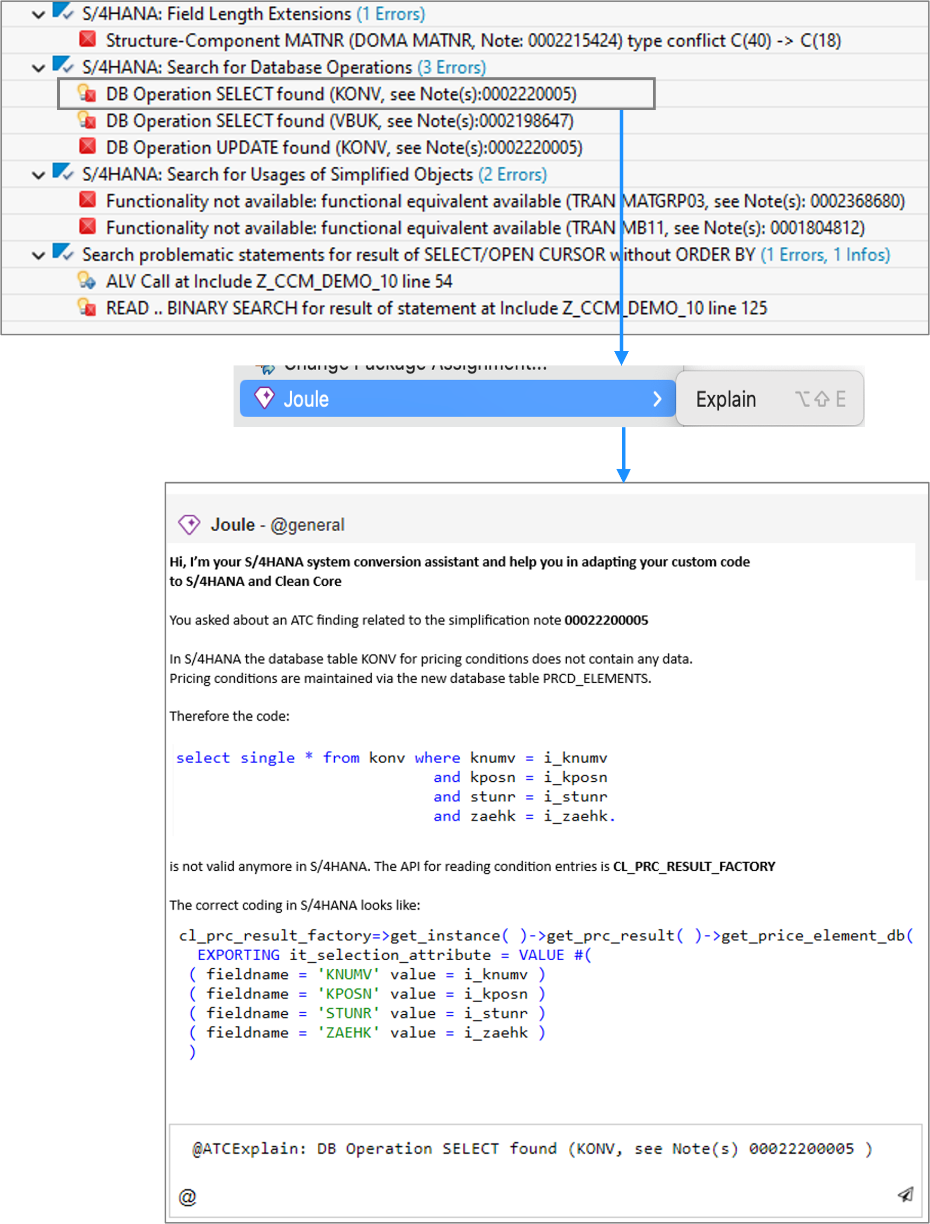
SAP Joule for Developer (J4D) – AI Features Summary
J4D Features
ATC Explain – Explains S/4HANA ATC findings and provides step-by-step resolution guidance for custom code adaptation
Code Explain – Explains the business purpose and processing logic of custom ABAP code
Docs Chat – Conversational access to SAP simplification notes and S/4HANA documentation
Generate Code Proposal – AI-based code adaptation suggestions for S/4HANA ATC issues (programs, function groups and classes)
Agentic Features
Mass Quick Fix – Automatically executes available deterministic quick fixes across multiple objects and development packages
AI Fixes – Applies AI-generated code fixes automatically
Example: Explain ATC finding and get AI code proposal for SAP S/4HANA adaptation
Prerequisites
For All J4D Features
ABAP Development Tools – SAP S/4HANA target system (≥ 2021 release, private cloud or on-premise*)
SAP Joule for Developers – ABAP AI Capabilities – Entitlement for SAP Joule for Developers with ABAP AI capabilities
Additionally for Agentic Features
AI Assistant License – Valid license for an AI assistant (GitHub Copilot or Amazon Q Developer), installed as Eclipse Plugin from the Eclipse Marketplace
* Availability of SAP Joule for Developers ABAP AI capabilities for SAP S/4HANA On-Premises ≥ 2021 is subject to RISE with SAP contract conditions (SAP Sapphire).
Further details :
https://community.sap.com/t5/technology-blog-posts-by-sap/s-4hana-custom-code-migration-agent-accelerating-ecc-to-sap-s-4hana/ba-p/14418929

Slide 15
Thank you.
<name>
SAP D@S - App Dev & Int - India

