Slide 1
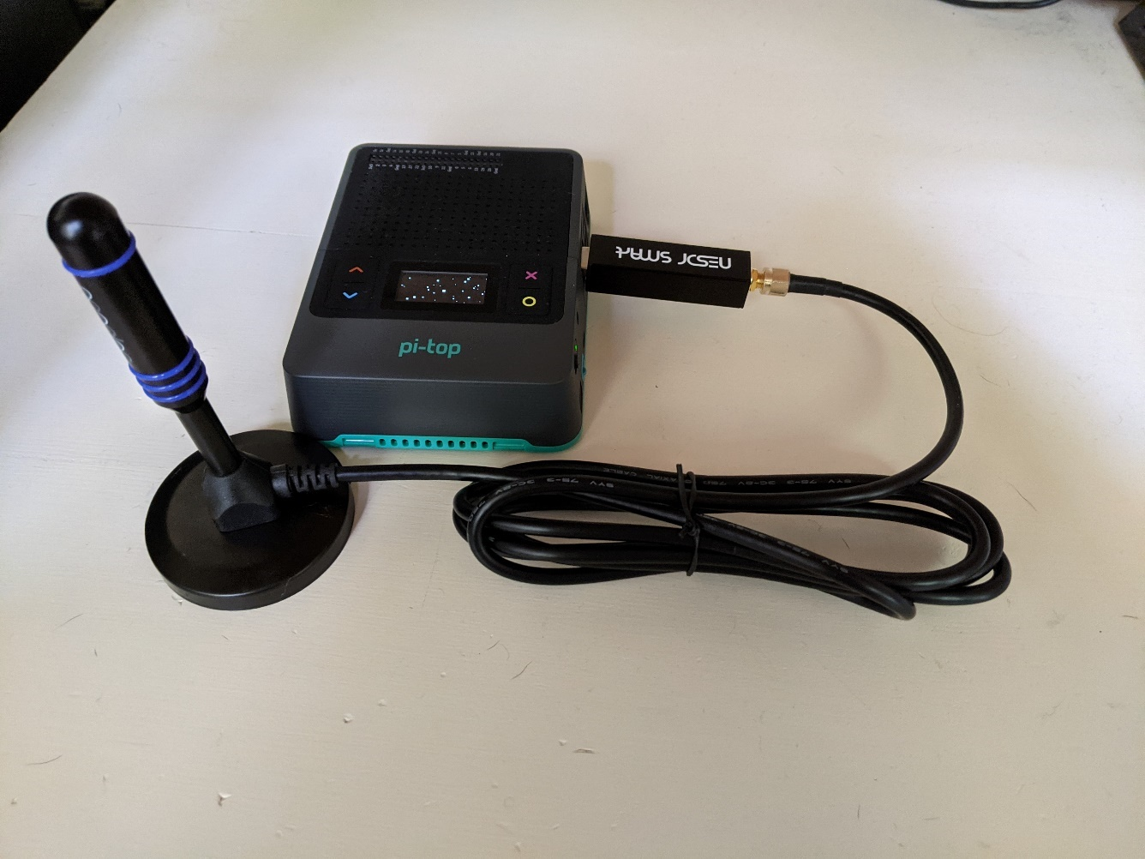
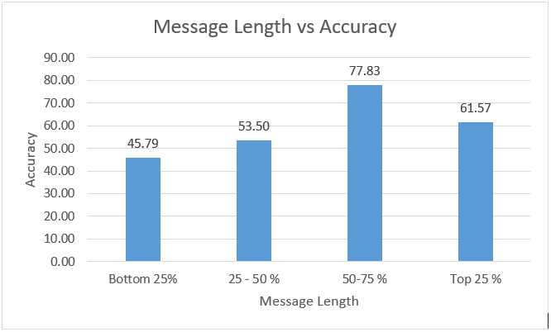
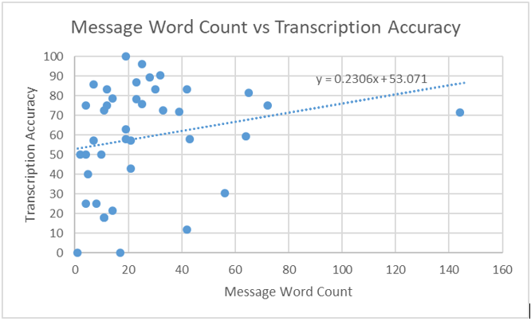
Portable Software Defined Radio (SDR) for Monitoring Emergency Services’ P25 Radio Communication and
An Investigation of AI Speech-to-Text Service for Transcription of P25 Radio Communication
Anthony Orlowski
Indiana University| Department of Intelligent Systems Engineering|
Abstract
What did you do?
Example Transcription
We present a tutorial (Part I) for concerned citizens, VOST team members, students and educators to build their own inexpensive and portable SDR radio capable of monitoring FM, NOAA weather, and P25 emergency service radio communications. We demonstrate its use on the Indiana SAFE-T P25 radio network using Bloomington, IN as a demonstration network. We did this using existing SDR software (GQRX, OP25), a Raspberry Pi, consumer SDR dongles, and the pi-top[4] case. We also used this radio and the trunk-recorder software to record P25 radio transmissions and transcribe them using Amazon’s speech-to-text service “Amazon Transcribe”. We determined the service provides ~59% word accuracy when compared to human transcription, which is not enough for immediate real-world application, however, it warrants further investigation into improving the service with existing but unexplored features including custom vocabularies and custom training data. We propose future improvements and investigations of the design of the P25 radio recording system, the AI transcription service, and the experiment, that will be useful for future students, researchers, or our own efforts. We document our work and methods for future replicability by students or researchers.
This is a two part project. Part I is a tutorial of how to create your own portable (or non-portable) SDR radio using cheap consumer SDR electronics and a Raspberry Pi single board computer. We demonstrate how to use SDR software including GQRX and OP25 to tune and listen to FM radio, NOAA Weather Radio, and P25 radio (emergency services communications). Part II is an investigation into AI speech-to-text services—offered by leading cloud providers such as Amazon Web Services—where we use the trunk-recorder software to record P25 radio communications, and then use Amazon Transcribe to transcribe them. We compare human transcription to AI transcription to see if existing AI speech-to-text-services may have utility for automatically transcribing radio communications, which could be useful in situational awareness applications. We use software defined radio components and Raspberry Pi computers because they are inexpensive consumer electronics that allow a broader community to replicate our tutorial. Existing SDR software is very advanced, but there is a need for more educational resources, such as our tutorial, to explain how to use it. We investigate general AI speech-to-text services offered by cloud providers to see how well these general models perform on the context and technology specific P25 radio domain. This provides insight into the future directions and experimentation for transcription of P25 radio communication, particularly in the emergency service and public sectors. This project provide insights into the situational awareness aspect of disaster informatics. Concerned citizens, Virtual Operational Support Team (VOST) members, students, and educators can benefit from our radio tutorial to learn about SDR and monitor their local P25 radio traffic. This can allow them greater situational awareness, for example, during an ongoing flash-flooding event like the one we recently experienced. Further, digital scanners are a single purpose and expensive device ($250+). Our tutorial allows users to learn about SDR and investigate P25 radio starting at a cost of $20. The speech-to-text investigation lays the ground work for further expansion of situational awareness in disaster informatics. If we can find a reliable way to transcribe P25 radio communications, then we can have a rich source of data to update situational awareness applications, generate alerts, and study how emergency personnel use radio to accomplish their mission. We were the stakeholder for Part I of the project, as we needed it to accomplish Part II, so in this sense it was purpose built for our use. We added the portable aspect and tutorial to allow a broader set of users to benefit from our work. We reviewed existing tutorials on SDR software and determined a more comprehensive tutorial was required to reduce the time and frustration we experienced as we built our SDR. Part II was a cursory look into speech-to-text software to generate some foundational experience and insights, so we did not do an extensive literature review. However, we found only one experiments for the automatic transcription of P25 radio, and very few for other radio transcription. The key limitations for this project were the cost and time allowed. We needed our SDR solution to be inexpensive to meet our and our users’ goals. We also had limited time to investigate speech-to-text services, so the experiment design and size was limited to a single service on a small dataset with manual measurement.
Human:
Showing a 2010 grey Toyota Prius to a Edwin and Jeanne Marugo Cadenas out of Indy, showing expiring in 22 of INDISCERNABLE. Check that, it’s expired in July 21st 22 INDISCERNABLE. Be advised that 22, then its okay then. That’s affirmative, apologies. 621.
AI: (Around 58% accurate, which is close to the experiment average)
Showing a 2010 gray Toyota Prius to Edwin and G. N. Morocco. Catania's Showing expiring 22 technologies. Check that it's expired in July. I think. Like 22 then. And it's uh it's okay then. That's affirmative. Apologies. 611
Reflection
I learned that SDR is a complex field, but that it can be made accessible to users of all experience levels. I gained a better understanding of how P25 and trunked radio systems operate which improved my ability to design communication technology for emergency service personnel.
I learned that application context is crucial in speech-to-text transcription. Emergency service personnel frequently use call signs, radio-codes, addresses, and industry jargon that generic speech-to-text models do not transcribe well. Future models will need to take this into account. Further, while striving for high word accuracy is a good goal, it is probably not the best measure. Certain words and phrases, like a name or address, convey more of the meaning of a message, and therefore, a context aware measure of meaning retention will be a better measure of transcription success.
If I had additional time, I would write software to automate the transcription of the recorded transmissions. This project utilized the AWS web GUI. I would also create software that would make it easier for a humans to transcribe the audio recordings to generate a larger dataset. Our accuracy metric was calculated by manual analysis, which could be replaced by software that replicates our ruleset. Further, I would investigate additional AI speech-to-text services, such as those offered by Google Cloud or Microsoft Azure, and additional speech-to-text service features such as custom vocabularies and custom training data to see if we can improve the accuracy. A distant goal would be to automatically mark events on a situational awareness map based on transcribed radio transmissions and unit GPS data.
Results
Our first result is the Pi Radio Tutorial where we provide a step-by-step guide to build our radio starting at $20 up to $264.37 depending on user goals.
Our second result is our investigation of Speech-to-Text Services for P25 Radio where we demonstrate a 59% word accuracy of AI transcription for 50 radio messages (~8.33 mins). While not immediately useful for real-world use, we propose future improvements into the experiment, the P25 recording system, and AI transcription system.
Below we present our findings on AI transcription accuracy viewed from the perspective of message length. We find a correlation between message length and accuracy, but with more variation with longer messages due to missing fragments of unclear sections of longer radio communications.
(Links to VIDEO DEMO)
References & Links
Who? (e.g., Who are your stakeholders?)
All references can be found at https://github.com/aporlowski/pi-sdr#references and https://github.com/aporlowski/pi-sdr/blob/main/README-Speech-to-Text.md#references
Our radio built tutorial is here: Pi Radio Tutorial
Our P25 transcription investigation is here: Speech-to-Text Services for P25 Radio
For Part I, the users we target are concerned citizens, VOST team members, students and educators interested in monitoring P25 radio and learning about SDR. They wish to achieve this in a cost effective and educational experience. We assume very basic computer and radio literacy in our tutorial, and present outside resources, to make our tutorial accessible by a broad range of users.
For Part II we have a distant end goal of improving disaster situational awareness (SA )by providing automatic transcription of P25 radio communication. This could eventually impact dispatchers and emergency managers by providing a rich dataset for inclusion in SA applications. In the mean time our work mainly impacts students and researchers who wish to continue our investigation of transcribing P25 radio.
Would you be willing for us to share this slide with local first responders?
Yes
Would you be interested in receiving email communications after the class is over from the first responders? If so provide one or more email addresses
Yes, email: antorlowski@gmail.com

