Slide 1
The Battle of Neighborhoods

Slide 2
Introduction
Purpose
The purpose of this whole exercise is for submission of the final capstone project for the "IBM Data Science" course on Coursera as well as to determine what neighborhood of Toronto would be the most optimal to open a new Greek Restaurant.
Target
Target audience for this analysis would be individuals/entrepreneurs who are planning to open a Greek Restaurant in Toronto and are looking for the optimal neighbourhood to do it.

Slide 3
Data
List of postal codes of Canada Wiki: https://en.wikipedia.org/wiki/List_of_postal_codes_of_Canada:_M for access to neighborhood data of Toronto region.
Geographical coordinates of the neighborhoods: http://cocl.us/Geospatial_data for getting the longitude and latitude data for the neighborhoods.
Foursquare database: https://Foursquare.com to be used in order to explore the desired neighborhood data for various restaurant details and access the JSON files. This data shall be utilized to map the Indian restaurants in various locations.

Slide 4
Methodology
We utilized numerous Python libraries to fetch the information , to control the content and to break down and visualize those datasets. We have utilized Foursquare API to investigate the settings in neighborhoods of Toronto, get great measure of data from Wikipedia which we scraped with the Beautifulsoup Web scraping Library. We also visualized utilizing different plots present in seaborn and matplotlib libraries. Similarly, we applied AI strategy to anticipate the error given the information and utilized Folium to picture it on a map.

Slide 5
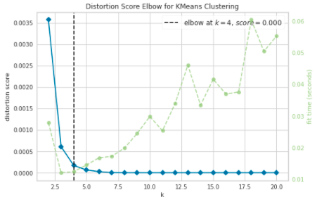
Methodology
Some techniques that we used for this analysis were One Hot Encoding and Elbow Point Technique:

Slide 6
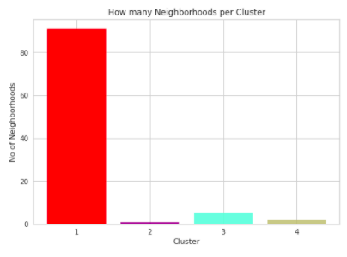
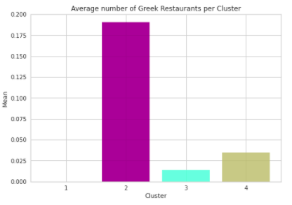
Results
We see that Cluster 2 has the least neighborhoods (1) while cluster 1 has the most (91). Cluster 3 has 5 neighborhoods and cluster 4 has only 2. Then we compared the average Greek Restaurants per cluster. This information is crucial as we can see that even through there is only 1 neighborhood in Cluster 2, it has the highest number of Greek Restaurants while Cluster 1 has the most neighborhoods but has the least average of Greek Restaurants.

Slide 7
Discussion
Even though there is a huge amount of Neighborhoods in cluster 1, there are no Greek Restaurants at all, so it would be one of the optimal neighborhoods to consider when planning to open a new Greek Restaurant.
We also see that the North York area (cluster 3) has the second last average of Greek Restaurants. Looking at the nearby venues, Fairview, Henry Farm, and Oriole, would be a great opportunity to open up a new Greek Restaurant.
We wouldn't suggest opening a Greek Restaurant in Central Toronto, as there is also a lot of competition. This concludes the optimal findings for this project and recommends the entrepreneur to open an authentic Italian restaurant in these locations with little to no competition.

Slide 8
Conclusion
Places that have room for improvement or certain drawbacks gives us that this project can be additionally improved with the assistance of more information and distinctive Machine Learning strategies. Additionally, we can utilize this venture to investigate any situation, for example, opening an alternate cuisine or opening of a Liquor Store and so forth. Ideally, this task acts as an initial direction to tackle more complex real-life problems using data-science.

