Slide 1
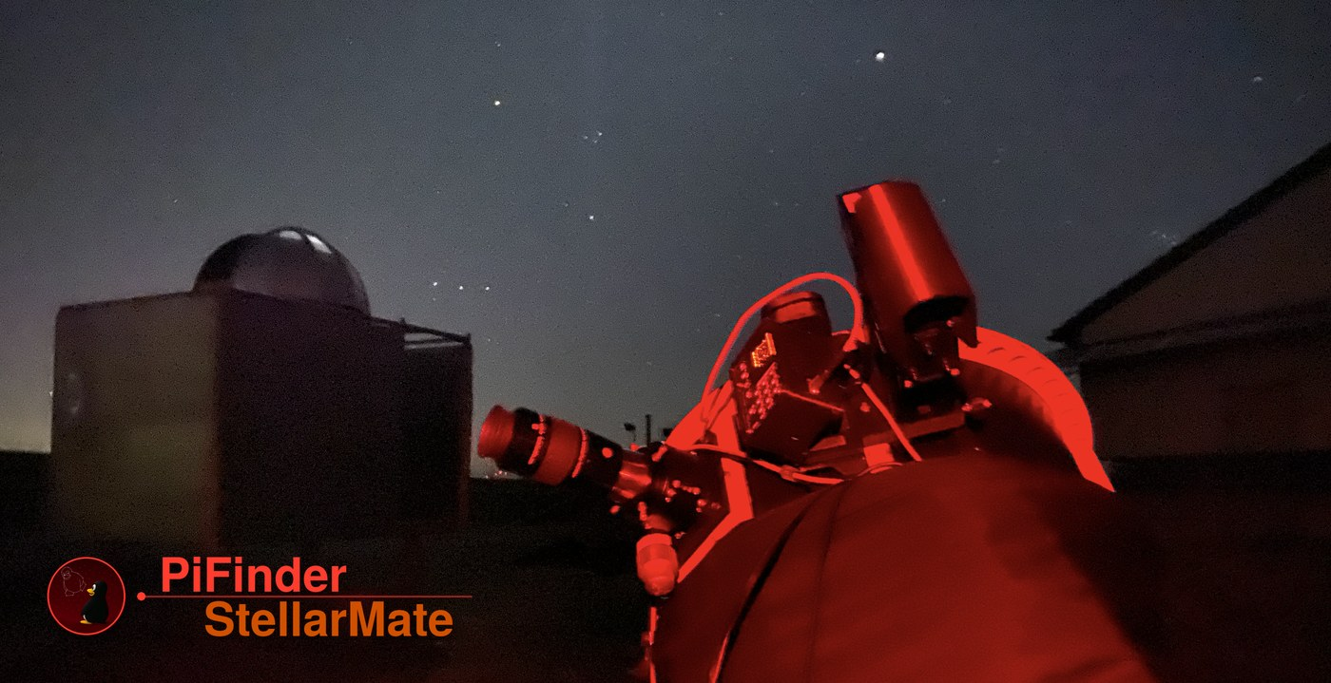
Plate-solving push-to,
on a full imaging rig.
One Raspberry Pi. PiFinder answers “where am I pointing”, StellarMate drives everything else — joined over INDI.
github.com/apos/PiFinder_Stellarmate
Community project — not affiliated with PiFinder or StellarMate

Slide 2
AGENDA
What this deck covers
1
Project summary & focus
2
PFSM Control Center
3
PF LX200 & PF Mount Bridge
4
PF Simulator
Then two takeaways — PiFinder: where to send PRs. StellarMate: how the SMOS app could drive PFSM.

Slide 3
FOR DUMMIES · 1 / 3
Two problems, one telescope
?
Where am I pointing?
★
Drive the whole rig
A Dobson or push-to EQ has no encoders — the software has no idea where the tube looks.
Camera, mount, guiding, focus — all need one coordinated control layer: INDI, KStars/Ekos, an app.
For dummies

Slide 4
FOR DUMMIES · 2 / 3
Each project owns one half
PiFinder
StellarMate
▸ Global-shutter camera + plate-solver.
▸ Live sky position + push-to arrows.
▸ Python, open hardware & software.
▸ INDI — the device-driver standard.
▸ KStars / Ekos — capture & automation.
▸ The StellarMate phone/tablet app.
For dummies

Slide 5
FOR DUMMIES · 3 / 3
PFSM is the wiring. INDI is the connector.
PiFinder
Mount Bridge
Your rig
exposes its solved
position as an
INDI telescope
couples that to
any INDI mount
(optional)
KStars / Ekos, the
mount, the app —
unchanged
PiFinder is patched in place, never forked. The mount side is generic INDI.
For dummies

Slide 6
01
PART ONE
Project summary & focus

Slide 7
SCOPE
What PFSM is
▸ A setup script — installs & patches PiFinder onto StellarMate OS.
▸ diffs/*.diff patches — applied to a stock checkout via patch(1).
▸ Three INDI drivers — LX200, Mount Bridge, Simulator.
▸ A web Control Center — stdlib-only, port 8765.
Part 1 · Summary

Slide 8
SCOPE
What PFSM is not
▸ Not a fork of PiFinder — patches re-applied every update, kept minimal.
▸ Not a fork of StellarMate — stock INDI, Web Manager, KStars.
▸ Not a replacement for the INDI Control Panel — it stays for advanced work.
▸ Not PiFinder-version-specific — talks only to the stable /api/*.
Part 1 · Summary

Slide 9
THE KEY DECISION
Why INDI
Both sides already speak it.
▸ PiFinder exposes its position as an INDI telescope.
▸ The Mount Bridge couples that to any INDI mount — no per-mount code.
Part 1 · Summary

Slide 10
TESTED AGAINST
Versions & platforms
PiFinder 2.6.3 · StellarMate OS 2.3.0
▸ Pi 4 — fully tested.
▸ Pi 5 — fully tested.
▸ UTM x86 — install + Control Center + Mount Bridge vs. the Simulator (no real solving).
Pinned to a fixed release tag, not the upstream release branch. The README table is the single source of truth.
Part 1 · Summary

Slide 11
02
PART TWO
PFSM Control Center
Install, mode-switching, hardware checks and the Mount Bridge — one web page, no SSH.

Slide 12
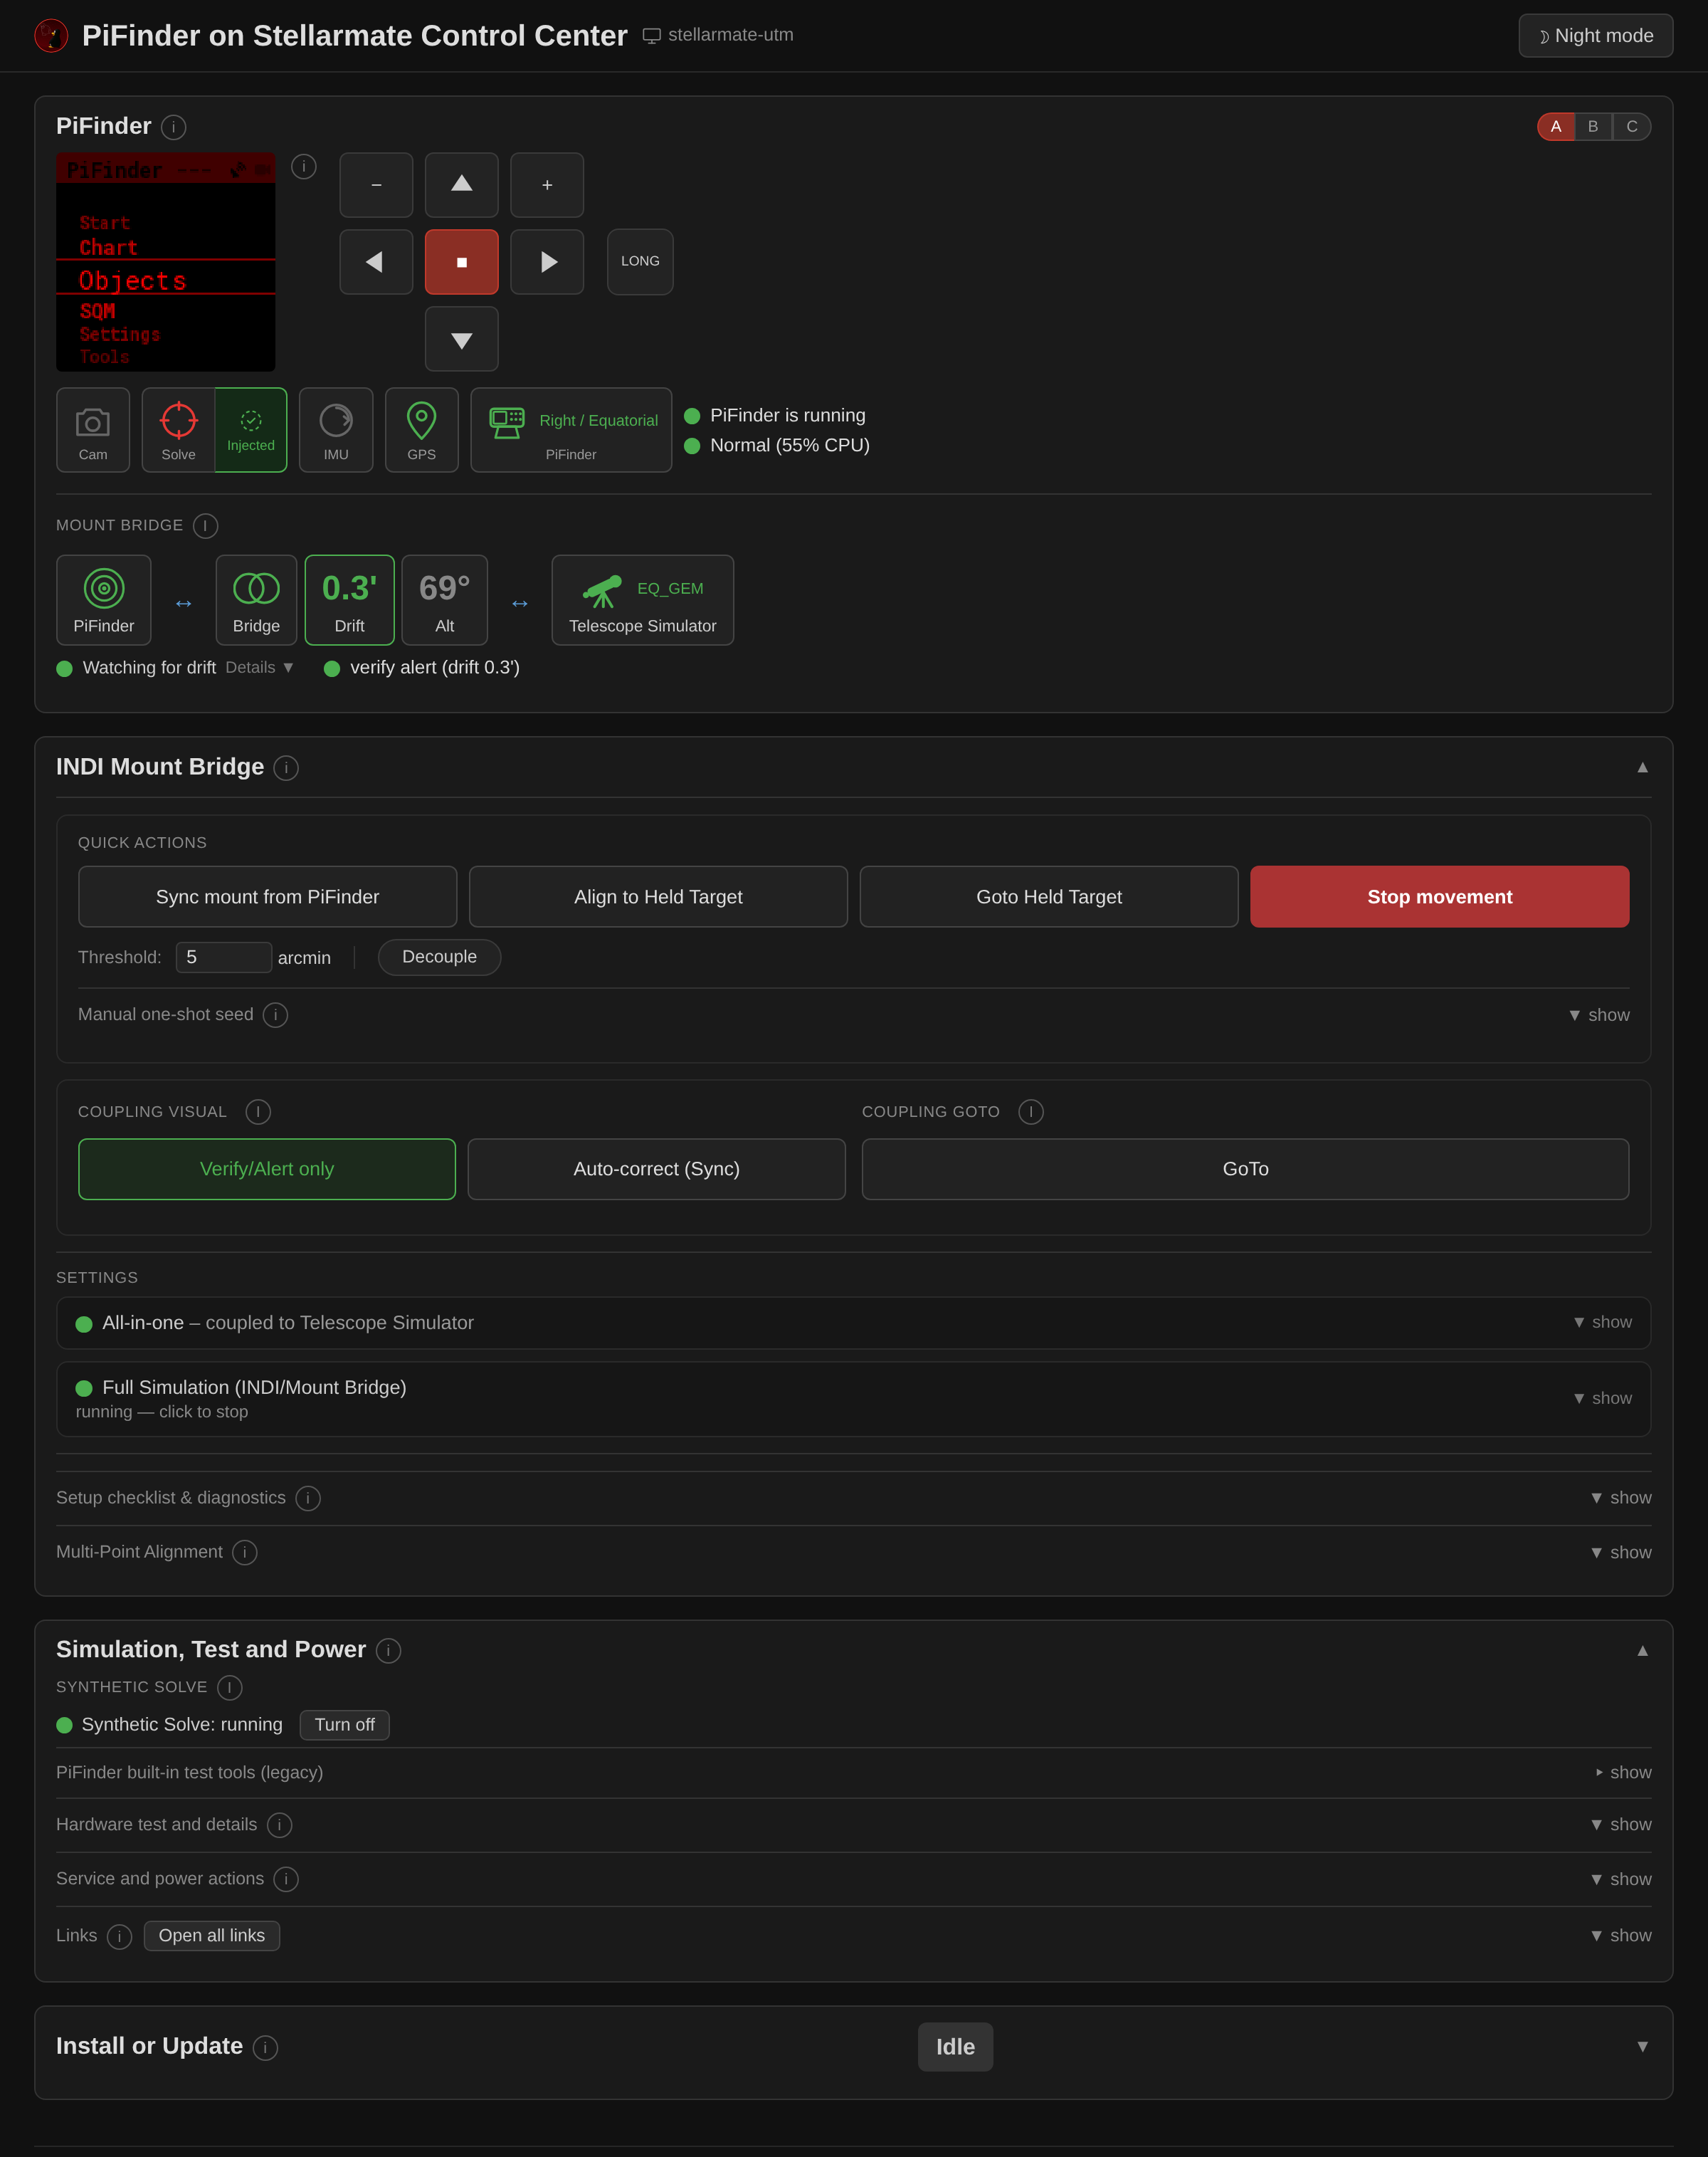
MOTIVATION
Why a Control Center
▸ Watch an install from a phone at the scope.
▸ Switch Fake Mode ⟷ the real service.
▸ Check camera / IMU / GPS are really detected.
▸ Reboot the Pi without SSH.
Part 2 · Control Center

Slide 13
ARCHITECTURE
Stdlib only — by necessity
It bootstraps the very venv that PiFinder needs, so it can’t depend on one.
▸ http.server on :8765, polled every 1–2 s.
▸ HTTP Basic auth against the system account (PAM).
Part 2 · Control Center

Slide 14
STATUS LANGUAGE
Traffic-light badges
White not applicable yet
Green verified functional
Yellow degraded / estimate
Red broken or wrong
The rule: verify real state, never “the process is alive”.
Part 2 · Control Center

Slide 15
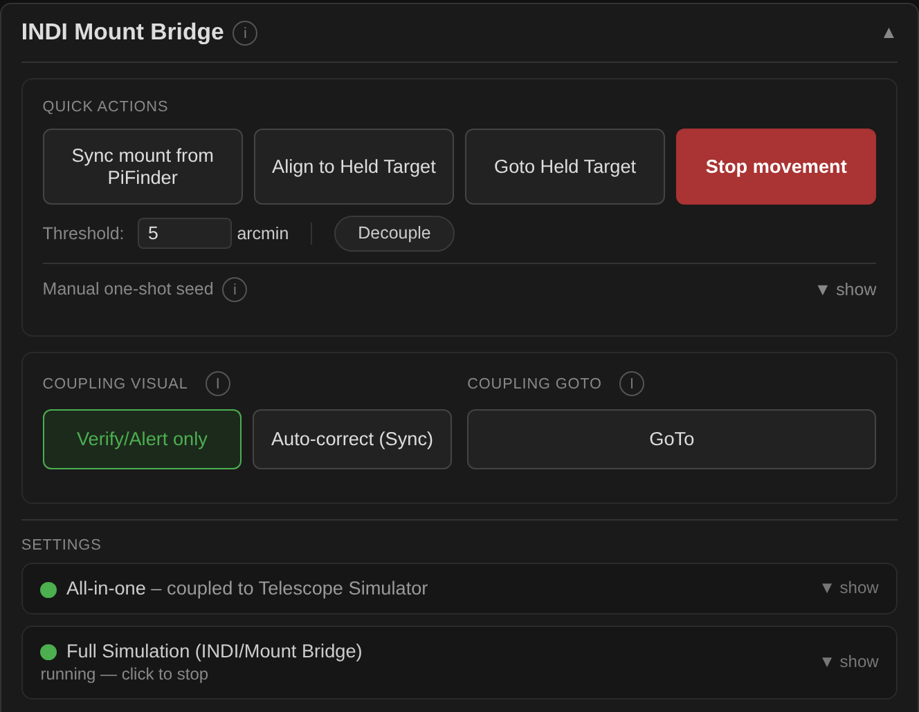
OPERATING IT
Coupling, without the INDI panel
▸ Quick Actions — one-shots
▸ Coupling presets — one click
▸ Settings — set once, hidden
Part 2 · Control Center

Slide 16
03
PART THREE
PF LX200 & PF Mount Bridge
PiFinder as a telescope, plus a generic bridge to any INDI mount.

Slide 17
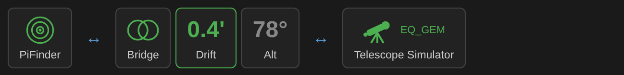
THE INDI LAYER
Three building blocks
1
PiFinder LX200
INDI telescope. Reports the solved position; a GoTo becomes a push-to. Required.
2
PiFinder Mount Bridge
Optional. Snoops PiFinder + the mount and couples them. Generic INDI only.
3
Your mount’s driver
Not ours — whatever your mount already uses. Only for a motorised mount.
The Mount Bridge status row — the three, wired together:

Slide 18
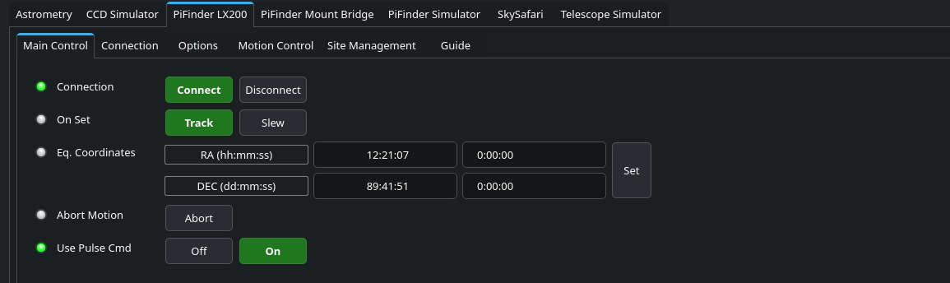
THE TELESCOPE DRIVER
PiFinder LX200
▸ Talks LX200 to PiFinder’s pos_server.py (TCP 4030).
▸ Reports the solved position each poll; a GoTo is only a push-to.
▸ No Sync — PiFinder measures the truth every frame.
Part 3 · INDI Control Panel — On Set: Track / Slew, no Sync

Slide 19
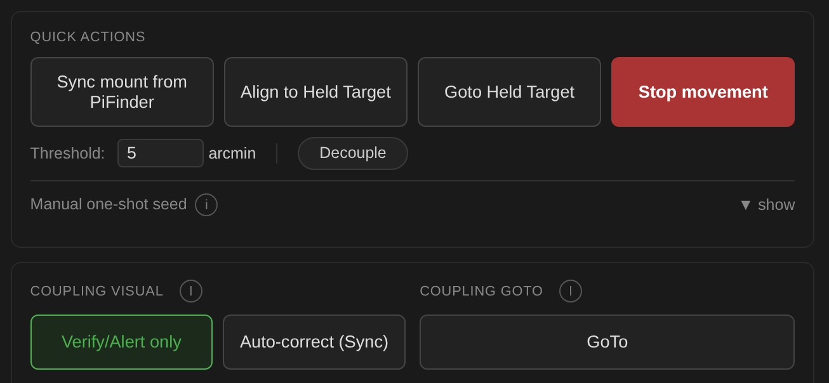
ONE PROPERTY, FOUR POSITIONS
The Coupling Dial
1
Off
pure push-to
2
Verify / Alert only
warn only, hands off
3
Auto-correct on drift
Sync past threshold
4
Goto-Forward
The dial in the Control Center — Decouple + the three presets.
real slew, then refine
Part 3 · Auto-correct → Sync (any mount); Goto-Forward → Goto / Track

Slide 20
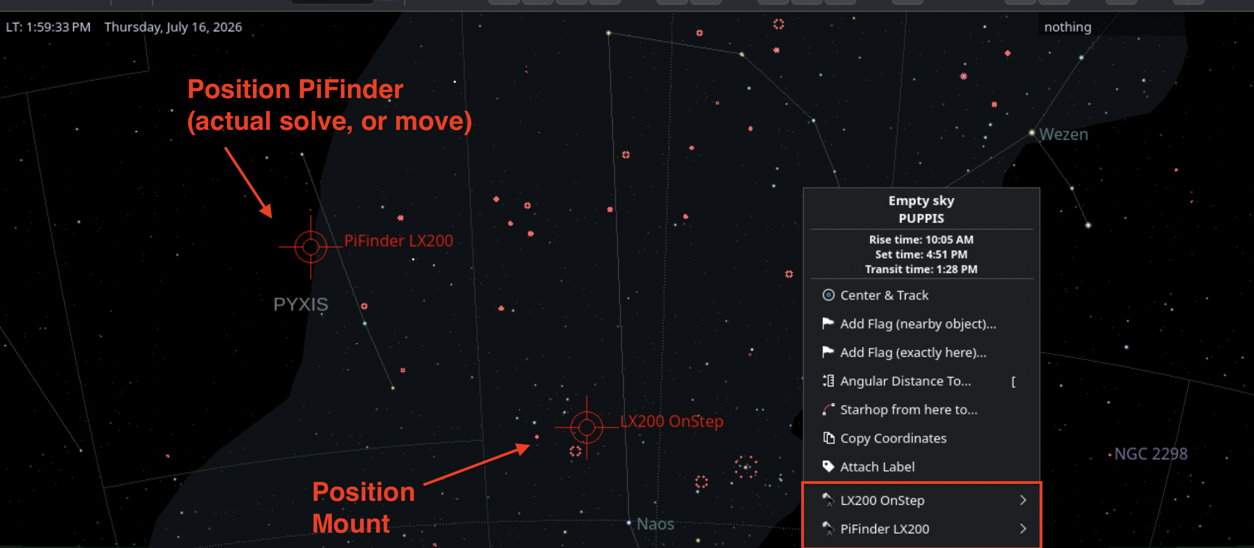
WORKS WITH ANY MOUNT
Generic INDI, nothing mount-specific
Only EQUATORIAL_EOD_COORD + ON_COORD_SET — never a mount command.
Multi-Point Alignment (#191) · Reposition detection · Shadow Sync
Part 3 · PiFinder + the mount, co-located on the KStars sky map — right-click either

Slide 21
04
PART FOUR
PF Simulator
Test the Mount Bridge with no real mount and no clear sky.

Slide 22
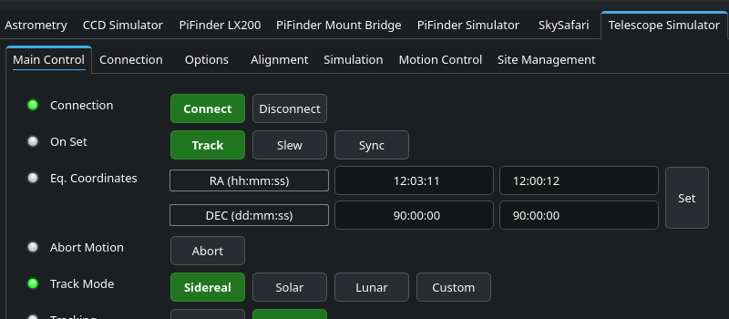
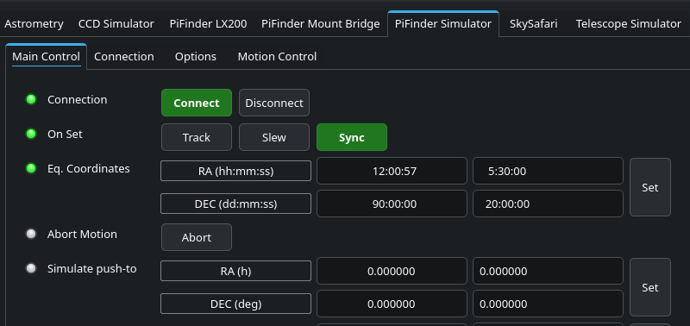
HARDWARE-FREE TESTING
A mount side and a PiFinder side
Mount side
PiFinder side
Stock INDI Telescope Simulator — Sync or GoTo like a real mount.
▸ Simulator — holds a settable RA/Dec.
▸ Truth Injector — POSTs to /api/fake_solve.
Part 4 · Simulator

Slide 23
BEHAVIOUR & NEXT
Simulator details
▸ Sync == Goto — no motion to model; the RA/Dec just becomes the held value.
▸ Inject every cycle — keeps PiFinder’s solve timestamp fresh.
▸ FOLLOW_MOUNT_DEVICE (#239) — optionally dead-reckon along a mount’s slews.
Next (v3.x): render a GSC star field and run PiFinder’s real solver on it — issue #344.
Part 4 · Simulator

Slide 24
→
TAKEAWAY ONE · FOR PIFINDER DEVS
Where PFSM could send PRs

Slide 25
DOCS/UPSTREAM_PATCH_INVENTORY.MD
Patches that aren’t PFSM-specific
▸ Test Mode toggle + status readback — a reliable API trigger (keypress sim was flaky).
▸ Camera-process resilience — fall back to the debug camera instead of crashing.
▸ all_ips() — show every network address, not just the default route.
▸ LX200 “no position yet” — return None, not a parseable fake coordinate.
▸ Near-pole /api/fake_solve RA — filed as brickbots/PiFinder#645.
Ready-to-file PR text: docs/upstream_pr_templates.md
Takeaway 1 · PiFinder PRs

Slide 26
CONCRETELY
How to help — PiFinder
▸ Pick one from the inventory — each is already triaged.
▸ PR text is written in docs/upstream_pr_templates.md, in dependency order.
▸ Mind the caveats — debug_solve needs an upstream regression fixed first.
Takeaway 1 · PiFinder PRs

Slide 27
→
TAKEAWAY TWO · FOR STELLARMATE DEVS
Extending the SMOS app for PFSM

Slide 28
BASIC USAGE IN THE APP
What a thin integration needs
▸ Start / stop the selected INDI profile.
▸ Add / remove just the PiFinder drivers.
▸ Pick “the mount” from the loaded drivers.
▸ Three Coupling presets, in PiFinder’s words.
The coupling logic is already framework-agnostic Python — a thin adapter ports it.
Takeaway 2 · SMOS app

Slide 29
MAPPING
CC feature → app screen
1
Status badges
a read-only status card
2
Coupling presets
a segmented control
3
Quick Actions
buttons on that card
Where each maps from, in the Control Center
APIs: /api/mount_bridge_*, or INDI.
Takeaway 2 · SMOS app

Slide 30
Roadmap & where to jump in
v2.x — consolidate
v3.x — integrate
▸ Harden & test what exists.
▸ Send selected patches upstream.
▸ A guiding watcher.
▸ Deeper SMOS integration (#35, #36).
▸ PFSM actions in the PiFinder app (#43).
▸ A “real” GSC-solving simulator (#344).
github.com/apos/PiFinder_Stellarmate · GitHub Project #15 · CHANGELOG.md

Slide 31



© github.com/apos 2026
Unofficial community project — not affiliated with StellarMate or PiFinder.
youtube.com/heyapos · avvp.de

