Slide 1


C/C++ Project 2
Implement a convolutional neural network (CNN) using C/C++
11510815 王 康
计算机科学与技术
2021-01-08

Slide 2
目录
The CNN model
The C++ implementation
Verification
Speedup
ARM development board deployment

Slide 3
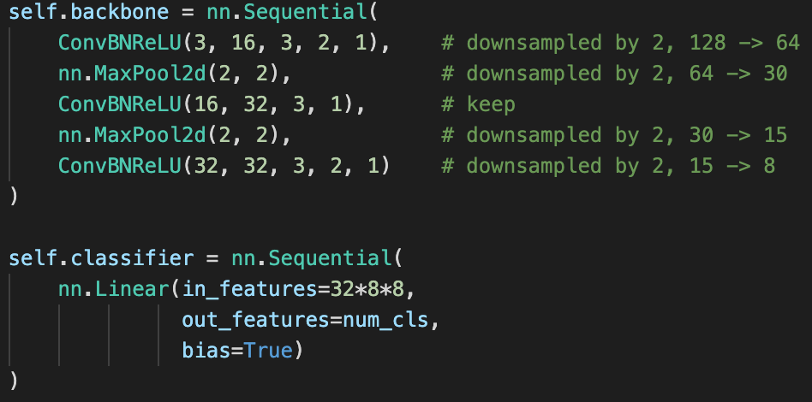

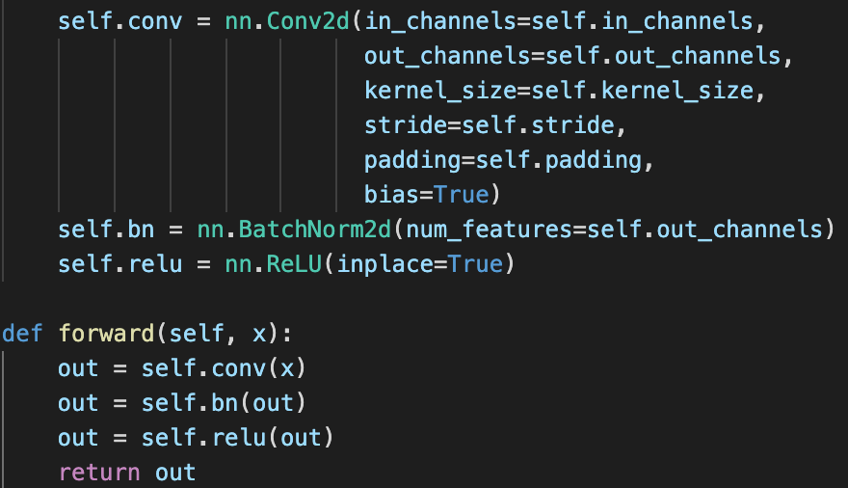
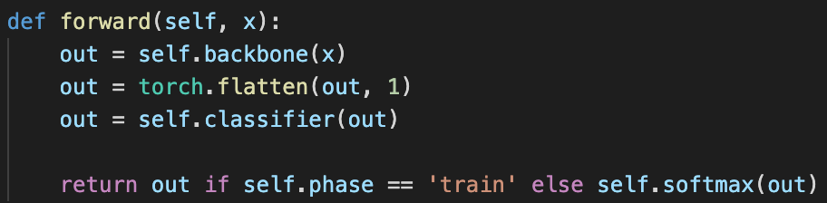
The CNN Model
The model can predict if the input image is a person (upper body only) or not.

Slide 4
The C++ implementation
See the code.

Slide 5

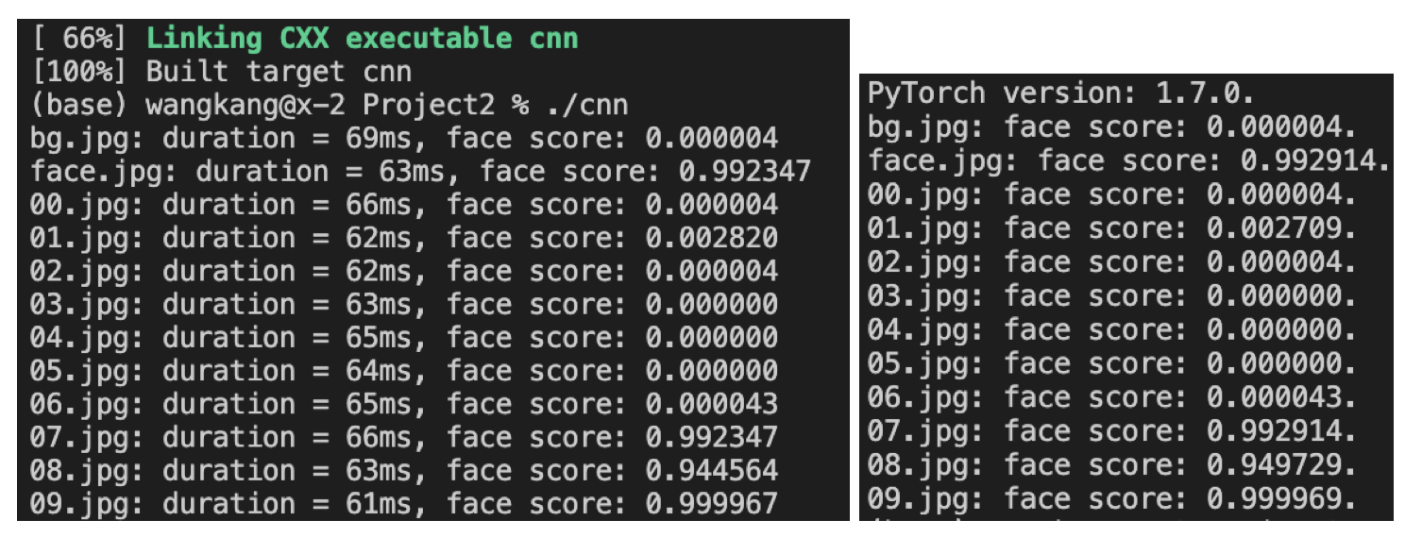
Verification

Slide 6

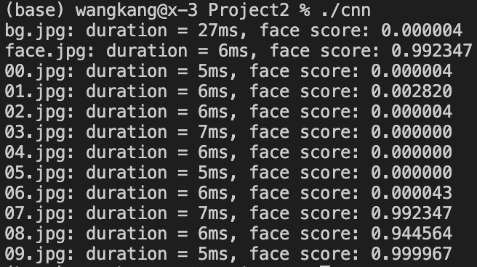
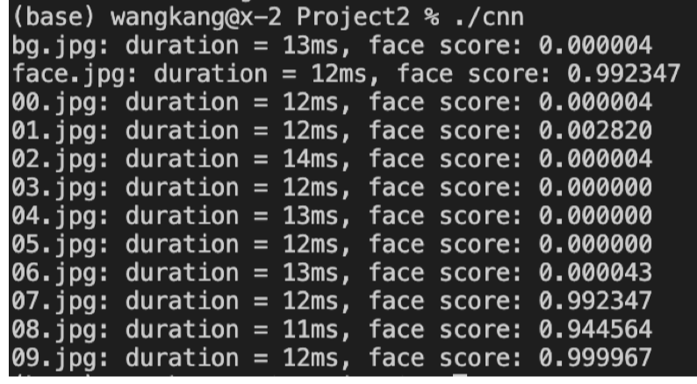
Speedup
set(CMAKE_CXX_FLAGS "-O3 ${OpenMP_CXX_FLAGS}")
set(CMAKE_CXX_FLAGS "-O3 ${OpenMP_CXX_FLAGS}")

Slide 7
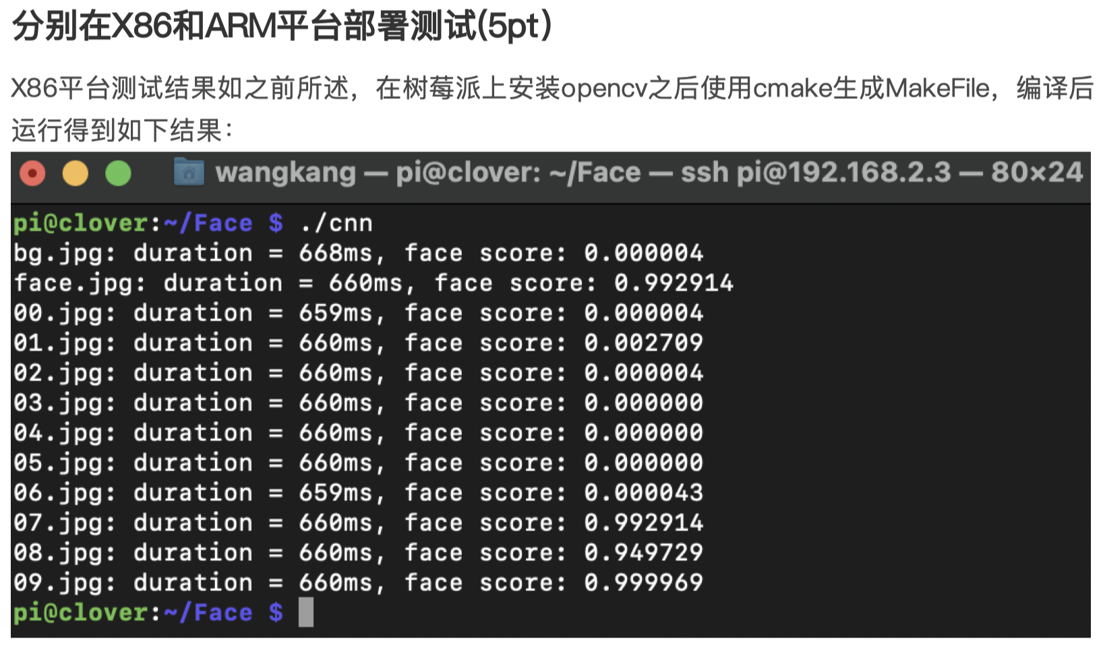
ARM dev. board deployment

Slide 8

THANK YOU

