Slide 1

Distributed computational system for managing the activities of an owners’ association
Apostol Madalin-Mihai
Ciuturoianu Maria-Gabriela
Tuta Camelia-Stefania

Slide 2
Introduction
The purpose of this document is to give a detailed description of the functionalities for the “Distributed computational system for managing the activities of an owners’ association” software. It illustrate an overall description of what the system is trying to achieve, its functions, the interfaces of the system, and how the system react with the users .
The software was developed using Java CRUD and SWING.
We chose to develop the project using the mentioned software, because we were much more familiar with the concepts and we had more trust in them.

Slide 3
In the following we will make a brief description of the user interface
At first, every person, even if is user or admin, that wants to use the application must either Log in or Register with a new account.
Then, the application will know which is which and a new window will appear with different options.
Each window is assigned with a go back button, so you can do multiple actions easily in the app.
Also there is a Log out button for each user, so they can log out from the app whenever they want.
The user interface is both simple and easy to use. We used minimalistic colors and structures to keep it manageable.

Slide 4
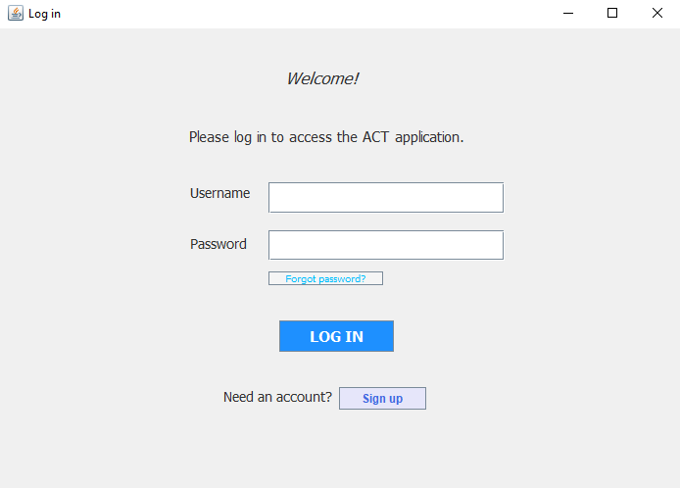
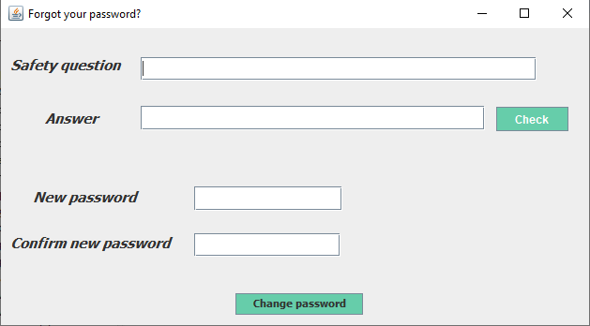
Log in window
This window is used by the user to log in to the personal account.
The login form has a responsive design which means that the user must introduce a valid username and password, otherwise he will be advertised by the system.
In case the user can not remember his password, he can press the “Forgot password?” button.

Slide 5
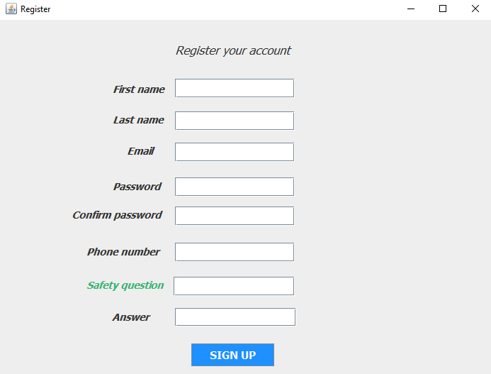
Register window
Each user can register into our app, but the tenants have to gain account approval from the ABA for security reasons.
We used Reg Ex patterns to check the quality of the email and password
The user's personal data is secured and saved in the database
The user must enter a safety question and answer, so he can later change his password. We recommend that the question is very personal for the best security

Slide 6
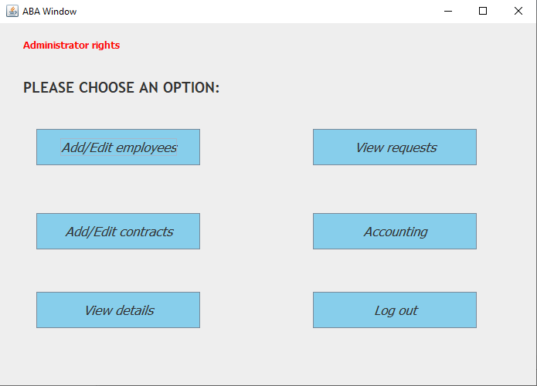
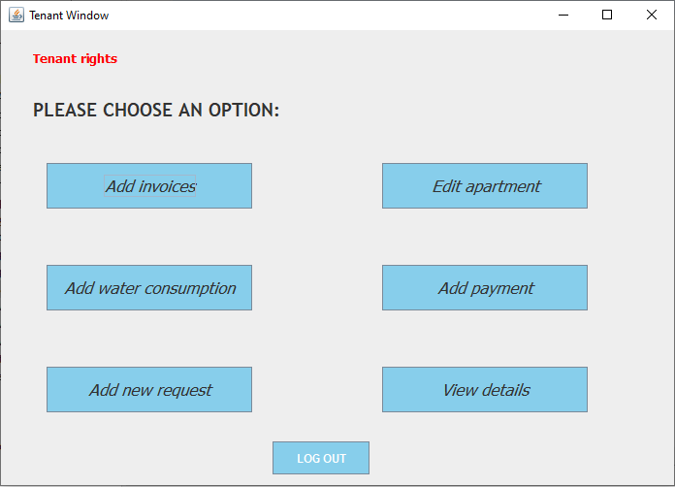
ABA & TENANT PAGES:
Each of the users have different options of actions that they can perform in the app

Slide 7
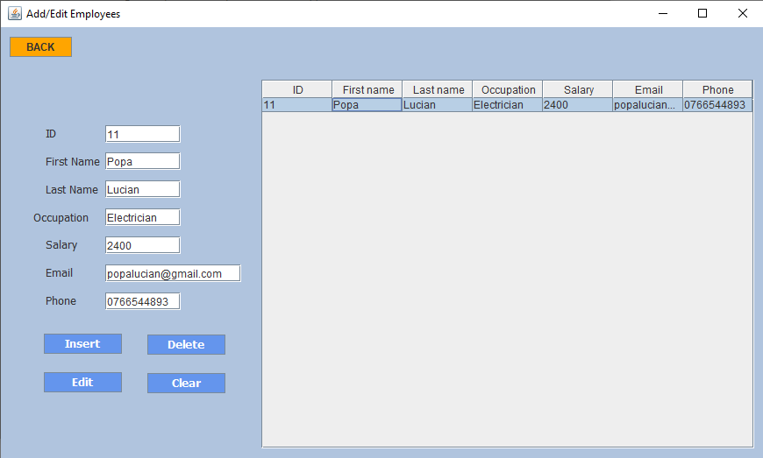
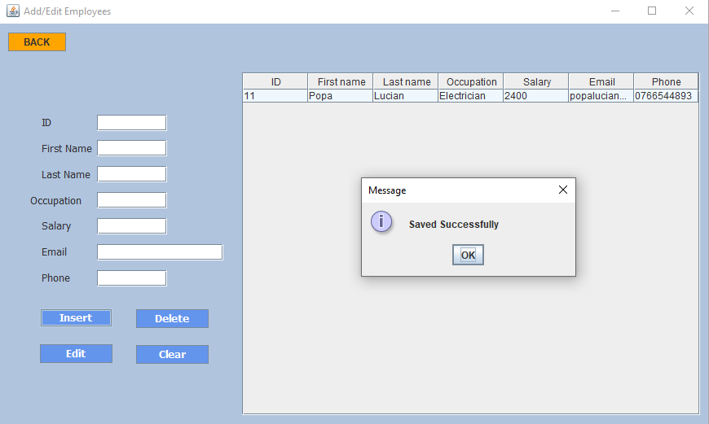
ABA ADD Employees
Here the ABA user can ADD/EDIT/DELETE employees
They will be saved in a table as is seen, ABA can edit any employee in any order
Various messages will appear to let the user know the actions were done successfully

Slide 8
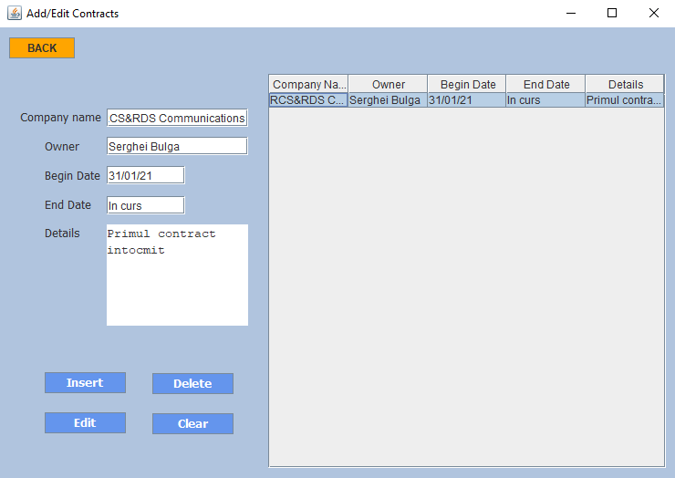
ABA aDD contracts
Similarly with add employees, ABA can ADD/EDIT/DELETE contracts.

Slide 9
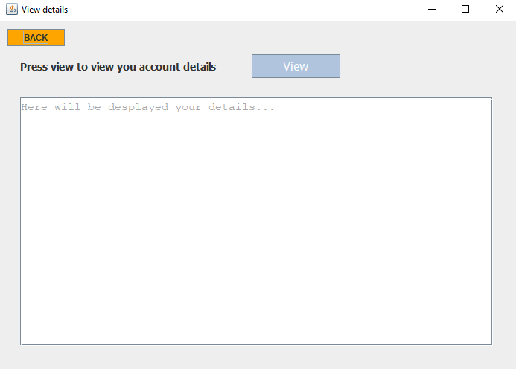
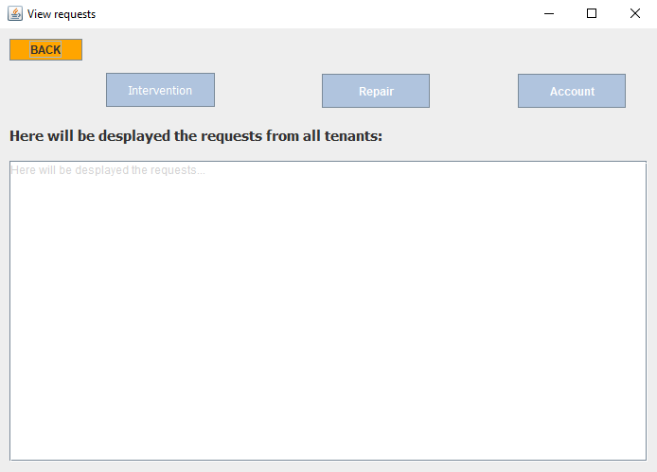
ABA view details & view requests
Here the ABA can view details about apartments and users
And in the 2nd window, he can see the requests from tenants, and the account approval requests, which he needs to check.

Slide 10
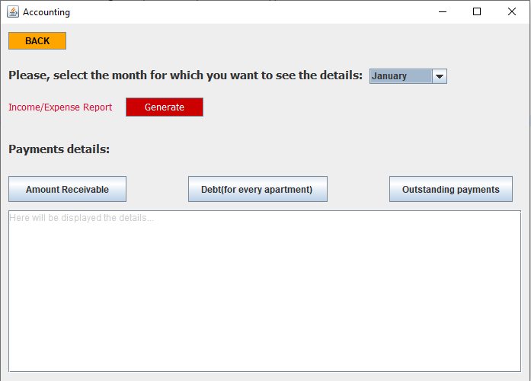
ABA ACCOUNTING
ABA will be able to see the details for every apartment by month
He will be able to generate a report that will be shown in the text area below.

Slide 11
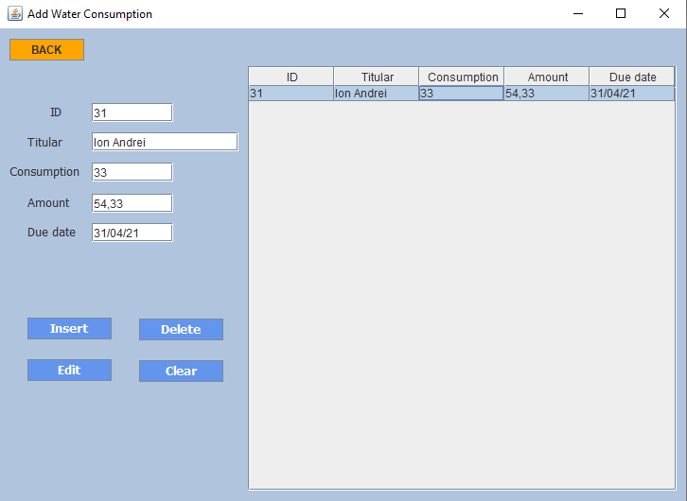
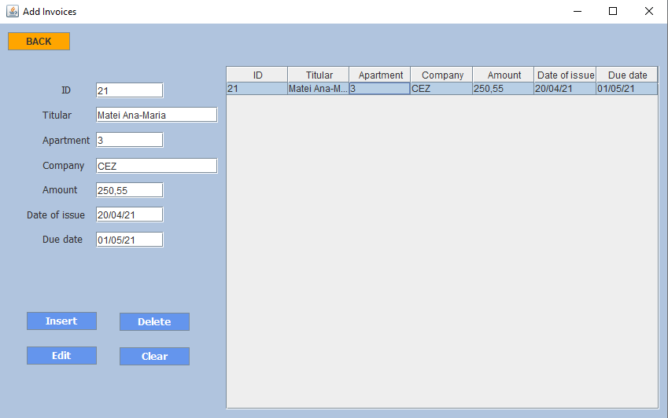
Tenant invoices & water consumption
The layout is the same as ABA’s and also the functionalities
He can add data, then store it in the table to keep and edit later

Slide 12
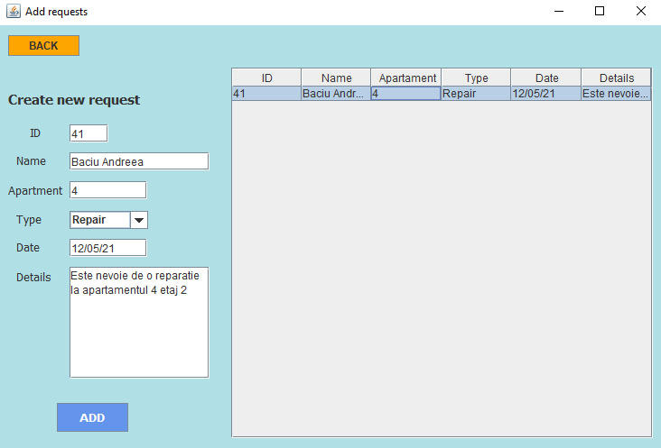
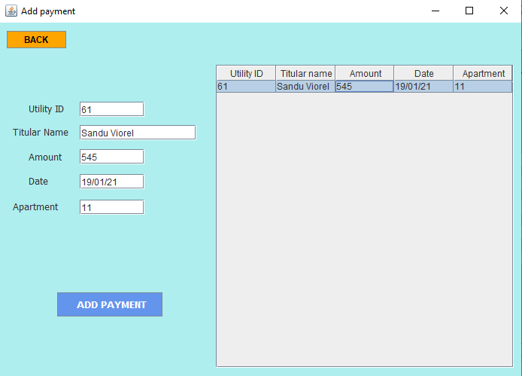
Tenant add request & add payment
The tenant can only add and manually edit, using the mouse, the payments and requests

Slide 13
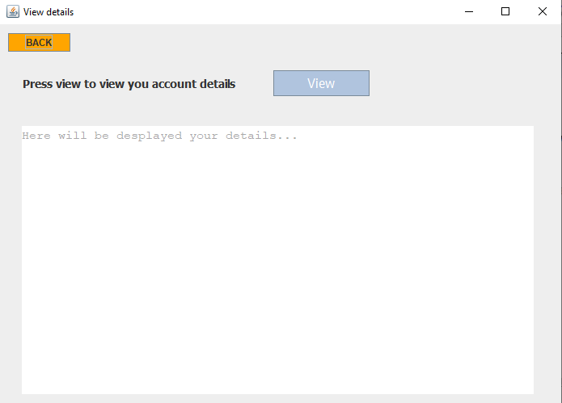
Tenant details
As well as the ABA, the tenant can view his details : payments, utilities etc.

Slide 14

Nothing comes to your act, when your tenants
Thank you!

