Slide 1
Medical Insurance Cost Prediction
Predicting health insurance premiums using ML and Streamlit
Presenter: apostolosmav - https://github.com/apostolosmav

Slide 2
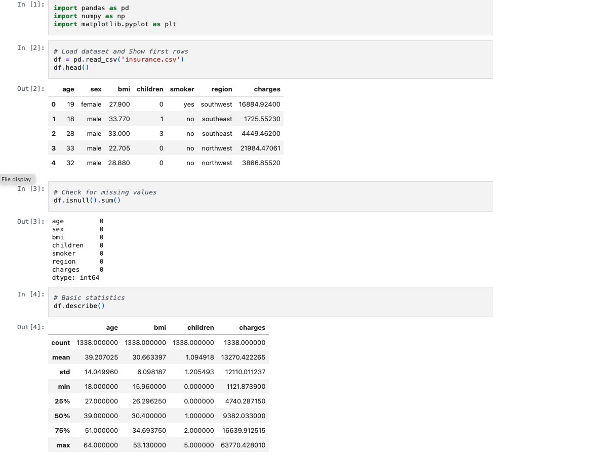
Dataset & Features
- Dataset Features: Age, Sex, BMI, Children, Smoker, Region, Charges

Slide 3
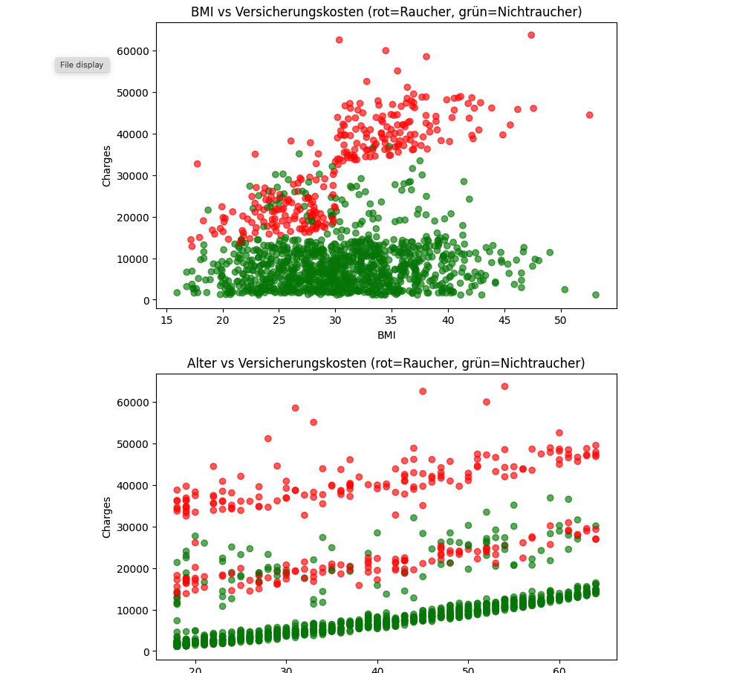
Exploratory Data Analysis

Slide 4
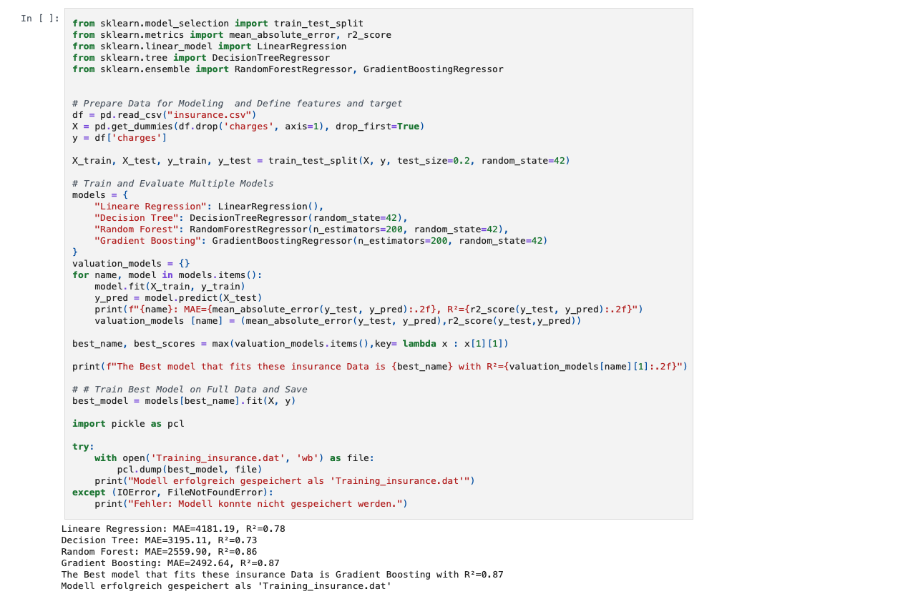
Model Performance
- R² and MAE for all models
- Best model: Gradient Boosting Regressor (R² ≈ 0.87)

Slide 5
Technical Overview
- Backend: Python, Scikit-learn
- Frontend: Streamlit
- Visualization: Matplotlib, Seaborn
- Models: Linear Regression, Decision Tree, Random Forest, Gradient Boosting
- Project in Notebook:
https://github.com/apostolosmav/medical-insurance-analysis-prediction/blob/main/Medical_Insurance_Cost_with_Linear_Regression.ipyn

Slide 6
App Features
- Inputs: Age, Sex, BMI, Children, Smoker, Region
- Outputs: Predicted charges & interactive charts
- Features: Dynamic sliders, real-time predictions

Slide 7
How It Works
1. User inputs data via Streamlit app (Age, Sex, BMI, etc.)
2. Data is preprocessed (encoding, scaling)
3. Trained Gradient Boosting Regressor model generates predictions
4. Outputs displayed with predicted charges and interactive charts
Workflow: User Input → Preprocessing → ML Model → Predictions & Charts

Slide 8
Exploratory Data Analysis & Insights
Visualizations of insurance charges distribution
- Charges by smoker status, gender, region
- BMI vs Charges, Age vs Charges

Slide 9
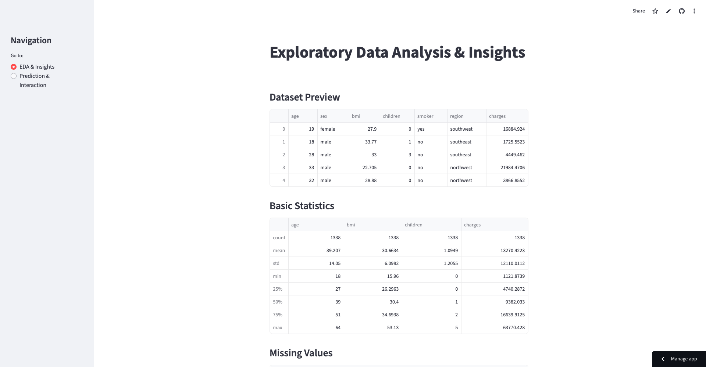
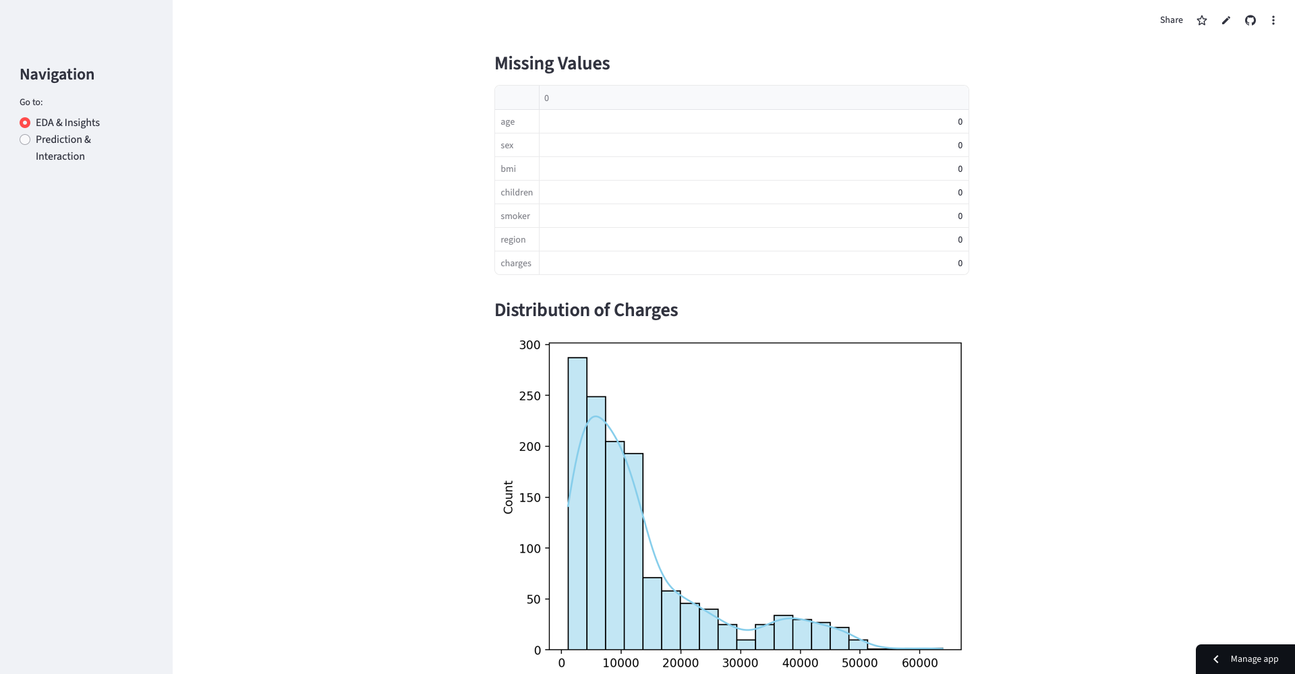

Slide 10
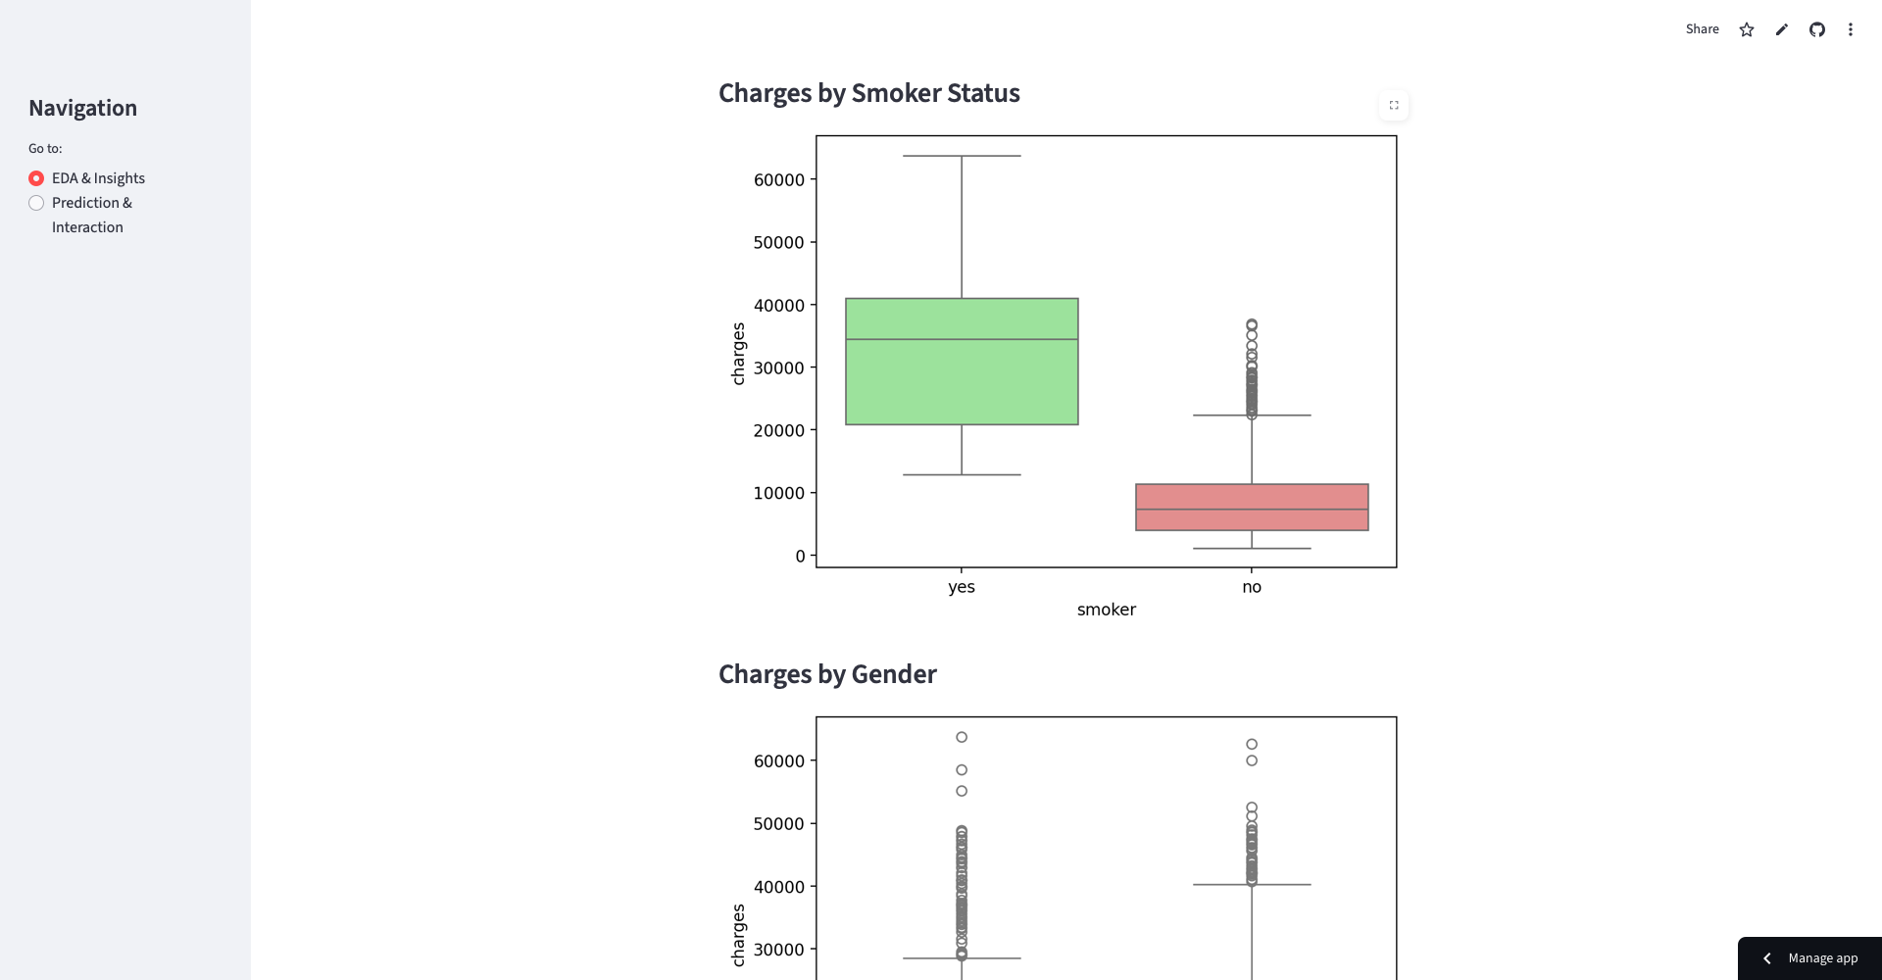

Slide 11
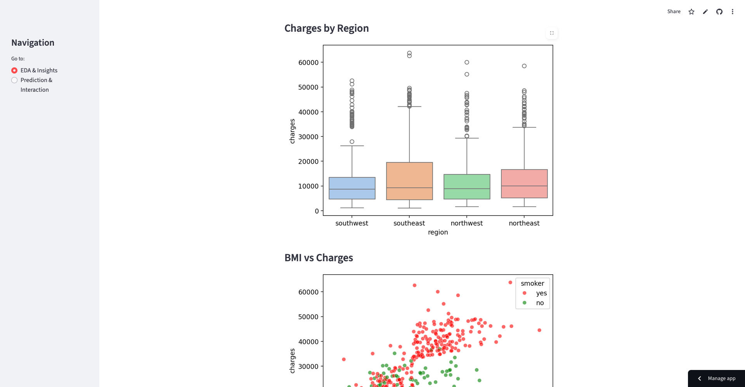

Slide 12
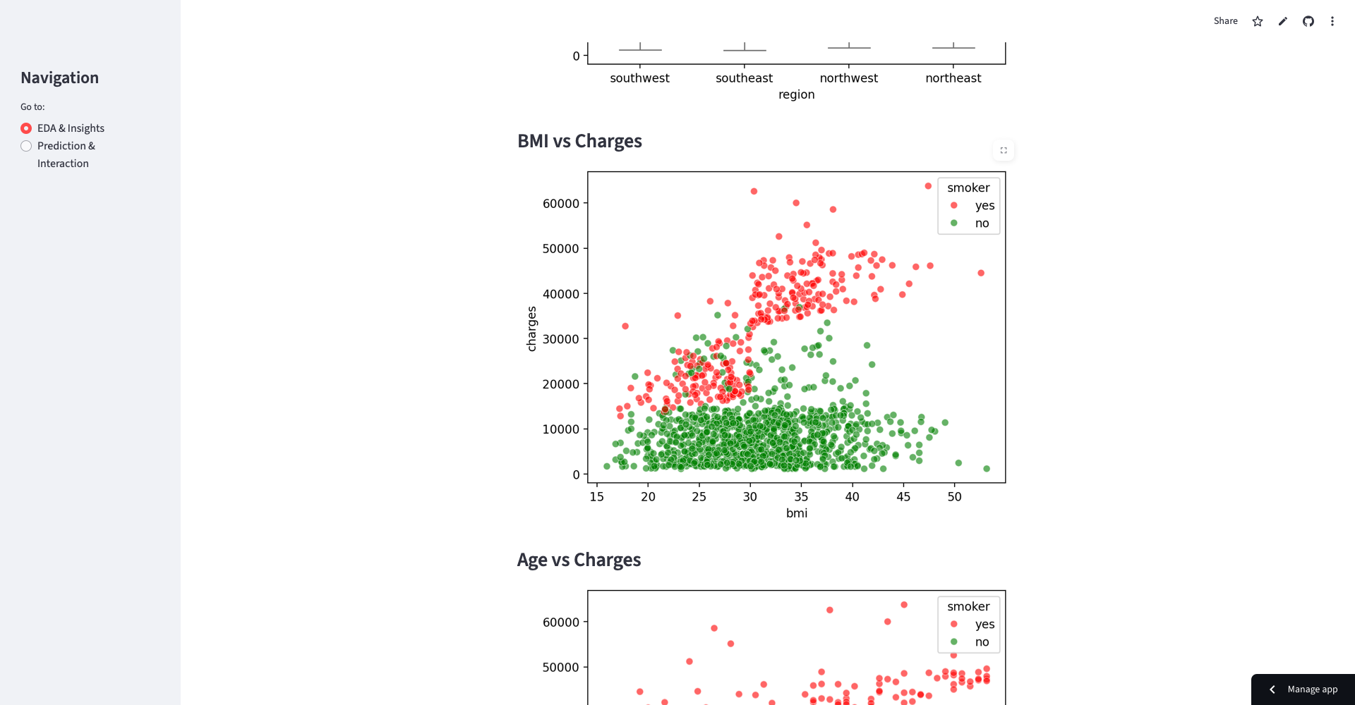

Slide 13
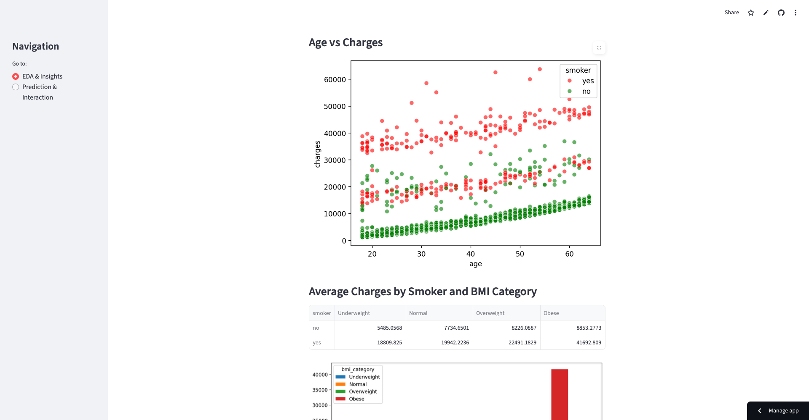

Slide 14
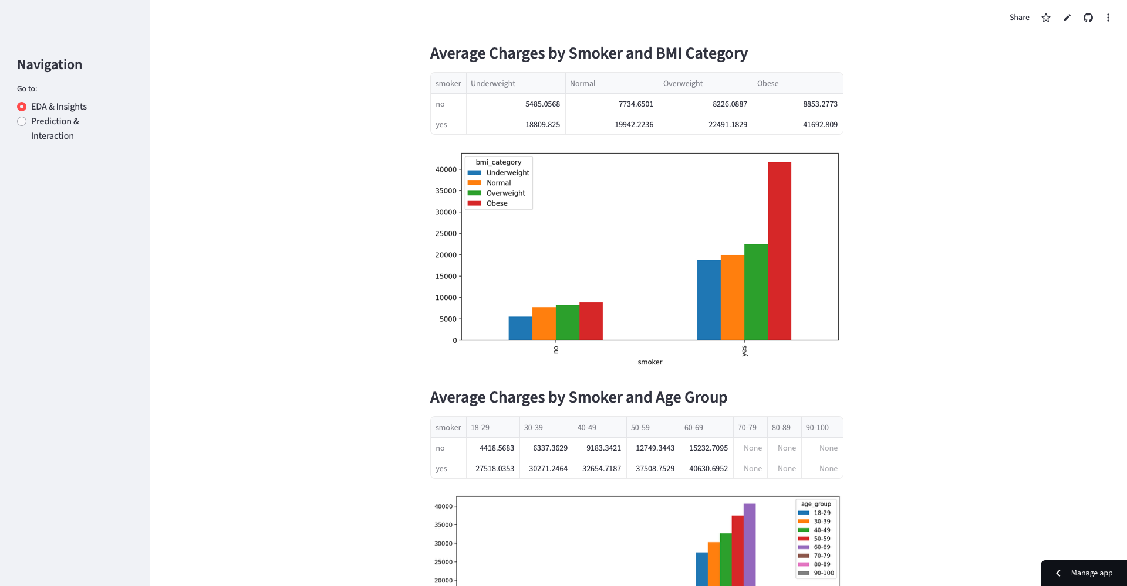

Slide 15
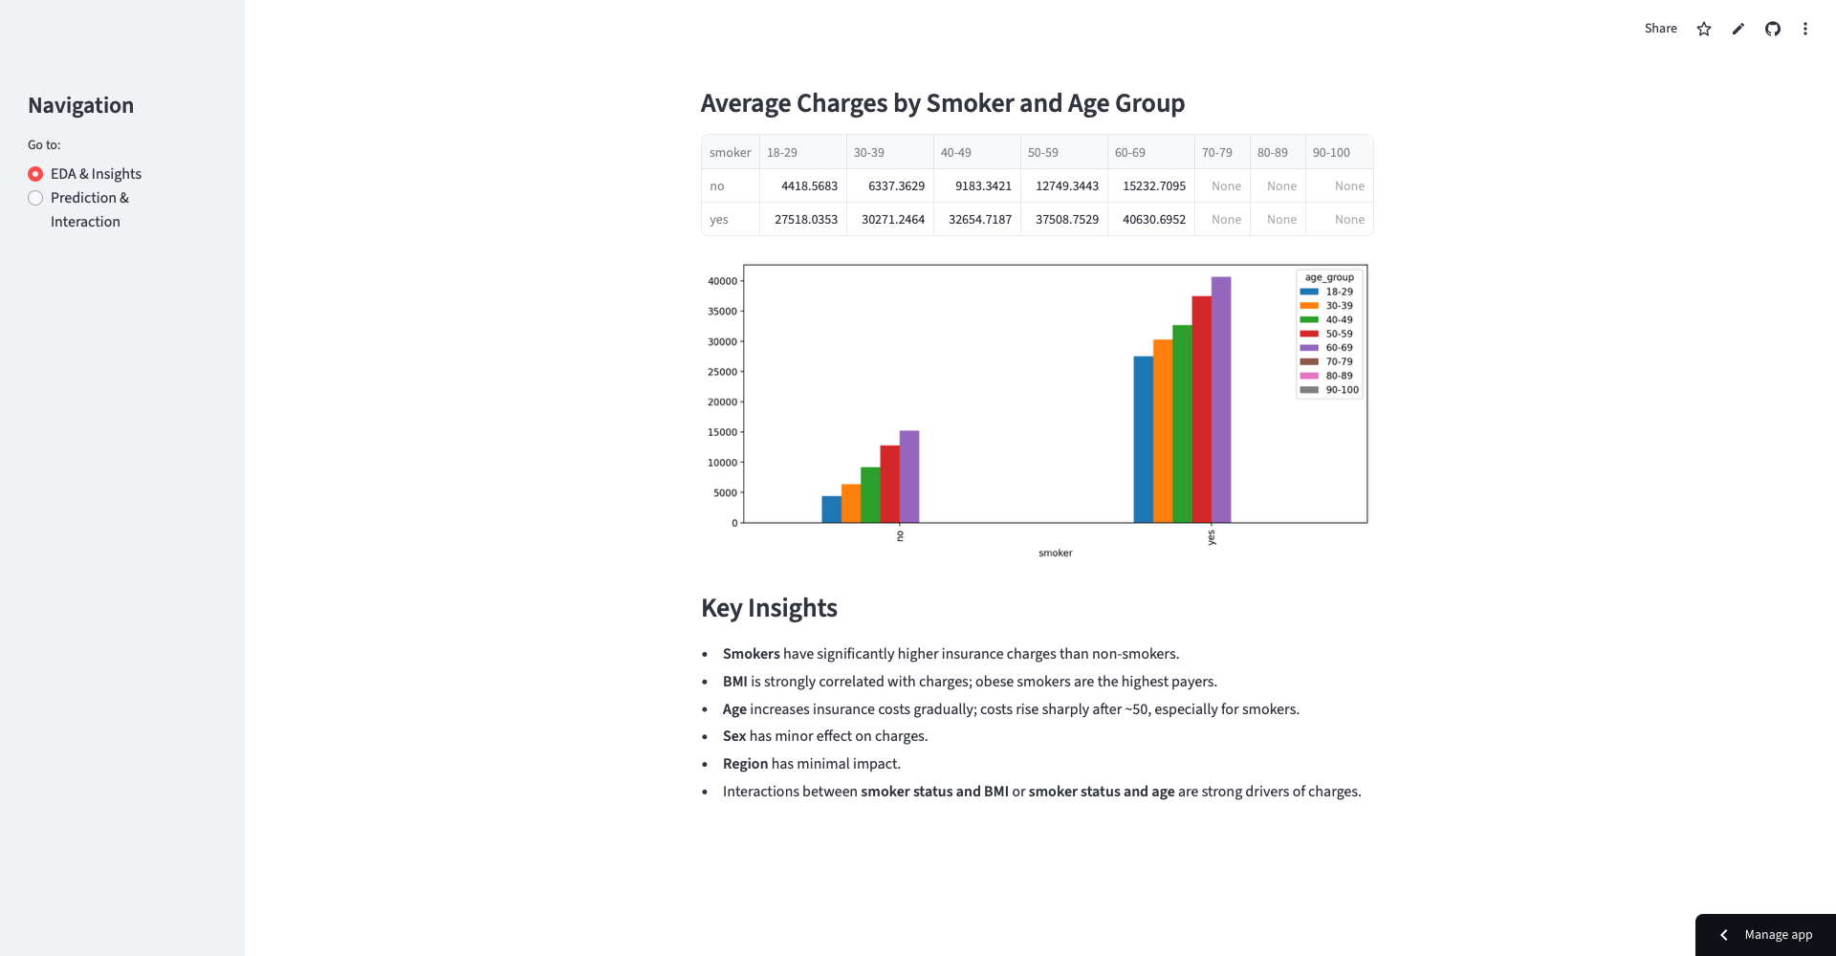

Slide 16
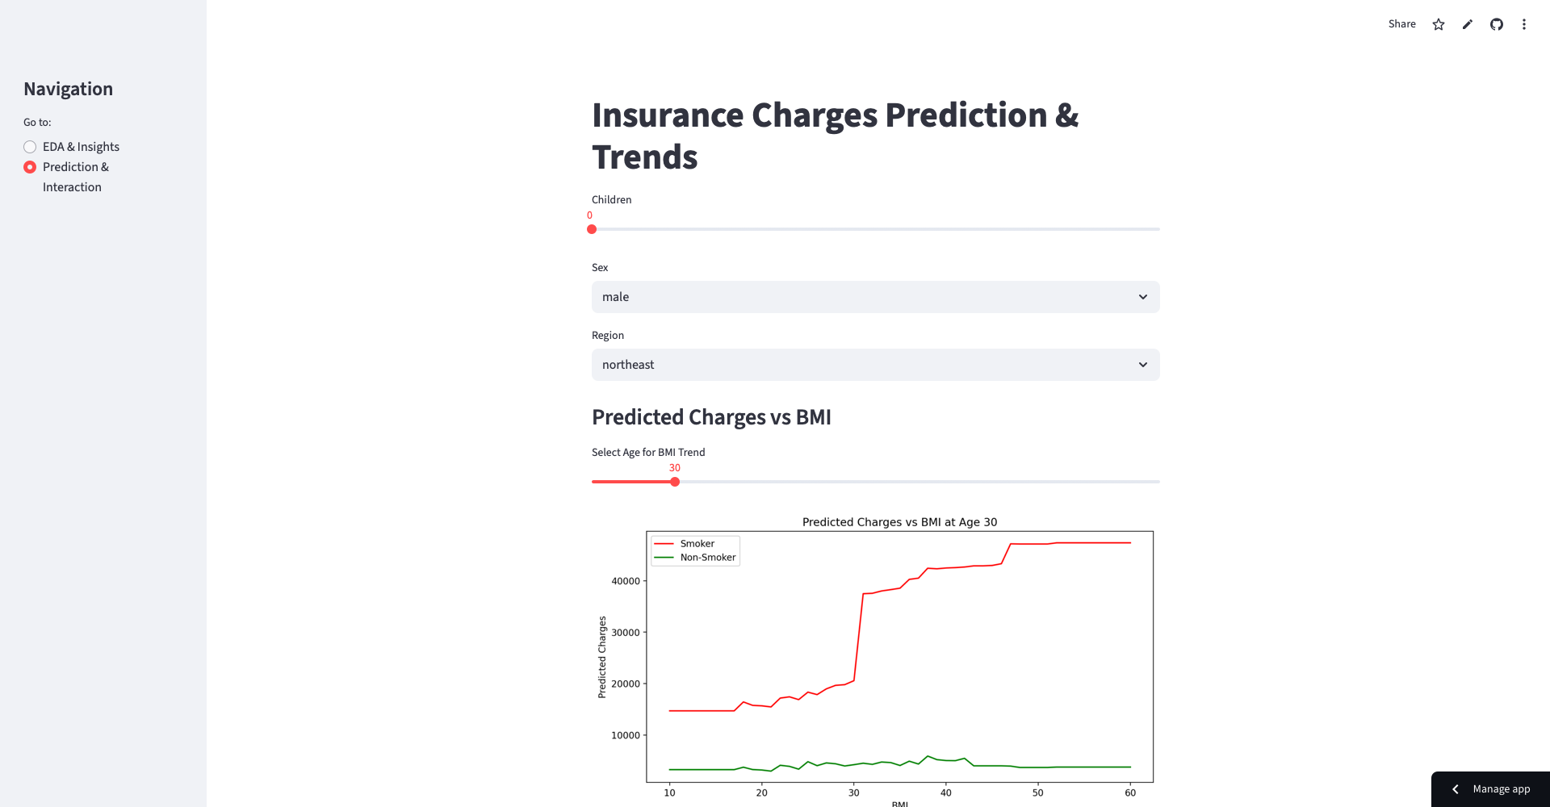
Prediction & Interaction

Slide 17
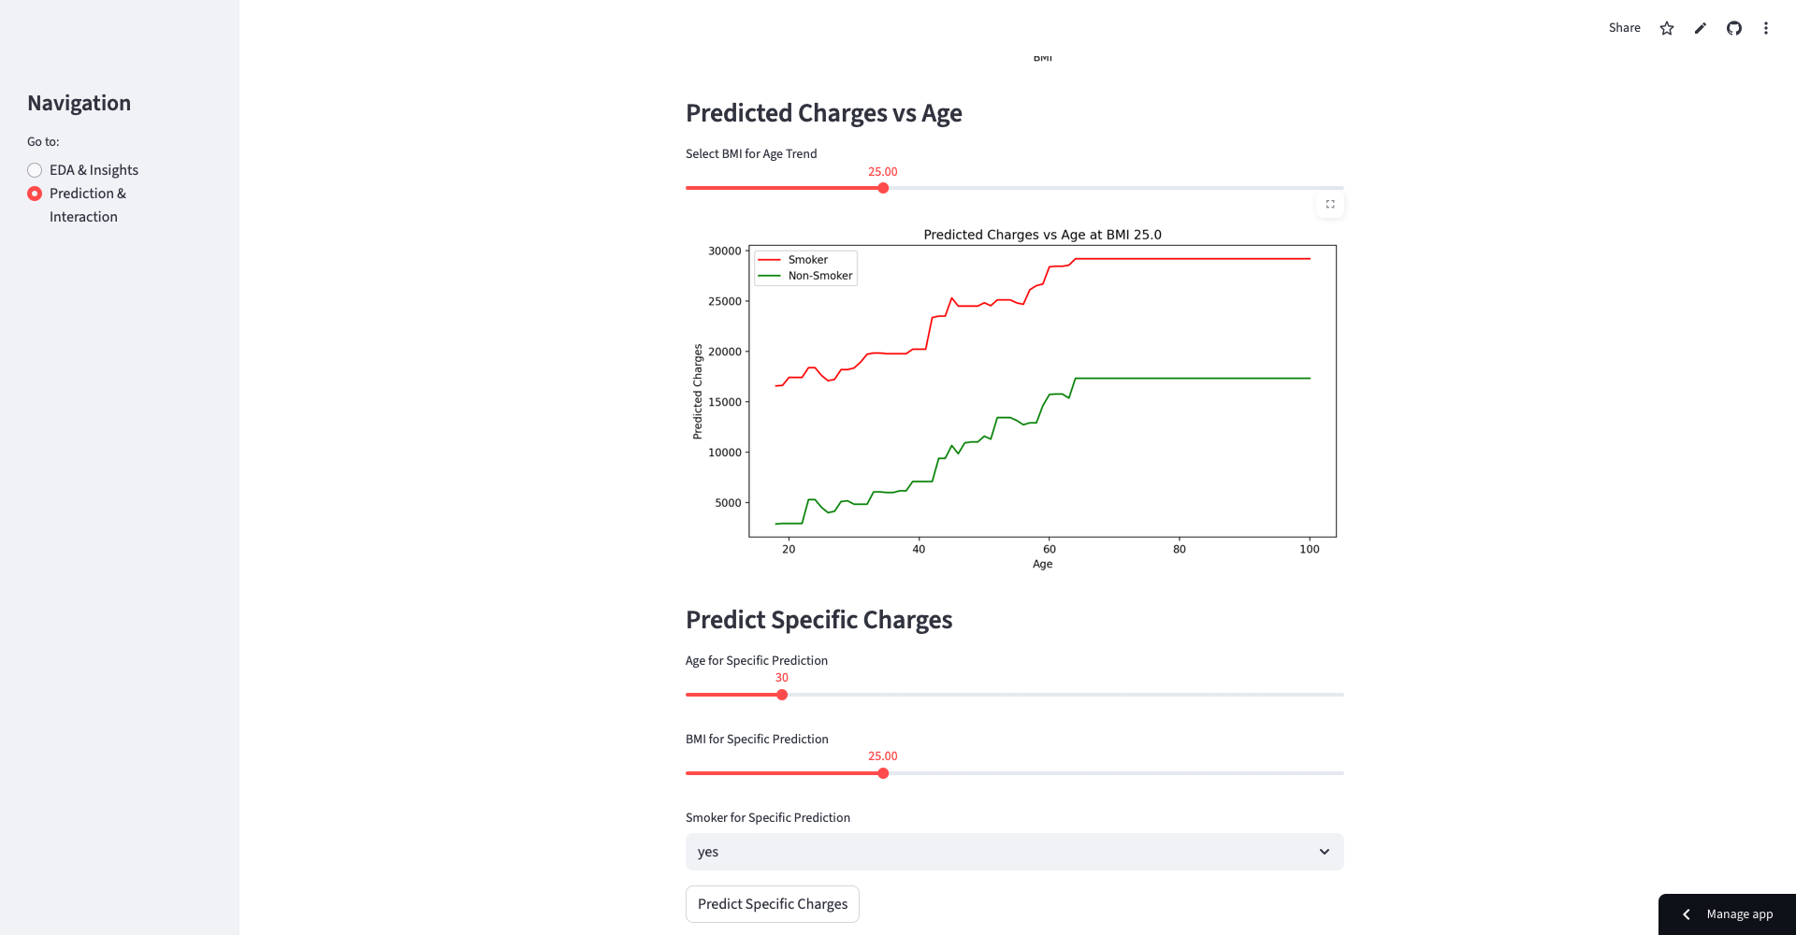
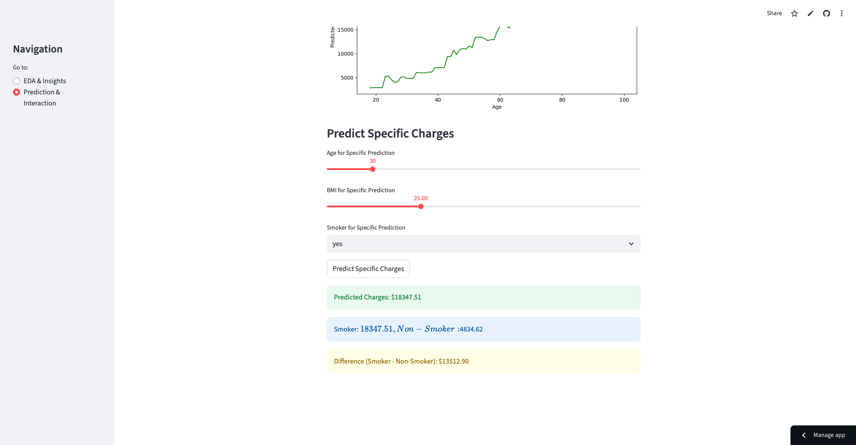

Slide 18
Live Demo
- App Link: https://medical-insurance-analysis-prediction-rvk9rtjnciunuonjlzdbry.streamlit.app
- Demo walkthrough: input data, view predicted charges, compare smoker vs non-smoker

Slide 19
Key Insights
- Smokers pay significantly more
- High BMI increases costs, especially for smokers
- Costs rise with age (>50)
- Gender & region minor effects

Slide 20
Future Enhancements
- Include more features (income, pre-existing conditions)
- Add explainable AI
- Multi-page app with insurance plan comparison

Slide 21
Conclusion
- Accurate insurance cost predictions
- Interactive, user-friendly interface
- Useful for individuals & insurance professionals

