Slide 1
Loading Files: 100%|██████████| 31/31 [00:25<00:00, 1.21it/s]
Loading Files: 100%|██████████| 31/31 [00:01<00:00, 18.61it/s]
<class 'pandas.core.frame.DataFrame'>
RangeIndex: 4107315 entries, 0 to 4107314
Data columns (total 28 columns):
# Column Dtype
--- ------ -----
0 rid int64
1 horseName object
2 age float64
3 saddle float64
4 decimalPrice float64
5 isFav int64
6 trainerName object
7 jockeyName object
8 position int64
9 positionL object
10 dist object
11 weightSt int64
12 weightLb int64
13 overWeight float64
14 outHandicap float64
15 headGear object
16 RPR float64
17 TR float64
18 OR float64
19 father object
20 mother object
21 gfather object
22 runners int64
23 margin float64
24 weight int64
25 res_win float64
26 res_place float64
27 price object
dtypes: float64(11), int64(7), object(10)
memory usage: 877.4+ MB
<class 'pandas.core.frame.DataFrame'>
RangeIndex: 396572 entries, 0 to 396571
Data columns (total 19 columns):
# Column Non-Null Count Dtype
--- ------ -------------- -----
0 rid 396572 non-null int64
1 course 396572 non-null object
2 time 396572 non-null object
3 date 396572 non-null object
4 title 396571 non-null object
5 rclass 243580 non-null object
6 band 165263 non-null object
7 ages 383518 non-null object
8 distance 396572 non-null object
9 condition 396524 non-null object
10 hurdles 121619 non-null object
11 prizes 396572 non-null object
12 winningTime 396572 non-null float64
13 prize 376864 non-null float64
14 metric 396572 non-null float64
15 countryCode 396572 non-null object
16 ncond 396572 non-null object
17 class 396572 non-null int64
18 currency 9281 non-null object
dtypes: float64(3), int64(2), object(14)
memory usage: 57.5+ MB

Slide 2
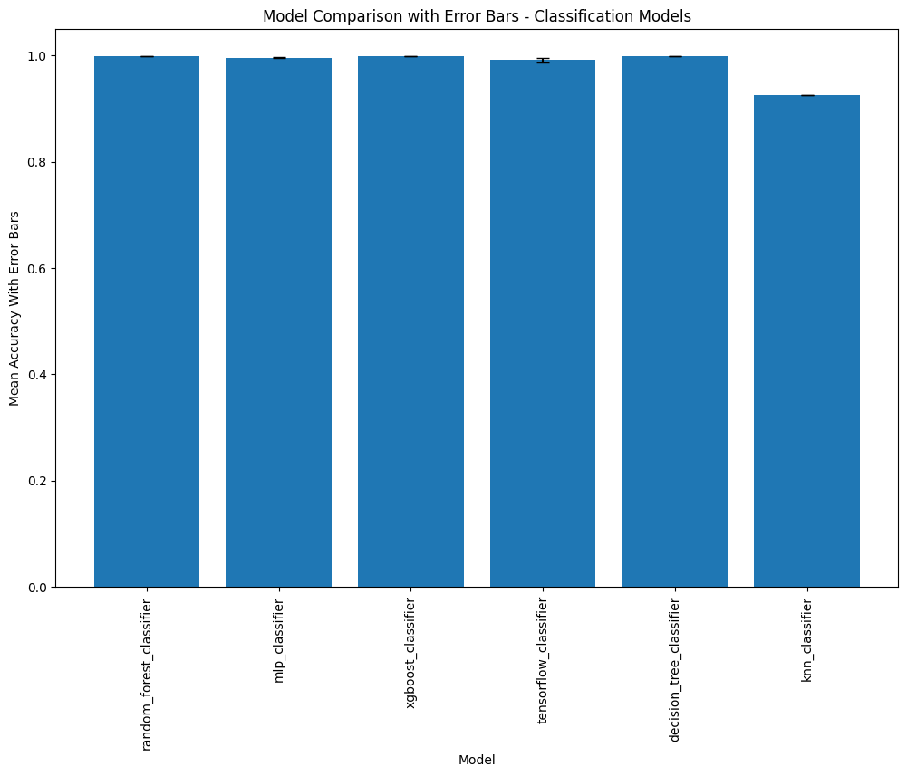

Without data reshuffling
With data reshuffling

Slide 3
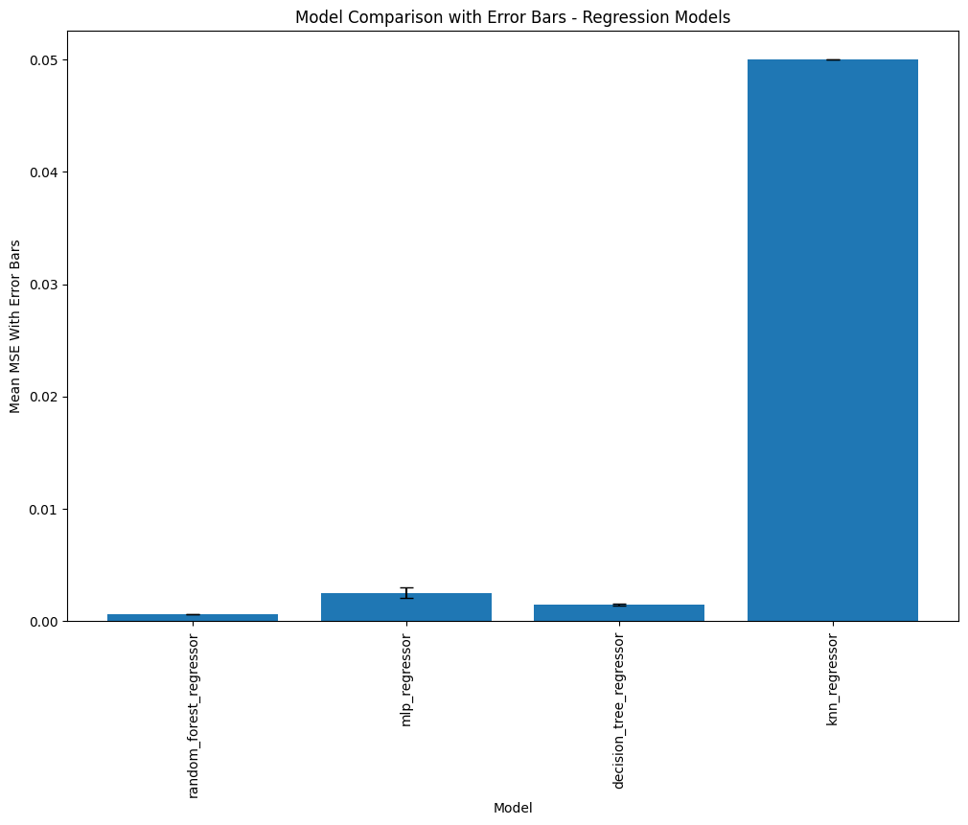
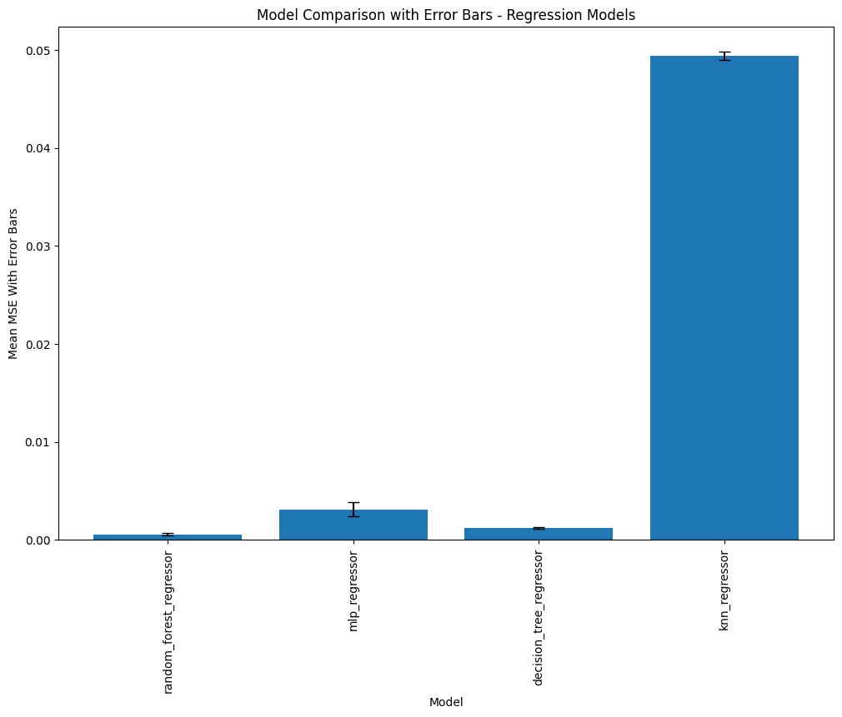
Without data reshuffling
With data reshuffling

