Slide 1
T2 – Relational vs. NoSQL
By tudor florian apostol (gr. 333)

Slide 2
Objectives & system architecture
Project Goals:
Compare Data Modeling (Normalized vs. Embedded).
Benchmark Query Latency (Simple vs. Analytical).
Demonstrate CAP Theorem trade-offs (Node Failure).
Tech Stack:
Infrastructure: Docker Compose (Isolated Environment).
Databases: PostgreSQL 16 (SQL) & MongoDB 7.0 (NoSQL).
Logic: Python 3.11 with Faker library for smart data generation.

Slide 3
Data modeling strategies
PostgreSQL: Uses Normalization (3 Tables: Users, Products, Orders) linked by Foreign Keys.
MongoDB: Uses Embedding (Denormalization). Product details are nested inside the orders document for faster read access.

Slide 4
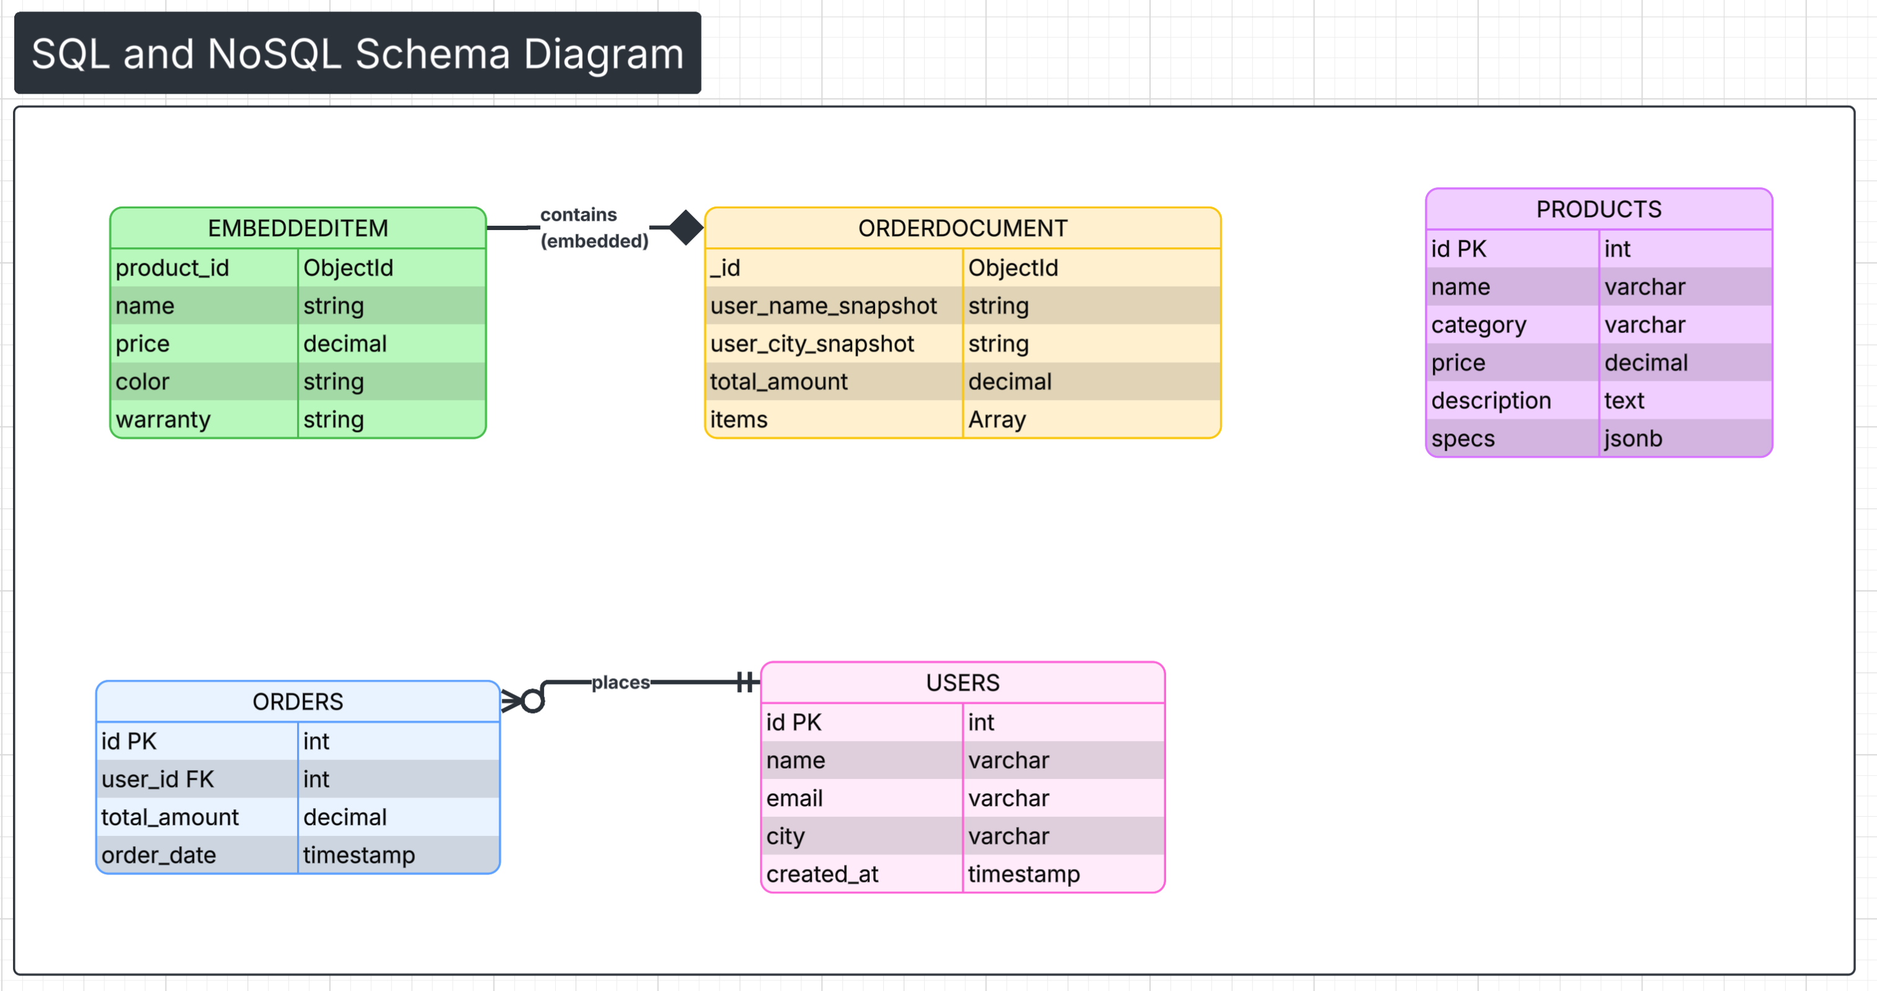

Slide 5
Performance benchmark results
Dataset: 100 Users, 500 Products, ~2000 Orders (Identical in both DBs).
Results:
Simple Query (Find ID): Both systems are instant (~0.15ms).
Aggregate Query (Analytics): MongoDB is faster due to data locality (no JOINs required).

Slide 6
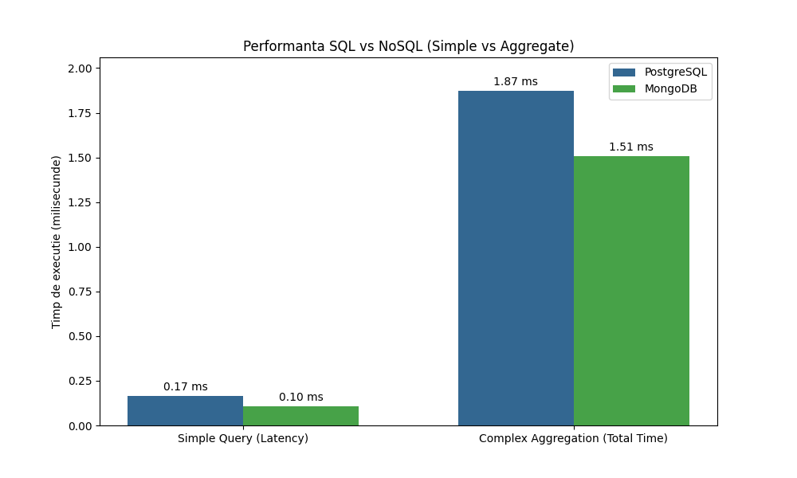
Performance benchmark results

Slide 7
Reliability & Chaos Testing
Scenario: Manual Node Failure (docker stop bdnv_mongo).
Observation:
Downtime: Script detected connection loss immediately (caught Exception).
Recovery: Script automatically resumed data processing once the container was restored.
Conclusion: Validated the application's error handling and reconnection logic.

Slide 8
Conclusions & trade-offs
PostgreSQL: Best for Data Integrity and complex relationships (ACID).
MongoDB: Best for Flexibility and high-speed Read Analytics.
Final Verdict: Architecture choice depends on the workload (Transactional vs. Analytical).
References: PostgreSQL Docs, MongoDB Manual, Brewer’s CAP Theorem, Google Gemini.

