Slide 1
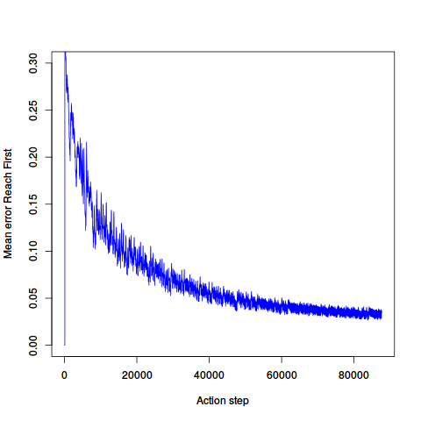
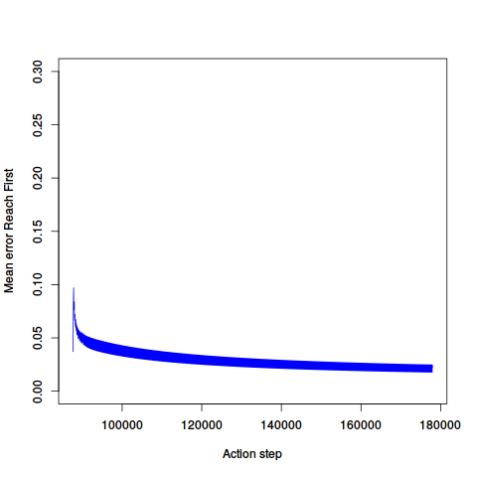
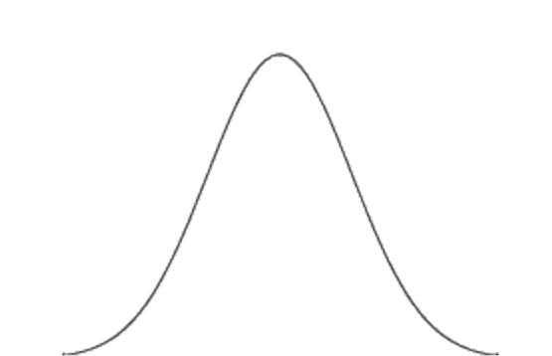
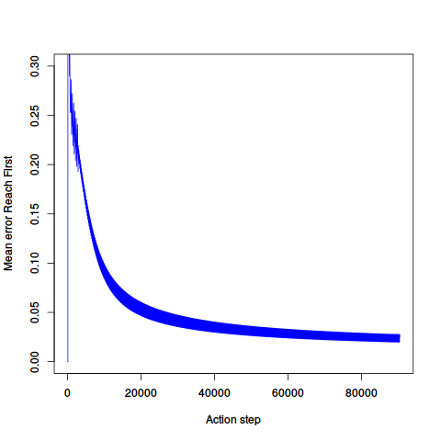
Action task
Visual habituation
Higher
Interest value
Lower
Reach First
(a)
(b)
Mean error
Mean error
0.00
Action Step
Action Step
Mean error
Interest
Interest value
Higher
Lower
Watch First
(c)
Mean error
Action Step

Slide 2
Action task
Visual habituation
Higher
Interest value
Lower
0.30
0.30
0.20
0.20
Reach First
(a)
Mean error
(b)
Mean error
0.10
0.10
0.00
0.00
0
20000
40000
60000
80000
100000
140000
180000
Action Step
Action Step
Interest value
Mean error
Interest
Higher
Lower
0.30
0.20
Watch First
Mean error
(c)
0.10
0.00
0
20000
40000
60000
80000
Action Step

Slide 3
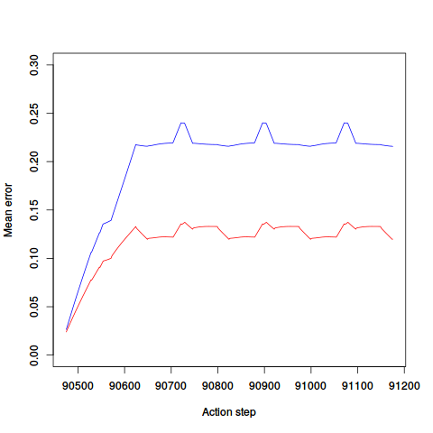
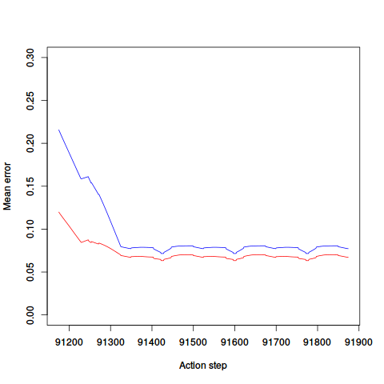
(a)
New goal
(b)
New path
Interest value
Interest value
Higher
Lower
Higher
Lower
Mean error
Mean error
Reach-first
Watch-first
Reach-first
Watch-first

Slide 4
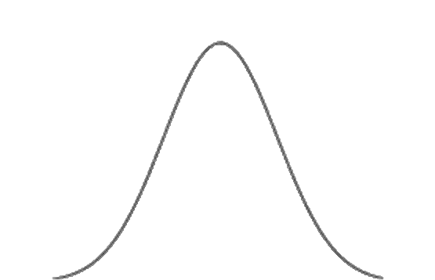

(a)
New goal
(b)
New path
Interest value
Higher
Interest value
Higher
Lower
Lower
0.30
0.30
0.20
0.20
Mean error
Mean error
0.10
0.10
0.00
0.00
Reach-first
Watch-first
Reach-first
Watch-first

Slide 5
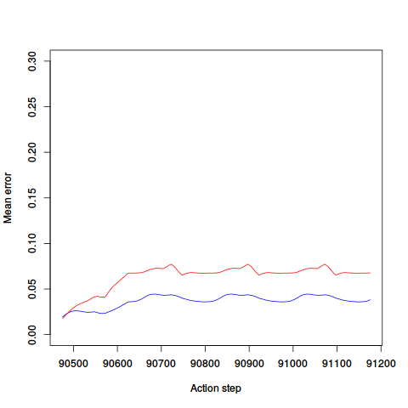
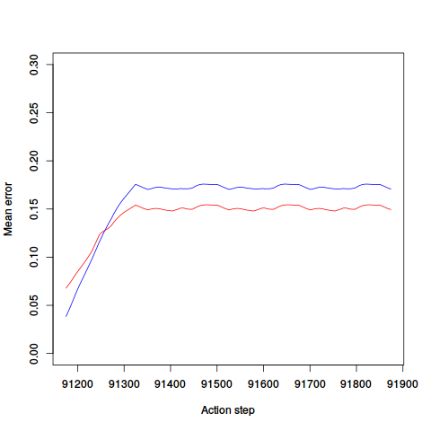
New goal
New path
Mean error
Mean error
Attention function
Attention function

Slide 6
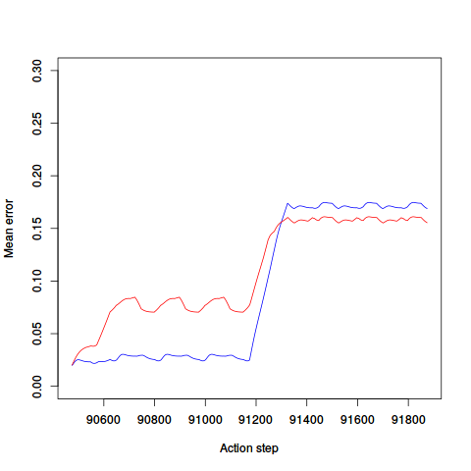
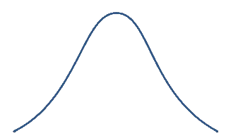
Trajectory only
Reach First
Watch First
New path
New goal
Attention

Slide 7
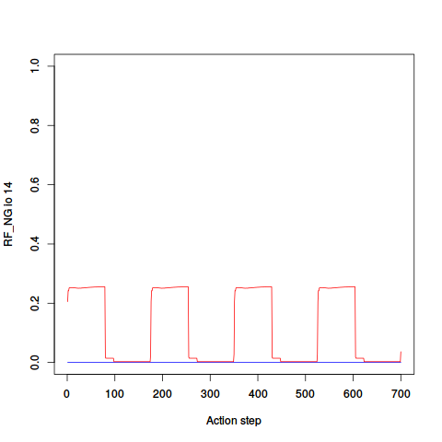
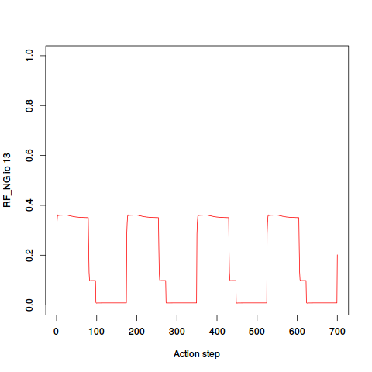
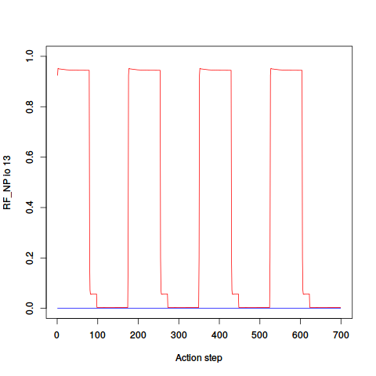
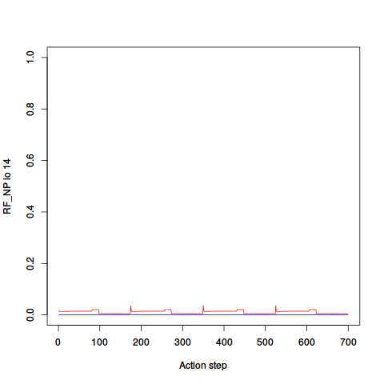
Goal 1
Goal 2
New goal
Goal 1
Goal 2
New path

Slide 8
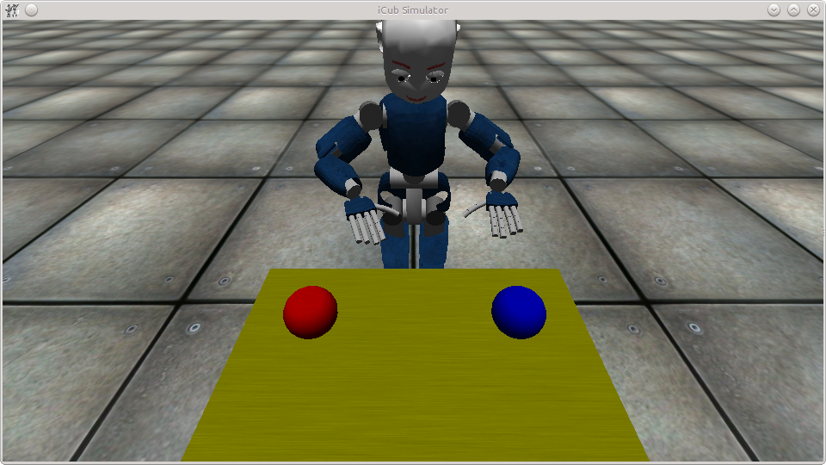
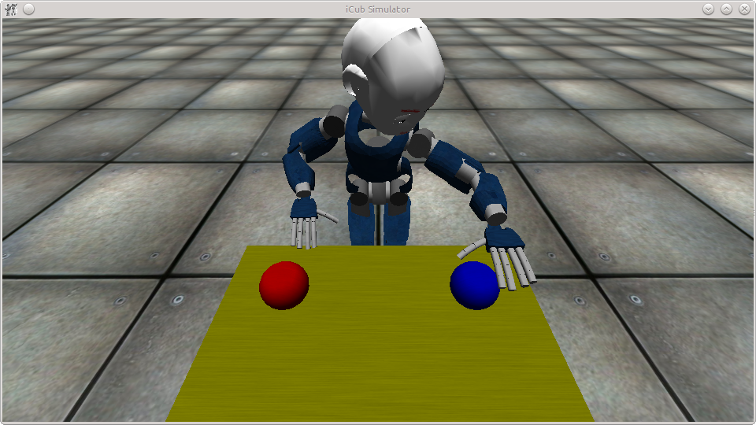
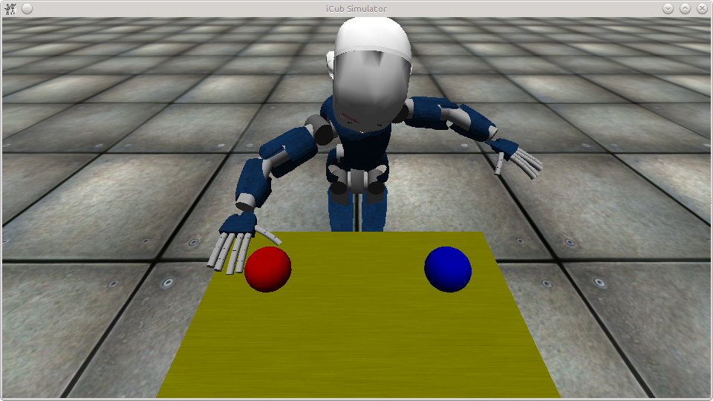
(a)
(b)
(c)

