Slide 1
Hierarchical Clustering
Unsupervised Method
(this means what?)

Slide 2
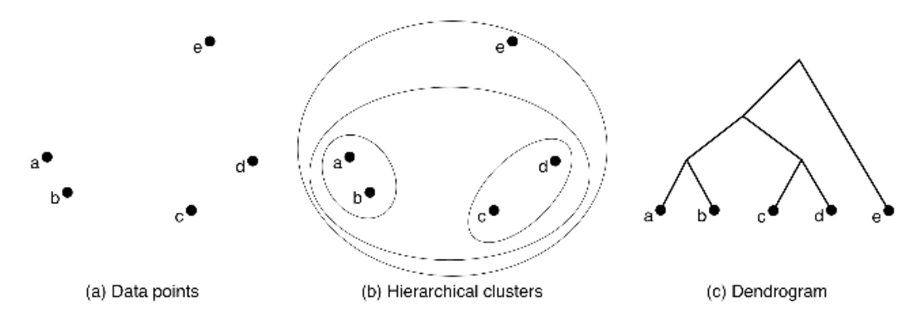
Generates Trees!

Slide 3
Example: Clustering cities
(in Italy) by distance

Slide 4
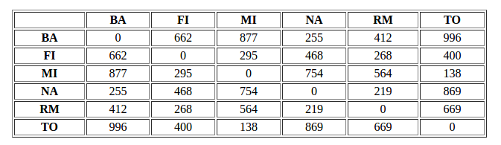
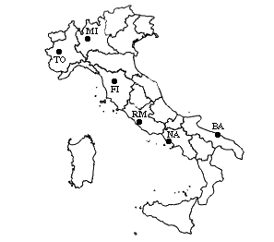
Step 1: Assign each item to its own class
This matrix keeps track of the distance between all the classes

Slide 5
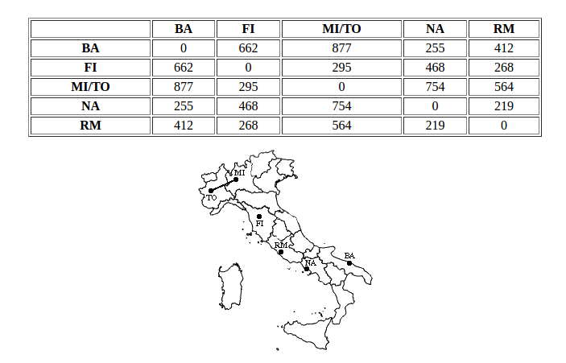
Step 2: Find the closest (most similar) pair of clusters and merge them into a single cluster, so that now you have one cluster less.
We have updated the distance matrix to store the distance between each class

Slide 6
So what exactly do we mean by “closest”?
Single linkage clustering – the minimum distance between objects in two clusters
Average linkage clustering – the mean distance between objects in two clusters
Full linkage clustering – the max distance between objects in two clusters

Slide 7
Continue merging points and updating your distance matrix until there are no more datapoints left!

Slide 8
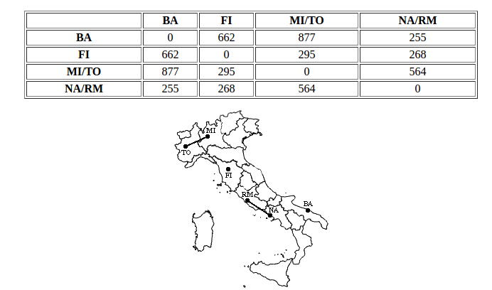

Slide 9
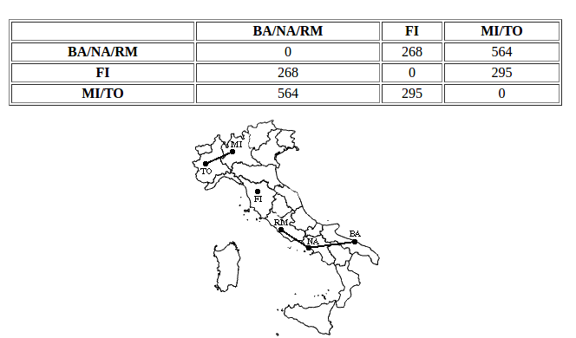

Slide 10
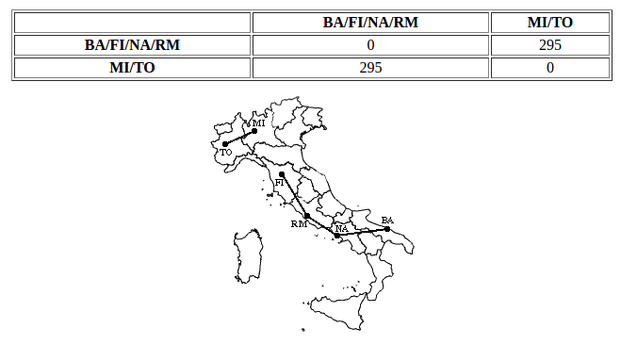

Slide 11
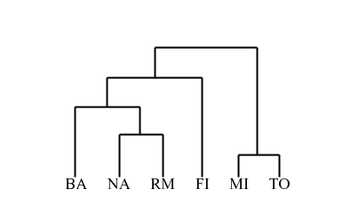
Finally, we draw the tree corresponding to the clustering

