Slide 1

Hypothesis testing and p-values: Playing Cards Example
You pick one card from the card deck at a time, note the color of the card, and return it to the deck (this is one “trial” of our experiment)
This is a binomial distribution!
There are 2 possible outcomes (black →1 , red → 0)
Every time you pick a card (and put it back), you have the same probability of seeing a red card as a black card (“sampling with replacement”)
We say that each trial is “independent”
Can we still say the samples are independent if you didn't put the card back in the deck before you picked a new one?
The binomial formula tells you the probability of observing X black cards in a sample of N cards, assuming the probability of selecting a black card is p.

Slide 2
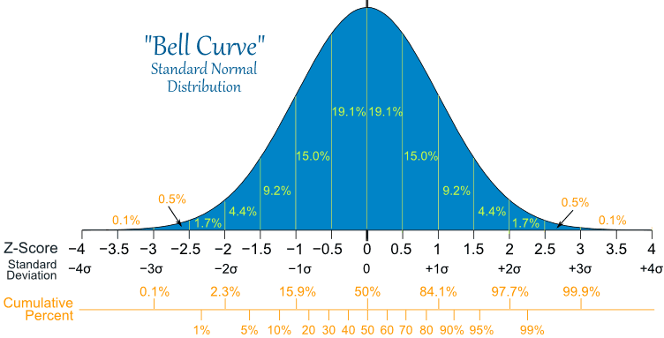
Standard Normal Distribution

Slide 3
One Sample T-test
Null Hypothesis (Ho): – this is what you expect: “The deck of cards is not biased.”
Specifically: The probability of drawing a black card in our card deck is not significantly different from drawing a black card in any standard card deck in the world.
Alternative Hypothesis (H1): You are lying to us, and the deck of cards is biased!
Specifically: The probability of drawing a black card in our card deck is significantly different from drawing a black card in any standard card deck in the world.
**Significantly different means that the probability of getting this difference by chance is very small. The variable “p” denotes the probability of getting this difference by chance. We typically want p< 0.05

Slide 4
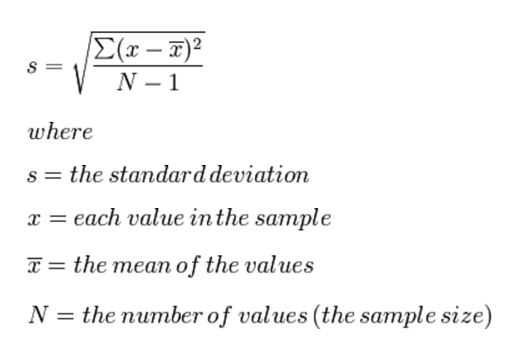
One Sample T-Test
1) Calculate the mean of the sample.
In our case, 1= ”black card” and “0” = red card, so calculating the mean is the same thing as calculating the probability of observing a black card.
x̅= sum of observations / number of observations
X̅ = (1+0+0+0+0+0+0+0+0+0)/10 = 0.1
2) Calculate the standard deviation of the sample.
S=0 in our case.

Slide 5
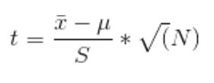
One Sample T-Test
3) Calculate your “t statistic”
4) Calculate degrees of freedom
d=N-1

Slide 6
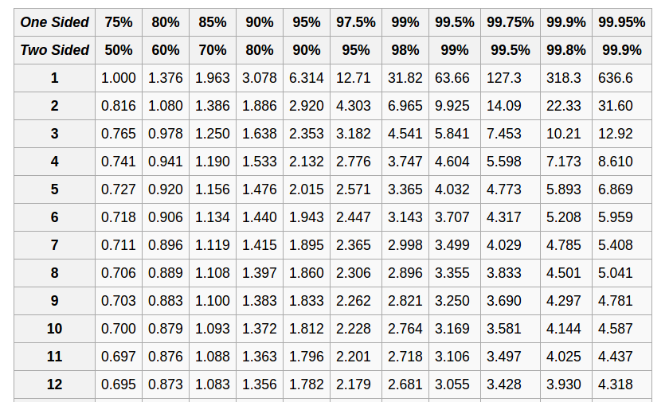
One Sample T-Test
5) Compare your t-statistic against a lookup table.
If your t-statistic is higher than the value in the table, you reject your null hypothesis.
i.e. we want to reject our null hypothesis with 99% confidence
P-value = ?

Slide 7
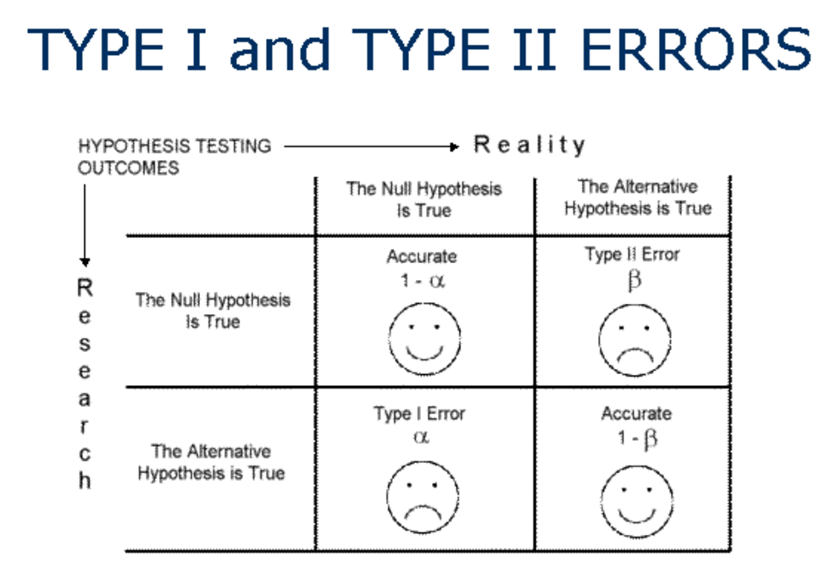

Slide 8
Two-Sample T-test (Welch's T-test)
If we have two groups of samples, are they statistically different from one another?
For example, consider gene “G”. We want to test the following hypothesis:
Ho (Null hypothesis)– The expression values of G are not statistically different in a group of healthy subjects and a group of subjects with prostate cancer.
H1 (Alternate hypothesis) – The expression values of G are statistically different in a group of healthy subjects and a group of subjects with prostate cancer.

Slide 9
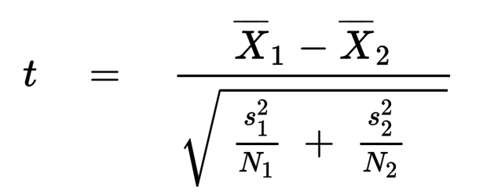
Two Sample T-test (Welch's T-test)
First, make sure your data are 'normally distributed' (i.e. they look like a bell curve).
Next, compute the t statistic using a slightly different formula than we saw for the one-sample test:
X1 – mean gene expression for your healthy subjects
X2 – mean gene expression for your sick subjects
S1 – standard deviation of gene expression in healthy subjects
S2 – standard deviation of gene expression in sick subjects
N1 – number of healthy subjects
N2 – number of sick subjects

Slide 10
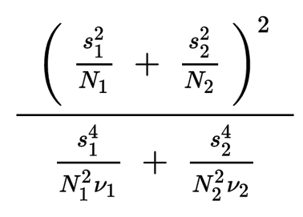
Two Sample T-test (Welch's T-test)
Calculate the degrees of freedom (the formula is a little long, sorry!), and look up the t-statistic in your table.
df =
S1 – standard deviation of gene expression in healthy subjects
S2 – standard deviation of gene expression in sick subjects
N1 – number of healthy subjects
N2 – number of sick subjects
V1= N1 -1
V2= N2 -1

