Slide 1
K-Means Clustering
… Or what to do when your
data doesn't have labels

Slide 2
Some example use cases of Unsupervised Learning
Unsupervised learning is performed when you don't have labels for your data, but you would like to check if there are any patterns.
Group emails or search results
Customer shopping patterns
Regions of images
Clusters of genes

Slide 3
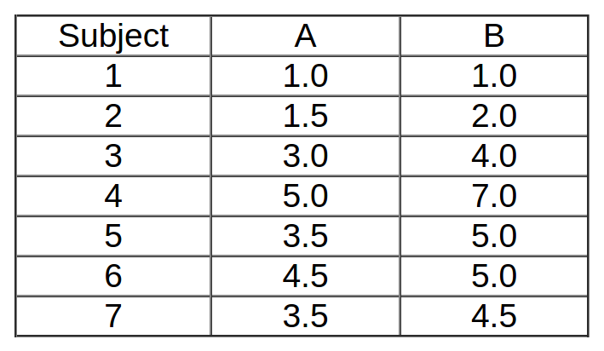
Example: Data

Slide 4
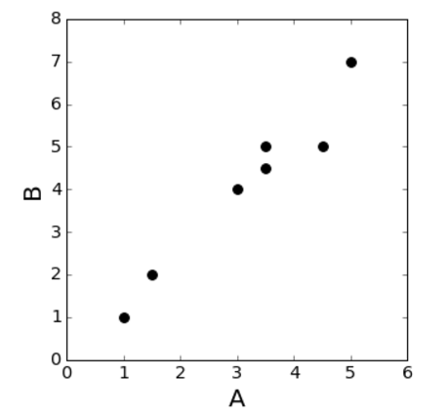
Goal: Split the data into 2 classes
K=2

Slide 5
Step 1: Randomly initialize the cluster centroids
The centroid refers to the “middle point” of the cluster in Euclidean space.
You can pick any point that is in the range of your dataset.
Our random number generator returns the following:

Slide 6
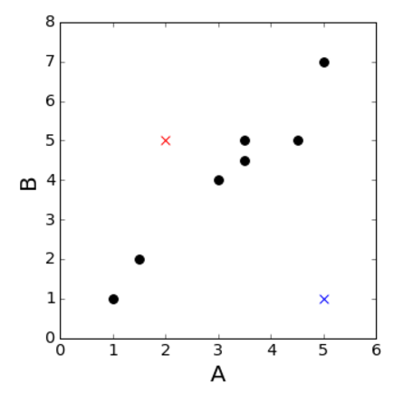
Step 1: Randomly initialize the cluster centroids
 | Red Cluster (0) | Blue Cluster (1)
A | 2 | 5
B | 5 | 1

Slide 7
Step 2: Find the Euclidean Distance of Each Point from Each Cluster
Datapoint | Distance from centroid 0 | Distance from centroid 1 | Closest centroid
1 | 4.12 | 4 | 1
2 | 3.04 | 3.64 | 0
3 | 1.4 | 3.60 | 0
4 | 3.60 | 6.0 | 0
5 | 1.5 | 4.2 | 0
6 | 2.5 | 4.03 | 0
7 | 1.58 | 3.80 | 0

Slide 8
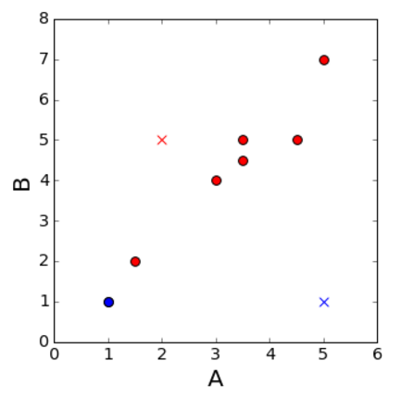
Give labels to your point: points get the label of the closest cluster

Slide 9
Recalculate the centroids: find the mean A & B for each cluster
Centroid of cluster 0: A=mean(1.5,3.0,5.0,3.5,4.5,3.5)
A= 3.5
B= mean(2.0,4.0,7.0,5.0,5.0,4.5)
B=4.58
Centroid of cluster 1:
A=mean(1)
A=1
B=mean(1)
B=1

Slide 10
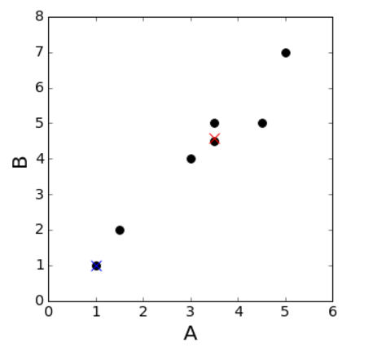
Our new centroids!

Slide 11
Repeat the two steps until your labels don't change anymore
Reassign your labels:
Datapoint | Distance from centroid 0 | Distance from centroid 1 | Closest centroid
1 | 4.36 | 0 | 1
2 | 3.26 | 1.11 | 1
3 | 0.76 | 3.60 | 0
4 | 2.84 | 7.21 | 0
5 | 0.419 | 4.71 | 0
6 | 1.08 | 5.31 | 0
7 | 0.08 | 4.3 | 0

Slide 12
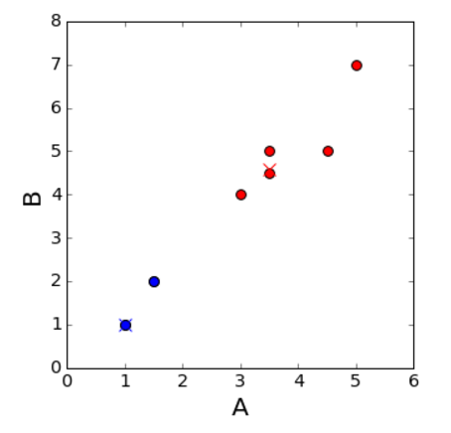

Slide 13
Repeat the two steps until your labels don't change anymore
Recompute your centroids
Centroid of cluster 0: A=mean(3.0,5.0,3.5,4.5,3.5)
A= 3.89
B= mean(4.0,7.0,5.0,5.0,4.5)
B=5.09
Centroid of cluster 1:
A=mean(1,1.5)
A=1.25
B=mean(1,2)
B=1.5

Slide 14
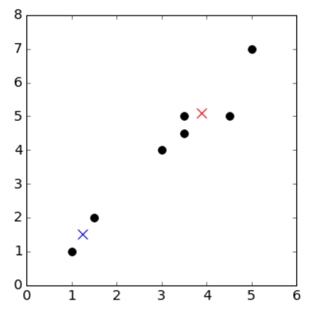

Slide 15
Repeat the two steps until your labels don't change anymore
Reassign your labels:
Datapoint | Distance from centroid 0 | Distance from centroid 1 | Closest centroid
1 | 5.00 | 0.55 | 1
2 | 3.91 | 0.55 | 1
3 | 1.40 | 3.05 | 0
4 | 2.21 | 6.65 | 0
5 | 0.400 | 4.16 | 0
6 | 0.61 | 4.77 | 0
7 | 0.70 | 3.75 | 0

Slide 16
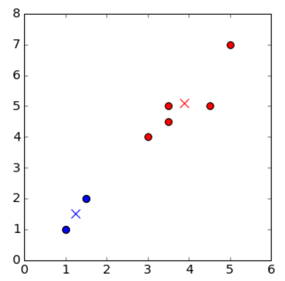
Our labels have not changed since the last iteration, so we're done!

Slide 17
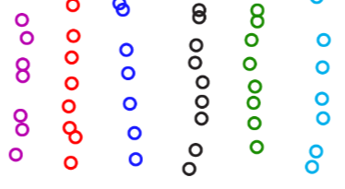
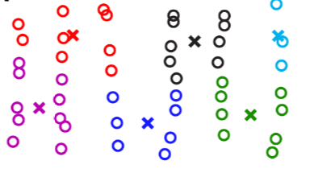
When will K-Means fail?

Slide 18
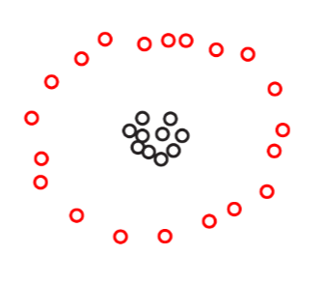
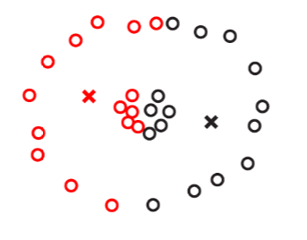
When will K-means fail?

