Slide 1




Security Vendors, Integrators,
App Developers
Enhance security
Lower costs
Relying Parties and Users
Better protection
Superior experience
FIDO
Alliance
Authenticator Vendors
Increase attach rate
Accelerate adoption
Extend to mobile
Computing Device Manufacturers
Embed security
Differentiate
Add customer value

Slide 2


FIDO-enabled Software, Services, & Components
FIDO Protocols
User Device
Relying Party
User Agent
Mobile App, Browser, ...
Discovery
Web Application
Registration
FIDO Client
(Windows, Mac, iOS, Android)
Authentication
FIDO
Server
OS/Server Security Components
Confirmation
Authenticator Abstraction
FIDO Authenticator Metadata Validation
Risk & Identity Systems
FIDO Authenticators

Slide 3
User Device
Relying Party
FIDO Client
(Windows, Mac, iOS, Android, ...)
User Agent (App, Browser, ...)
Web App
FIDO Server
Initiate Registration
1
Registration Request
+ Policy
2
4
Registration Response + Attestation + User's Public Key
FIDO Authenticators
5
Validate Response
& Attestation,
Store User’s
Public Key
3
Enroll User &
Generate New Key Pair
(specific to RP WebApp)

Slide 4
User Device
Relying Party
FIDO Client
(Windows, Mac, iOS, Android, ...)
User Agent (App, Browser, ...)
Web App
FIDO Server
Initiate Transaction
1
Authentication Request
+ Transaction Text
2
Authentication Response + Text Hash Signed by User's Private Key
4
FIDO Authenticators
5
Validate Response & Text Hash
Using User’s
Public Key
3
Verify User, Display Text, & Unlock Private Key
(specific to User + RP WebApp)

Slide 5
User Device
Relying Party
FIDO Client
(Windows, Mac, iOS, Android, ...)
User Agent (App, Browser, ...)
Web App
FIDO Server
1
Contact RP
Deregistration Request
2
3
Delete local RP key material
FIDO Authenticators

Slide 6
User Device
Relying Party
FIDO Client
(Windows, Mac, iOS, Android, ...)
User Agent (App, Browser, ...)
Web App
FIDO Server
Initiate Authentication
1
Authentication Request
+ Challenge + Policy
2
Authentication Response Signed by User's Private Key
4
FIDO Authenticators
5
Validate Response
Using User’s
Public Key
3
Verify User & Unlock Private Key
(specific to User + RP WebApp)

Slide 7
Federated Relying Party Website
Federated Relying Party Website
Federated Relying Party Website
Identity Provider and
Relying Party
Identity Provider Services
(2) Federated Identity
Management Protocols
(e.g. OpenID, SAML)
Web Application
User Device
User Agent (Mobile App, Browser, ...
(1) FIDO Registration, Authentication, Confirmation
FIDO
Server
OS/Server Security Components
FIDO Client
(Windows, Mac, iOS, Android)
Authenticator Abstraction
FIDO Authenticator Metadata Validation
Risk & Identity Systems
FIDO Authenticators

Slide 8
Unused/Obsolete slides

Slide 9
Federated Relying Party Website
Federated Relying Party Website
Federated Relying Party Website
identity provider &
FIDO Relying Party
FEDERATED IDENTITY
MANAGEMENT PROTOCOLS
(OPENID, SAML, ETC)
Identity Provider Service
FIDO user device
FIDO user device
Browser
Mobile App
FIDO user device
Browser
Mobile App
FIDO Authentication + discovery, provisioning, confirmation, Attestation
Browser
Mobile App
Web Application
FIDO Client
(Windows, Mac, iOS, Android)
FIDO Client
(Windows, Mac, iOS, Android)
FIDO Client
(Windows, Mac, iOS, Android)
FIDO
Server
Risk & Identity Systems
Authenticator Abstraction
Authenticator Abstraction
Authenticator Abstraction
FIDO authenticators
FIDO authenticators
FIDO authenticators
FIDO attestation Service

Slide 10




User Authenticator Registration
QUERY CAPABILITIES
REPORT CAPABILITIES
USER’S SYSTEM
WEBSITE’S SERVER
TPM
TPM
REGISTER AUTHENTICATOR
PROVISION CREDENTIAL
VOICE BIOMETRIC
VOICE BIOMETRIC
FINGERPRINT
SENSOR
FINGERPRINT
SENSOR
PROTECT CREDENTIAL LOCALLY

Slide 11







Authentication
REQUESTS ACTION
QUERY FOR REGISTERED AUTHENTICATORS
USER’S
SYSTEM
REPORT REGISTERED AUTHENTICATORS
WEBSITE’S
SERVER
CHALLENGE & SPECIFY AUTHENTICATOR(S)
EXAMINES RISK &
POLICIES, CHOOSES:
FINGERPRINT
SENSOR
FINGERPRINT
SENSOR
RESPOND TO CHALLENGE
AUTHENTICATE
USER

Slide 12
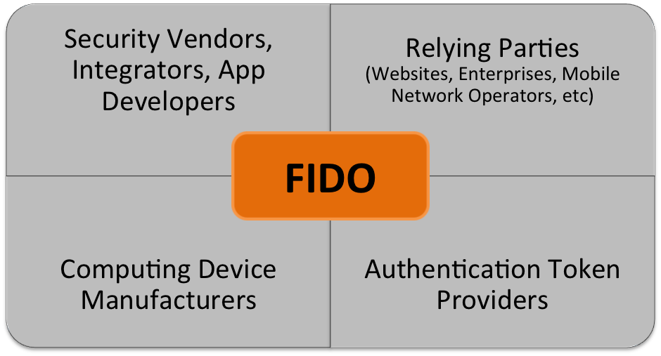
Deprecated figure (used slide #1 instead)

Slide 13





Proprietary Software Stack 1
Multiple Authentication methods, tokens, protocols
Proprietary Software Stack 2
Security Token
Multiple passwords, tokens, etc.
Website 1
finger
Security Token
USB
?
Website 2
?
Browser
Proprietary Software Stack n - 1
Website n - 1
Security Token
Proprietary Software Stack n
TPM
Website n
Security Token
?

Slide 14
This slide was restructured
FIDO Protocols
FIDO user device
Relying Party
Browser
Mobile App
discovery
Web Application
Provisioning
FIDO Client
(Windows, Mac, iOS, Android)
Authentication
FIDO
Server
Risk & Identity Systems
confirmation
Authenticator Abstraction
Attestation
FIDO attestation Service
FIDO authenticators
FIDO-enabled Software, Services, & components
FIDO PROTOCOLS

Slide 15
This slide was restructured
FIDO Protocols
FIDO user device
Relying Party
Browser
Mobile App
discovery
Web Application
Provisioning
FIDO Client
(Windows, Mac, iOS, Android)
Authentication
FIDO
Server
Risk & Identity Systems
confirmation
Authenticator Abstraction
Attestation
FIDO attestation Service
FIDO authenticators
FIDO-enabled Software, Services, & components
FIDO PROTOCOLS

Slide 16
Federated Relying party website
Obsolete slide
Federated Relying party website
Federated Relying party website
identity provider &
FIDO Relying Party
FEDERATED IDENTITY
MANAGEMENT PROTOCOLS
(OPENID, SAML, ETC)
Identity Provider Service
FIDO user device
FIDO user device
Browser
Mobile App
FIDO user device
Browser
Mobile App
FIDO Authentication + discovery, provisioning, confirmation, Attestation
Browser
Mobile App
Web Application
FIDO Client
(Windows, Mac, iOS, Android)
FIDO Client
(Windows, Mac, iOS, Android)
FIDO Client
(Windows, Mac, iOS, Android)
FIDO
Server
Risk & Identity Systems
Authenticator Abstraction
Authenticator Abstraction
Authenticator Abstraction
FIDO authenticators
FIDO authenticators
FIDO authenticators
FIDO attestation Service

Slide 17
Federated Relying party website
Federated Relying party website
Federated Relying party website
Fido-enabled identity provider
(2) FEDERATED IDENTITY
MANAGEMENT PROTOCOLS
(OPENID, SAML, ETC)
FIDO user device
FIDO user device
Identity Provider Service
FIDO user device
Browser
Browser
Browser
[ FIDO components ]
[ FIDO components ]
[ FIDO components ]
(1) FIDO Protocols
(peer-entity authentication)
FIDO Server
FIDO authenticators
Risk & Identity Systems
FIDO authenticators
FIDO authenticators

Slide 18
Federated Relying party website
Obsolete slide
Federated Relying party website
Federated Relying party website
Fido-enabled identity provider
(2) FEDERATED IDENTITY
MANAGEMENT PROTOCOLS
(OPENID, SAML, ETC)
FIDO user device
FIDO user device
Identity Provider Service
FIDO user device
Browser
Browser
Browser
[ FIDO components ]
[ FIDO components ]
[ FIDO components ]
(1) FIDO Protocols
(peer-entity authentication)
FIDO Server
FIDO authenticators
Risk & Identity Systems
FIDO authenticators
FIDO authenticators

