Slide 1

CHI crime
An Analysis of Homicides and Non-Fatal Shootings in Chicago
By Gregory Edwards
2025.2.28
Notes:
This is the intro

Slide 2
Project topic
In 2024 in Chicago* there were:
2726 shootings
501 shooting deaths
Representing an 18.4% lethality
Many attempts have been made to track and reduce the number of shootings in Chicago. In contrast, I want to ask the question: Can we make these shootings less lethal?
Can we build a good predictive model that will tell us who is likely to be killed in a shooting, where and when? If so, then maybe we could imagine interventions that specifically address the lethality of shootings, as opposed to their prevalence.
My project aims to create a classifier model that predicts whether someone victimized in a shooting will be killed.
* Source: City of Chicago. (2025). Violence Reduction - Victims of Homicides and Non- Fatal Shootings (Updated on February 24, 2025) [Data set]. https://data.cityofchicago.org/Public-Safety/Violence-Reduction-Victims-of- Homicides-and-Non-Fa/gumc-mgzr/about_data
Notes:
This is the topic

Slide 3
Data
My data source is the City of Chicago’s Violence Reduction - Victims of Homicides and Non-Fatal Shootings dataset*
This dataset contains individual-level homicide and non-fatal shooting victimizations, including homicide data from 1991 to the present, and non-fatal shooting data from 2010 to the present (2010 is the earliest available year for shooting data).
The data is 61,140 rows with 38 columns, in a file that's 17.7 MB.
Many of the columns are string object types
* Source: City of Chicago. (2025). Violence Reduction - Victims of Homicides and Non- Fatal Shootings (Updated on February 24, 2025) [Data set]. https://data.cityofchicago.org/Public-Safety/Violence-Reduction-Victims-of- Homicides-and-Non-Fa/gumc-mgzr/about_data

Slide 4
Data cleaning
Some necessary cleaning and prepping work ahead:
Creating a target column. Currently, fatal shootings are indicated by a value in the VICTIMIZATION_PRIMARY column of "HOMICIDE" alongside a GUNSHOT_INJURY_I value of "YES." Non-fatal shootings are indicated by any other values in VICTIMIZATION_PRIMARY.
Converting type "string" columns into useful features — including breaking out RACE into a series of binary features.
Eliminating extraneous features, such as victim name.
Manipulating columns to get useful date/time and location features.
Dropping samples that have either nulls in important features, or will throw off the analysis (such as entries from before 2010, the first year that non-fatal shootings were tracked in this dataset.
My cleaned data has 46106 samples across 16 features and 1 target: FATAL.
It takes up only 6.6 MB.

Slide 5
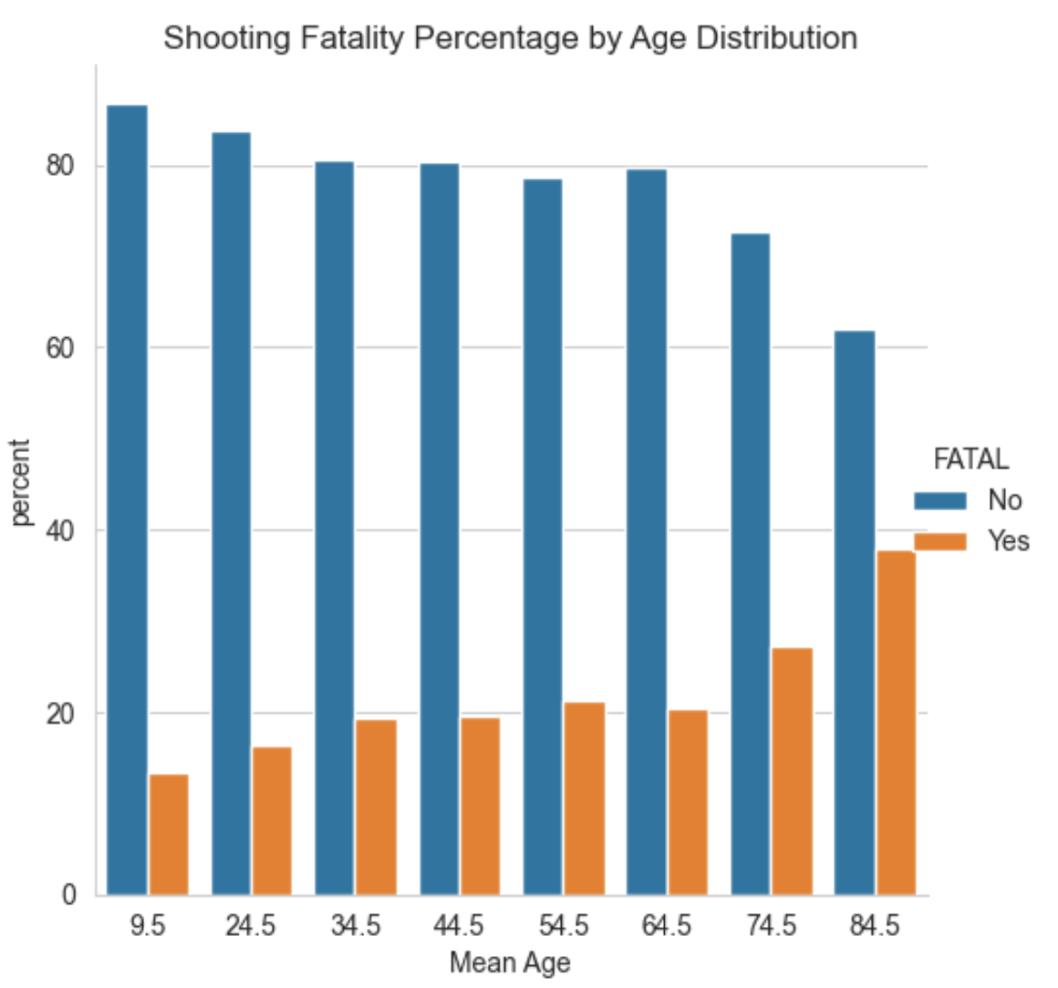
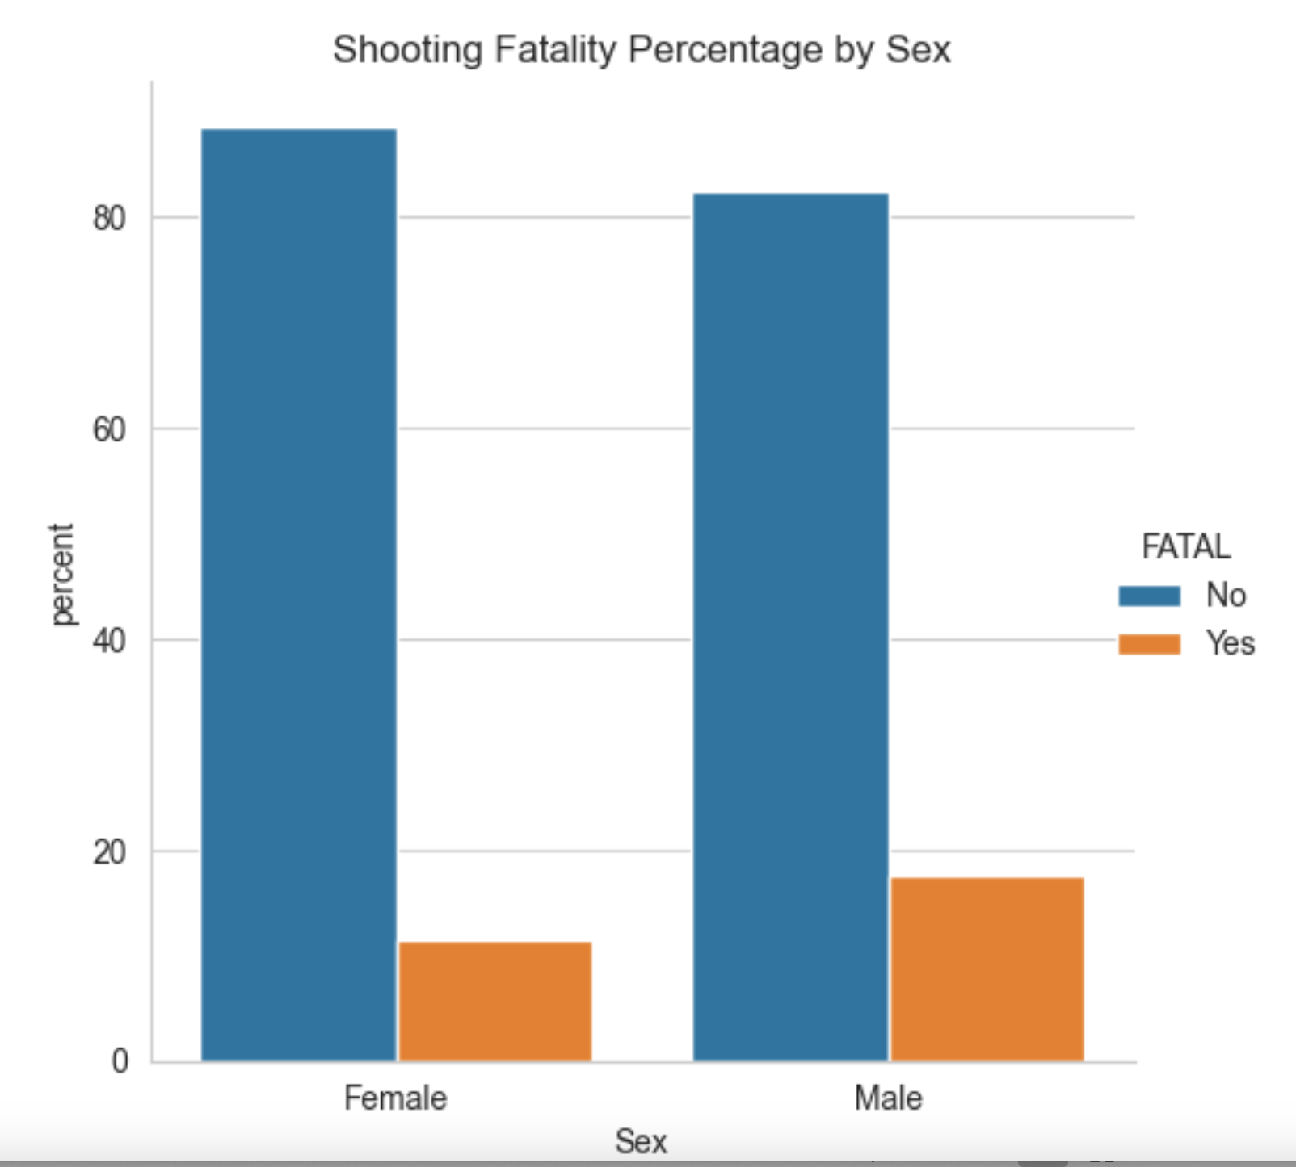
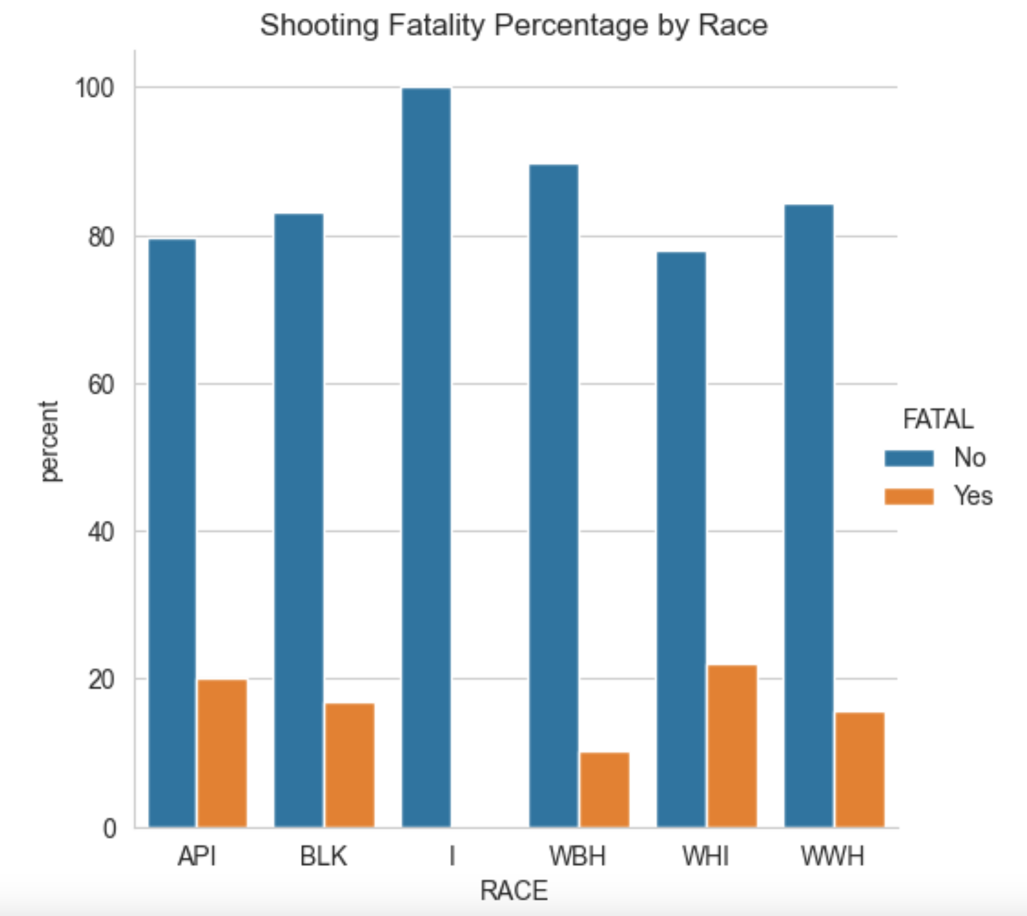
Exploratory data analysis
Fatality seems to have a demographic component

Slide 6
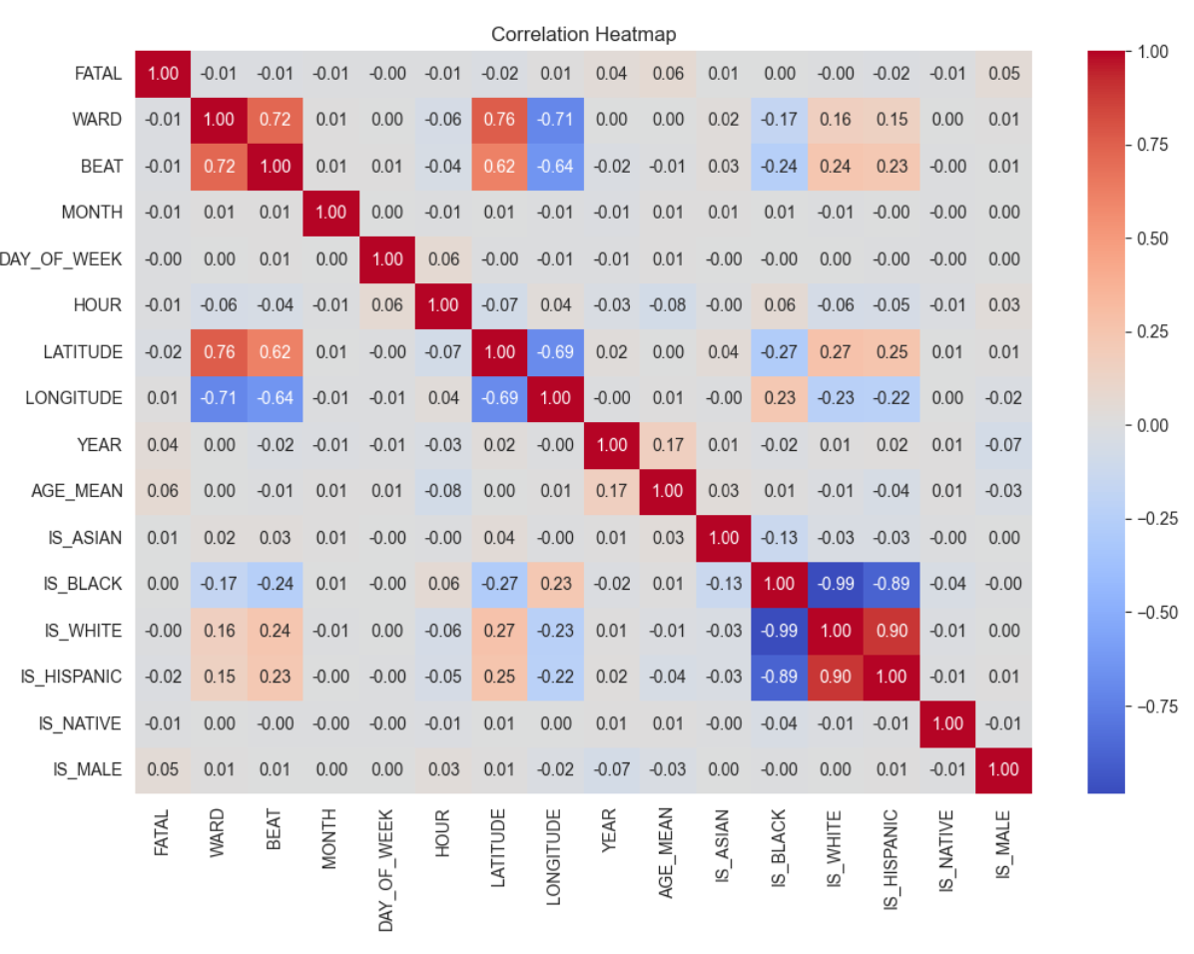
Exploratory data analysis
In addition to showing the correlation consistent with segregation,
the correlation matrix shows the influence of age, year and sex on fatality

Slide 7
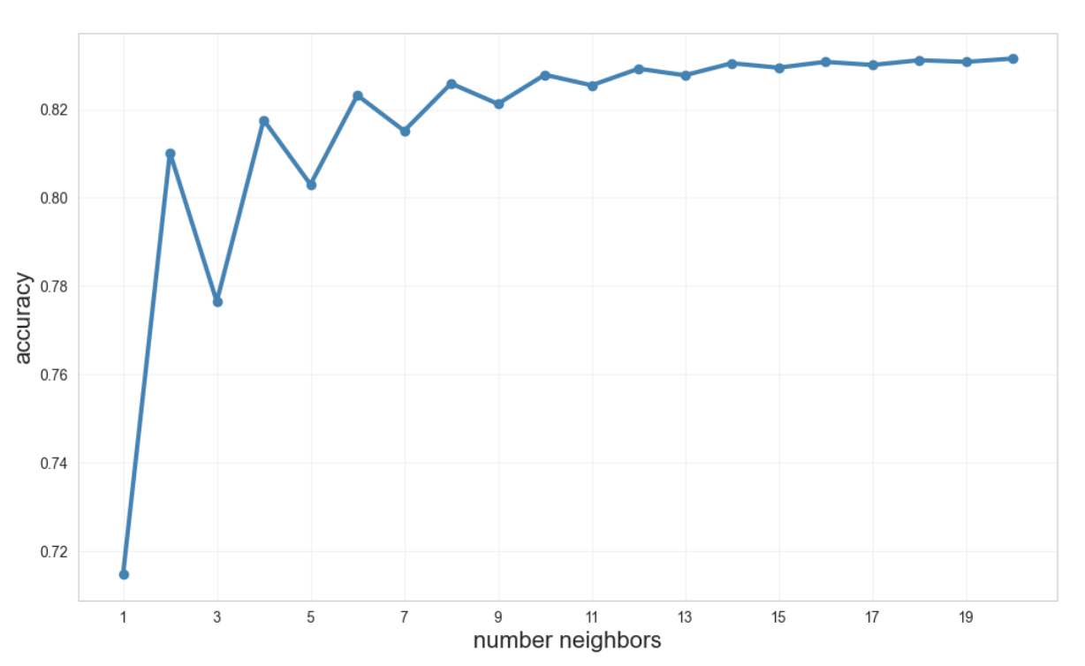
Models: KNN
I start by trying the k-nearest neighbors classifier because I have a large, many-featured dataset with weak correlations
A trial of a k=5 KNN gives me an 80% accuracy rate: not too bad
Tuning k by looking at k=1 to k=20 shows the accuracy maxing out at about 83% (and reaching a decent 82.3% at k=6)

Slide 8
Models: AdaBoost and SVM
To compare my KNN model, I experimented with AdaBoost and a Support Vector Machine models
With n=300 Decision Tree weak estimators, AdaBoost gave me an accuracy of 82.8%
Tuning n improved the accuracy to 83.2% with n=50 estimators
An “out of the box” SVM model also gave me an accuracy of 83.2%
When I tried to tune the SVM for C and gamma, my machine basically locked up and I had to kill the process
Given the increased complexity and minimal improvement over KNN, I am sticking with the KNN model

Slide 9
Results and analysis
Maximum accuracy by model:
KNN: 0.832 (with 20 nearest neighbors)
AdaBoost: 0.832 (with 50 estimators)
SVM: 0.83
Running SVM took much longer than the other two models (unsurprising, given that SVM is known to be poor with large datasets). In fact, when I tried to do an automated tuning of the SVM model for C and gamma, the process was taking so long that I just killed it. So SVM gets ruled out as an efficient model.
Given that KNN performed faster than AdaBoost, the fact that AdaBoost is more prone to overfitting, and the equality of the accuracy scores, my preference is to choose the KNN model.
Weighted averages for KNN with k=6:
Precision: 73%
Recall: 83%
F1 score: 76%

Slide 10
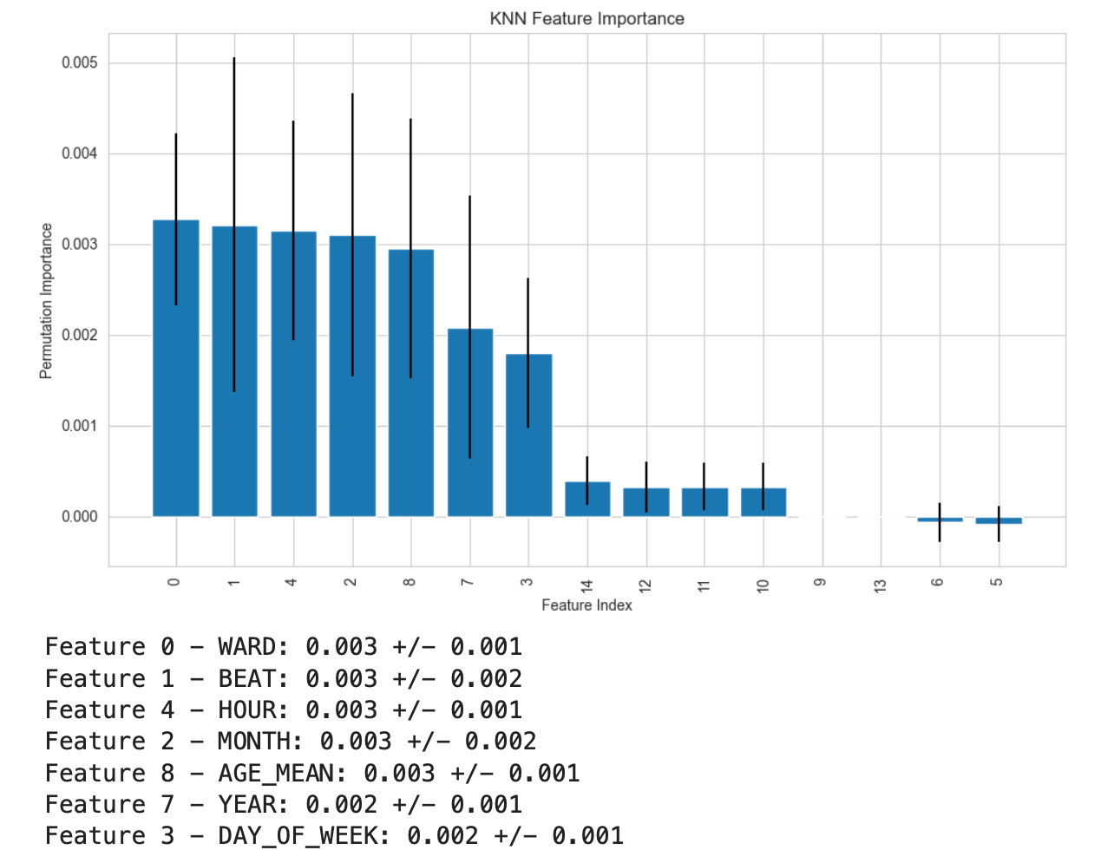
Results and analysis
Finding the significant features
Going back to the KNN model, now I want to check the feature importance and compare it to my intuitions from my original correlation matrix.
To recall, my original correlation matrix highlighted the features IS_MALE, IS_WHITE, AGE_MEAN and YEAR.
In my KNN model, however, the sex and race features appear to be entirely irrelevant, and WARD, BEAT, HOUR, MONTH and DAY_OF_WEEK make a reasonable showing.

Slide 11
Discussion and conclusion
LEARNINGS
Other than age, demographic features don’t seem predictive
Time and place ARE predictive
WHAT DIDN’T WORK
The correlation between race and fatality somehow vanished in the model
WHAT COULD BE IMPROVED
I should be able to improve the model by isolating better features related to time and place — and, I believe, demographics
Given the stakes are literally life and death, I would want to focus on improving the recall of my model

Slide 12
Discussion and conclusion
Final thoughts:
Where and when you were when you got shot matter a lot more than who you are — unless you're old
The relevance of ward and police beat suggests to me that there are some emergency services units that are underperforming others
With the passage of years, fatality percentages are getting worse — so this is not a problem we can ignore

