Slide 1
Forecasting Overnight stay
(Time Series)
By Apurv Rathore

Slide 2
AGENDA
Data Preparation
Data Analysis
Outlier Detection
Forecast for 2016 & 2017
Business Insights

Slide 3
Data Preparation
The data set contains the number of Overnight stay in hotels per month in INDIA from January 1992 to December 2015
Converted the given data into Time series data
The cycle of this time series is 12months in a year
The number of stays are distributed across the spectrum

Slide 4
Data Analysis
There is a seasonal pattern in the number of Stays per month.
There is a peak every summer, and a trough every winter.
It is an additive time series, as the seasonal fluctuations are roughly constant in size over time and random fluctuations are also roughly constant in size over time.
The year on year trend clearly shows that the No. of stays have been increasing without fail during summers

Slide 5
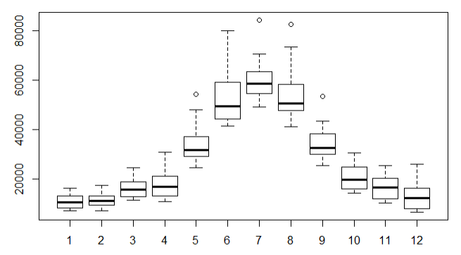
The variance and the mean value in June , July and August is much higher than rest of the months.

Slide 6
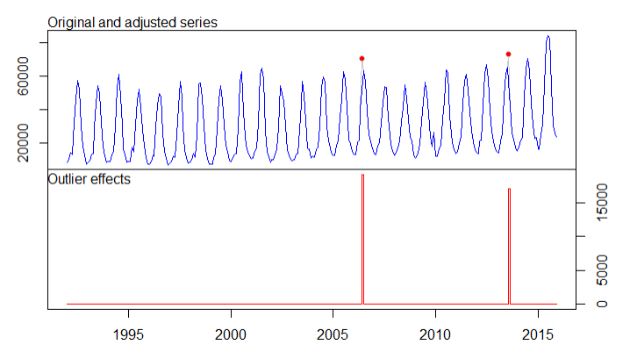
Outlier Detection
Used tsoutliers library for finding outliers
Two Outliers were detected
June 2006-70528
August 2013-73357

Slide 7
Forecast for 2016 & 2017
Month | 2016 | 2017
January | 21514 | 24206
February | 22205 | 24534
March | 28835 | 31032
April | 32131 | 34624
May | 53742 | 56201
June | 71529 | 74516
July | 77828 | 80610
August | 74195 | 77283
September | 51290 | 53853
October | 35792 | 37806
November | 30096 | 32138
December | 27522 | 29680

Slide 8
Business Insights
Hotels Administration should increase occupancy during peak months of June , July and August
Hotels Admin. Should keep good no. of rooms (as per forecast of visitors )for last minute bookings and sell on much higher rates.
Lucrative discounts and bundle packs should be offered to visitors in the months when frequency of visitors is low ,specially during winters

