Slide 1
Psychographic Segmentation
Satish Menon-A17025
Apurv Rathore-A17006
S.Sathiya Narayanan-B16040

Slide 2
Project Flow
Exploring of Data
Data Cleaning
Managing Unreliable/Vague Responses, Missing values
Use of K-Means Clustering
Profiling Segments based on Psychographic Parameters
Profile based Answers to Project Questions

Slide 3
Data Exploration
Data Dimensions:
664 Records
26 Attributes
Data Understanding
Cross checking Variable Data and Names

Slide 4
Data Cleaning
Managing Unreliable/Vague Responses
Removed Vague/Unreliable responses for e.g., where the participant has given the same score for all the questions.
Missing values
In case the missing values were found to be imputable, then we replaced it with its corresponding mode value.

Slide 5
Checking unreliable responses
32 rows were filtered with same responses or had no response.
Truncated 28 rows and maintained one unique case for each filtered response.

Slide 6
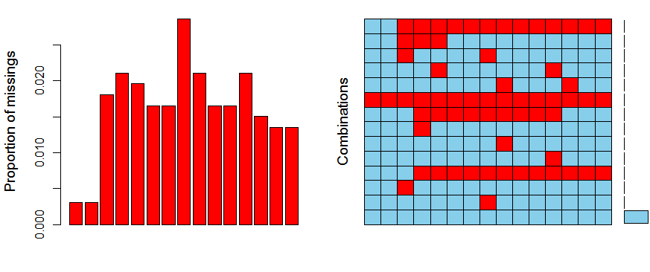
Managing Missing Responses
Case 1: Majority of responses for psychographic indicators are missing
Detection:
Y-axis is represent the indices for the responses while X-axis are the columns.
The red strip represents the missing values

Slide 7
Managing Missing Responses
Found that Majority of the Pscychographic indicators were missing.
So, Removed such responses.
Unavailable Responses
They were Imputed using Mode

Slide 8
Data after Cleaning
Data Dimensions after cleaning:
630 Observations and 25 Variables
No Missing Values
Fixed Variables Names

Slide 9
Cluster Solutions with K-means Clustering
Prepared different Clustering Possibilities with Psychographic Indicators
Tried Clustering using 3, 4 and 5 Clusters
3 Clusters Solution obtained required Discriminant features and Separation
Mean / Summary Statistics for all Indictors were found
Extreme Values (i.e. 120% more than Mean Value) were picked for studying behavior or pattern within the clusters.
Cluster Solutions were obtained on basis of:
Size of the Cluster
Separation between Clusters on basis of Distance (Dissimilarity)

Slide 10
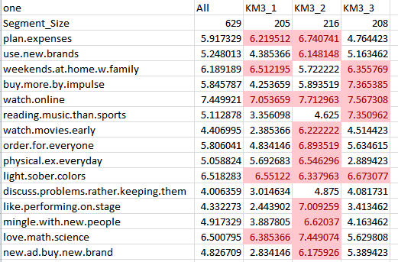
Clustering Decision Data and Profiling Parameters

Slide 11
Profiling
Names for each of the Segments:
Segment 1: ‘The Inhibited’
They aren’t very open to try new things like movies, going out, meeting new people etc. This segment has members who are reserved to a large extent.
Segment 2: ‘Adventure Savvy’
They are very open to try new things like movies, dancing, meeting new people, buying new products that are recently launched.
Segment 3: ‘Community Oriented’
They are at peace with their families. The idea of happiness is being with close family members

Slide 12
Profiling
Brands that can target the found segments:
Insider.in
This is a brand/company that organizes show tickets for plays and comic shows.
Target is Segment 2 (The Adventure Savvy) who like to watch new movies, try out new things generally.
Swiggy
This brand/company that arranges for Food Delivery at your DoorStep.
Target is Segment 3 (the Community Oriented) who like to stay indoors with their families generally.

