Slide 1




Cloud Native Applications
Workshop Kickoff

Slide 2


Cincinnati – Aug 23rd – 8:00 AM – 3:00 PM
Welcome!

Slide 3
Logistics
Breaks
Lunch
‘The Facilities’
Email & Cellphone Etiquette
Questions

Slide 4
Speakers
Vinod Dsouza
Manager of Platform Architecture, Pivotal
Ravi Appalla
Platform Architect, Pivotal

Slide 5
Agenda
8:00 AM - 8:30 AM Breakfast and Kickoff
Enjoy breakfast with the team
8:30 AM - 9:15 AM Cloud Native Introduction
Industry Trends and Overview including: 12 Factor Apps, Microservices and Cloud Platforms
9:15 AM - 10:15 AM Cloud Native Platform
An overview of Pivotal Cloud Foundry (PCF) and its Architecture
10:15AM - 10:30 AM Break
10:30 AM - 11:00 AM Cloud Native .NET
Architecture, Cloud Native Antipatterns, Demo and Roadmap
11:00 AM - 12:00 PM The Cloud Native Enterprise
Devops, Continuous Delivery, Microservices, what’s new, what isn’t, what matters
Notes:
At 11:30 get setup to do the install

Slide 6
Agenda
12:00 PM - 1:00 PM Lunch
Lunch will be provided
1:00 PM - 2:30 PM Developer Workshop
Hands-on pushing code with PCF
Break as needed
2:30 PM - 3:00 PM Wrap Up, Q&A, Feedback

Slide 7
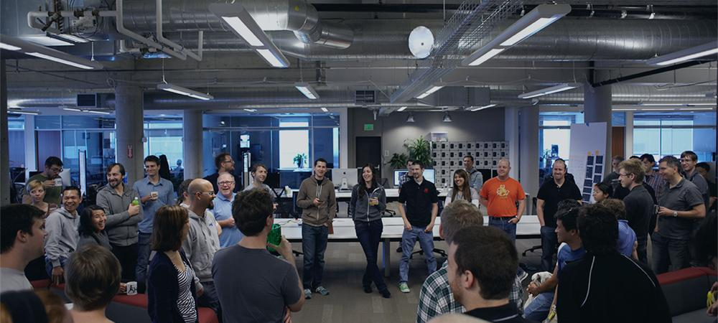
Introductions
Name, Team, Apps

