Slide 1



Cloud Native Enterprise
Continuous Delivery & Microservice Architectures in the Enterprise with Spring and Cloud Foundry
Notes:
Resting slide on screen before you begin presenting.

Slide 2
Characteristics of Cloud Native Architectures
Twelve Factor Apps (http://12factor.net/)
Continuously Delivered
Microservices
DevOps
Self-Service agile infrastructure
API-based collaboration
Anti-fragility

Slide 3
Characteristics of Cloud Native Architectures
Twelve Factor Apps (http://12factor.net/)
Continuously Delivered
Microservices
DevOps
Self-Service agile infrastructure
API-based collaboration
Anti-fragility

Slide 4
12-Factor Applications
Codebase
Dependencies
Configuration
Backing Services
Build, release, run
Processes
Port binding
Concurrency
Disposability
Dev/prod parity
Logs
Admin processes
APPS
contract
Cloud Platform
Architectural and development practices – http://12factor.net
Notes:
References:
http://12factor.net/
Architectural and development practices, that ensure an optimal experience on a cloud platform.

Slide 5
Characteristics of Cloud Native Architectures
Twelve Factor Apps (http://12factor.net/)
Continuously Delivered
Microservices
DevOps
Self-Service agile infrastructure
API-based collaboration
Anti-fragility

Slide 6
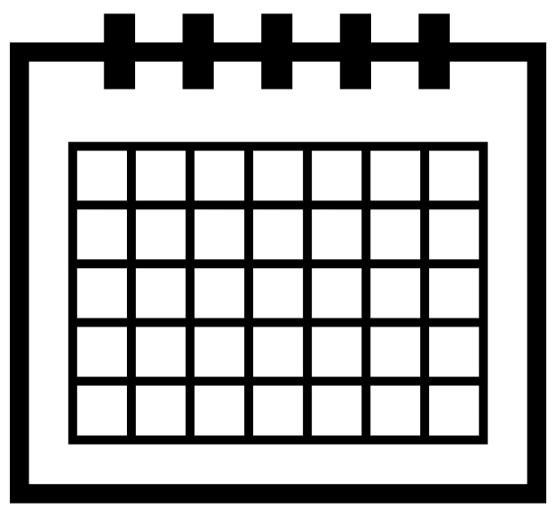
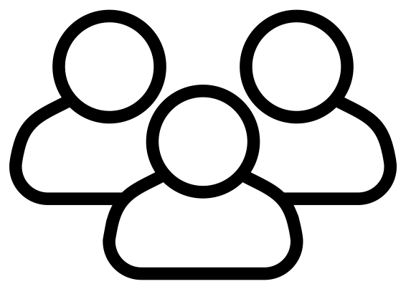
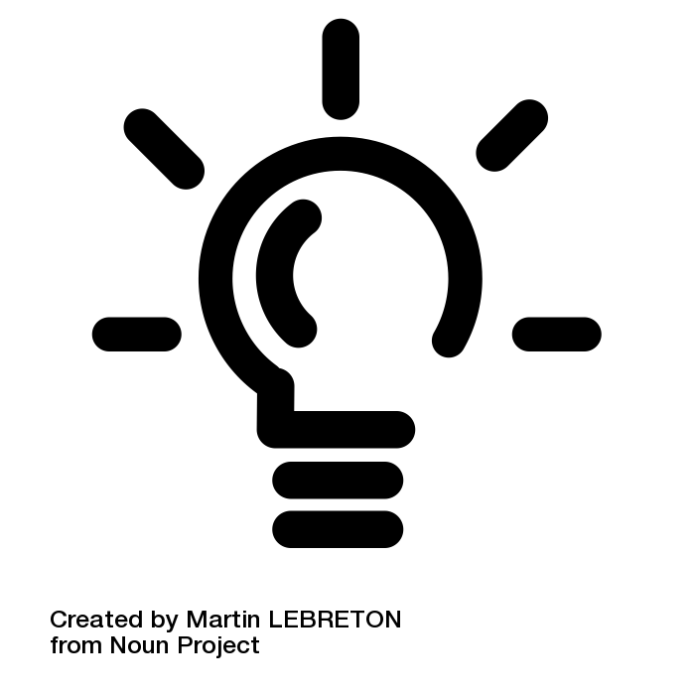
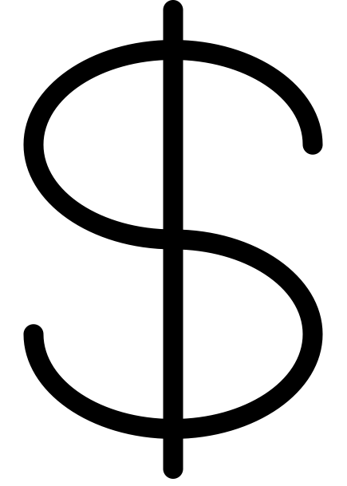
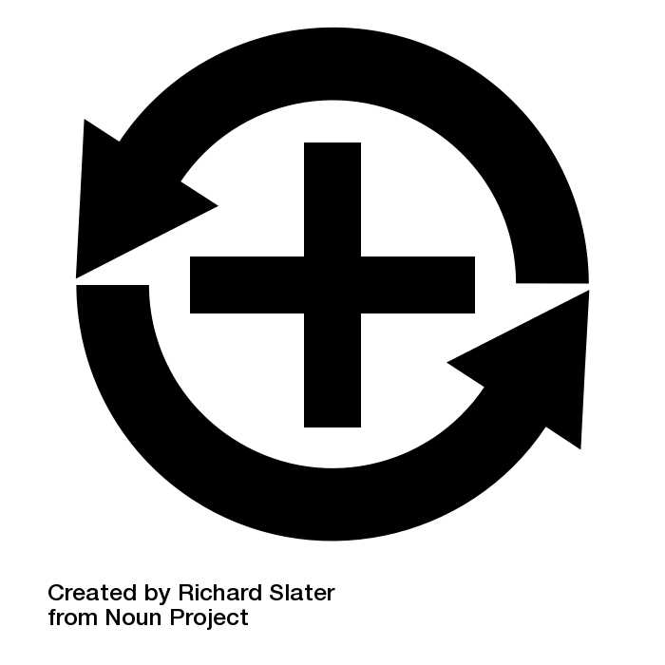
Apps
6+ Months
Plan
Dev
Test
Deploy
Operate
Notes:
Light Bulb by Martin LEBRETON from the Noun Project
multiple users by To Uyen from the Noun Project
dollar sign by icon 54 from the Noun Project
Positive Feedback Loop by Richard Slater from the Noun Project
Calendar by Star and Anchor Design from the Noun Project

Slide 7
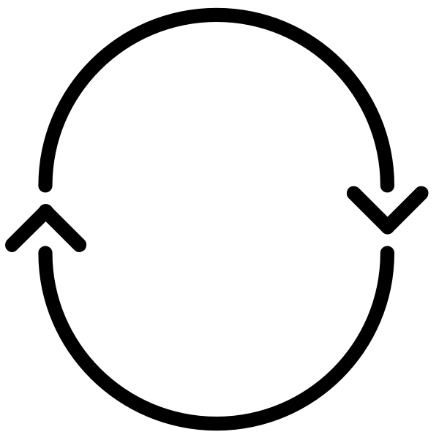
Apps
Agile!
6+ Months
CI
Plan
Dev
Test
Deploy
Operate
Notes:
Light Bulb by Martin LEBRETON from the Noun Project
multiple users by To Uyen from the Noun Project
dollar sign by icon 54 from the Noun Project
Positive Feedback Loop by Richard Slater from the Noun Project
Calendar by Star and Anchor Design from the Noun Project
cycle by Chris Jones from the Noun Project

Slide 8
Apps
Water -
Scrum
Agile!
- Fall
CI
Plan
Dev
Test
Deploy
Operate
CI
-Code
-CI
-Build
-Unit Tests
-Artifact
SIT
FT
UAT
Perf
Prod
-H/W & VM
-OS
-Runtime
-Middleware
-Network
-Services
-Config
-Code
-Tests
-H/W & VM
-OS
-Runtime
-Middleware
-Network
-Services
-Config
-Code
-Tests
-H/W & VM
-OS
-Runtime
-Middleware
-Network
-Services
-Config
-Code
-Tests
-H/W & VM
-OS
-Runtime
-Middleware
-Network
-Services
-Config
-Code
-Tests
-H/W & VM
-OS
-Runtime
-Middleware
-Network
-Services
-Config
-Code
-Tests
Inconsistent, Corrupt & Dirty
Notes:
Light Bulb by Martin LEBRETON from the Noun Project
multiple users by To Uyen from the Noun Project
dollar sign by icon 54 from the Noun Project
Positive Feedback Loop by Richard Slater from the Noun Project
Calendar by Star and Anchor Design from the Noun Project
cycle by Chris Jones from the Noun Project

Slide 9
Apps
Agile
DevOps
CI
CD - Automate
Plan
Dev
Test
Deploy
Operate
CI
-Code
-CI
-Build
-Unit Tests
-Artifact
SIT
FT
UAT
Perf
Prod
-H/W & VM
-OS
-Runtime
-Middleware
-Network
-Services
-Config
-Code
-Tests
-H/W & VM
-OS
-Runtime
-Middleware
-Network
-Services
-Config
-Code
-Tests
-H/W & VM
-OS
-Runtime
-Middleware
-Network
-Services
-Config
-Code
-Tests
-H/W & VM
-OS
-Runtime
-Middleware
-Network
-Services
-Config
-Code
-Tests
-H/W & VM
-OS
-Runtime
-Middleware
-Network
-Services
-Config
-Code
-Tests
Automated Platform
Notes:
Light Bulb by Martin LEBRETON from the Noun Project
multiple users by To Uyen from the Noun Project
dollar sign by icon 54 from the Noun Project
Positive Feedback Loop by Richard Slater from the Noun Project
Calendar by Star and Anchor Design from the Noun Project
cycle by Chris Jones from the Noun Project

Slide 10
Characteristics of Cloud Native Architectures
Twelve Factor Apps (http://12factor.net/)
Continuously Delivered
Microservices
DevOps
Self-Service agile infrastructure
API-based collaboration
Anti-fragility

Slide 11
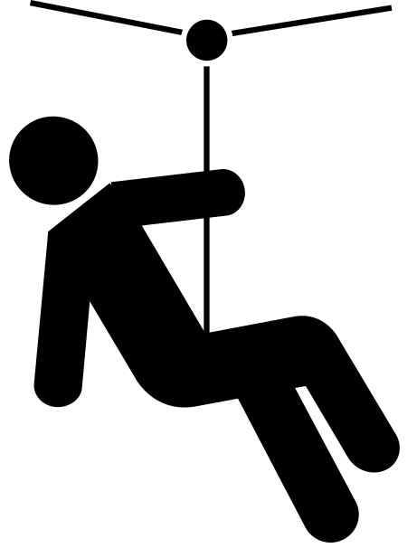
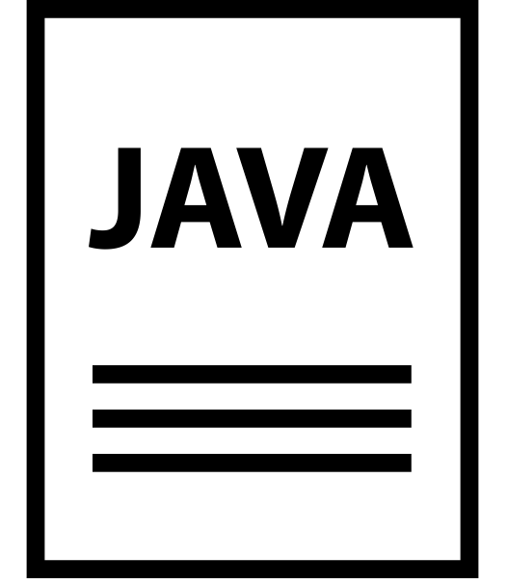
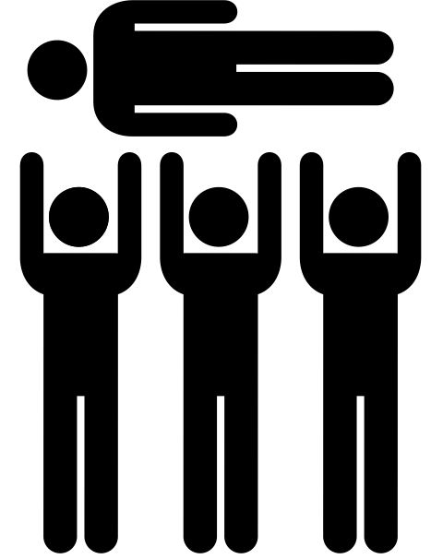
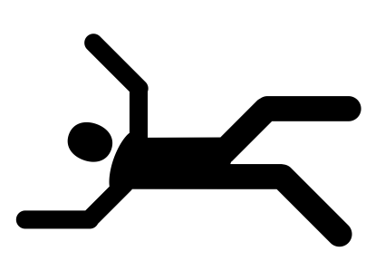
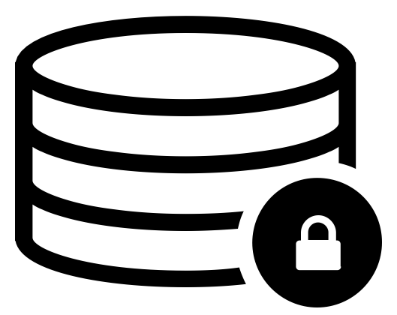
The Monolithic Application
HTML
Java
Script
MVC
X
Service
Service
6+ Months
Data Access
Notes:
Big commitment
falling by Eric Benoit from the Noun Project
Zipline by Miranda Dempster from the Noun Project
Crowd Surfing by Gilbert Bages from the Noun Project
JAVA File by Alfredo Hernandez from the Noun Project
Secure Database by Leonardo Schneider from the Noun Project

Slide 12
What are Microservices?
If every service has to be updated in concert, it’s not loosely coupled!
Loosely coupled service oriented architecture with bounded contexts
If you have to know about surrounding services you don’t have a bounded context.
Notes:
I presume you’re all familiar with microservices and cloud-native, but quickly, here’s an introduction. They’re loosely coupled, service oriented architecture with bounded contexts.
Because each service can be updated independently, your teams can work in parallel. Because each service is isolated, it’s much easier to automate your testing.

Slide 13
Trend towards new lightweight architectures
Microservices addressing speed to market and cloud scale
MONOLITHIC/LAYERED
MICROSERVICES
Notes:
Enterprise companies in finance and telco industries are embracing microservice and cloud-native models.
There are new architectures emerging atop these lightweight app servers to address the scale, speed and safety: new ways of tackling cloud scale and speed to market. Microservices has emerged from the internet giants as such an alternative: a change in culture, organization structure and technology that allows teams to work more independently, and increase velocity. It’s a key part of cloud-native applications, which we’ll talk about shortly.
Microservices are both a cultural and organizational change as a change in how we design and implement systems.

Slide 14
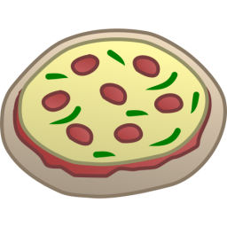
One-Size-Fits-All Methodologies have become an Anti-pattern to the Business
HTML
Java
Script
MVC
Service
Service
Data Access
Monolithic Application
> 2 Pizzas Per Project = Too Many Pizzas

Slide 15



Agile, Disruptive Companies Use Non-traditional, Modular Approaches to Software Systems
Microservice based architecture
Relational
DB
Key/Value
Store
AQMP
…..........
Shared
DB
DB Service
Caching Service
Messaging Service
Two Pizzas Per Microservice = Manageable!
Notes:
To build a Microservices architecture at scale requires a platform

Slide 16
Microservices are NOT
Monolithic Application
Service
Service
HTML
JavaScript
MVC
Enterprise Service Bus
Service
Service
OR
Data Access
Service
Service
Tightly Coupled
Centralized

Slide 17
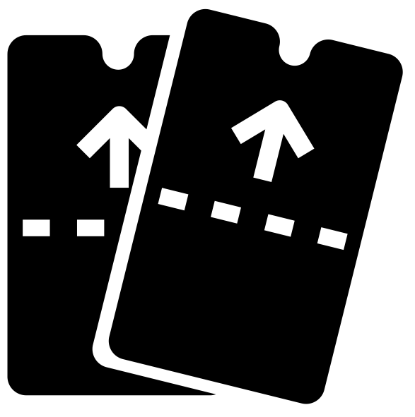
SOA Architecture
Business Change
HTML
JavaScript
MVC
Service
Service
Enterprise Service Bus
Data Access
Notes:
Zipline by Miranda Dempster from the Noun Project
tickets by Kerry Webster from the Noun Project

Slide 18




Microservice Architecture
Business Change
HTTP
HTTP
HTTP
HTTP
HTTP
HTTP
AMQP
AMQP
…
Relational
DB
Key/Value
Store
Graph
DB
Notes:
REST and message-driven services
Polyglot persistence, services encapsulate data store semantics
Diversity of clients acknowledged
API Gateway for service aggregation, reduce chattiness, protocol translation, reduce latency/round-trips, deal with mobile device fragmentation, build use case/device specific API’s

Slide 19
Characteristics of Cloud Native Architectures
Twelve Factor Apps (http://12factor.net/)
Continuously Delivered
Microservices
DevOps
Self-Service agile infrastructure
API-based collaboration
Anti-fragility

Slide 20
Apps
Agile
DevOps
CI
CD - Automate
Plan
Dev
Test
Deploy
Operate
CI
-Code
-CI
-Build
-Unit Tests
-Artifact
SIT
FT
UAT
Perf
Prod
-H/W & VM
-OS
-Runtime
-Middleware
-Network
-Services
-Config
-Code
-Tests
-H/W & VM
-OS
-Runtime
-Middleware
-Network
-Services
-Config
-Code
-Tests
-H/W & VM
-OS
-Runtime
-Middleware
-Network
-Services
-Config
-Code
-Tests
-H/W & VM
-OS
-Runtime
-Middleware
-Network
-Services
-Config
-Code
-Tests
-H/W & VM
-OS
-Runtime
-Middleware
-Network
-Services
-Config
-Code
-Tests
Automated Platform
Notes:
Light Bulb by Martin LEBRETON from the Noun Project
multiple users by To Uyen from the Noun Project
dollar sign by icon 54 from the Noun Project
Positive Feedback Loop by Richard Slater from the Noun Project
Calendar by Star and Anchor Design from the Noun Project
cycle by Chris Jones from the Noun Project

Slide 21
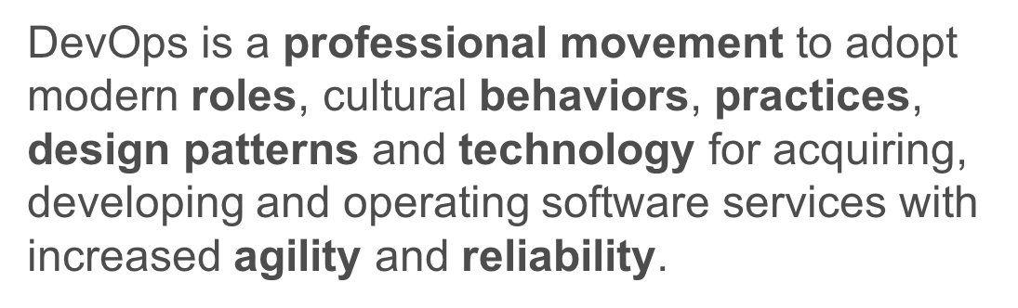

Slide 22
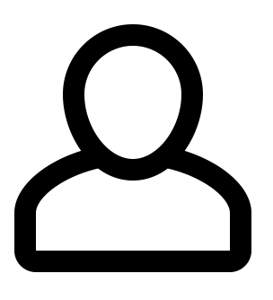
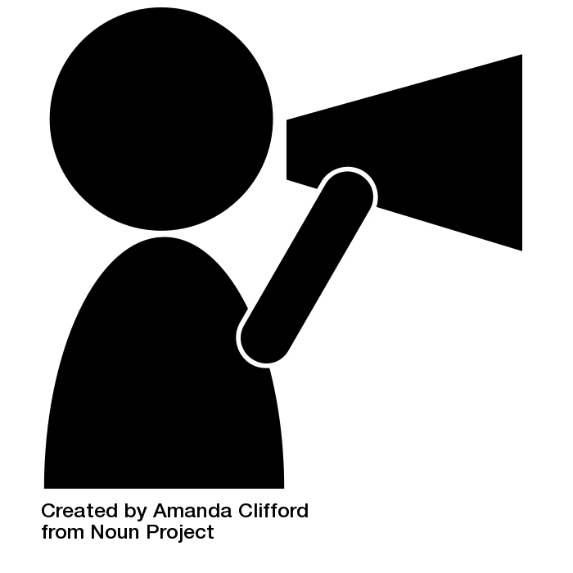
Agile Org Structures
BO/Product
BO/Product
BO/Product
Arch
UI/Mobile
Services
DBA
Deploy
Infrastructure
OPS
Notes:
User by Sergey Demushkin from the Noun Project
Announcement by Amanda Clifford from the Noun Project

Slide 23
Conway’s Law
“Any organization that designs a system (defined broadly) will produce a design whose structure is a copy of the organization's communication structure.”
- Melvin Conway, 1967
http://www.melconway.com/Home/Committees_Paper.html
Notes:
Inverse Conway Maneuver coined by Thoughtworks - http://jonnyleroy.com/2011/02/03/dealing-with-creaky-legacy-platforms/
Goal is to create self contained, business aligned teams with the smallest feedback loop.
Business capability teams interact with platform operations team via APIs and not meetings. This creates a friction free experience for the business capability team who now have the tools to

Slide 24
Inverse Conway Maneuver Enable Continuous Delivery
Product Mgr.
Dev
UX
QA
DBA
Self
Service
APIS
Sys Admin
Network Admin
Storage Admin
Business Capabilities Team Using Microservices
Platform Operations Team
http://jonnyleroy.com/2011/02/03/dealing-with-creaky-legacy-platforms/
http://www.slideshare.net/adriancockcroft/microservices-the-good-bad-and-the-ugly
Notes:
References:
Inverse Conway Maneuver coined by Thoughtworks - http://jonnyleroy.com/2011/02/03/dealing-with-creaky-legacy-platforms/
http://www.slideshare.net/adriancockcroft/microservices-the-good-bad-and-the-ugly
Notes:
Goal is to create self contained, business aligned teams with the smallest feedback loop.
Business capability teams interact with platform operations team via APIs and not meetings. This creates a friction free experience for the business capability team who now have the tools to

Slide 25
Enabling Continuous Delivery
Production Release
ORDERS
Production Release
Production Release
SHIPPING
Production Release

Slide 26
Characteristics of Cloud Native Architectures
Continuously Delivered
DevOps
Twelve Factor Apps (http://12factor.net/)
Microservices
Self-Service agile infrastructure
API-based collaboration
Anti-fragility

Slide 27
It Takes a Platform
An end-to-end platform that makes implementing distributed application best practices, a turn-key and first practice
Notes:
Inverse Conway Maneuver coined by Thoughtworks - http://jonnyleroy.com/2011/02/03/dealing-with-creaky-legacy-platforms/
Goal is to create self contained, business aligned teams with the smallest feedback loop.
Business capability teams interact with platform operations team via APIs and not meetings. This creates a friction free experience for the business capability team who now have the tools to

Slide 28
Characteristics of Cloud Native Architectures
Continuously Delivered
DevOps
Twelve Factor Apps (http://12factor.net/)
Microservices
Self-Service agile infrastructure
API-based collaboration
Anti-fragility

Slide 29
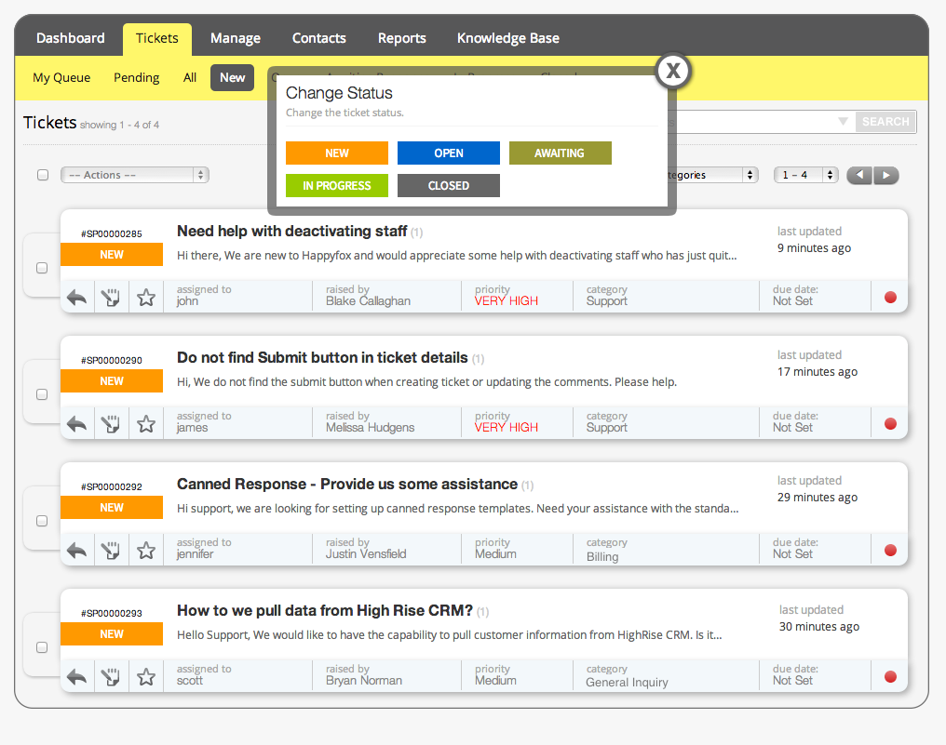

Slide 30
Characteristics of Cloud Native Architectures
Continuously Delivered
DevOps
Twelve Factor Apps (http://12factor.net/)
Microservices
Self-Service agile infrastructure
API-based collaboration
Anti-fragility

Slide 31
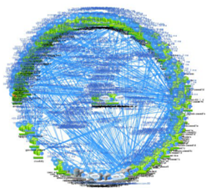
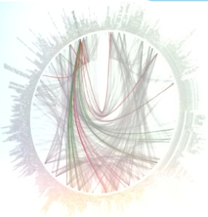


However… Microservices are Hard
Notes:
Distributed systems are HARD
Configuration Management
Service Registration & Discovery
Routing & Load Balancing
Fault Tolerance (Circuit Breakers)
Monitoring
Concurrent API Aggregation & Transformation
----- Meeting Notes (2/24/16 13:58) -----
Dependency Map

Slide 32
Challenges of Distributed Systems
Configuration Management
Service Registration & Discovery
Routing & Load Balancing
Fault Tolerance (Circuit Breakers)
Monitoring and Tracing
Concurrent API Aggregation & Transformation
Notes:
Everybody faces these, SCS takes PCF to the next level

Slide 33
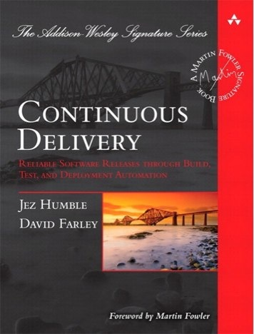
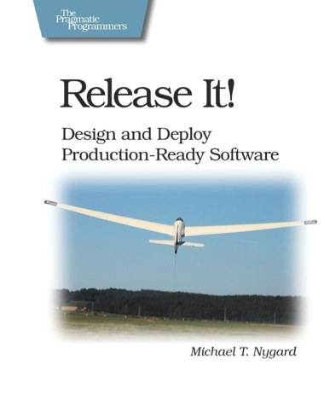
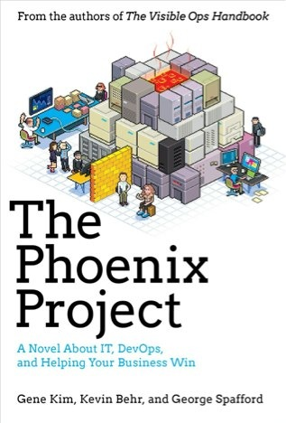
Foundations
Notes:
continuous integration of development changes
one package / many deploys
automation
deploy smaller batches more frequently
automate all testing where test failures would prevent prod release

