Slide 1


Spring Boot

Slide 2
Agenda
Challenges building non-Boot applications
What is Spring Boot?
Capabilities

Slide 3
Agenda
Challenges building non-Boot applications
What is Spring Boot?
Capabilities

Slide 4
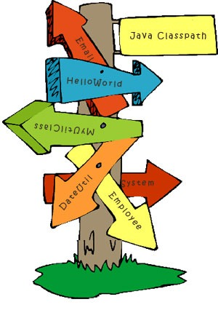
Classpath Hell
A Jar is missing
There is one Jar too many
A class is not visible where it should be

Slide 5
Resolving Classpath Hell
start
Unresolved symbol?
Yes
No
build
Yes
NoClassDefFound?
Read docs/blogs/copy previous project structure
run
Write Code
No
Download jars
Add jars to classpath
end

Slide 6
Setup
Perform setup operations as “root”
Update /etc/hosts with entries for “localhost”
Create a new group (oinstall) and user (oracle)
Create directories in which Oracle will be installed
Add ORACLE_BASE, ORACLE_HOME, MW_HOME, WLS_HOME, WL_HOME, DOMAIN_BASE, DOMAIN_HOME, JAVA_HOME to .bash_profile
Installation
Download the installer
Run the installer as “oracle” user
Choose Inventory Directory and Operating System Group
Choose MIDDLEWARE_HOME
Install
Configuration
Choose a Domain Location
Create a Domain using product templates
Provide administrator credentials
Choose JDK
Configure Admin Server
Configure Node Manager
Configure Managed Servers
Configure Clusters
Complex Application Server Setup
Post Installation
Start WebLogic server
Manage and monitor through an administrator console

Slide 7
Environment Drift
Standard war/ear packaging causes drift across environments
war / ear
war / ear
App Server classpath
App Server classpath
Configuration
Configuration
Dev. Environment
Prod. Environment

Slide 8
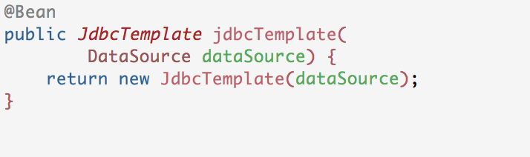
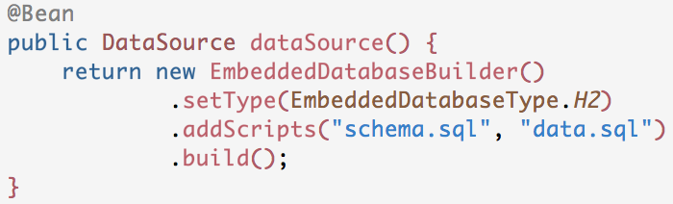
Boilerplate code
Every application that accesses a relational database with JDBC needs to configure a JdbcTemplate and a DataSource

Slide 9
Agenda
Challenges building non-Boot applications
What is Spring Boot?
Capabilities

Slide 10
Spring Boot is an opinionated framework to simplify bootstrapping and development of new Spring Applications
Notes:
Spring Boot is designed to help us build good apps rapidly. A key piece of making this happen is how Boot plugs in its opinions. Boot is not an exclusive concept. There are other opinionated frameworks out there like Play and Dropwizard. Some of these may even leverage Boot under the hood and use features of Boot that are very useful. However, Spring Boot, to it’s credit, makes things trivial for the Developer to say, “No. I don’t agree with you Boot. I know what I’m doing and I’d like to do it my way because I understand my business use case better than you do.” Boot tries to be non-intrusive. i.e. Boot says “Mr Developer, I will only start doing things if you choose not to.” And if the Developer chooses to build his application the way he likes, Boot will happily step aside.
Boot believes the correct way is the easiest way.
While, the Spring Framework makes things simple. Spring Boot takes Spring a step further by making the simplest thing the easiest.

Slide 11
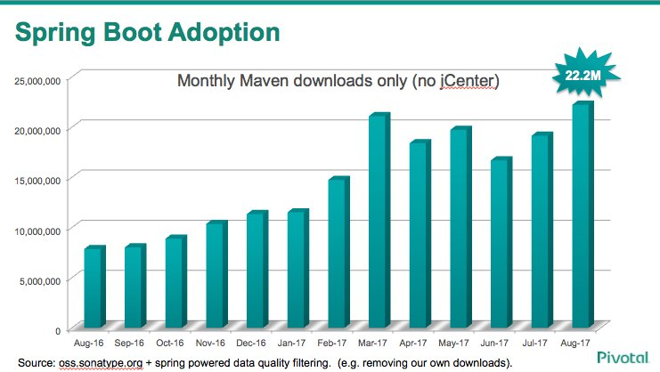
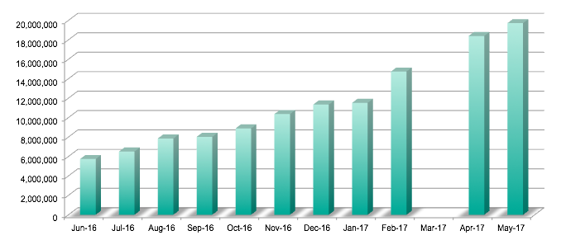
Spring Boot Adoption
19.7M
Monthly Maven downloads
Source: oss.sonatype.org

Slide 12
Agenda
Challenges building non-Boot applications
What is Spring Boot?
Capabilities

Slide 13
Capabilities
Quick start project generation
Automatic project dependency management
Configuration drift prevention
Conditional configuration

Slide 14
Developer Productivity Tooling
Auto-configuration
Monitoring and management endpoints
Microservices-friendliness

Slide 15
Spring Initializr
(Quick start project generation)

Slide 16
Spring Initializr is a configurable service to consistently and easily generate a quick start project

Slide 17
Generates a Spring Boot project structure
Provides a Maven/Gradle build specification
Doesn’t generate application code
You can customize the Spring Initialzr
https://github.com/spring-io/initializr/

Slide 18
Spring Initializr has three supported interfaces

Slide 19
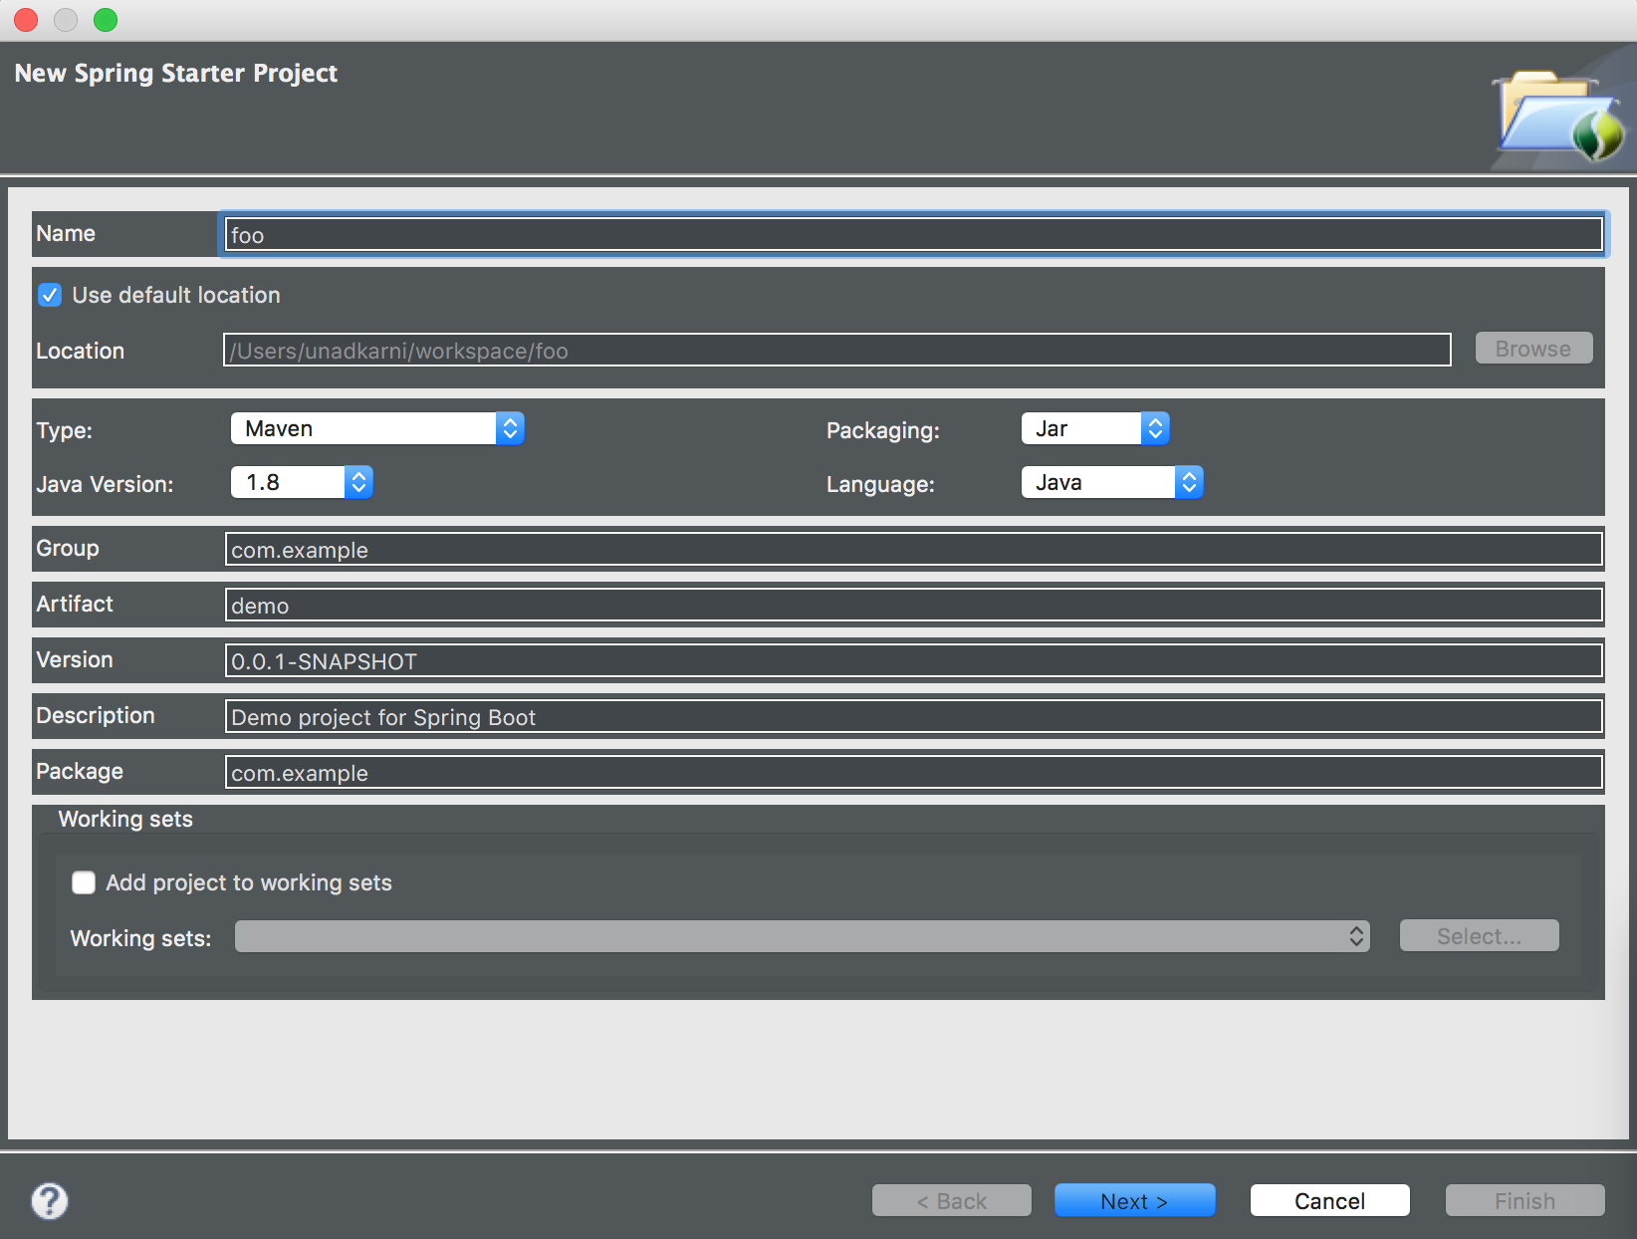
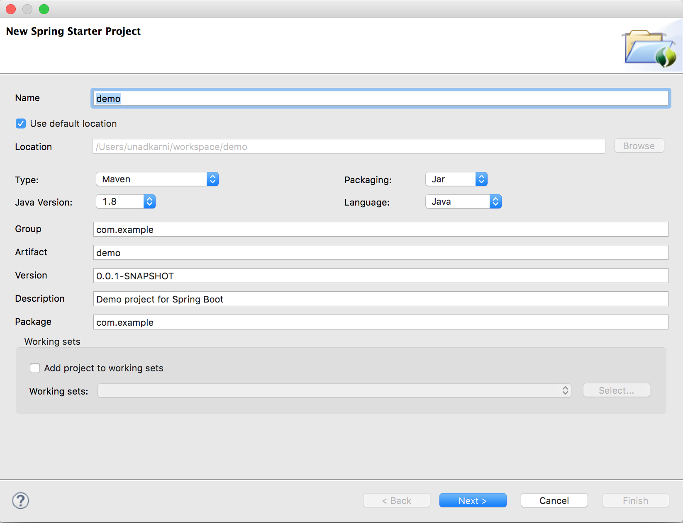
IDE
Eclipse
Intellij

Slide 20
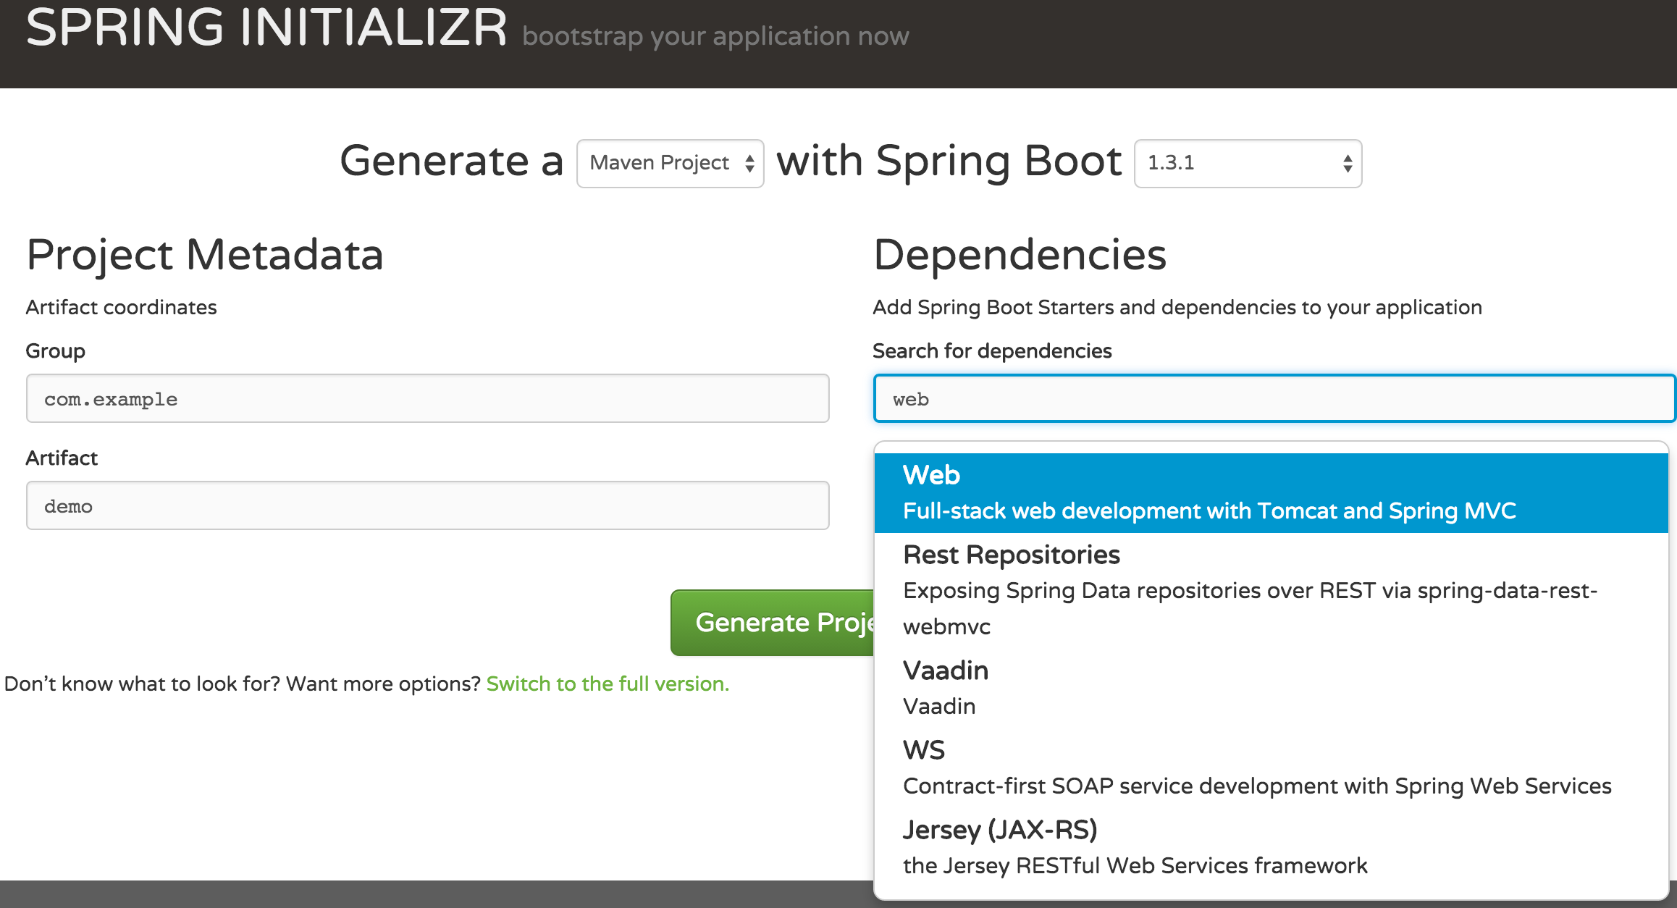
Web-based Interface

Slide 21
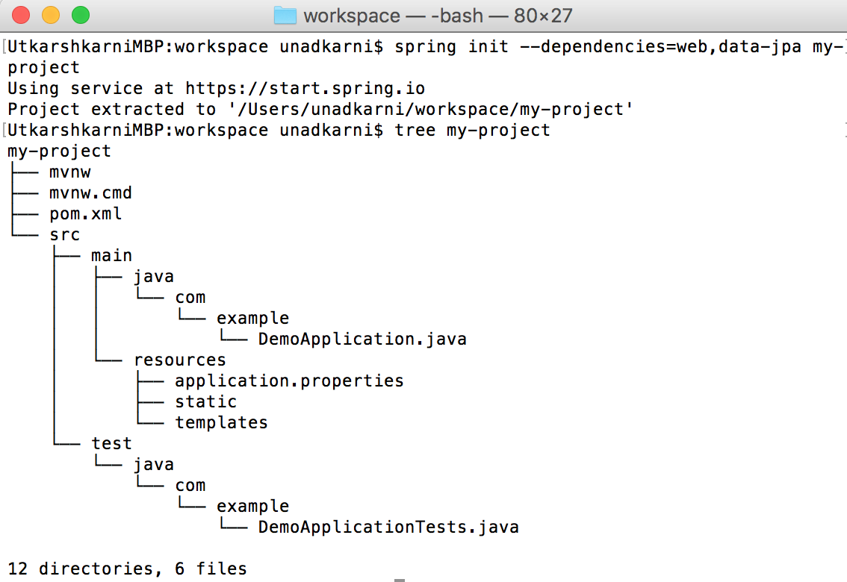
Command Line Interface
Directory structure of Boot Maven project

Slide 22
Spring Boot starters
(Automatic project dependency management)

Slide 23
Are virtual packages deployed to Maven central
They pull in other dependencies while containing no code of their own
spring-boot-starter-web
spring-web
spring-boot-starter-tomcat
spring-boot-starter-validation
spring-webmvc
jackson-databind

Slide 24
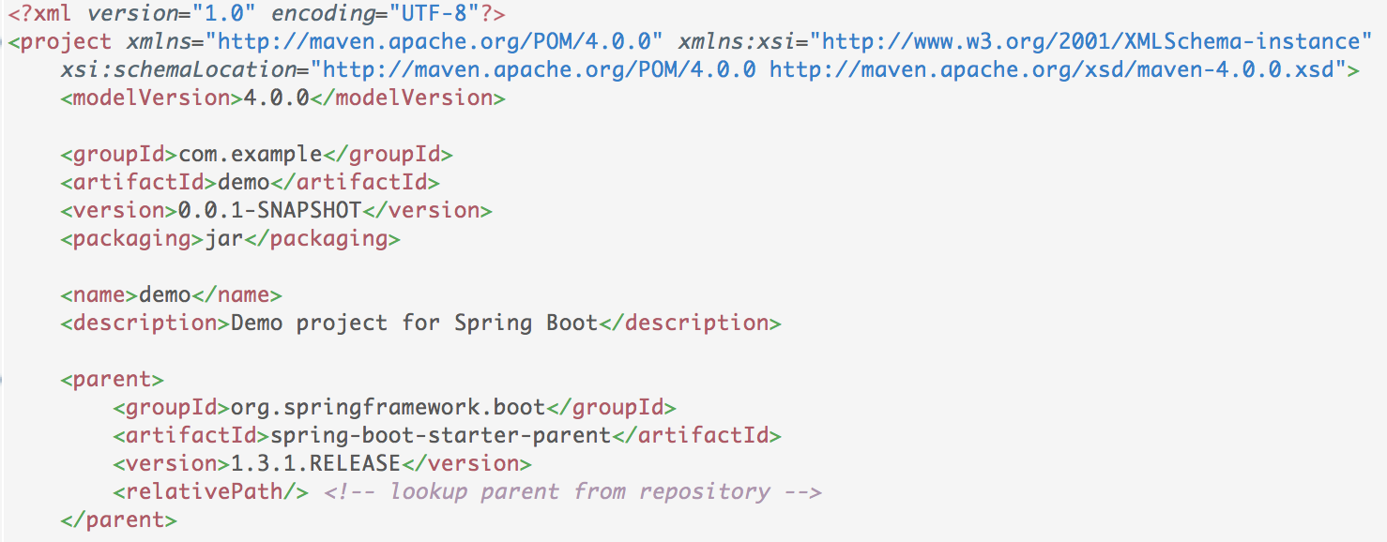
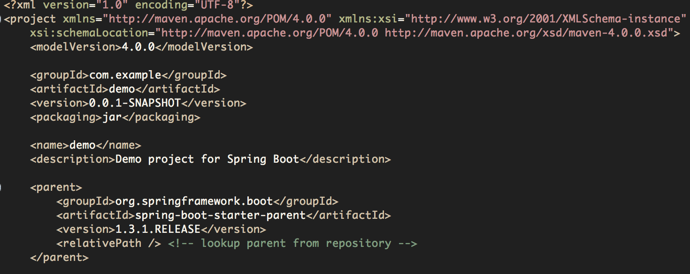
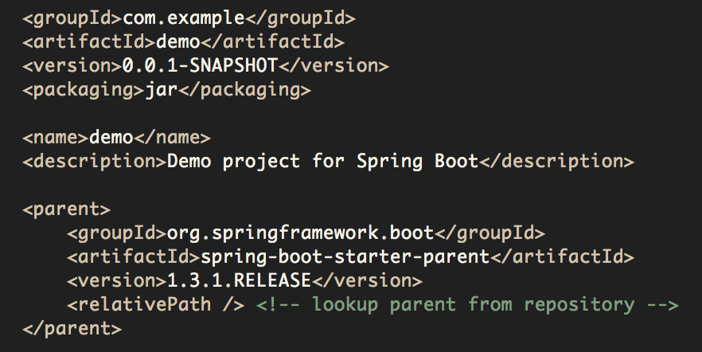
Project pom.xml
Set parent of your pom.xml as spring-boot-starter-parent
Inherit preset version numbers

Slide 25
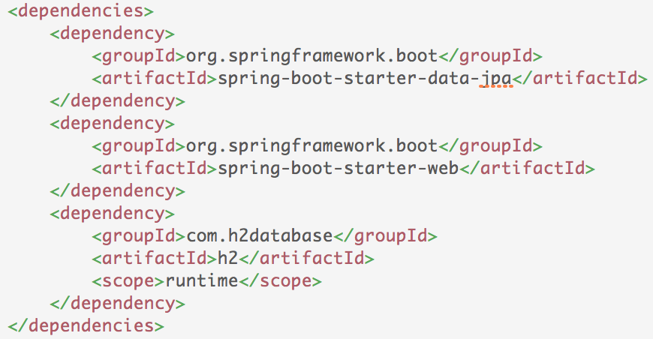
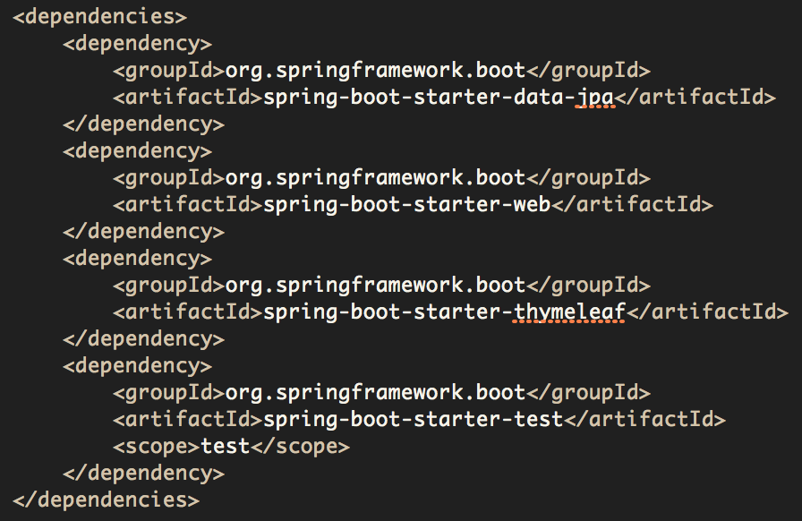
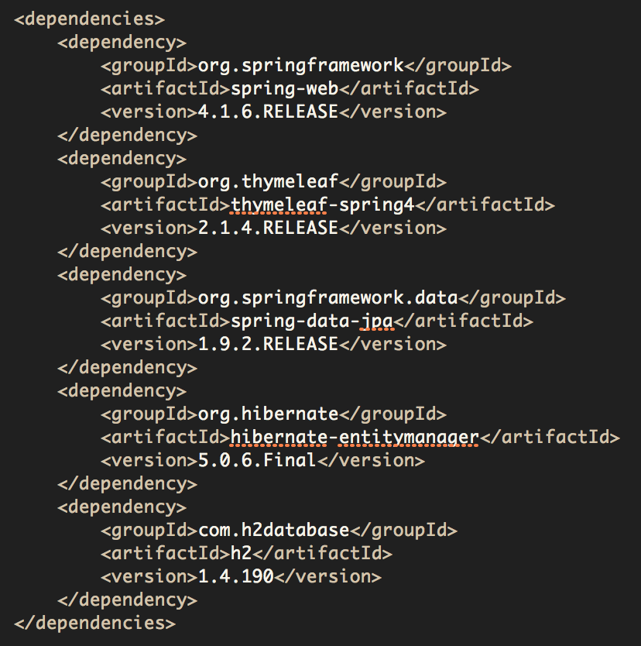
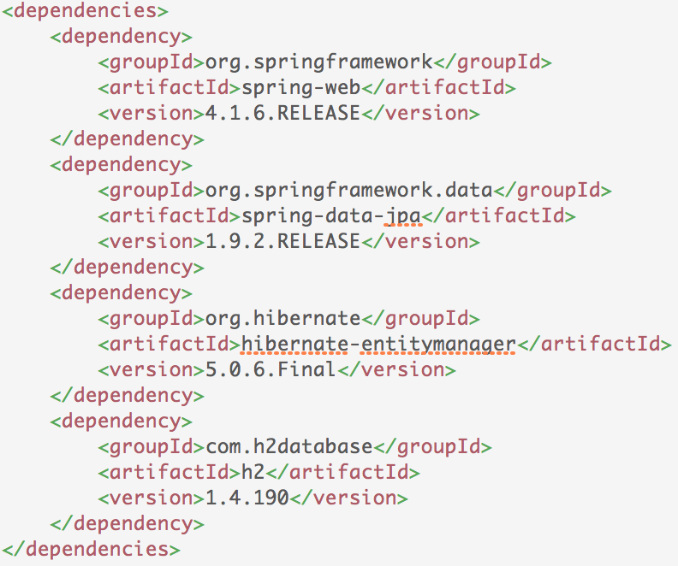
Starters vs Current Practice
Starter versions determined by version of Spring Boot used.
Dependencies guaranteed to be compatible.
Are the version numbers compatible with each other?
Is the list of dependencies complete?
Concise. Boot pom.xml without version numbers.
Verbose. Non-boot pom.xml with version numbers.

Slide 26
Packaging
(Configuration drift prevention)

Slide 27
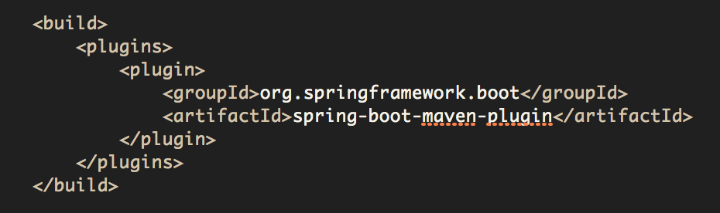
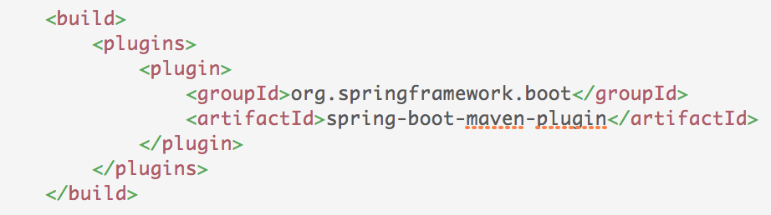



Make Jar not War!
Boot’s Maven / Gradle plugins produce an executable “fat jar”
Embedded Server
Application Code
Dependent Jars

Slide 28

Benefits
No installation of application servers
No setting classpath
Promotes consistency across environments
Can be started as Unix services using
init.d
systemd

Slide 29

Setup
Perform setup operations as “root”
Update /etc/hosts with entries for “localhost”
Create a new group (oinstall) and user (oracle)
Create directories in which Oracle will be installed
Add ORACLE_BASE, ORACLE_HOME, MW_HOME, WLS_HOME, WL_HOME, DOMAIN_BASE, DOMAIN_HOME, JAVA_HOME to .bash_profile
Installation
Download the installer
Run the installer as “oracle” user
Choose Inventory Directory and Operating System Group
Choose MIDDLEWARE_HOME
Install
Configuration
Choose a Domain Location
Create a Domain using product templates
Provide administrator credentials
Choose JDK
Configure Admin Server
Configure Node Manager
Configure Managed Servers
Configure Clusters
The Traditional JEE App Server is Dead!
Post Installation
Start WebLogic server
Manage and monitor through an administrator console

Slide 30
Profiles
(Conditional configuration)

Slide 31
Segregate parts of the application configuration and make it available in certain environments via
Annotations
Properties file

Slide 32
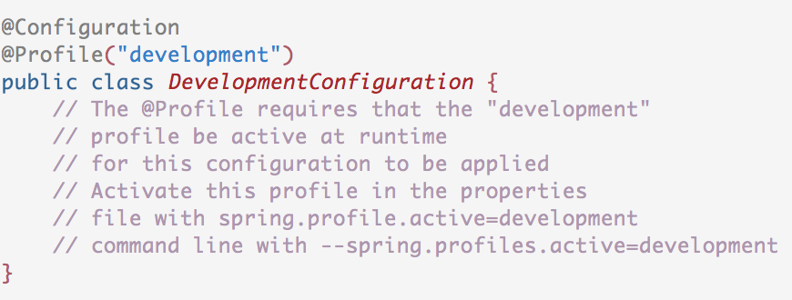
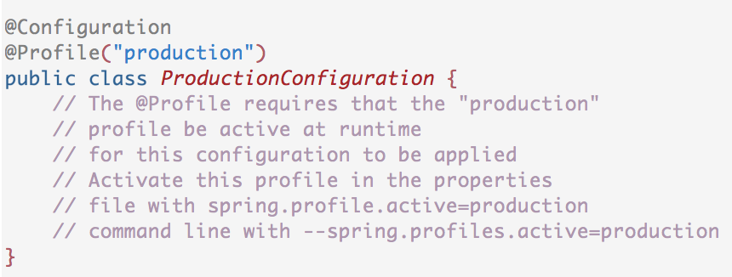
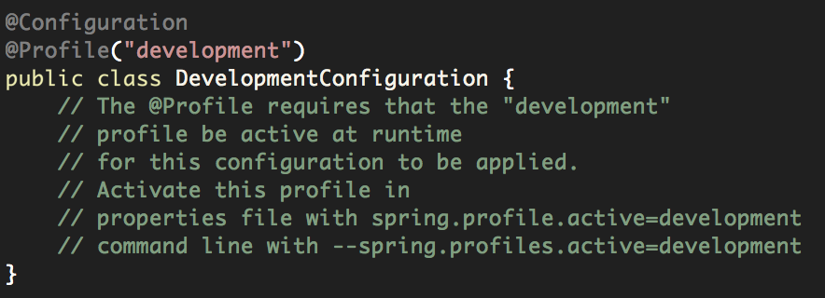
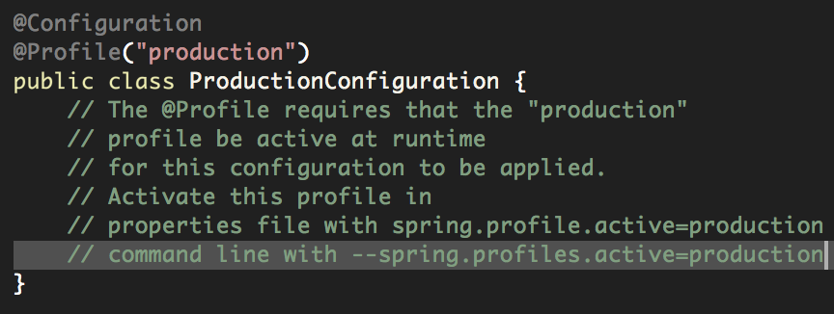
Mark @Component or @Configuration with @Profile to limit when it is loaded.

Slide 33
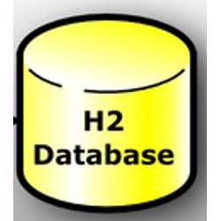
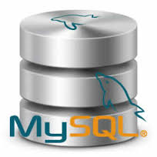
Checkout code from source control
Active config
Build an executable jar
Dev. Configuration
Dev. Configuration
Active config
Configuration activated based on active profile
Check out code from a Version Control System
Prod. Configuration
Prod. Configuration
Prod. Configuration
Deploy anywhere
Boot Application
It Just Works!
Boot Application
No Code Changes
No Configuration Changes
Dev. Environment
Prod. Environment

Slide 34
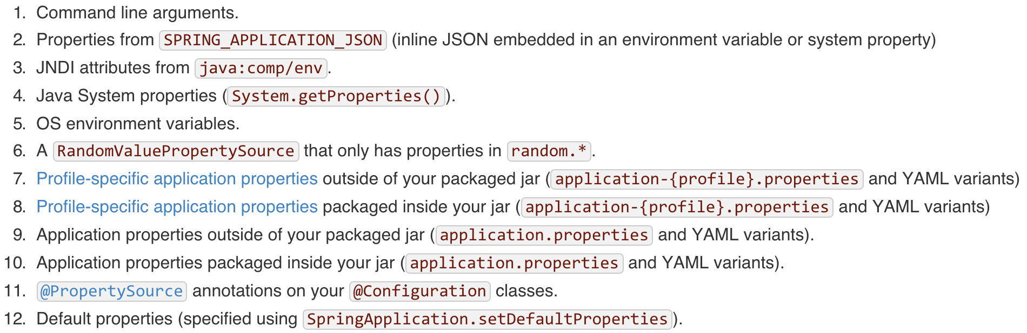
Precedence of externalized configuration

Slide 35
Developer Tools
(Developer Productivity Tools)

Slide 36
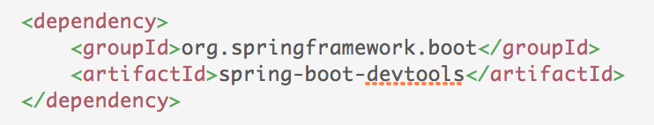
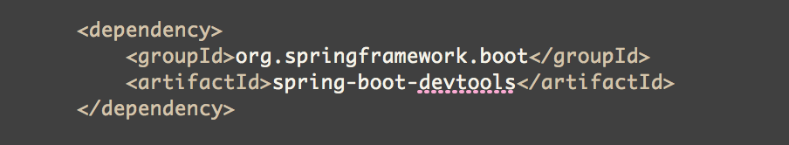
Automatic restart
LiveReload

Slide 37
Automatic Restart
Restarts a running application when files are changed in the classpath
Excludes static resources from restart considerations
/META-INF/resources
/resources
/static
/public
/templates

Slide 38

LiveReload support
Install the LiveReload plugin into your browser
Boot starts an embedded LiveReload server
Changes to resources trigger a browser refresh automatically

Slide 39
Auto-Configuration

Slide 40



Auto-Configuration
Automatically configures application based on the classpath
You have H2 in the classpath
You have Thymeleaf in the classpath
Application Context
H2 datasource
Jdbc
Template
template resolver
view resolver
template engine
You don’t have database connection beans configured manually
Let me auto-configure a Thymeleaf template resolver, view resolver, and template engine
Application Code
Let me auto-configure H2 datasource and JdbcTemplate
classpath
jars

Slide 41
Explicitly exclude Auto-Configuration
You have H2 in your classpath
You have Thymeleaf in your classpath
Application Context
template resolver
view resolver
template engine
You want to explicitly exclude auto-configuration of the DataSoure
Let me auto-configure a Thymeleaf template resolver, view resolver, and template engine
Application Code
@EnableAutoConfiguration(exclude=
{DataSourceAutoConfiguration.class})
I’ll step aside.
classpath

Slide 42
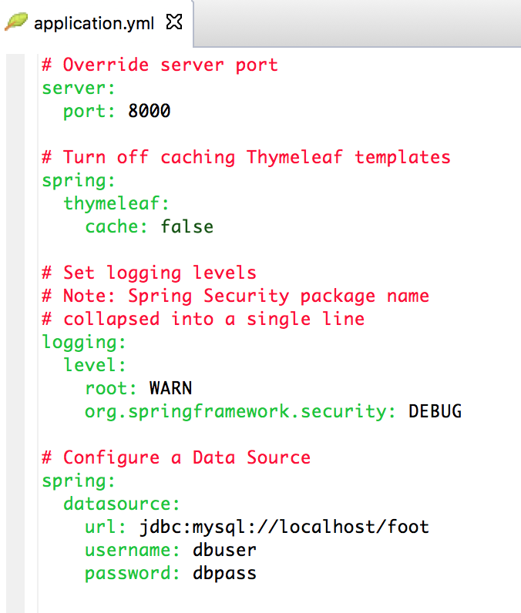
Fine Tuning Auto-Configuration
Over 300 properties to tweak beans in a Boot application via
Command line arguments
Environment variables
.properties / .yml file

Slide 43
Actuator
(Monitoring & Management Endpoints)

Slide 44
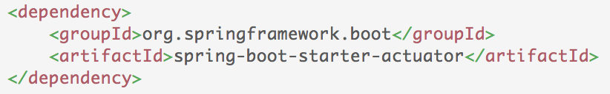
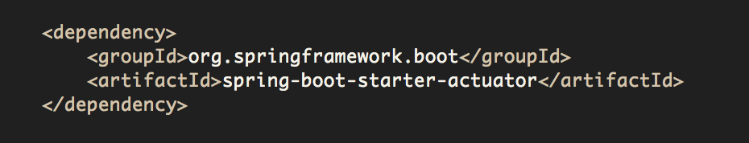
Offers production-ready features such as monitoring and metrics to improve operator efficiency

Slide 45
Actuator Services are exposed through
HTTP endpoints
shell interface
JMX Beans
REST endpoint (Spring MVC App)
shell interface
JMX
beans
Spring Boot Application
Actuator

Slide 46
Types of Actuator Endpoints
Configuration
/beans
/autoconfig
/env
/configprops
/controller
Metrics
/metrics
/trace
/dump
Miscellaneous
/shutdown
/info

Slide 47
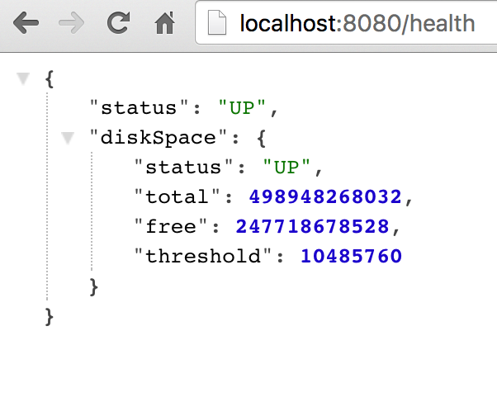
/health
Reports health metrics for the application
Each check returns a Health object
status
UP
DOWN
UNKONWN
OUT_OF_SERVICE
Plugin your own health definitions

Slide 48
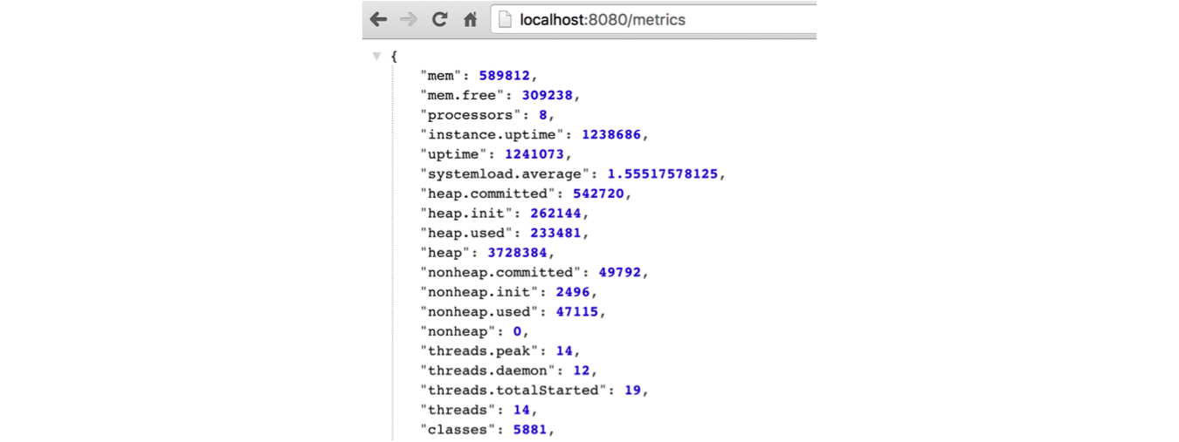
/metrics
Reports application metrics such as
Memory usage and
HTTP request counters

Slide 49
Microservices
(Microservices-friendliness)

Slide 50
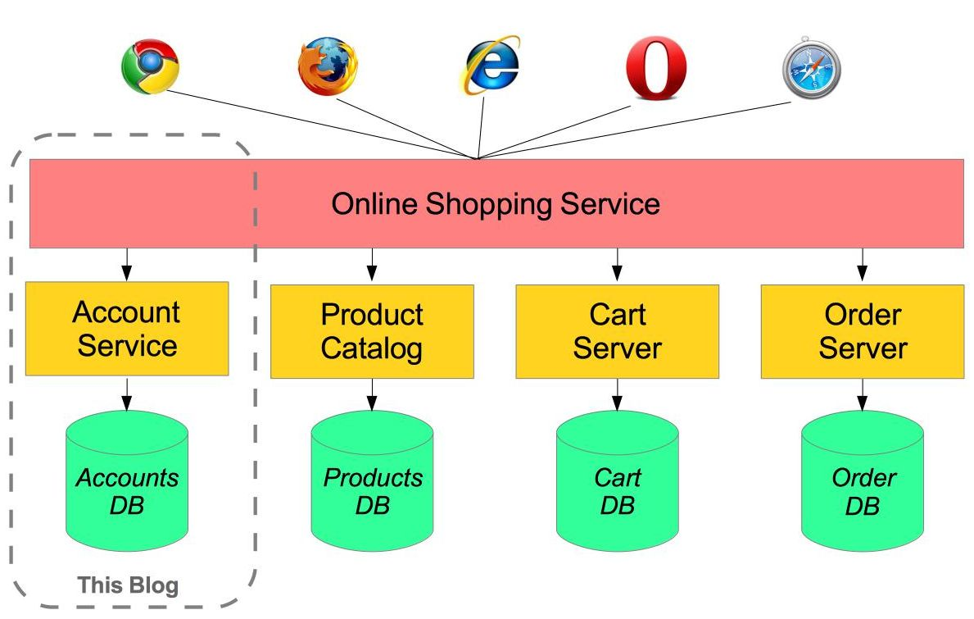
Each microservice is a Spring Boot fat jar
Microservice

Slide 51
Microservices
You are going to do a lot more of this
Declare dependencies
Configure (logging, datastores, etc)
Load properties files
Setup Monitoring / Metrics

Slide 52
Spring Boot and PCF
(Actuator Health Checks in PCF Apps Manager)

Slide 53
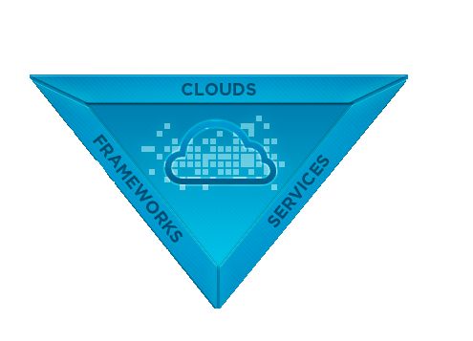
























The Open Platform as a Service
CUSTOM SERVICES

Slide 54
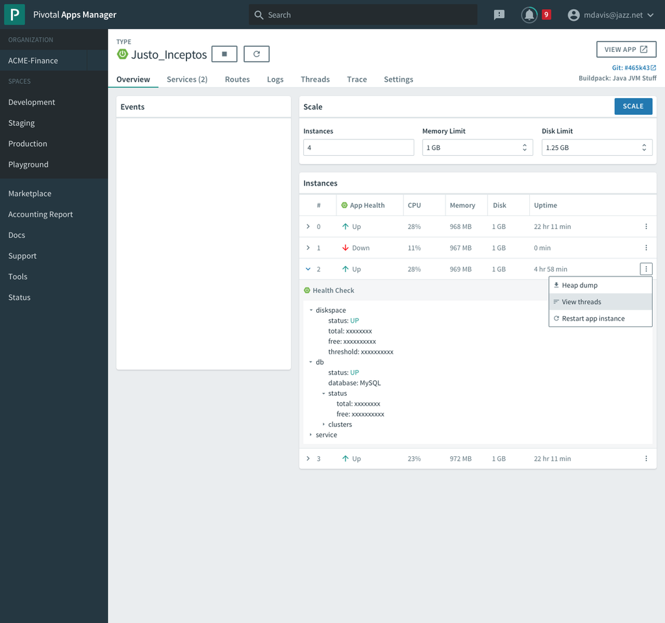
Notes:
Here’s a proposed UI for displaying the Health Metrics from the Actuator endpoint into PCF’s Apps Manager

Slide 55
Thank You

