Slide 1


Cloud Native Applications
Polyglot Persistence with Spring Data
Notes:
Resting slide on screen before you begin presenting.

Slide 2
Spring Data
Provides a familiar and consistent, Spring-based programming model for data access while still retaining the special traits of the underlying data store.
It makes it easy to use data access technologies, relational and non-relational databases, map-reduce frameworks, and cloud-based data services.

Slide 3
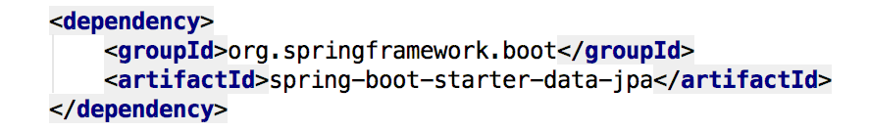
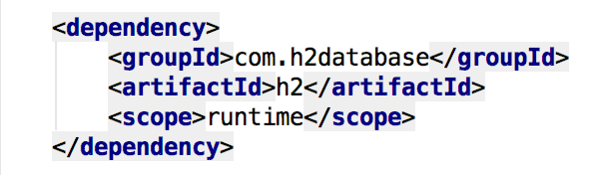

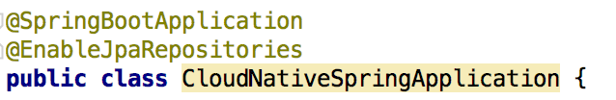
Spring Data JPA
Add the Spring Data JPA starter to our pom.xml file
Sprinkle a database connector into our pom.xml
Sprinkle a little @EnableJpaRepositories annotation into our Spring Boot application

Slide 4
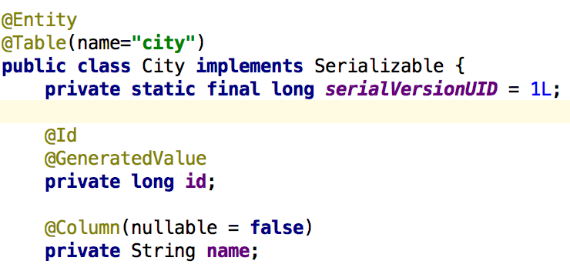
Spring Data JPA, @Entity & Repository
Let’s create an @Entity to manage
Let’s create a JPA Repository to manage our @Entity

Slide 5
Supported Repositories
Spring
JPA
MongoDB
Redis
Solr
GemFire
KeyValue
Community
Aerospike
Cassandra
Couchbase
DynamoDB
ElasticSearch
Neo4J

Slide 6

Lab

