Slide 1
Pivotal Cloud Foundry

Slide 2



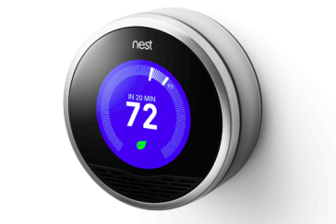


Software is Changing Industries
$6B valuation
Financial Services
$40B valuation
Transportation
$20B valuation
Entertainment
$13B valuation
Travel & Hospitality
$3.2B Acquisition by Google
Home Automation
$26B Evaluation
Automotive

Slide 3
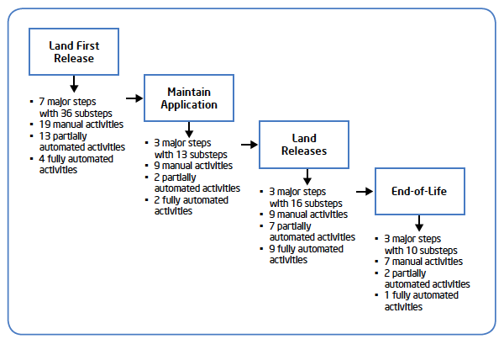


Traditional App Lifecycle: Too Lengthy and Complex
Traditional App Deployment:
8+ manual steps, developers out of the workflow
Traditional App Lifecycle:
Each phase compounds time and complexity, sacrificing agility
Developer
Operators
Request Servers
Wait for hardware/VM creation
3-7 major steps
7-19 manual activities
2-13 partially automated acts
2-9 fully automated activities
Setup Operating System
Install Software
Setup monitoring
Deploy website
Check / Test
Add to Load Balancer
...

Slide 4
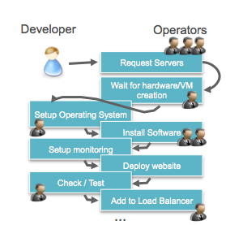
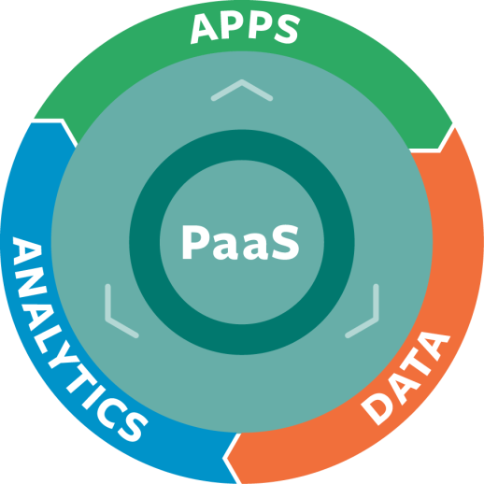
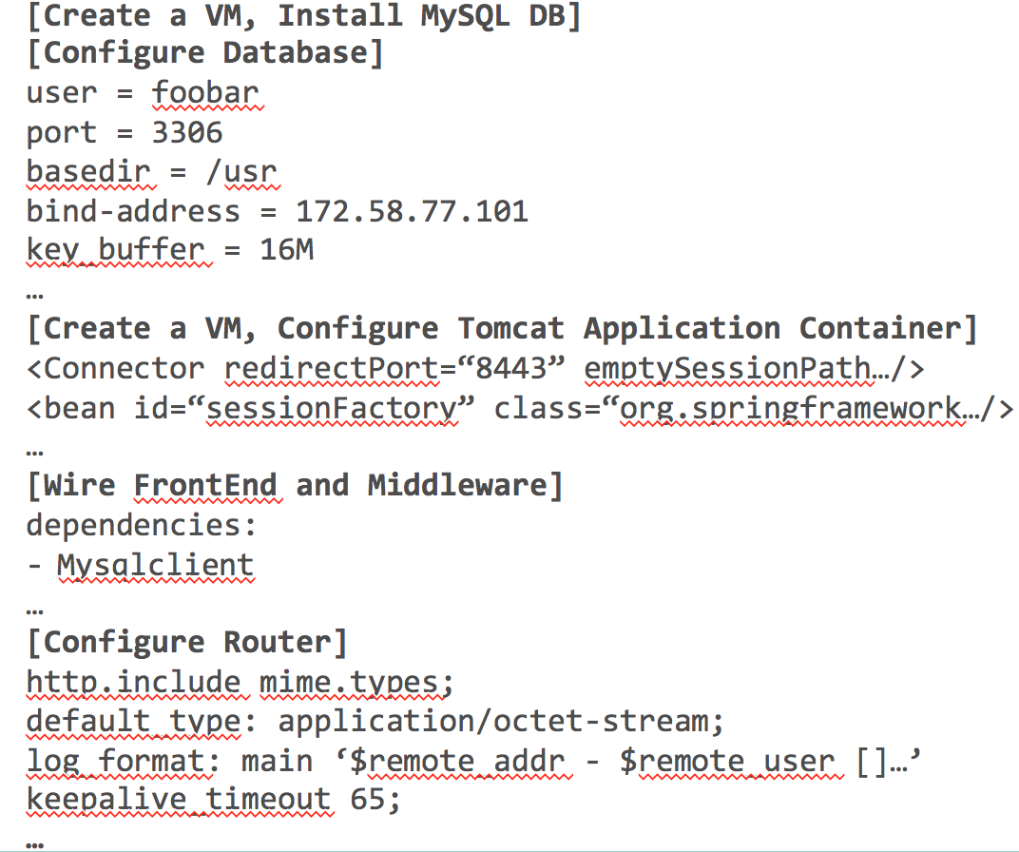
10x+ Increase in Speed and Agility
Old World:
App Deployment in Days/Hours
Pivotal CF:
App Deployment in Minutes/Seconds
App deployment waits for 8+ manual steps
Target <cloud>
Push <app>
IT configures complex middleware
1-Click to Scale

Slide 5
The Power of PaaS (On Premise & Off Premise)
Business Value, Agility & Cost Savings
Traditional IT
IaaS
PaaS
You Manage
Applications
You Manage
Applications
Applications
Data
Data
Data
You Manage
Runtime
Runtime
Runtime
Middleware
Middleware
Middleware
Pivotal CF
+
Choice of IaaS
O/S
O/S
O/S
Virtualization
Virtualization
Virtualization
Servers
Servers
IaaS
Servers
Storage
Storage
Storage
Networking
Networking
Networking

Slide 6

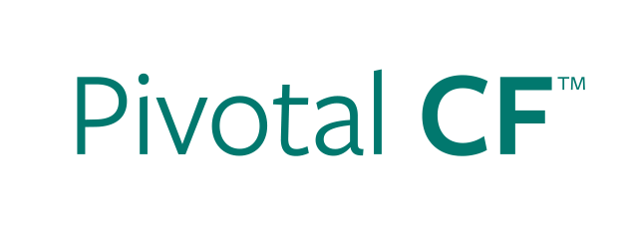
Deploy An Application
Provision VM
Install Application Runtime
Deploy Application
Configure Load Balancer
Configure SSL Termination
Configure Service Connectivity
cf push

Slide 7

























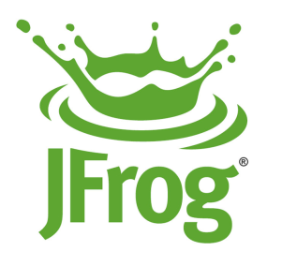






The Cloud Foundry Foundation
Platinum members
Gold members
Silver members

Slide 8















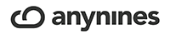

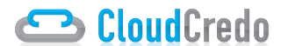

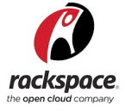












Largest Open PaaS Ecosystem (100k+ downloads)
Notes:
There’s also an ecosystem of service providers, service creators, hosting providers.

Slide 9


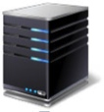




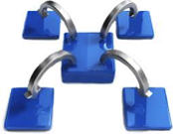





Pivotal CF: Cloud-Independent Enterprise PaaS
Simple, Developer Friendly Commands & API
Operational Benefits for Every Application
Broad Choice of Services
Runtimes
App Health Management, Load Balancing & High Availability
Mobile Services
Web Server and App Server Configuration
Data Services
Middleware Components
Policy, Identity and Roles Management
Platform Services
Deploy, Operate, Update & Scale with minimal downtime on Any IaaS
Notes:
Building the Pivotal CF story via animation
Developer experience - where we started from and keep improving
Operation benefits - When we started selling to enterprise customer beyond a cloud service, both at the Cloud Ops and Application Ops level
3 groups of build-in services (Pivotal and ecosystem) – Apps, Data/Analytics & Mobile. All Services are both deployed in a consistent / cloud in depended way by Cloud Ops and exposed to App Developer for easy binding to applications via the ERS marketplace
All 3 pillars (Dev, Ops, Services) enjoy a common operational, continuous delivery and scale on any IaaS without app/service code of config changes

Slide 10












Elastic Runtime High Level Architecture
Pivotal CF Elastic Runtime
Turnkey, fully automated Platform-as-a-Service
Scalable runtime environment, extensible to most modern frameworks and languages running on Linux
Instant expansion or upgrade with no downtime
Deploy, scale and manage applications with bindable services using simplified semantics and APIs
Dynamic Router
ROUTING
OAuth 2.0 Server (UAA)
Login Server
AUTHENTICATION
Cloud Controller
Health Manager
APP LIFECYCLE
Message Bus(NATS)
MESSAGING
Service Brokers
Application Execution (DEA)
Blob Store
APP STORAGE
& EXECUTION
Warden
Build Packs
Sys Log
Collector
App Log
METRICS & LOGGING
Pivotal CF OpsManager
Notes:
Some people suggest explaining each block in couple of sentences and emphasize our IP. I [Cornelia Davis] don’t feel there is value in that here. I use this as a transition to say “the elastic runtime deployed a cluster of VMs – each of the green boxes is one, usually deployed in duplicates – and BOSH/Pivotal CF OpsManager is what we will talk about now…

Slide 11
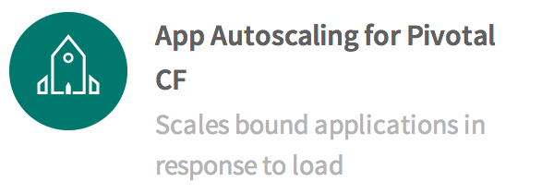
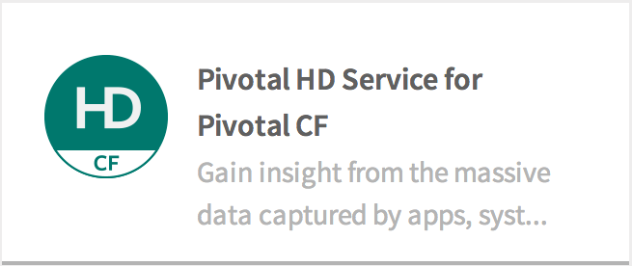
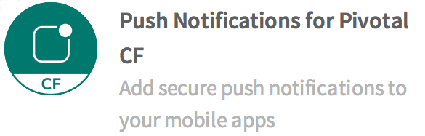

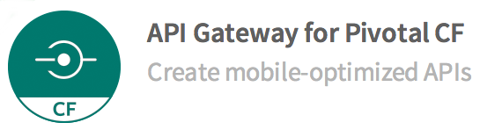
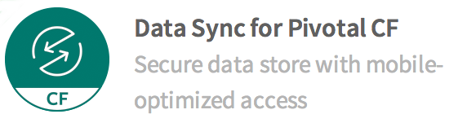
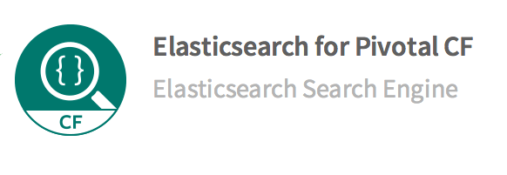
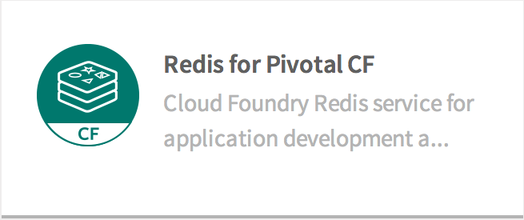
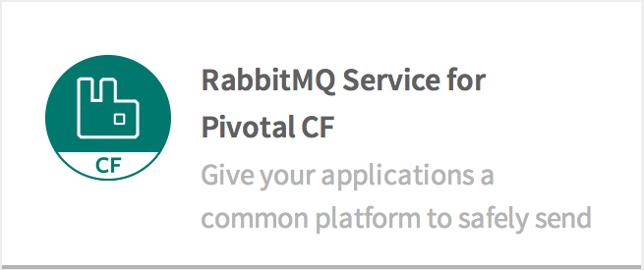
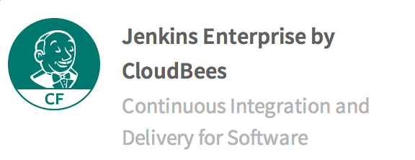
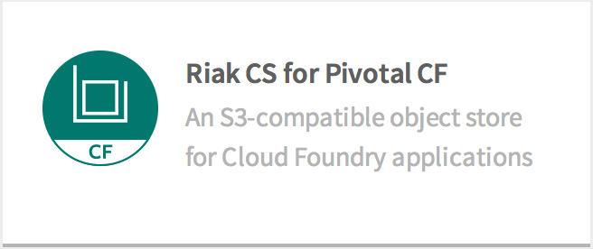
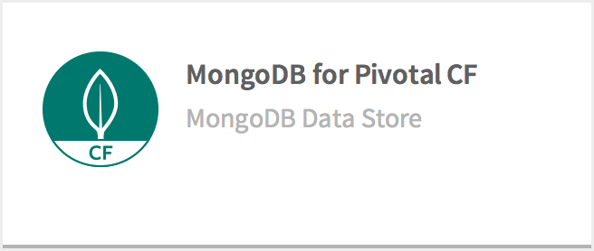
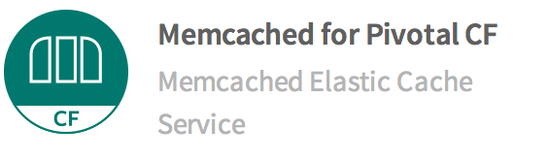
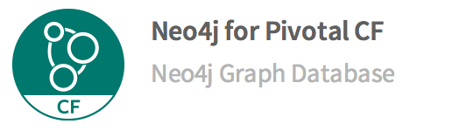
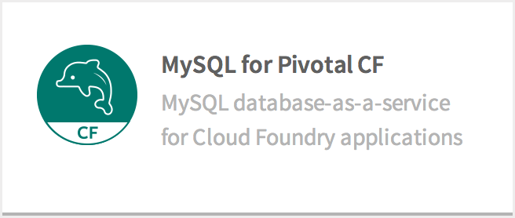
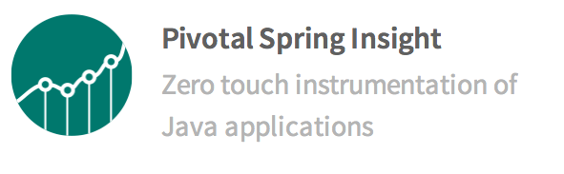
Pivotal CF Services

Slide 12
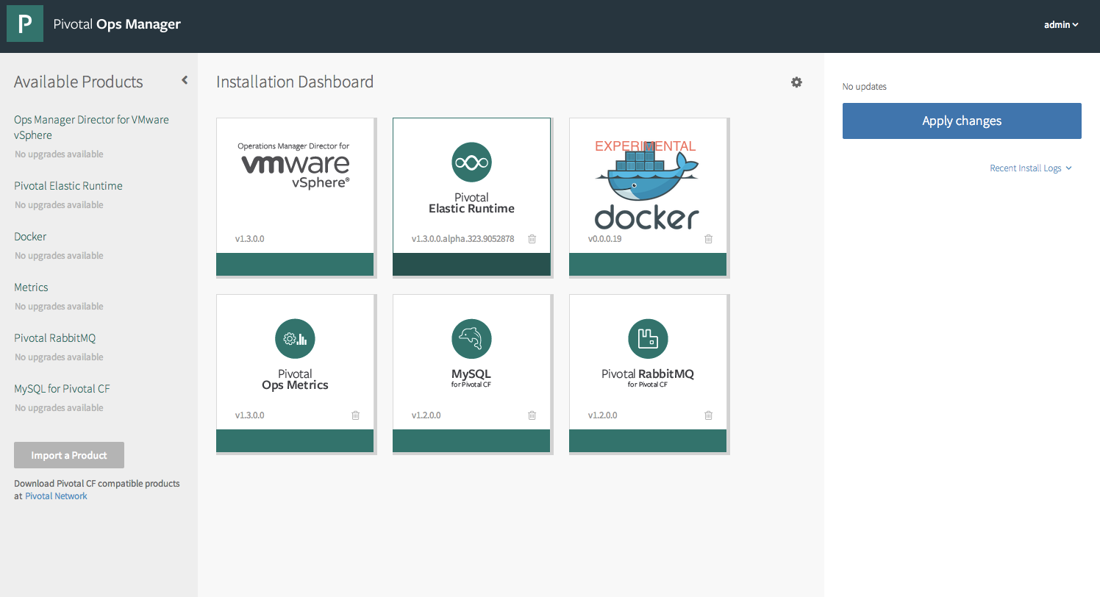
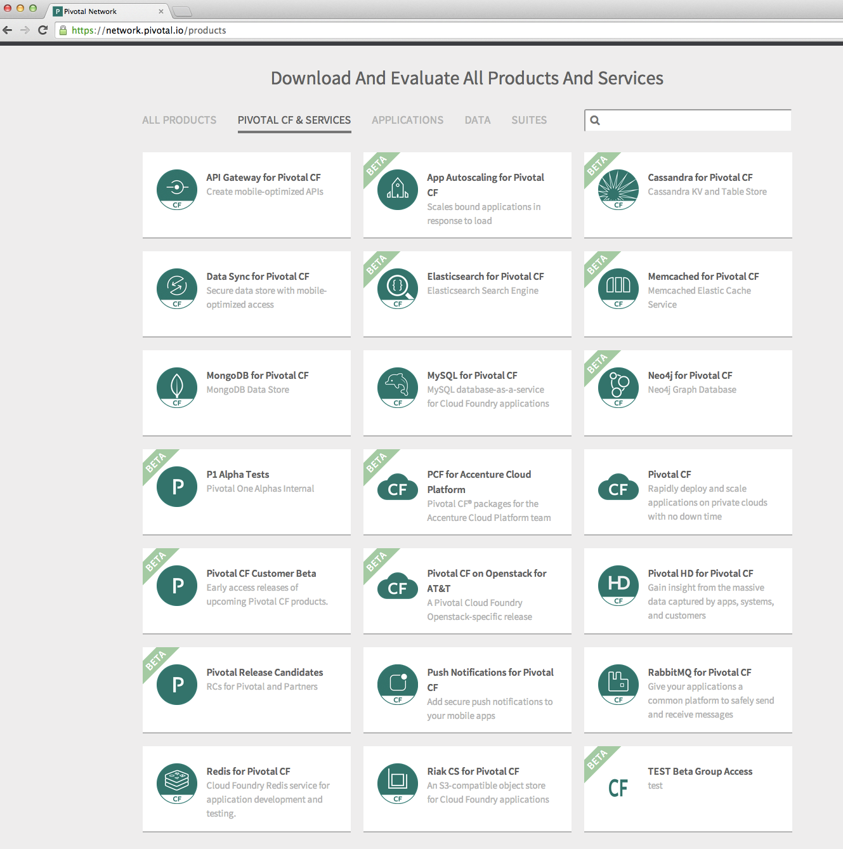
Pivotal Ops Manager

