Slide 1
Spring Boot

Slide 2
1. Application Framework
Frameworks To Support Cloud Native
Spring
#1 Enterprise Java App Framework
Netflix
Open Source
Spring Boot
Quick Start
Little to no config
Opinionated View
Spring Cloud
Distributed Config
Service Registration and Discovery
Routing/Load Balancing
Service Integration
Fault Tolerance
Notes:
#1 Enterprise Java App Dev Framework
Used heavily by Netflix and F2000
OSS, Apache 2.0 licensed
Millions of downloads
Integrated into PCF, BDS

Slide 3
Spring Boot
An opinionated view of Spring
A tool for getting started very quickly with Spring
A single point of focus (instead of the collection of spring-* projects)
Common non-functional requirements for a “real” application
Exposes a lot of useful features by default
Gets out of the way quickly if you want to change the defaults
http://projects.spring.io/spring-boot/
Notes:
Opinionated - for instance, conventional locations for common configuration files, and endpoints for common management and monitoring tasks.

Slide 4
Some Things Spring Boot Addresses
Web App Development
Auto-configuration
External configuration
Profiles
Logging
Monitoring & management
Notes:
Web apps – embedded web server and Spring MVC
Auto Config - For example, if HSQLDB is in the classpath, and there are no manually configured database connection beans, Spring Boot will auto configure an in memory database.
Monitoring & management – Spring Boot Actuator

Slide 5
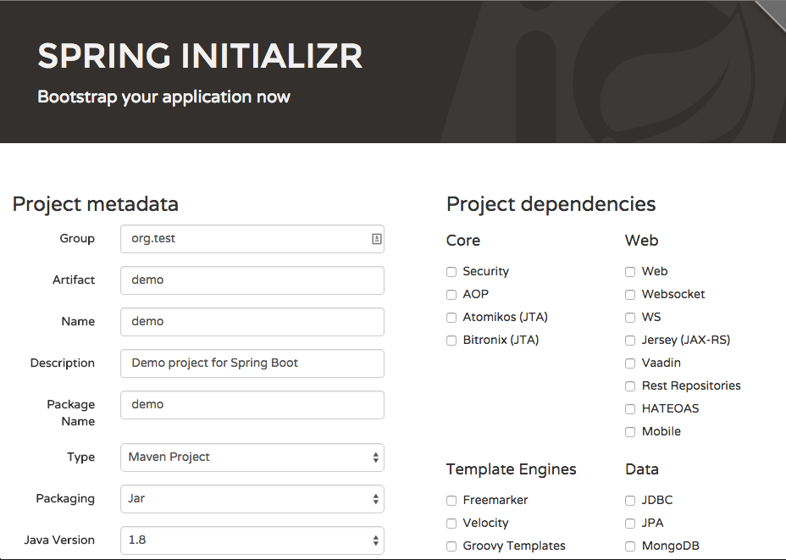
http://start.spring.io

