Slide 1
Spring Cloud Services on Pivotal Cloud Foundry

Slide 2
1. Application Framework
Frameworks To Support Cloud Native
Spring
#1 Enterprise Java App Framework
Netflix
Open Source
Spring Boot
Quick Start
Little to no config
Opinionated View
Spring Cloud
Distributed Config
Service Registration and Discovery
Routing/Load Balancing
Service Integration
Fault Tolerance
Notes:
#1 Enterprise Java App Dev Framework
Used heavily by Netflix and F2000
OSS, Apache 2.0 licensed
Millions of downloads
Integrated into PCF, BDS

Slide 3
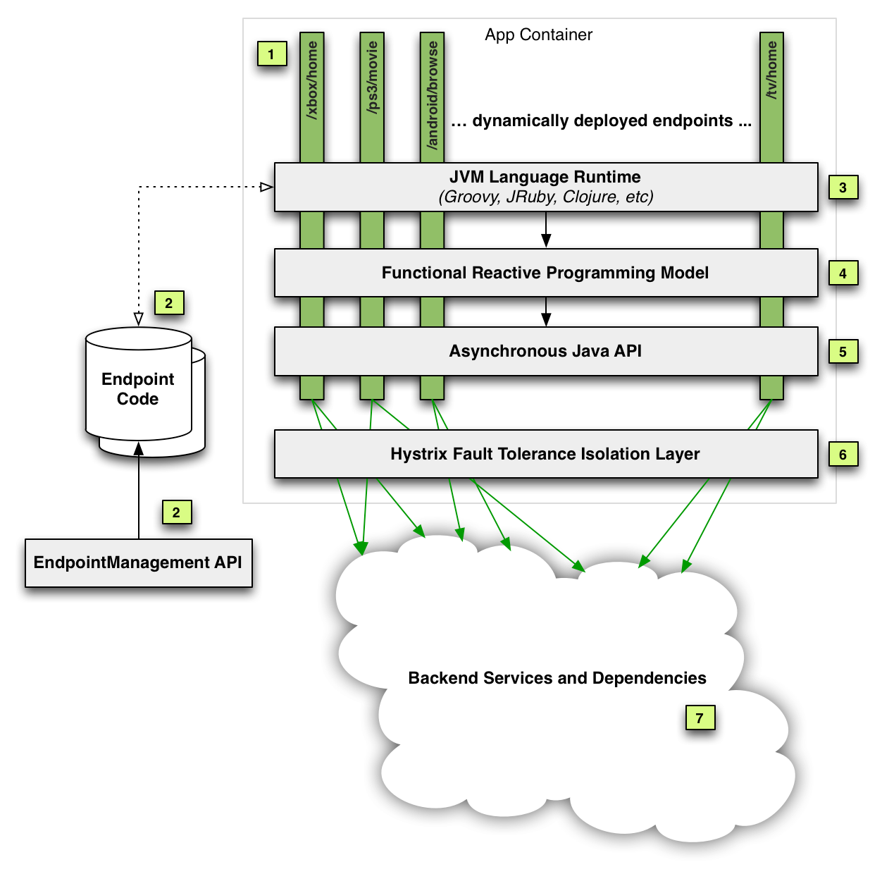
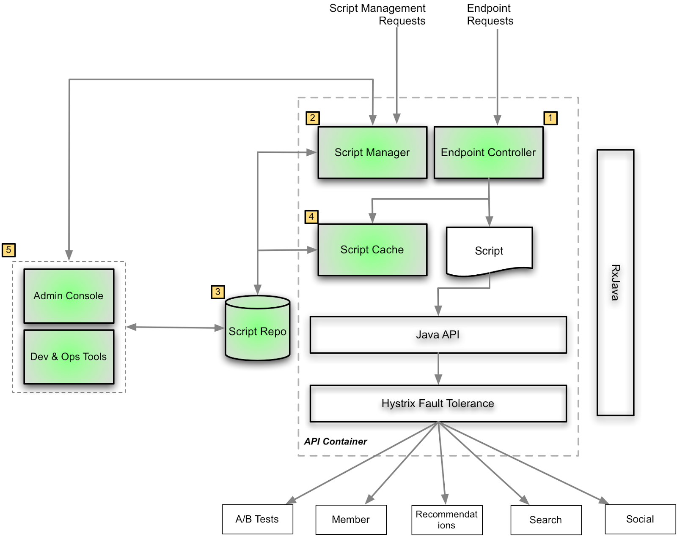
Netflix Invented A Lot Of Hard Stuff
http://techblog.netflix.com/2013/01/optimizing-netflix-api.html
http://techblog.netflix.com/2015/03/the-netflix-dynamic-scripting-platform.html
Notes:
Remember, when they started, IaaS was all they had. They had to invent PaaS + Microservice infrastructure at app layer before.
Left is logical arch for edge services @ netlflix (green bars are device types with)
On right is the physical platform deployables to support that architecture – the PaaS
Can’t just take some VMs and deploy this stuff atop azure or aws.
Netflix didn’t OSS the analytics, monitoring That’s the secret sauce. They are slowly open sourcing more (project Atlas) but that’s still not a complete solution.

Slide 4

Spring Cloud Netflix
Eureka (Service Discovery)
Hystrix + Turbine (Circuit Breaker)
Ribbon (Load Balancer)
Feign (REST Client)
Zuul (Gateway/Proxy)

Slide 5
Spring Cloud And Netflix OSS
Tools to solve common problems in distributed systems
Spring Cloud Config Server (distributed configuration)
Eureka (service registration and discovery)
Hystrix (circuit breaker/fault tolerance library)
Hystrix Dashboard (service health dashboard)
Ribbon (client side load balancing, including RestTemplate integration)
Feign (easy REST clients)
Zuul (routing & server side load balancing)
Spring Cloud Bus (distributed Spring Boot actuator)
Spring Cloud Security
http://projects.spring.io/spring-cloud
Notes:
Zuul is “a JVM based router and server side load balancer” – can also create Zuul filters.
Archaius has its own set of configuration files and loading priorities; Spring applications should generally not use it directly. Spring Environment Bridge allows Archaius to read properties from Spring Environment.
Spring Cloud Bus links nodes of a distributed system with a lightweight message broker. This can be used to broadcast config changes or other management instructions. It’s like a distribtuted Actuator for Spring Boot apps that is scaled out, but can also be used as a communication channel between apps. AMQP is the only currently supported transport.
Turbine aggregates all relevant hystrix endpoints for use in the Hystrix Dashboard.
Ribbon algorithms include: simple round robin, weighted response time, zone aware round robin, random

Slide 6

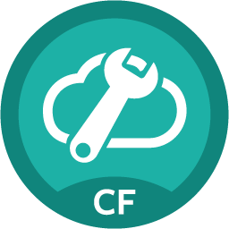

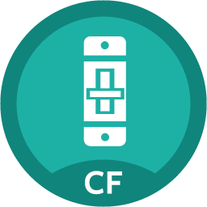
Spring Cloud Services Components
Spring Cloud Services
Config Server
Service Registry
Circuit Breaker
Dashboard
Notes:
Dependencies of Spring Cloud Services – MySQL and RabbitMQ
This is stuff we have tiles for
Ribbon and Hystrix are really client libraries – hence no tile.
This is what’s in the box for 1.0 –
Service Registry: Eureka (not any others, need something that “just works” for devs
Config Server – can use SVN, Git
Circuit Breaker – Hystrix Dashboard + turbine.

Slide 7
Spring Cloud Services Overview
Enabling µServices on the World’s Leading Spring Platform: Pivotal Cloud Foundry
CONFIG
SERVER
Externalized application configuration management to easily manage external properties for applications across all environments
SERVICE
REGISTRY
Enable service discoverability for applications running in a Pivotal Cloud Foundry environment
CIRCUIT
BREAKER
Spring applications running in PCF can utilize the Circuit Breaker Pattern
Netflix OSS: Eureka
Netflix OSS: Hystrix and Turbine Circuit Breaker
Pivotal Developed

Slide 8
Service Discovery (Eureka)
Application Service
2. Discover
“customers”
Service Registry
3. Connect
“customers”
“stores”
Store Service
Customer Service
Store Service
Customer Service
1. Register
Store Service
Customer Service
Health Endpoint
Host:port
Home page URL

Slide 9
Service Discovery: Running a Registry
@SpringBootApplication
@EnableEurekaServer
public class EurekaApplication {
public static void main(String[] args) {
SpringApplication.run(EurekaApplication.class, args);
}
}
Just a Spring Boot Application

Slide 10
Service Discovery: Registration/Discovery
@SpringBootApplication
@EnableCircuitBreaker
@EnableDiscoveryClient
public class CustomerApp extends RepositoryRestMvcConfiguration {
@Override
protected void configureRepositoryRestConfiguration(RepositoryRestConfiguration config) {
config.exposeIdsFor(Customer.class);
}
public static void main(String[] args) {
SpringApplication.run(CustomerApp.class, args);
}
}
Just a Spring Boot Application

Slide 11
Spring Cloud Service Registry
Service Registration and Discovery via Netflix OSS Eureka
Service Binding via Spring Cloud Connector
Single-tenant, scoped to CF space
Registration via CF Route
Service Registry
Notes:
Ask
Consul, Zoookeeper
Cloudfoundry has a global router so that all instances of the same app have the same hostname (it’s the same in other PaaS solutions with a similar architecture). This isn’t necessarily a barrier to using Eureka, but if you use the router (recommended, or even mandatory depending on the way your platform was set up), you need to explicitly set the hostname and port numbers (secure or non-secure) so that they use the router. You might also want to use instance metadata so you can distinguish between the instances on the client (e.g. in a custom load balancer).
Depending on the way the security rules are set up in your Cloudfoundry instance, you might be able to register and use the IP address of the host VM for direct service-to-service calls. This feature is not (yet) available on Pivotal Web Services (PWS). Maybe you need to do custom load balancing?

Slide 12
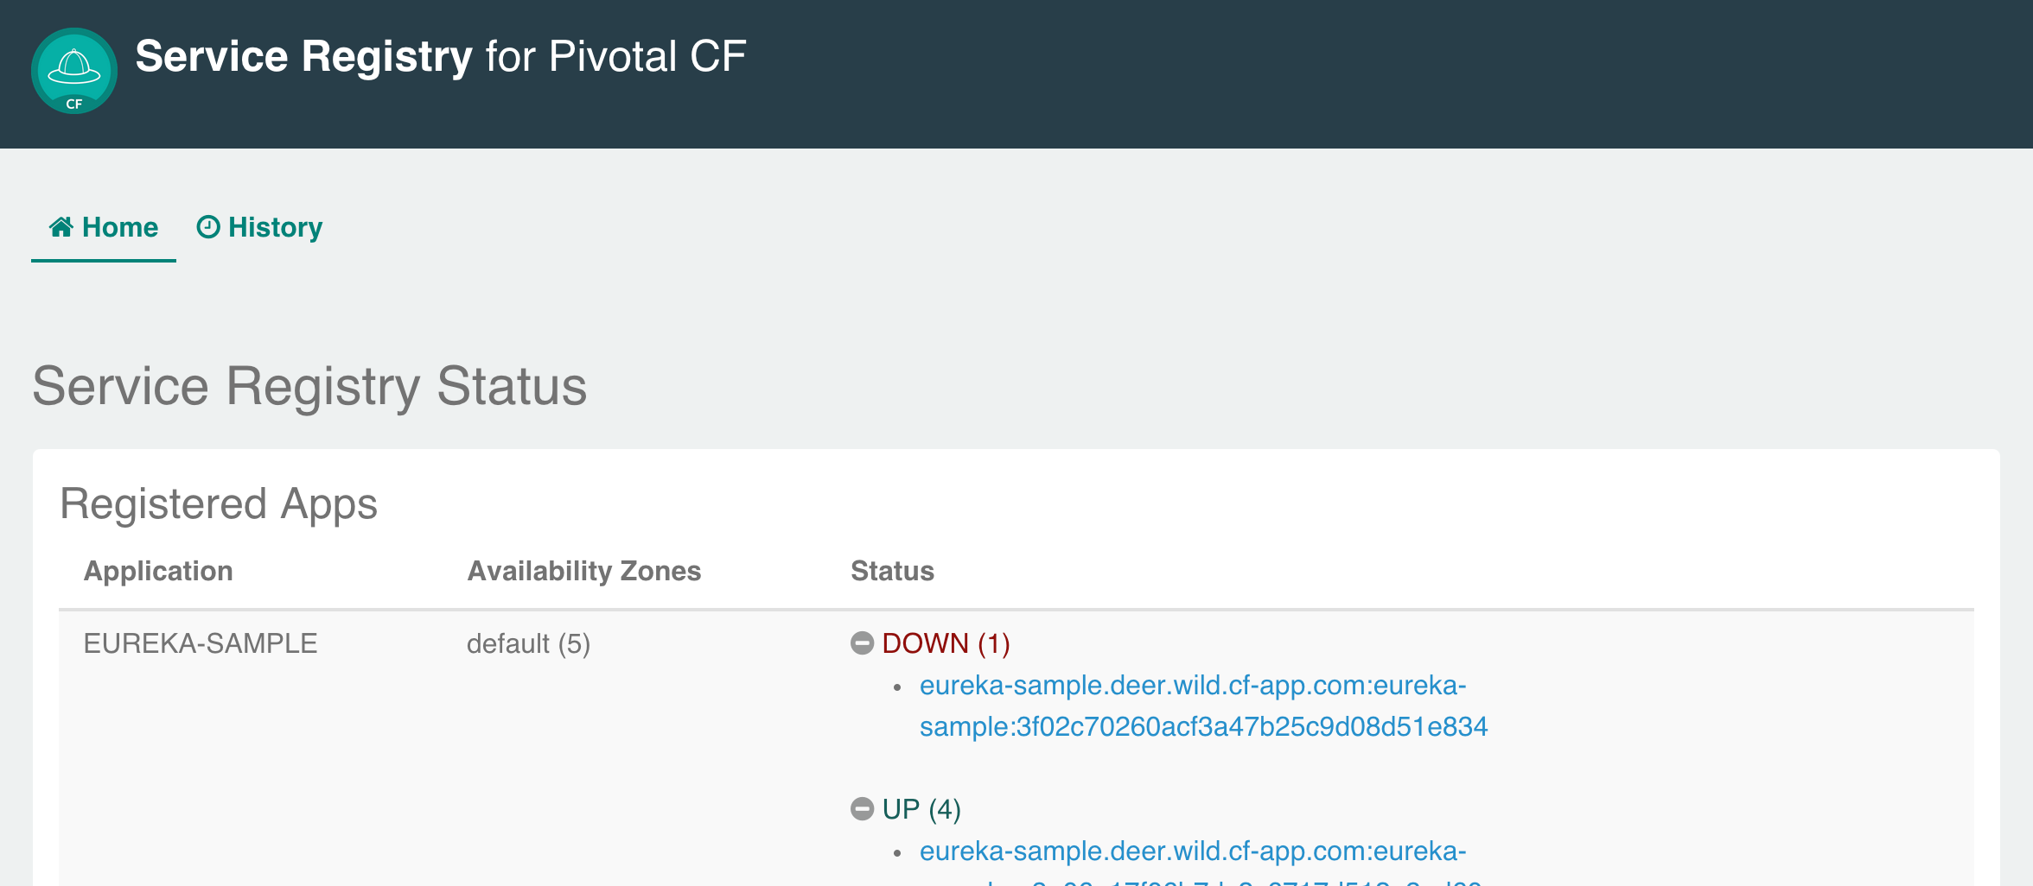
Spring Cloud Service Registry Dashboard

Slide 13
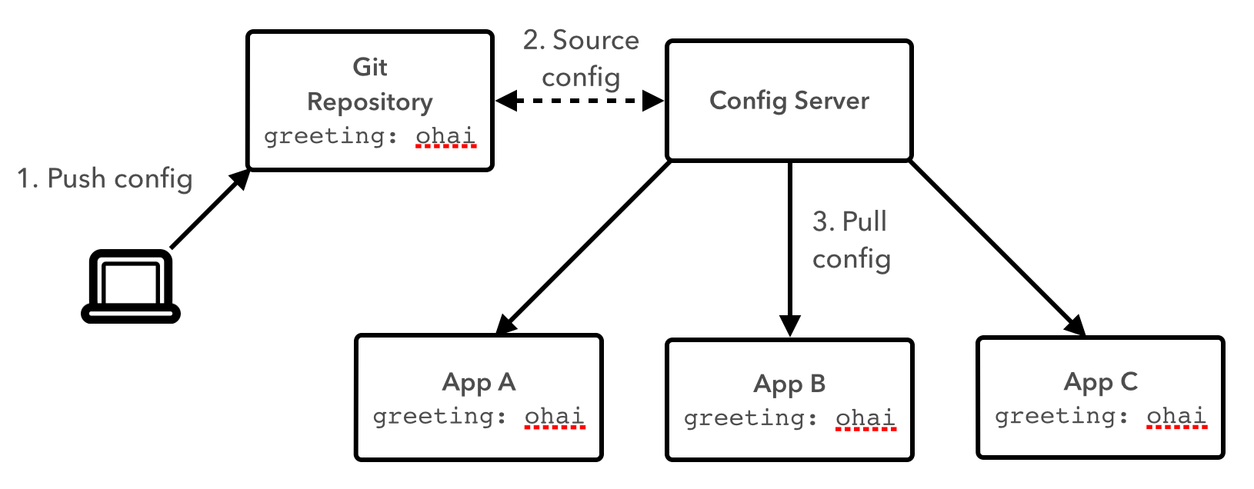
Configuration Server
Spring Cloud Config Server

Slide 14
Running Configuration Server
Spring Cloud Config Server
@SpringBootApplication
@EnableConfigServer
public class ConfigServerApplication {
public static void main(String[] args) {
SpringApplication.run(ConfigServerApplication.class, args);
}
}
Just a Spring Boot Application
Github URL in Application.Properties

Slide 15
Spring Cloud Config Server
Service Binding via Spring Cloud Connector
Git/SVN URL for Config Repo provided via Service Dashboard (post-provisioning)
Single tenant, scoped to CF space (nothing prevents shared Git repo)
Config Server
Notes:
Spring’s priorities for configuration:
Command Line Args
JNDI
Java System Properties
OS Environment Variables
Properties Files - i.e. application.yml, but the file is part of the deployable artifact. Whole point of this is to not change the artifacts as they move between environments
@PropertySource
Defaults

Slide 16
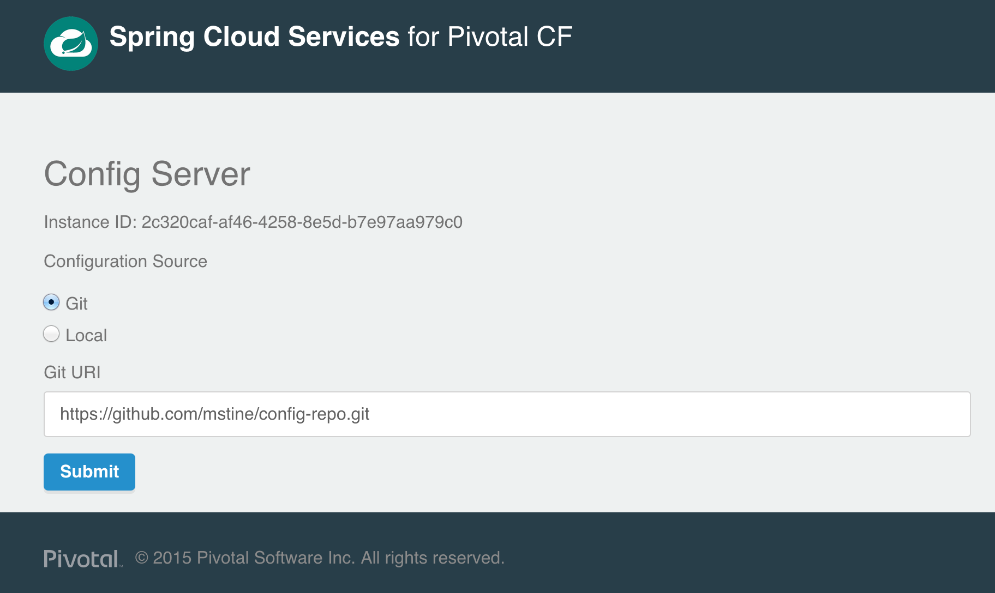
Spring Cloud Config Server Dashboard

Slide 17
Circuit Breaker Example

Slide 18
Enable Circuit Breaker
@HystrixCommand(fallbackMethod = "defaultLink")
public Link getStoresByLocationLink(Map<String, Object> parameters) {
URI storesUri = URI.create(uri);
try {
ServiceInstance instance = loadBalancer.choose("stores");
storesUri = URI.create(String.format("http://%s:%s", instance.getHost(), instance.getPort()));
}
catch (RuntimeException e) {
// Eureka not available
}
Traverson traverson = new Traverson(storesUri, MediaTypes.HAL_JSON);
Link link = traverson.follow("stores", "search", "by-location")
.withTemplateParameters(parameters).asLink();
return link;
}
Client-Side Load Balancing

Slide 19
Enable Circuit Breaker
@SpringBootApplication
@EnableCircuitBreaker
@EnableDiscoveryClient
public class CustomerApp extends RepositoryRestMvcConfiguration {
@Override
protected void configureRepositoryRestConfiguration(RepositoryRestConfiguration config) {
config.exposeIdsFor(Customer.class);
}
public static void main(String[] args) {
SpringApplication.run(CustomerApp.class, args);
}
}

Slide 20
Enable Circuit Breaker – Fallback
@HystrixCommand(fallbackMethod = "defaultLink")
public Link getStoresByLocationLink(Map<String, Object> parameters) {
//...
}
public Link defaultLink(Map<String, Object> parameters) {
return null;
}

Slide 21
Hystrix Dashboard
@SpringBootApplication
@EnableHystrixDashboard
@Controller
public class Application {
@RequestMapping(“/”)
Public String home() {
return “forward:/hystrix”;
}
}

Slide 22
Spring Cloud Services Circuit Breaker Dashboard
Netflix OSS Turbine + Hystrix Dashboard
Aggregation via AMQP (RabbitMQ)
Binding via Spring Cloud Connector
Single-tenant, scoped to CF space
Circuit Breaker
Dashboard

