Slide 1
What is SVM(support vector machine)
Support vector machine or SVM is one of the most popular supervised learning algorithms, which is used for classification as well as regression problems. However, primarily, it is used for classification problems in machine learning.
The goal of the SVM algorithm is to create the best line or decision boundary that can segregate n-dimensional space into classes so that we can easily put the new data point in the correct category in the future.
This best decision boundary is called a hyperplane.
SVM chooses the extreme points/vectors that help in creating the hyperplane. These extreme cases are called as support vectors, and hence algorithm is termed as support vector machine.

Slide 2


Slide 3
What are the tyes of SVM
SVM can be of two types:
Linear SVM: linear SVM is used for linearly separable data, which means if a dataset can be classified into two classes by using a single straight line, then such data is termed as linearly separable data, and classifier is used called as linear SVM classifier.
Non-linear svm: non-linear svm is used for non-linearly separated data, which means if a dataset cannot be classified by using a straight line, then such data is termed as non-linear data and classifier used is called as non-linear svm classifier.

Slide 4
Define support vector
The data points or vectors that are the closest to the hyperplane and which affect the position of the hyperplane are termed as support vector. Since these vectors support the hyperplane, hence called a support vector.

Slide 5
Define hyperplane
Hyperplane: there can be multiple lines/decision boundaries to segregate the classes in n-dimensional space, but we need to find out the best decision boundary that helps to classify the data points. This best boundary is known as the hyperplane of SVM.

Slide 6
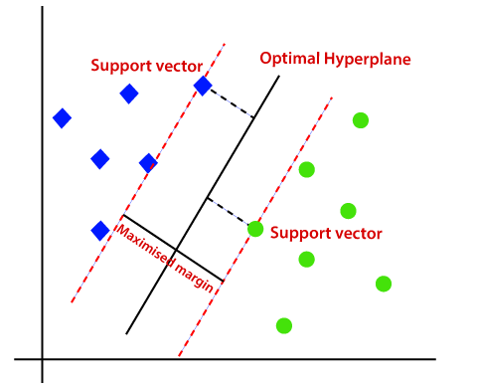
Define margine
The distance between the vectors and the hyperplane is called as margin. And the goal of SVM is to maximize this margin. The hyperplane with maximum margin is called the optimal hyperplane.

Slide 7
What is difference between linear separable data set and nonlinear separable data set
Linearly separable data is data that if graphed in two dimensions, can be separated by a straight line.
The data that is not separable by a straight line in 2d is called nonlinear separable

Slide 8
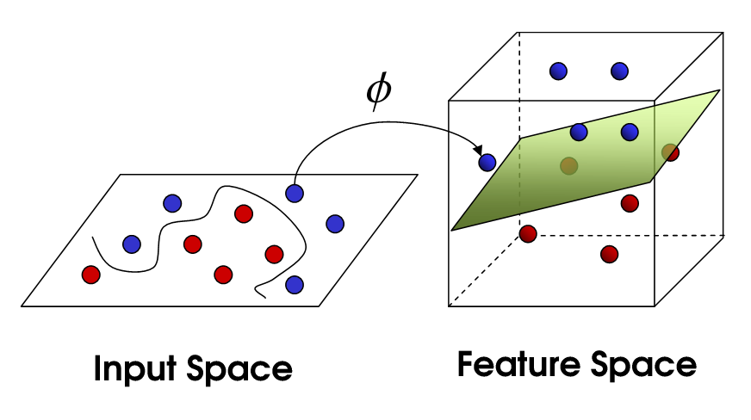
How kernel trick is useful in NLSVM

Slide 9
We have seen how higher dimensional transformations can allow us to separate data in order to make classification predictions. It seems that in order to train a support vector classifier and optimize our objective function, we would have to perform operations with the higher dimensional vectors in the transformed feature space. In real applications, there might be many features in the data and applying transformations that involve many polynomial combinations of these features will lead to extremely high and impractical computational costs.
The kernel trick provides a solution to this problem. The “trick” is that kernel methods represent the data only through a set of pairwise similarity comparisons between the original data observations x (with the original coordinates in the lower dimensional space), instead of explicitly applying the transformations ϕ(x) and representing the data by these transformed coordinates in the higher dimensional feature space.

Slide 10
What are the pros and cons of SVM
Pros:
It works really well with a clear margin of separation
It is effective in high dimensional spaces.
It is effective in cases where the number of dimensions is greater than the number of samples.
It uses a subset of training points in the decision function (called support vectors), so it is also memory efficient.
Cons:
It doesn’t perform well when we have large data set because the required training time is higher
It also doesn’t perform very well, when the data set has more noise i.E. Target classes are overlapping
SVM doesn’t directly provide probability estimates, these are calculated using an expensive five-fold cross-validation. It is included in the related SVC method of python scikit-learn library.

Slide 11
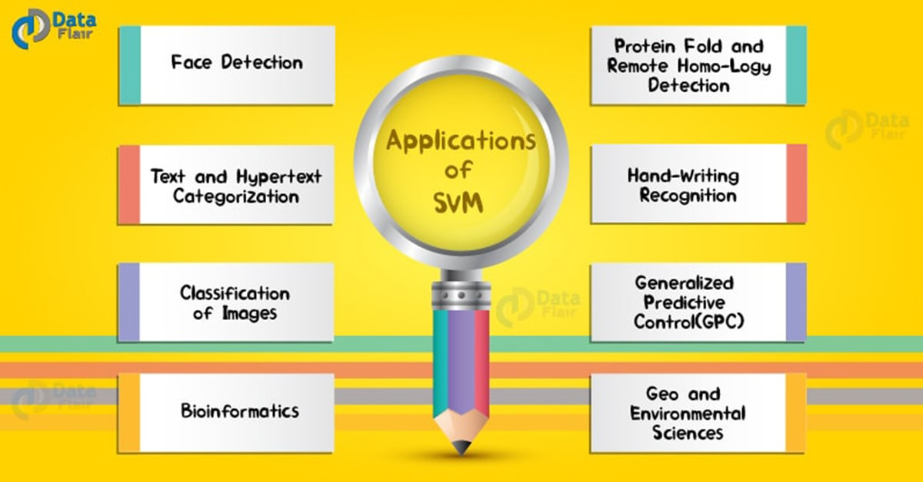
Applications of svm

