Slide 1
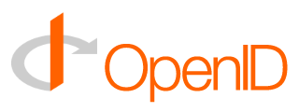
  Brad Fitzpatrick
  brad@danga.com
  Six Apart, Ltd. / LiveJournal / Danga
  August 2005

Slide 2
What is OpenID?
an identity system
  all the rage lately
a protocol
  gratis, libre
not a service or company
  not Passport
  not TypeKey
  not Sxip
survives if companies turn evil or go out of business

Slide 3
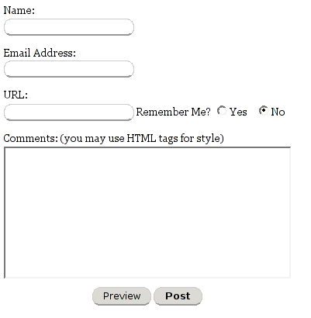
Why?
lame
no authentication way too common
comment spam
auth interop
  LiveJournal
  TypePad
  Movable Type
  DeadJournal, WordPress, TextPattern, .....

Slide 4
Design Goals
low barrier to entry
  works with static HTML pages
  no registration (no central server)
  understandable identity (a URL)
    no new namespace
    no public keys (key revocation, etc...)
  no SSL required
  no browser plugins
most simple protocol possible
  other needs layered atop

Slide 5
What OpenID isn't...
a trust system
  need identity before you can have trust
a solution for all identity problems
perfectly secure
  DNS spoofing
  man-in-the-middle
    between some parts

Slide 6
How's it work?
proves “who” you are
  one-time assertions w/ digital signature
  see openid.net for specs
not that you're a good person
  spammers can/will/have setup OpenID servers
  better than state of email today
  Trust/reputation providers on their way
    5+ companies working on this
    TrustRank

Slide 7
Chicken / Egg
LiveJournal / TypePad / Movable Type
  all support OpenID server
  OpenID consumer in LJ/MT
    TypePad soon enough
TypeKey
  still speaks TypeKey. also speaks OpenID
  an OpenID provider for people without their own
10M+ OpenID users who don't know it
  already: DeadJ/GreatestJ/LiveJ interop

Slide 8
Why URLs as identity?
already the convention
  Comment by Matt at 7:23pm
  mouseover to see which Matt
users don't understand public keys
users don't understand namespaces
users do understand URLs
  10+ years of billboards and TV commercials
you can click them
  tangible

Slide 9
Why should you use OpenID?
interop with others using OpenID
  your users can mark external users leaving comments as “trusted” or “friends”
  your users can bring their identity to other sites, thus advertising your service
not theoretical, already in use
can support OpenID + _______ in future
  no reason to only support OpenID
free
open libraries for most languages

