Slide 1

  David Recordon
  drecordon@verisign.com
  IOS Vancouver 2006

Slide 2
What was OpenID 1.1?
An identity authentication system
A protocol
  gratis, libre
Not a service or company
  not Passport
  not TypeKey
  not Sxip
Survives if companies turn evil or go out of business

Slide 3
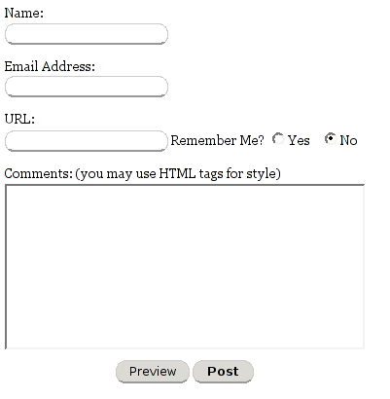
Why Was It Developed?
lame
No authentication was way too common
Comment spam
Auth interop
  LiveJournal
  TypePad
  Movable Type
  WordPress
  DeadJournal

Slide 4
Design Goals For Auth
Low barrier to entry
  Works with static HTML pages
  Decentralized
  Understandable identity (a URL)
    No new namespace
    No public keys (key revocation, etc...)
  No SSL required
  No browser plugins
Most simple protocol possible
  Other needs layered atop

Slide 5
What is OpenID 2.0?
An identity system framework
Multiple protocols
  Discovery (Yadis)
  Authentication
    URLs
    i-names
  Messaging (DTP)
  Profile Exchange (Many layered atop DTP)
  …
Still not a service or company
Open community development within the incubating Apache Heraldry Podling

Slide 6
Design Goals For OpenID 2.0
Identity 2.0
  User Centric
  Internet Scale
  Privacy Protecting
  Community Driven
Framework of interoperable specifications
  Handful of twenty page specs versus one one-hundred-fifty page spec
Extensible
Interoperable

Slide 7
How's Auth Work?
Proves “who” you are
  You own a URL or an i-name
  One-time assertions w/ digital signature
  See openid.net for specs, libraries, etc
Not a trust system…yet
  Spammers can/will/have setup OpenID Authentication servers
  Better than the state of email today
  Trust/reputation providers can easily build atop the OpenID framework

Slide 8
Why URLs as identity?
Already the convention
  Comment by Matt at 7:23pm
  Mouseover to see which Matt
Users don't understand public keys
Users don't understand namespaces
Users associate email addresses with spam
Users do understand URLs
  10+ years of billboards and TV commercials
You can click them
  Tangible

Slide 9
Deployment
Relying Parties
  Six Apart’s blogging properties
  Zooomr
  ClaimID
  Opinity
  PeopleAggregator
Patches / Active Development
  WordPress
  MoinMoin
  Drupal
  phpBB
  MediaWiki
  Mailman
Identity Providers
  MyOpenID.com
  VeriSign Lab’s Personal Identity Provider
  GetOpenID.com
  Videntity.com

Slide 10
Code!
Free libraries
  PHP
  Perl
  Python
  C#
  Ruby
  Java
  C++

Slide 11
Questions?
www.OpenID.net
www.OpenIDEnabled.com
yadis@lists.danga.com
David Recordon (drecordon@verisign.com)

