Slide 1
ACADEMIC CALENDAR TO COLOR CODED
ICAL
TEAM 22:
S SAI PREETHAM
APPARI LALITH

Slide 2
PROBLEM STATEMENT
The objective of this project is to create a data structure of dates and events from an academic calender.
Using the data structure constructed above we can export the data to calendar based applications.(ex: iCalendar,google calendar).

Slide 3
MOTIVATION
Now a days, each and every task done by a person were mostly automated.
So, In our busy daily life it is not so easy to spare much time on each task of ours and people usually get confused or forget the important tasks of theirs. Here comes the use of reminders. So there is necessity of automation of reminders.

Slide 4
WORK FLOW
INPUT(time table image)
DETECT EDGES
Character recognition in bounding box
DETECT CORNERS
Data Structure creation
export

Slide 5
EDGE DETECTION-PRE PROCESSING
PRE PROCESSING THE IMAGE USING FOLLOWING FILTERS
SOBEL FILTER
PREWITT FILTER
LAPLACIAN FILTER
MODIFICATION USING COMBINATIONS OF ABOVE FILTERS FOR BETTER RESULTS

Slide 6
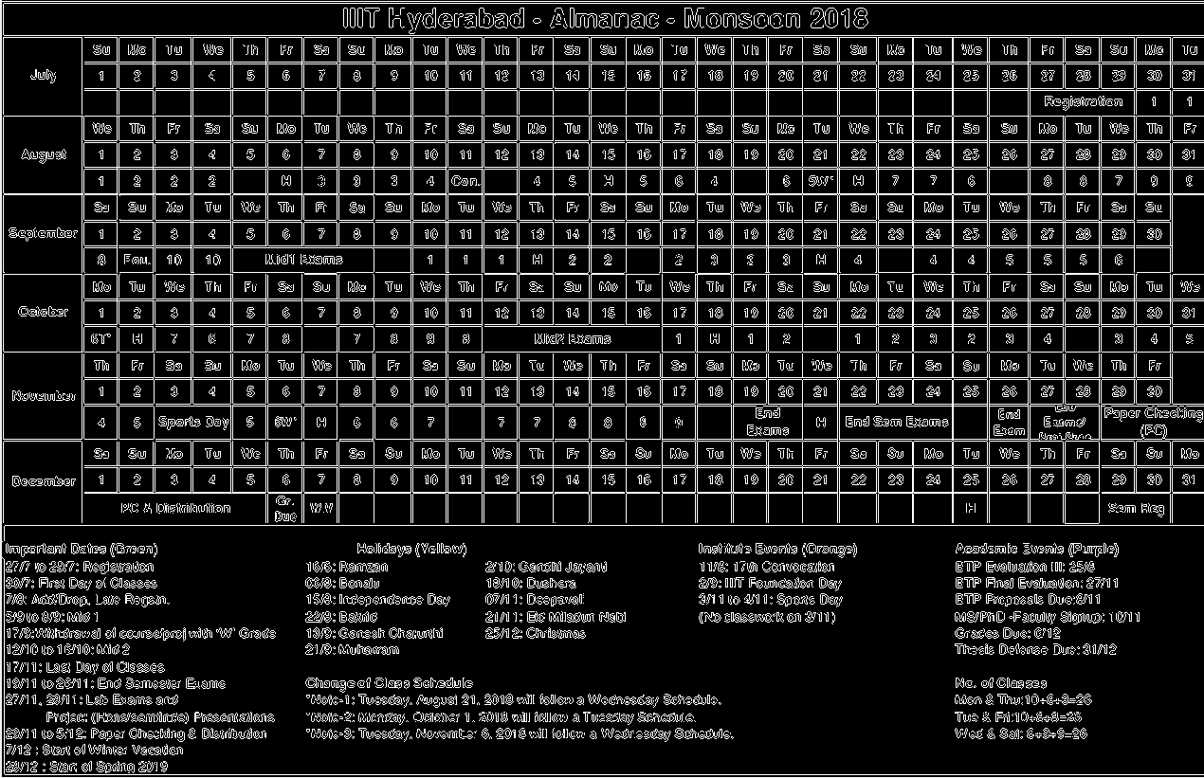
SOBEL

Slide 7
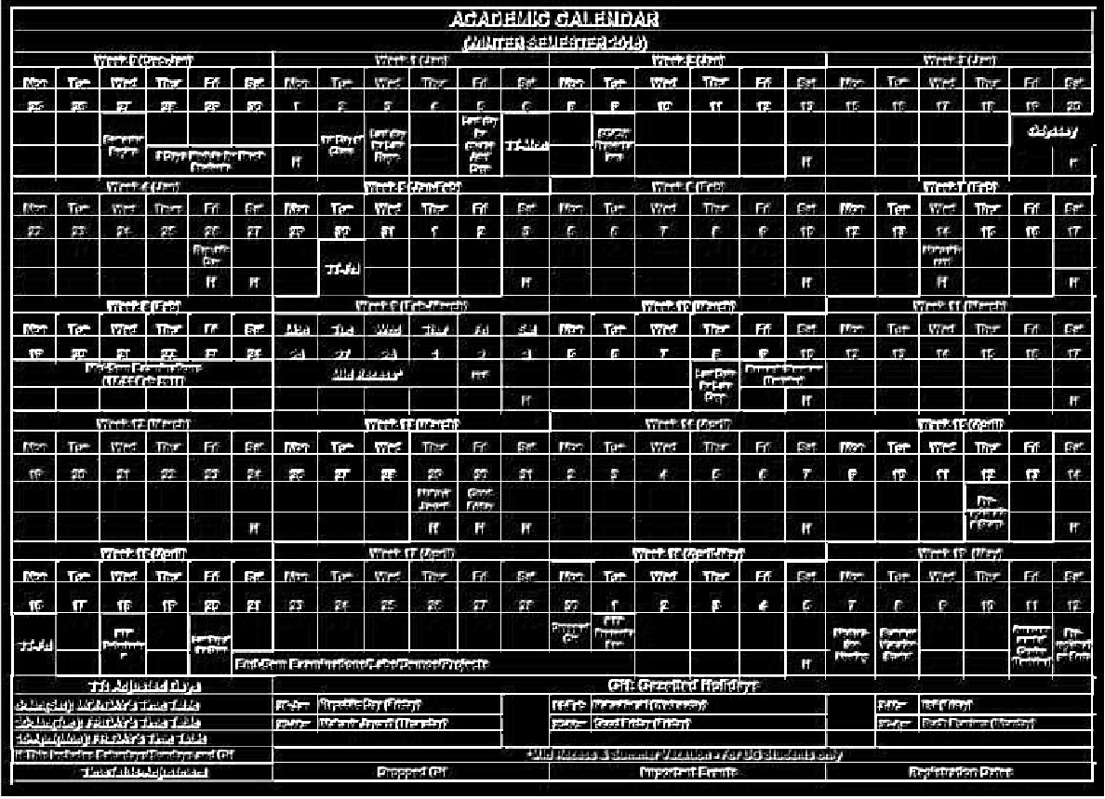
PREWITT

Slide 8
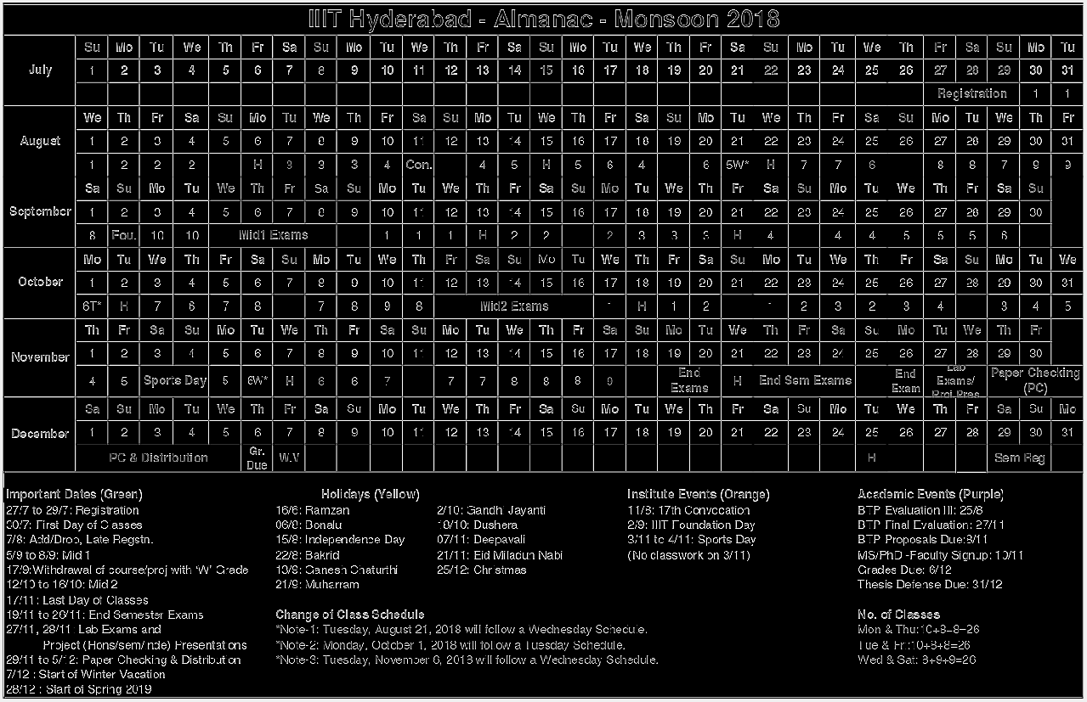
LAPLACIAN

Slide 9
EDGE DETECTION
APPLYING EDGE DETECTION IS DONE ON THE PROCESSED IMAGE WITH FOLLOWING FILTERS:
CANNY EDGE DETECTION
HOUGH TRANSFORM

Slide 10
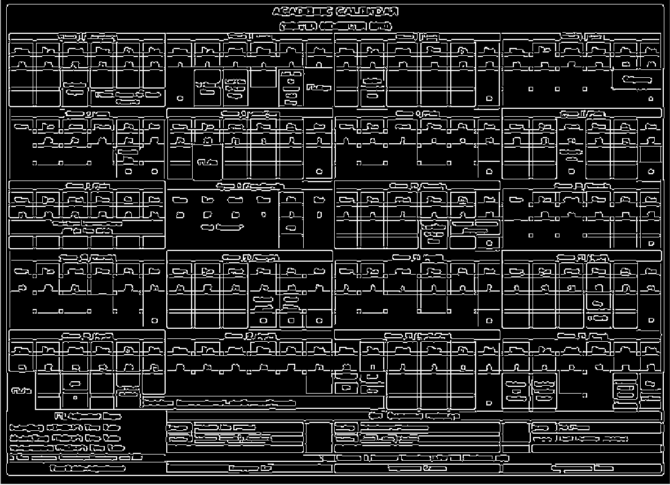
CANNY EDGE DETECTION

Slide 11
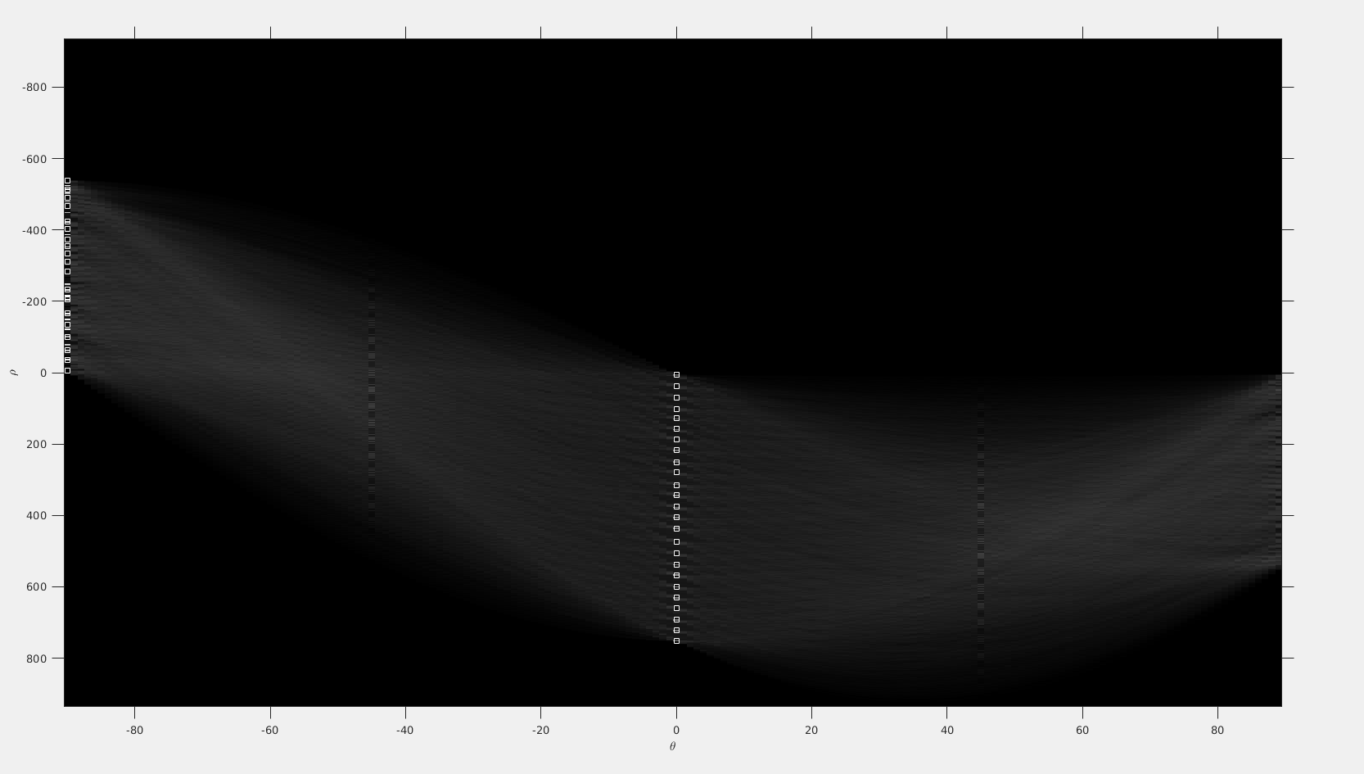
HOUGH TRANSFORM
We find the peaks with theta = -90 or 0 because all the edges are either horizontal or vertical.We got a total of 44 edges, 19 vertical and 25 horizontal.

Slide 12
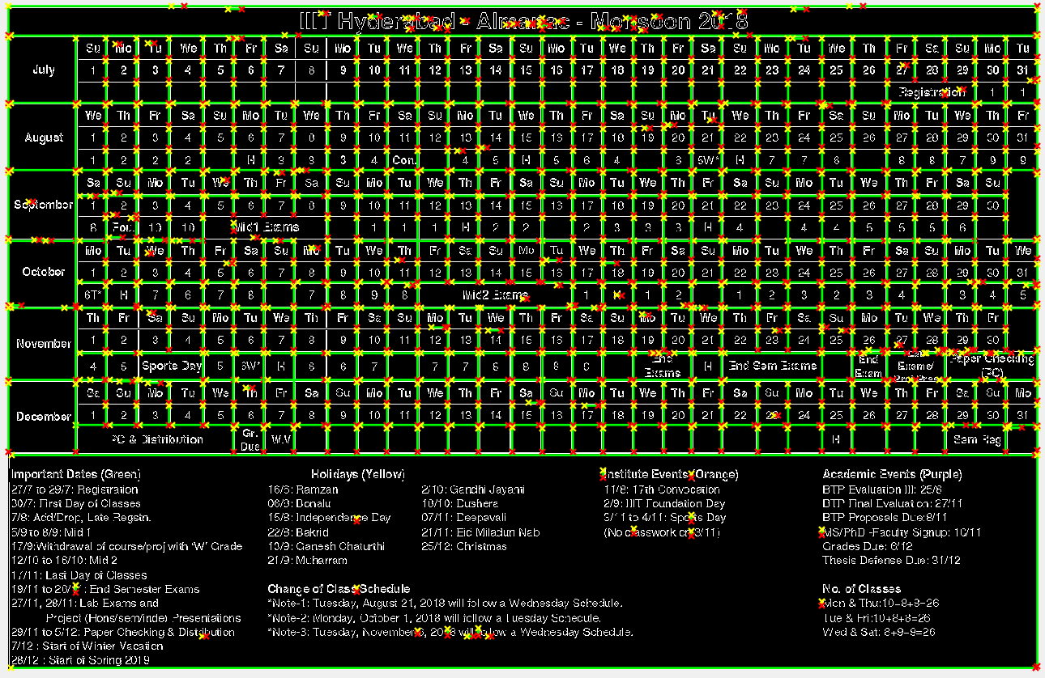
HOUGH TRANSFORM
EDGES DETECTED HAVE BEEN HIGHLIGHTED.

Slide 13
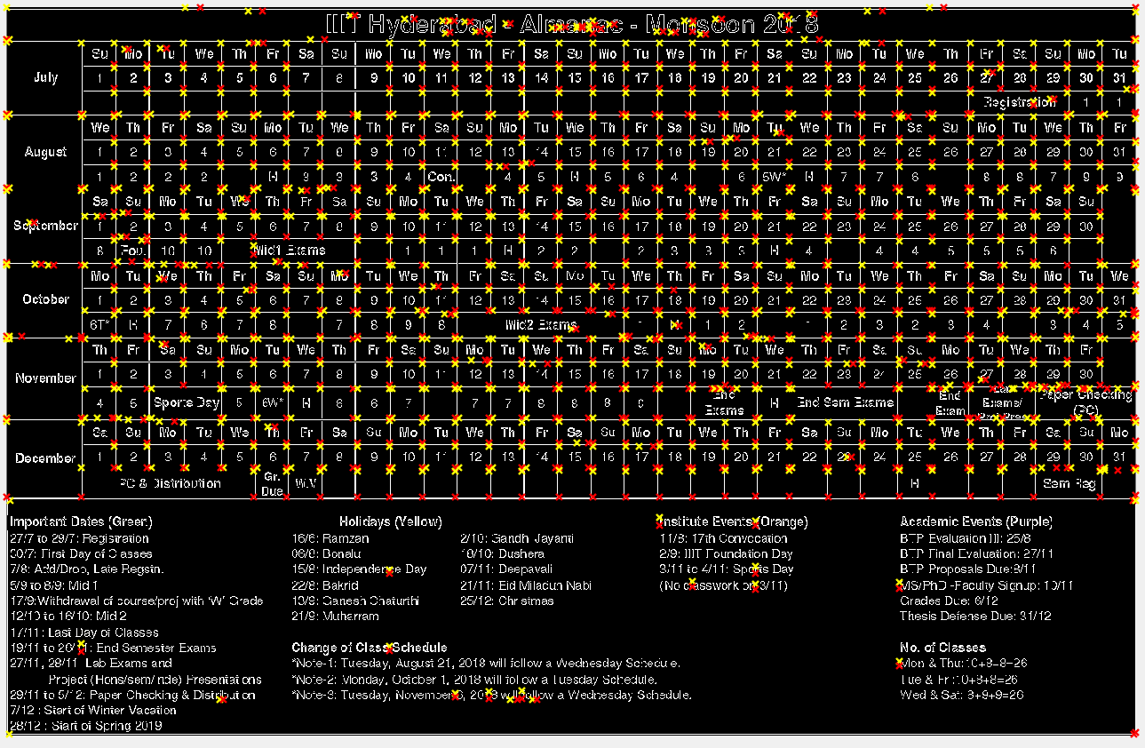
EDGE END POINTS

Slide 14
ELIMINATING DUPLICATE POINTS
DUPLICATE POINTS OF EDGES CAN BE ELIMINATED USING EUCLIDEAN DISTANCE i.e; BY KEEPING A THRESHOLD LIMIT OF OCCURANCE OF POINTS
IN A RADIUS

Slide 15
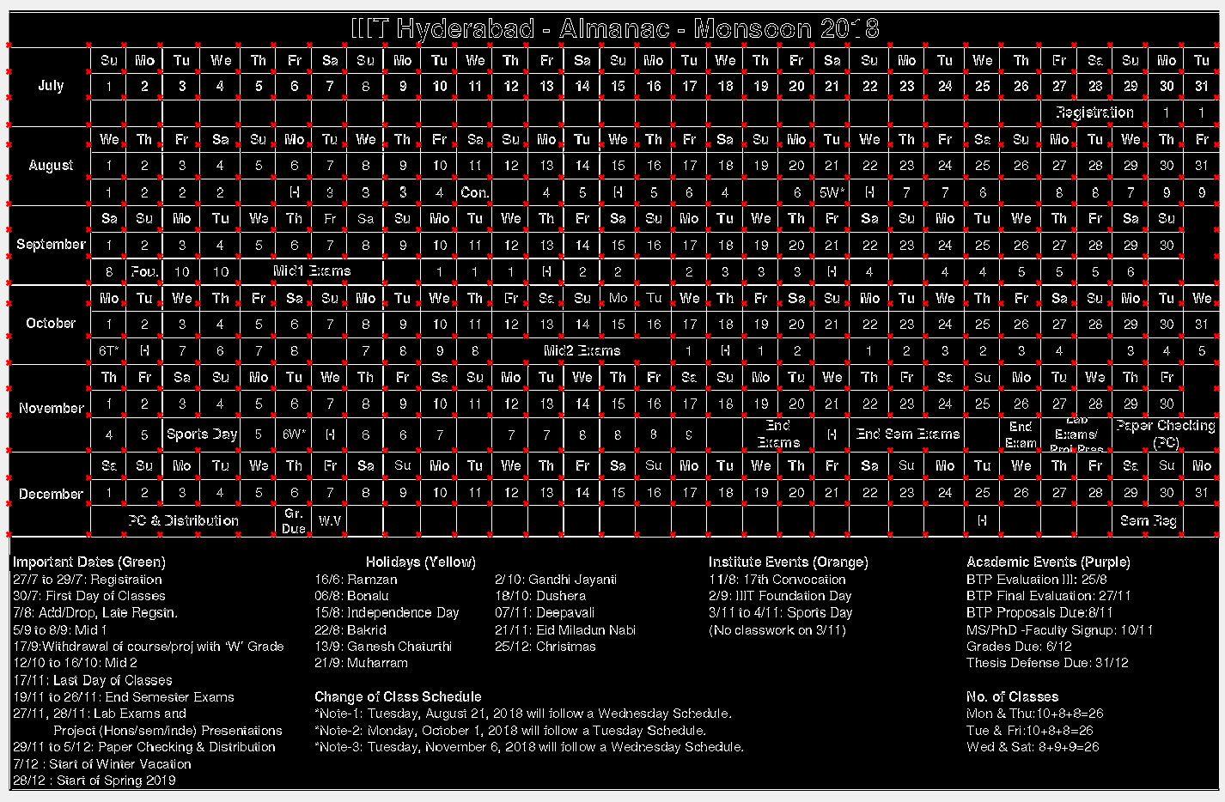
DETECT CORNERS

Slide 16
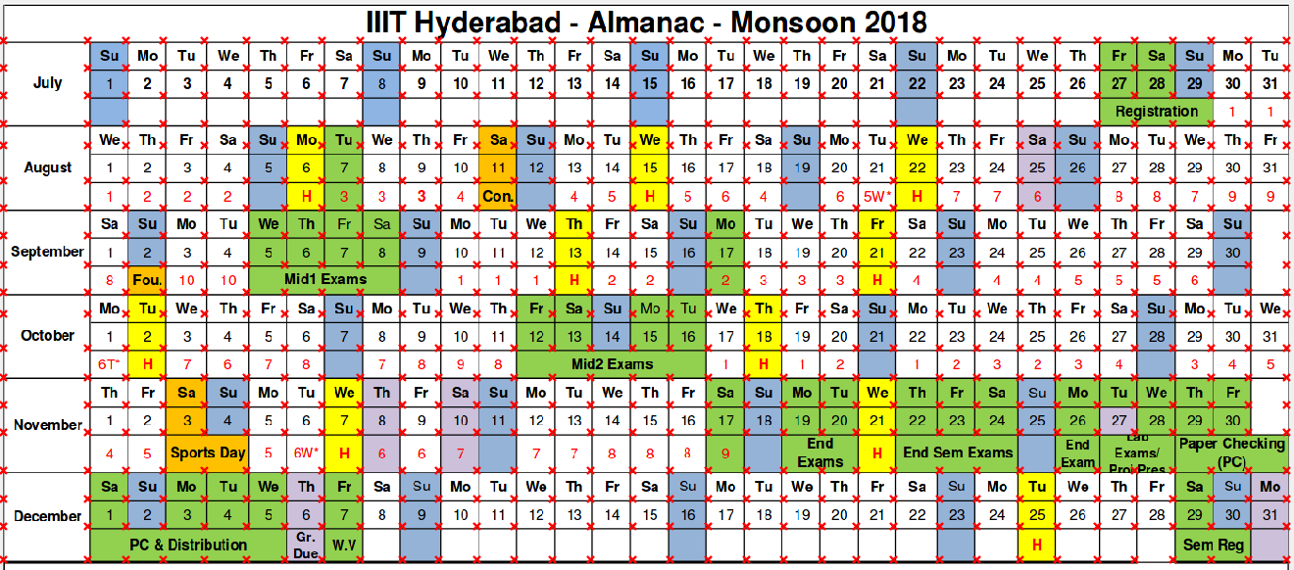
CORNERS ON COLOUR IMAGE

Slide 17
BOUNDING BOX IDENTIFICATION
FROM THE CORNERS OBTAINED FROM THE ABOVE STEP WE CAN ITERATE OVER THE CORNERS IN THE IMAGE TO FIND ALL BOXES POSSIBLE

Slide 18
PRE PROCESSING OF BOUNDING BOX
THE CONTENT INSIDE THE BOUNDING BOX IS NOT WELL DETECTED USING OCR (NAIVE) SO WE PRE PROCESSED THE IMAGE BY FOLLOWING STEPS:
ENLARGE THE BOUNDING BOX IMAGE AND BINARIZE IT.
GROW THE TEXT TO GET A BIGGER ROI AROUND THEM.
THIN THE LETTERS A BIT (TO DEAL WITH BLOCKY LETTERS).

Slide 19
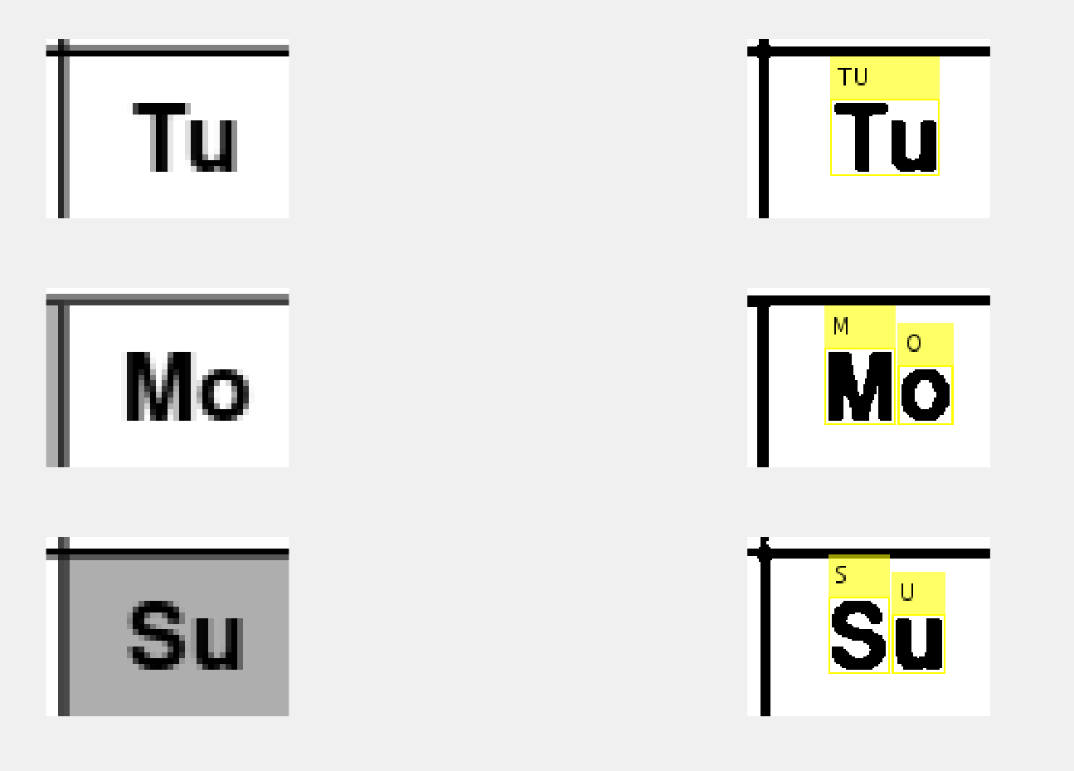
OCR ON BOUNDING BOX
APPLYING OCR WITH REQUIRED PARAMETERS IN ALL BOUNDING BOXES AND STORING THE TEXT RECOGNISED BY IT.

Slide 20
DATA STRUCTURE
A DATA STRUCTURE OF EACH BOUNDING BOX WITH FOLLOWING VALUES IN IT IS MAINTAINED:
TEXT
COLOUR
BOUNDING BOX COORDINATES
MONTH
EVENT
NOTE: event can be obtained from another data structure which contains dates and events.

Slide 21

FAILED CASES

Slide 22
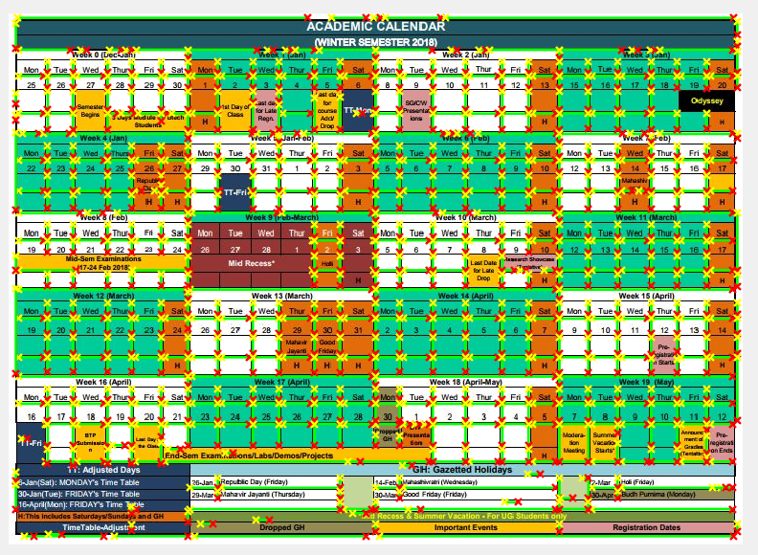
FAILED CASES

Slide 23
THINGS YET TO DO
EXPORT THE DATA STRUCTURE CREATED INTO CALENDAR APPLICATIONS

Slide 24
DEMO

Slide 25
THANK YOU

