Slide 1
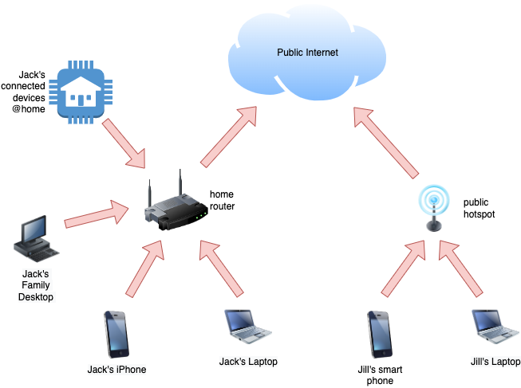
These days you and your family have many devices that connect to the internet. Your devices connect to internet either via you home wi-fi router or a public hotspot.

Slide 2
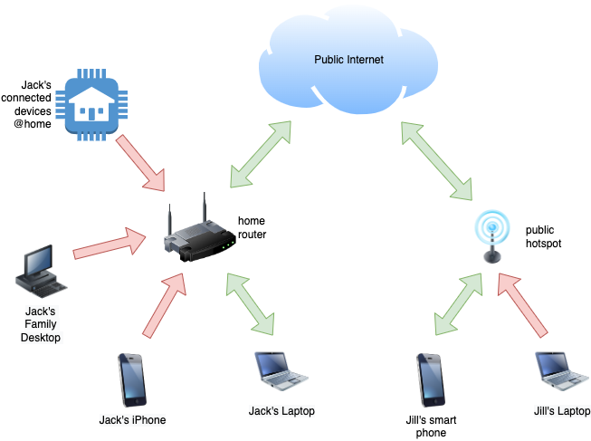
These days you and your family have many devices that connect to the internet. Your devices connect to internet either via you home wi-fi router or a public hotspot.
When you use applications and browsers data flows back and forth via these network connections to services in the public internet.

Slide 3

These days you and your family have many devices that connect to the internet. Your devices connect to internet either via you home wi-fi router or a public hotspot.
When you use applications and browsers data flows back and forth via these network connections to services in the public internet.
Although these applications encrypt the communication, there is still a lot of information that bad actors can snoop on at various transit points.

Slide 4
When you use applications and browsers data flows back and forth via these network connections to services in the public internet.
Although these applications encrypt the communication, there is still a lot of information that bad actors can snoop on at various transit points.
For example, applications issue DNS queries to locate servers they need to communicate with. Your internet provider can provide your router with DNS servers that track these requests allowing them to monitor your internet activity. These servers could also respond with malicious server addresses that hijack your data.

Slide 5
Although these applications encrypt the communication, there is still a lot of information that bad actors can snoop on at various transit points.
For example, applications issue DNS queries to locate servers they need to communicate with. Your internet provider can provide your router with DNS servers that track these requests allowing them to monitor your internet activity. These servers could also respond with malicious server addresses that hijack your data.
These days most of the applications and browsers you use will use HTTPs for communication. This encrypts the data in transit, but bad actors can still determine which servers you are communicating with. If they hijack the destination server and its certificate, then they would have access to the encrypted data.

Slide 6
These days most of the applications and browsers you use will use HTTPs for communication. This encrypts the data in transit, but bad actors can still determine which servers you are communicating with. If they hijack the destination server and its certificate, then they would have access to the encrypted data.
These bad actors can also block access to internet sites they do not want you to access only allowing you to see data that they have curated. They can restrict your freedom to access freely available data in the public internet. They can also prevent applications that they do not want you to use from working.

Slide 7
These bad actors can also block access to internet sites they do not want you to access only allowing you to see data that they have curated. They can restrict your freedom to access freely available data in the public internet. They can also prevent applications that they do not want you to use from working.
We need a way to secure our activity in the cloud and at the same time appear anonymous in the eyes of these bad actors. It is common knowledge that a VPN will help you do that, but we can use the technology to do much more.

