Slide 1
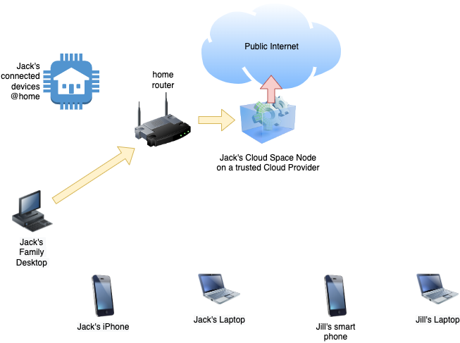
To secure his family’s access to the cloud Jack starts by launching a “Cloud Space” node using the MyCS admin client application. He will then register all his devices and invite Jill to join the “Cloud Space” which he created. He will also grant Jill’s devices access to the “Cloud Space”.

Slide 2
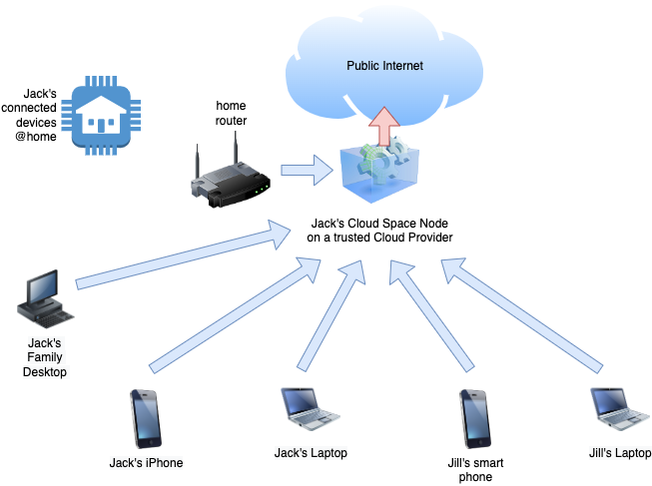
To secure his family’s access to the cloud Jack starts by launching a “Cloud Space” node using the MyCS admin client application. He will then register all his devices and invite Jill to join the “Cloud Space” which he created. He will also grant Jill’s devices access to the “Cloud Space”.
Next Jack and Jill will log-in to the “Cloud Space” using the MyCS network client on devices they wish to bring online. Jack can configure the “Cloud Space” as an exit node for all internet traffic from the “Cloud Space” network. This makes it harder for bad actors to eavesdrop unless they have compromised the Cloud Provider where the node runs. Moreover, the “Cloud Space” node can be deployed to a global region where these bad actors cannot operate.

Slide 3
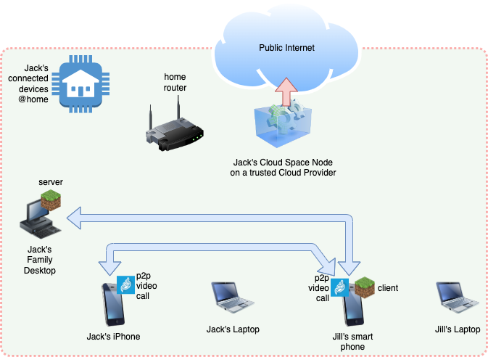
Next Jack and Jill will log-in to the “Cloud Space” using the MyCS network client on devices they wish to bring online. Jack can configure the “Cloud Space” as an exit node for all internet traffic from the “Cloud Space” network. This makes it harder for bad actors to eavesdrop unless they have compromised the Cloud Provider where the node runs. Moreover, the “Cloud Space” node can be deployed to a global region where these bad actors cannot operate.
Within the “Cloud Space” sandbox devices can communicate with each other directly. Jill can play Minecraft running on the family desktop at home while on the move or chat with Jack at home via Jitsi video call. Your activity never leaves the security of the sandbox.

Slide 4
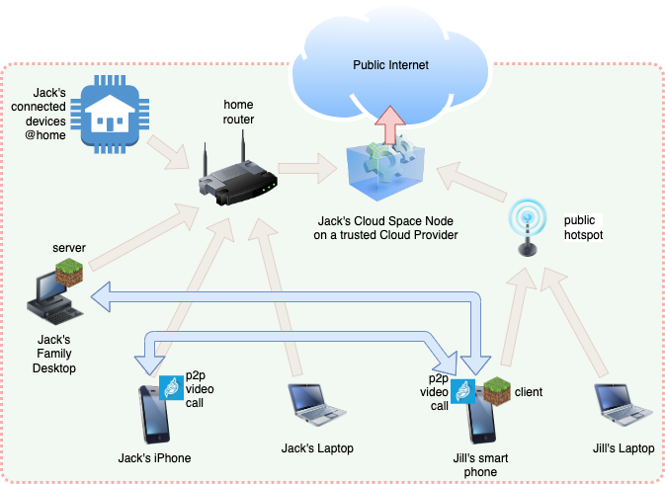


Within the “Cloud Space” sandbox devices can communicate with each other directly. Jill can play Minecraft running on the family desktop at home while on the move or chat with Jack at home via Jitsi video call. Your activity never leaves the security of the sandbox.
What the MyCS client along with Cloud Space Node service did was create a secure encrypted virtual network overlayed on the physical wi-fi hotspots and telco transit routers. This obfuscates all network traffic between your devices making it impossible for bad actors to eavesdrop on your activity.

Slide 5
What the MyCS client along with Cloud Space Node service did was create a secure encrypted virtual network overlayed on the physical wi-fi hotspots and telco transit routers. This obfuscates all network traffic between your devices making it impossible for bad actors to eavesdrop on your activity.
Now that Jack has laid the foundation for his “Cloud Space” he can install applications and services to the sandbox and share them with other “Cloud Space” users like Jill.

