Slide 1




6-<number>
Notes:
Module time: 60 mins (30 mins teaching, 30 mins lab)

Slide 2
Agenda
Using the HTTPClient API to fetch remote data
File uploads and downloads
Working with JSON and XML
Working with SOAP
6-<number>

Slide 3
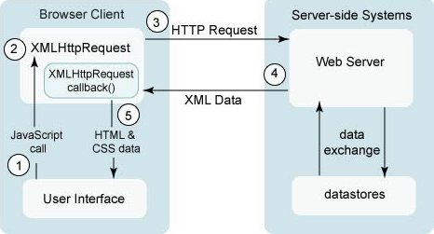
The XMLHTTPRequest Object
In the web browser, Ajax requests rely on the XMLHTTPRequest object provided by the browser
6-<number>
Notes:
In a web browser, Ajax works through a five step process as shown here
User interacts with page
Which creates an XHR object
Which passes an HTTP request to the server
The server creates a response and sends back XML or JSON data
The callback function of the XHR object updates the UI

Slide 4
The HTTPClient Object
Ti.Network.HTTPClient implements the XHR specification
That’s why you see “xhr” in sample code
Low level HTTP client interface with support for all HTTP verbs
Should be familiar to Ajax programmers
6-<number>
Notes:
Xhr refers to the XMLHTTPRequest object, and is seen in demo apps like the Kitchen Sink
Titanium implements XHR
Very similar to low-level Ajax without a jQuery type library
Support for all verbs: get, post, delete, put

Slide 5
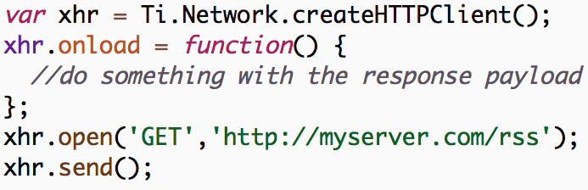
A Typical Network Request
6-<number>
Notes:
Define XHR object
Specify an onload callback and other lifecycle handlers
Open the the request
Then finally send the request
You can set HTTP headers: after open before send

Slide 6
Lifecycle Callbacks
Generally, network requests are asynchronous
This is a good idea – synchronous network is a bad idea
onload: function called when HTTP request returns
onerror: function called for HTTP request error
onreadystatechange: low-level handler for HTTP state
onsendstream/ondatastream: file upload/download
6-<number>
Notes:
XHR centered around callbacks
So, asynchronous
Could probably do sync but that’s not a best practice

Slide 7
Demo:
File Download
6-<number>
Notes:
Demo - KitchenSink
Platform > XHR > File Download
- click Set Web View (url)
examples/xhr_filedownload.js ~line 28
show onload(), responseData, and webview
show ondatastream()
show onerror()
Then, show open() and send()

Slide 8
Working With JSON
JSON namespace is built in to global scope
Recommended data transport format for Titanium Mobile
Super easy to serialize response data
JSON.parse() – convert string to JavaScript object
JSON.stringify() – convert JavaScript object to string
6-<number>
Notes:
JSON is built into and accessible in global scope
JSON is compact, easy to serialize and re-hydrate

Slide 9
Working With XML
XML DOM Level 2 API built in
XML document created for your for every HTTPClient request
XML related functions in the Ti.XML namespace
Many XML/XHR examples in Kitchen Sink
More data over the wire, but still commonly used
6-<number>
Notes:
Web services often publish their data in XML
An XML doc object is created when you fetch an XML document
See the Ti.XML namespace on the API docs
Examples in the KitchenSink

Slide 10
Demo:
Twitter XML
6-<number>
Notes:
Demo - Kitchen Sink
Platform tab > XHR > XML Data
Pulls public data stream from Twitter API
Get data from XML for label
Dumping raw data into a text field
examples/xhr_xml.js
XHR object, onload handler
Show how variables are extracted:
doc, elements, screenName, and text node
responseText dumped into textarea
open() & URL

Slide 11
A Few Words on SOAP
“Simple Object Access Protocol” – possibly the most ironic acronym in tech history
At the end of the day, it is just a layer of abstraction over the top of XML and HTTP
Plan A: Use a server-side proxy to return JSON
Plan B: Use the Suds helper library
Plan C: Manually construct SOAP envelopes
In practice, people usually go with Plan C
6-<number>
Notes:
Examples in the Kitchen Sink
Consuming/invoking SOAP web services means correctly setting the HTTP headers and XML payload (SOAP envelope) of the request
Lots of meta data included in every request, which means lots of data over a slow cellular connection
Suds at github.com/kwhinnery/Suds

Slide 12
Q&A
6-<number>

Slide 13
Lab Goals
Make TiBountyHunter communicate with a very simple web service over HTTP
Requirements:
Seed the database with results from the web service
Send a request to the server when a fugitive is captured
Demo and Lab URL
6-<number>
Notes:
Communicate over HTTP
Uninstall because of database changes
Seed database on first-run with data from web service
Demo: TiBHH255
Show populated and empty tabs
Capture a fugitive
Delete a fugitive

Slide 14
Lab Exercise
6-<number>

Slide 15
Solution
Walkthrough
6-<number>
Notes:
Code Walkthrough - TiBH260
network.js
Walk through all code, top to bottom
Load url in browser to show JSON data
db.js
‘seeded’ block at end
network call to get fugitives
ui.js
captureButton event listener (~line 74)
network call
delay in closing window on android to give time for alert to show

