Slide 1



Kevin Whinnery
Engineer and Platform Evangelist
Appcelerator, Inc.
@kevinwhinnery

Slide 2
Objectives
Share tips, developer to developer
Apply good design principles for JavaScript code
Optimize your development workflow
Explore APIs and techniques needed for higher order applications
Explore the emerging ecosystem of Titanium frameworks and tools

Slide 3
Agenda
Development workflow tips and tricks
Lessons Learned and Tweetanium
Testing your application
Titanium frameworks
Looking at your apps

Slide 4



Slide 5
Development Workflow
Titanium build scripts and SDK tools (Android emulator) can be slow
Need to use what is fast and avoid what is slow (duh)
Cross-platform development requires simultaneous platform testing (or pain later)
Best results for day to day – iOS emulator and Android device

Slide 6
Hacking Developer
Titanium Developer can be goofy sometimes
Developer is also very hackable for JavaScript developers
A GUI for Python build scripts – use this knowledge
Peek behind the veil with –debug (Demo)
Killing JSLint and how to hack Developer (Demo)

Slide 7
Working from the command line
Mobile SDK – what’s in the box? (Walkthrough)
titanium.py (Walkthrough)
Going further with the build scripts – getting info from Developer (Walkthrough)
Hacking the default project (Demo)

Slide 8
Debugging an Android device
Installing to a device – best way to test Android
What about the console?
Debug options
adb (Android Debug Bridge)
ddms (Dalvik Debug Monitor)
Walkthrough

Slide 9
iOS distribution errors
Titanium Developer’s error messages with regard to iOS packaging are… well…
build/iphone/build/build.log
Common issues:
Certificates and code signing
PNG crush and image format issues
Include this data when requesting help

Slide 10
Optimizing script loading
Compression and minification can assist in script loading times
Typically only a concern on older devices
Closure compiler works well
Consider adding Juicer to your build process:
https://github.com/cjohansen/juicer/

Slide 11
Using the new plug-in system
As of 1.5.x, custom Python scripts can be included as plug-ins
Good candidates:
Script compression
Custom builds
Continuous integration
Framework/Script auto-loading
Kitchen Sink demo

Slide 12


Slide 13


Slide 14
Running Tweetanium
http://github.com/appcelerator/Tweetanium
Requires xAuth enabled API keys – typically only given to real Twitter apps
Will need to drop your keys into config.js (README)

Slide 15
Tweetanium Key Features
Component Oriented, Event Driven
2D Animation
Code organization
Extending Titanium components
Simple Entity Storage

Slide 16
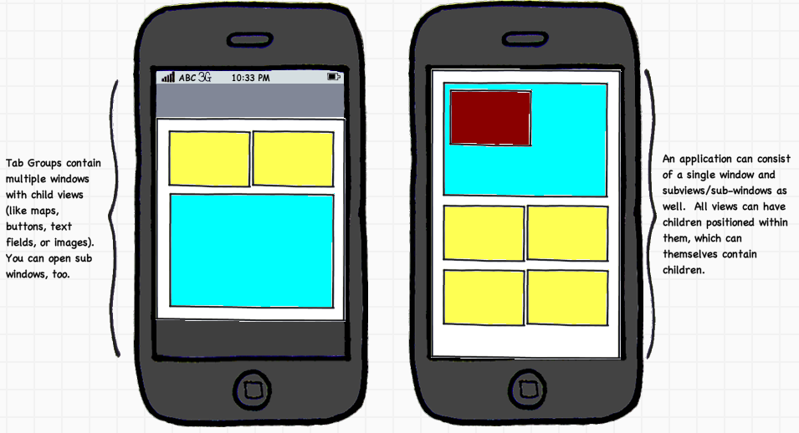
Component Oriented?
App is a combination of small, self-contained widgets

Slide 17
Benefits?
Separation of UI and business logic
Decoupling (to a large degree) one UI component from another
Easier to maintain
Easier to adapt cross-platform

Slide 18


Slide 19


Slide 20


Slide 21
Livetanium
Live source editing for Titanium (iOS)
Built on top of node.js
http://blog.krawaller.se/livetanium

Slide 22
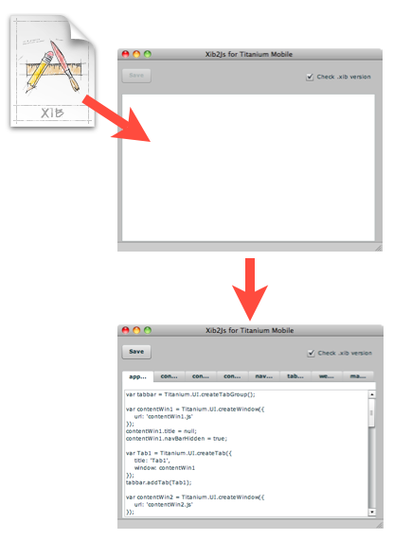
Xib2JS
Convert XIB to JS Code
AIR app ☹
Copy/Paste code from tool
http://blog.frogonmobile.com/apps/xib2js/

Slide 23
Eclipse Code Completion
Will be rendered obsolete eventually by Aptana-based IDE
Uses Aptana Studio today
http://jameslow.com/2010/05/31/titanium-autocomplete-eclipse/

Slide 24
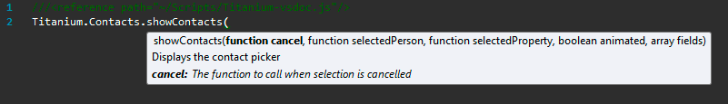
Visual Studio vsdoc
Adds contextual docs to Titanium in Visual Studio
http://www.jeremymelton.com/blog/2010/12/appcelerator-titanium-vsdoc-for-visual-studio-2/

Slide 25
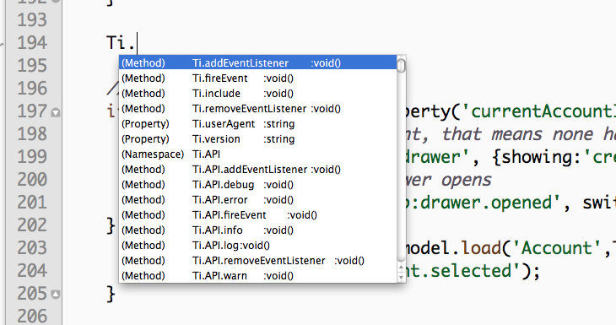
TextMate Bundle
Code Completion and docs for TextMate
https://github.com/subtleGradient/JavaScript-Appcelerator-Titanium-Mobile.tmbundle

Slide 26


Slide 27
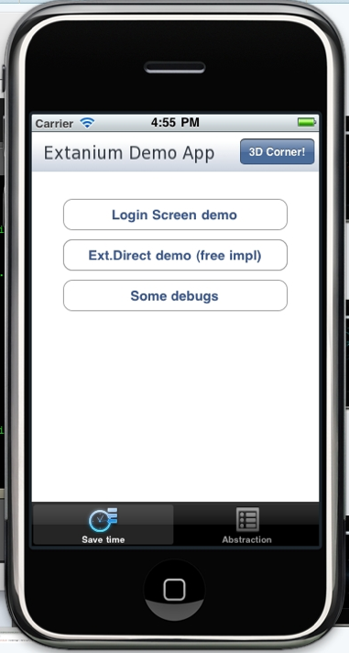
Extanium
An ExtJS style framework for OOP in Titanium
Ajax API
Ext.Direct
Ext.Core
http://www.extanium.org

Slide 28
Titanium Redux
Helper library for common tasks
Enhanced JSS
More concise code for UI construction
https://github.com/dawsontoth/Appcelerator-Titanium-Redux

Slide 29
TiFramework
jQuery-style chainable functions
Less verbose UI construction
https://github.com/rblalock/TiFramework

Slide 30
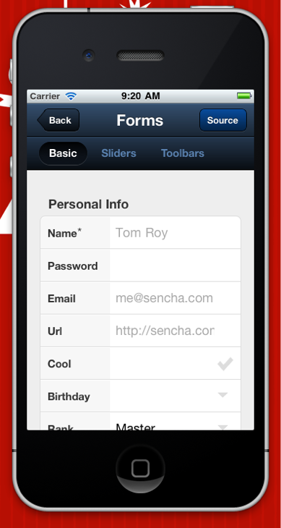
Sencha Touch
WebView based
Works great on iOS
Works okay on Android today
Built on top of ExtJS
Less native
http://www.sencha.com/products/touch

Slide 31
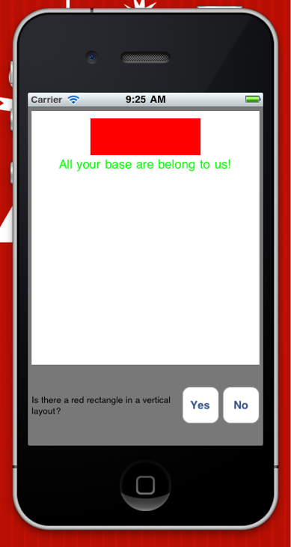
Helium
Codification of the component-oriented style
Built in visual/non-visual/asynchronous unit testing
JavaScript based styling
http://github.com/kwhinnery/Helium

Slide 32


Slide 33
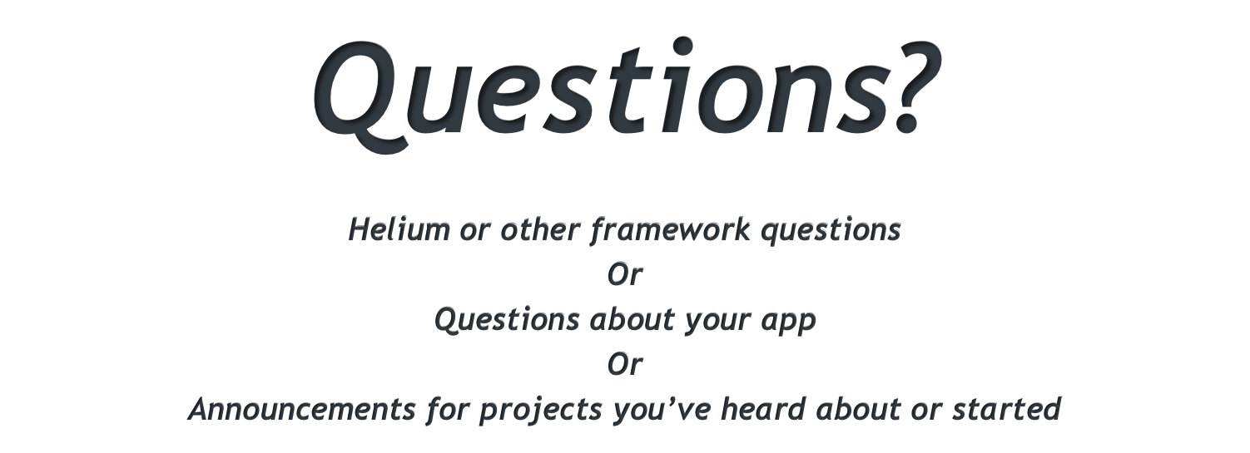

Slide 34
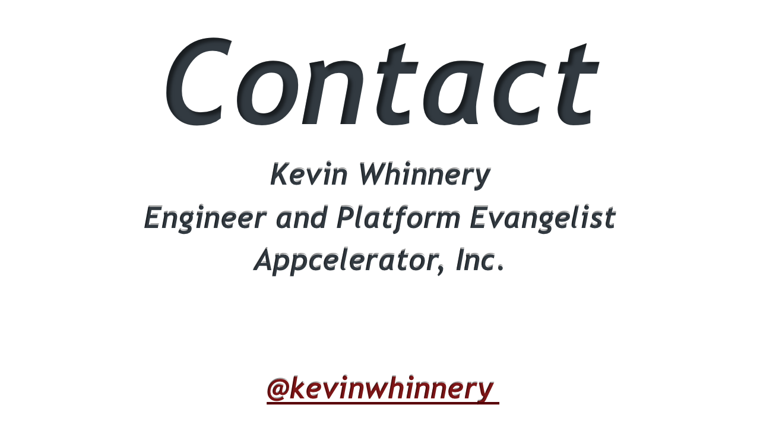

Slide 35


