Slide 1




5-<number>
Notes:
Module time: 60 mins (30 teaching, 30 lab)

Slide 2
アジェンダ
Titanium Mobileで複数の情報保持のメカニズムを理解する
SQLiteエンジンの基礎を学ぶ
設定やJavaScriptオブジェクトを保持するProperties APIを学ぶ
ユーザインタフェースの状態を保持する
5-<number>
Notes:
We’ll cover the differences between mechanisms and when you’d each

Slide 3
Local Data Persistenceメソッド
SQLiteデータベース
Properties API
大量の構造化されたデータ === データベース
設定や20個以下のオブジェクト === Properties
イメージ, バイナリデータ – なるべくblob形式を使わない様に
5-<number>

Slide 4
Properties API
軽量キーバリューストア
少量のデータ保持に最適 (設定情報, アプリの状態保存)
JSONに変換することで、複雑な形式も保持することが可能
5-<number>
Notes:
Properties plus JSON is live-coded in the persistence app, with you writing out a JavaScript object to a string property and then reading it back in.

Slide 5
JSON = JavaScript Object Notation
言語に依存しないオブジェクトをテキストにて表現するフォーマット
コンパクトなデータ形式, 速度の遅いネットワーク経由でも効率的
標準化され、多くの環境で利用されている - json.org
Javascript
JSON
      myObj.id = 1;
      myObj.firstname=“Fred”;
      Myobj.lastname=“Flintstone”;
JSON
stringify()
      {
      “id”: 1,
      “firstname”: “Fred”,
      “lastname”: “Flintstone”
      }
JSON
parse()
5-<number>
Notes:
Quick intro to JSON
Skip if students are familiar with topic

Slide 6
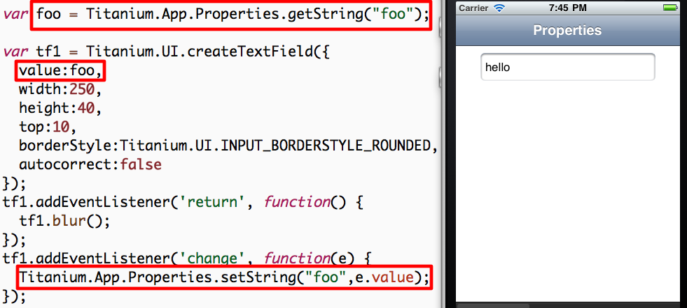
Demo: String Properties
5-<number>
Notes:
Demo for plain old properties uses the “Persistence” demo app
Launch in Developer and demo app
Enter data and quit
Fully quit app
Re-open to demonstrate persistence
Code review:
Open Resources/properties.js
Ti.App.Properties.getString() and mention data types
createTextField()
Change event listener, setString()

Slide 7
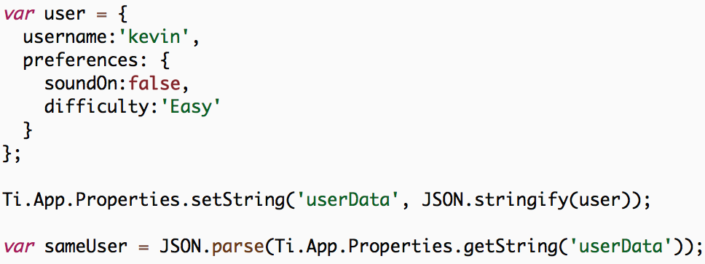
シンプルなオブジェクトを保存
5-<number>
Notes:
Ti Properties can be used to store simple objects
Example user object
Save to userData property via JSON.stringify()
Reconstitute using JSON.parse()

Slide 8
Database API
各プラットフォームの機能と内蔵SQLiteデータベース
大量な構造化されたデータを効率的に扱える
Ti.Database.install を使い、あらかじめ設定されたSQLiteデータベースファイルを利用可能
標準化されたSQL構文を利用可能
デモ: Persistence app
5-<number>
Notes:
NOTE: When shipping a pre-populated database, this will NOT use the SD card on Android and will increase the size of the installable binary. This can be an issue on older Android devices. Also, any time the binary size gets bigger, you should look at alternatives, like downloading your database from the web
Demo -- Persistence app
Open app, switch to Database tab
Add an entry
Click row, alert shows row index
Click Edit, click delete button, click Delete
Don’t do the code review here, next slides

Slide 9
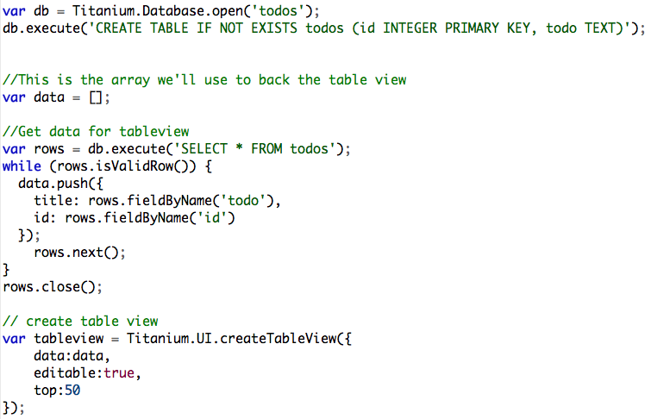
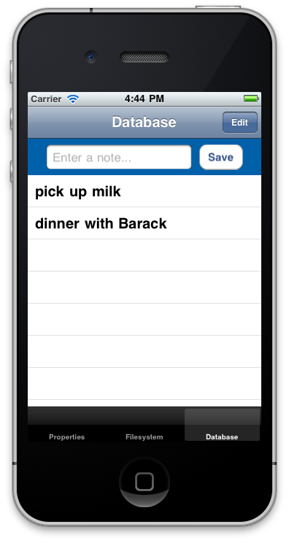
Persistence – データベースデモ
5-<number>
Notes:
Code walkthrough:
Open Resources/app.js and explain basic app structure
Open database.js
Grab reference to database with open()
Create table if it doesn’t exist
Very brief on views/buttons for entry
Retrieving data from DB and building the table row data
rows.next() critical, moves cursor to next record
rows.close() important for memory optimization
better to open and close than to leave open
Creating table, point out editable: true
Event handler on table for alert()
Event handler for delete
Event for adding new row to table
should use db.lastInsertRowID property instead

Slide 10
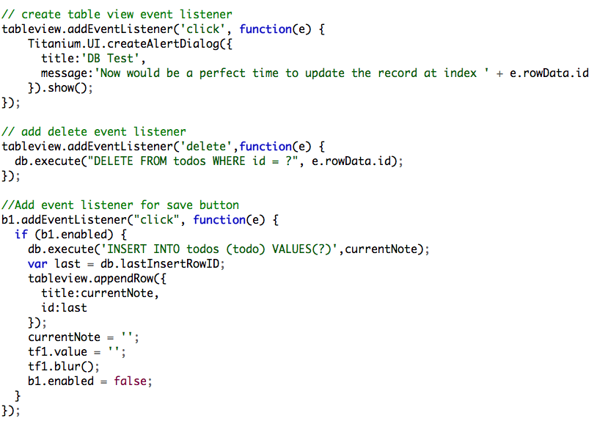
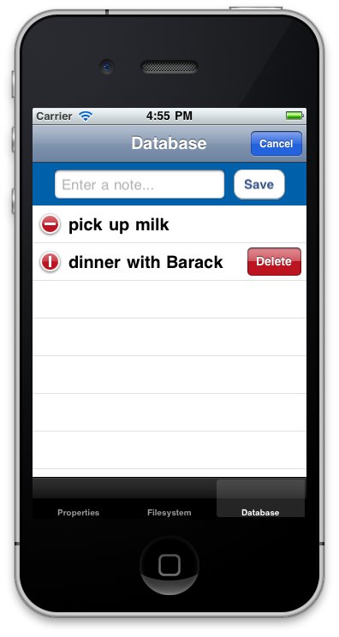
Persistence – データベースデモ
iOS-only
5-<number>
Notes:
iOS only is the table editing and delete event listener
Code walkthrough:
Open Resources/app.js and explain basic app structure
Open database.js
Grab reference to database with open()
Create table if it doesn’t exist
Very brief on views/buttons for entry
Retrieving data from DB and building the table row data
rows.next() critical, moves cursor to next record
rows.close() important for memory optimization
better to open and close than to leave open
Creating table, point out editable: true
Event handler on table for alert()
Event handler for delete
Event for adding new row to table
should use db.lastInsertRowID property instead

Slide 11
SQLiteのデータ型
組み込みのデータ型は少数
テキスト, 整数, 実数, Blob
その他のデータ型は上記のデータ型を利用して表現
論理型 – 整数の0 もしくは 1
日付 – タイムスタンプをテキストで表現
5-<number>
Notes:
SQLite supports more keywords when creating fields, such as VARCHAR
But “under the hood” the various field types are mapped to the four shown here

Slide 12
Q&A
5-<number>

Slide 13
Lab Goals
TiBountyHunterでSQLiteデータベースからデータを読み込む
要件:
CRUD操作をデータベースで行う
「詳細」ウインドーの動作とウインドーを追加する
逃亡者リストへ作成、編集、削除を行う
Demo and Lab URL
5-<number>
Notes:
Sticking with our recommendation for self-contained UI components, you’ll want your tableviews to be able to update themselves when fugitives are added, deleted, or updated. You’ll want to use events to notify elements of changes and add methods to your components to update themselves with the new data.
Demo app
Add a fugitive or two
Click to show details, capture (boolean switch)
Switch to Captured tab and there’s the fugitive
Delete the scoundrel and he’s gone from the table
Show that you’ll be using the menu on Android. Demo.
You can get menu code from the KitchenSink

Slide 14
Lab Exercise
5-<number>

Slide 15
Solution Walkthrough
5-<number>
Notes:
Walk through – TiBH250
app.js
new included file
db.js
DB open, create table, and close statements
list()
add() – note application level event
delete()
bust()
ui.js
Event listener in the tableview, calls populateTable()

