Slide 1




Cross Platform Mobile
Development in Titanium
Kevin Whinnery
Engineer and Platform Evangelist
Appcelerator, Inc.
kwhinnery@appcelerator.com
© 2011 Appcelerator, Inc.
Notes:
This module will cover how to cope with differences and use them for best practice.

Slide 2

Objective
Understand how to write code and compose project resources to deliver cross-platform mobile applications
© 2011 Appcelerator, Inc.
© 2011 Appcelerator, Inc.
Notes:
Writing cross-platform applications isn’t as simple as testing on a single device and expecting the code to work the same across all platforms and devices. This module will show developers how to structure their application code and resources for cross-platform development.

Slide 3
Agenda
Thinking about cross-platform in Titanium
Platform-specific project resources
Writing cross-platform JavaScript
Lab
Summary and Q&A
© 2011 Appcelerator, Inc.
© 2011 Appcelerator, Inc.
Notes:
Present agenda

Slide 4
Cross-Platform in Titanium
Cross-platform !== “Write Once, Run Everywhere”
Titanium is “Write Once, Adapt Everywhere”
We should be building “Best of Breed” apps
Accept and embrace platform differences
© 2011 Appcelerator, Inc.
© 2011 Appcelerator, Inc.
Notes:
The Titanium philosophy of cross-platform is not write once, run everywhere. In practice, that usually turns out to be a lie anyway, as even platforms as mature as Flash have proven.
Titanium provides the tools to reuse 60-90% of code across platforms, depending on the UI needed – write once, adapt anywhere is the mantra.
Titanium is intended to build best of breed applications – on iOS, that mean using Cocoa UI components and local notifications, or registering intents or controlling the hardware back button on Android
The best cross-platform mobile apps will focus on delivering the right native app on the platform, while sharing as much code as possible
Cross-platform differences, for that reason, should be expected and welcomed.

Slide 5
Platform-Specific Examples
Android: intents, background services, hardware menu button
iOS: routes in maps, pre-built animations, custom fonts, Cocoa UI
Platform-specific APIs are implemented in a platform-specific namespace
© 2011 Appcelerator, Inc.
© 2011 Appcelerator, Inc.
Notes:
special api sections, platform only supported logic, etc
resolutions, services, intents/actions.
Because you have these diffs, the API provided is not always supported in all platforms, be aware of this.
(perhaps show a appcelerator API function and the icons!!)

Slide 6
Developing for Multiple Platforms
Titanium API provides a platform variable that can be used with if statements
Platform-specific resources:
Code files
Images, text, and any other file type
Per-platform styles with JSS (SDK 1.5.0)
Platform-specific configuration
© 2011 Appcelerator, Inc.
© 2011 Appcelerator, Inc.
Notes:
The core of customization would be the platform name variable
How ever using Javascript you can implement it in a number of ways
Simple if statements being the simplest form
You can read the variable once and use it later for if statements
You would also be able to implement functions that return your variable so that it is easier to use in your code
Custom folders, containing javascript code/images and icons
Titanium API has special sections for each platform to be able to use the strengths from them
actions, intents, UI transitions etc
JSS new in SDK 1.5.0 can be used favorably to implement differences in platforms
Tiapp.xml provides special config options per platform
Lets take a look at some example code . .

Slide 7


Demo
© 2011 Appcelerator, Inc.

Slide 8
Platform Name
Us the platform name to branch:
Best to store in a single variable:
var isAndroid = false;
if (Titanium.Platform.name == 'android') {
isAndroid = true;
menu = Titanium.UI.Android.OptionMenu.createMenu();
}
pincolor = isAndroid ? "orange" : Titanium.Map.ANNOTATION_RED
if (!isAndroid) {
atlantaParams.pincolor = Titanium.Map.ANNOTATION_PURPLE;
} else {
atlantaParams.pinImage = "../images/map-pin.png";
}
© 2011 Appcelerator, Inc.
Notes:
As the build process runs it will compose files from these folders so that if a file is here it will be exchanged so that
the correct one is used in the root project instead.

Slide 9
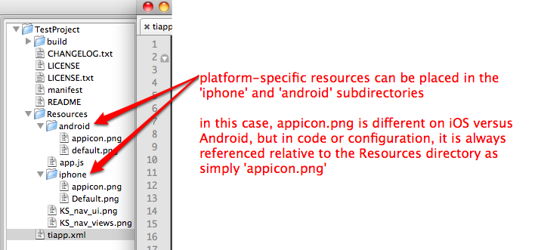
Platform-Specific Resources
© 2011 Appcelerator, Inc.
Notes:
As the build process runs it will compose files from these folders so that if a file is here it will be exchanged so that
the correct one is used in the root project instead.

Slide 10
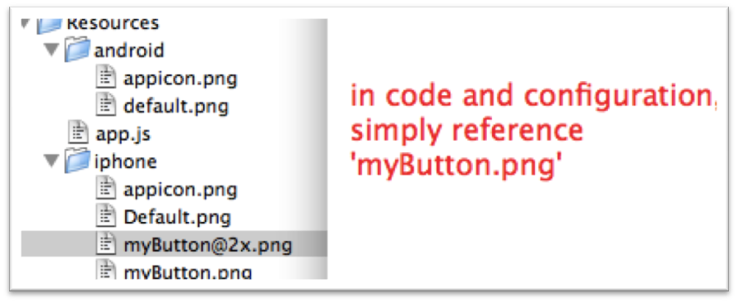
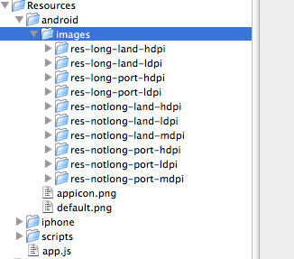
Resolution-Specific Resources
© 2011 Appcelerator, Inc.
Notes:
As the build process runs it will compose files from these folders so that if a file is here it will be exchanged so that
the correct one is used in the root project instead.

Slide 11
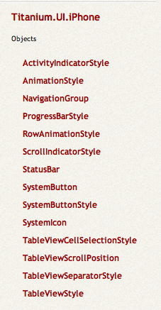
API specific sections
In the Titanium API you can
find functionality for a specific
platform in separate
name spaces.
© 2011 Appcelerator, Inc.
Notes:
So by using the platform name you can chose to enhance the experience for the respective platform user.

Slide 12
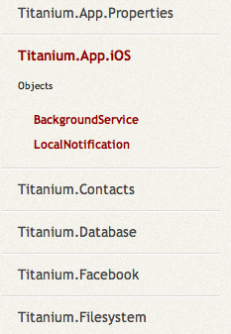
Platform Namespaces
Platform-specific functionality is broken out into sub-namespaces where appropriate
© 2011 Appcelerator, Inc.
Notes:
As the build process runs it will compose files from these folders so that if a file is here it will be exchanged so that
the correct one is used in the root project instead.

Slide 13
Platform-Specific JSS
JSS can be segregated per-platform:
app.jss
app.android.jss
app.android.high.jss
app.android.medium.jss
app.android.low.jss
app.iphone.jss
© 2011 Appcelerator, Inc.
Notes:
JSS files
http://guides.appcelerator.com/en/ui_design.html

Slide 14
Cross-Platform JavaScript Techniques
Component-Oriented UI
Custom UI factories
Smaller components are easier to adapt across platforms
Demo
© 2011 Appcelerator, Inc.
Notes:
JSS files

Slide 15
Lab Exercise
© 2011 Appcelerator, Inc.

Slide 16
Q&A
© 2011 Appcelerator, Inc.

