Slide 1


Integrating Contacts & Social APIs
Address Book & Social APIs

Slide 2
Objective
Utilize contact information & facebook for status and contact updates
Notes:
Discussion about 1.5.1 and facebook module. Currently unspoorted by Appcelerator, but will be rolled into 1.6

Slide 3
Agenda
Overview of contacts
Retrieving contact basics
Facebook Apps & Quick Setup
Using the Graph API
Demonstration
Q&A
Notes:
Overview of contacts – How to add, remove, modify the contacts on iOS. For Android only view the contacts.
Retrieving Contacts – How to pull all data of the contacts and single a person out.
Facebook Apps – Setting up your first Facebook App walkthrough. Getting your application ID & how to use it
Using the Graph API – Installing the Facebook Module for 1.5.1 and getitng it up and rolling
Demo & Lab – A quick demonstration and showing of the contact system and facebook information
Q&A – Questions about integration and testing environment

Slide 4
Overview of Contacts
Contacts are globally accessible. However there are limitations.
iOS
Android
View contacts
Add new contacts
Remove contacts
Group contacts
View contacts
Notes:
Contacts are primarily iOS strong as far as feature sets
At this time Android can only retrieve contact information
You can store local data agaist that information if you want, but it will be only accessible by that application
With iOS you have all control except editing a contact’s information.
A work around for this is removal and re-adding.
- Exception is if it is stored in a favorites list (it will be removed from the list)

Slide 5
Retrieving Contacts
Contact Retrieval is simple.
var people = Titanium.Contacts.getAllPeople();
However, you cannot trace output to console.
Notes:
Get all people will return an array of Person(s). This is the easy way to grab all contacts.
ShowContacts will open a modal window with all contacts in there. Not customizable. Think of it as a gallery picker.

Slide 6
Contact Data Structure
Groups & Person
Ti.Contact.Person – Represents a single contact
Ti.Contact.Group – Represents a group of contacts
Notes:
Person is a single contact with all the proper information that is expected. name, address, phone…. etc…
Group is not used as part of address book but is used in OSX’s address book application

Slide 7
Contact Person
There are strings & objects
Strings
Objects
firstName
lastName
created
modifed
URL
address
date
email
There are many more that will be shown in the lab.
Notes:
It is important to note the items that are strings and objects. The objects can be looped to provide
multiple addresses, dates (anniversay, others) and emails.
Strings are things that we would only have one entry for. Birthday you think would be a object rolled into date,
but it is a string.

Slide 8
Contact Person
Contact’s CAN be part of mulitple groups
Group.add();
Group.members();
Group.remove();
Group.sortedMembers();
Receives a Person
Lists all members
Receives a Person
First name or last name only
Notes:
Note that in groups are only iOS.
The functions are self explanatory but do expect a ‘Person’ to be there for them.
Sorted members can only be sorted by firstname or lastname.

Slide 9
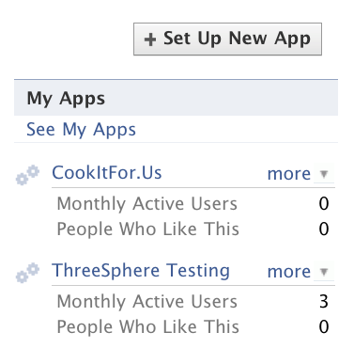
Facebook Introduction
Must have a valid Facebook Account
Need to create an App
http://www.facebook.com/developers/
Notes:
Facebook requires these items for it to work. It is important to start this process through the developer site.
You might have to sign a terms and conditions section if you haven’t developed an app prior to this.

Slide 10
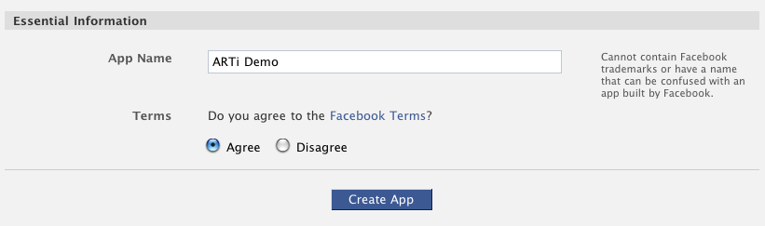
Facebook Apps
Create an App Name: Your App Name
Notes:
Creating an application is very simple, provide an app name.

Slide 11
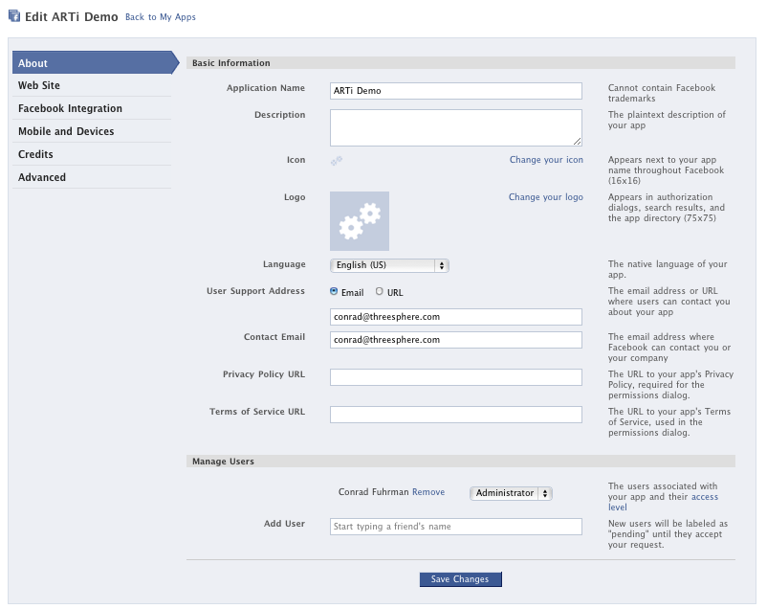
Facebook Apps
Once your done this is the screen you’ll see.
We are only concerned with one other section.
Mobile & Devices
Notes:
Adjust the mobile and deivce settinsg and add users to the account.
The users can be testers, admins, or other. This will help with sanboxing the application

Slide 12
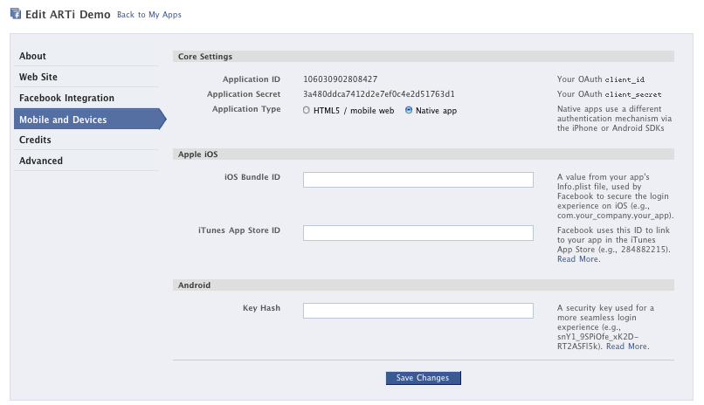
Facebook Apps
You need the following:
Application Type: Native App
Application ID
Application Secret
Notes:
Ensure that you set the application to Native. This will affect how authentication actually works.

Slide 13
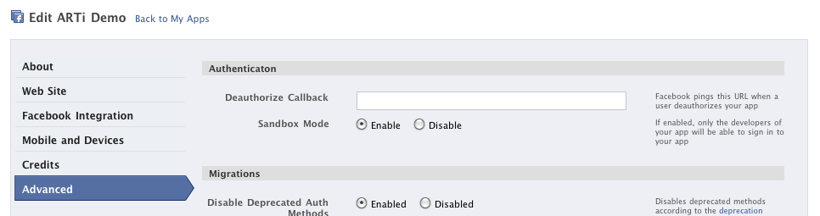

Facebook Apps
Sandbox Mode!
Notes:
Also enable sandbox mode here. This will ensure that only the people that you specify have access to your application.

Slide 14
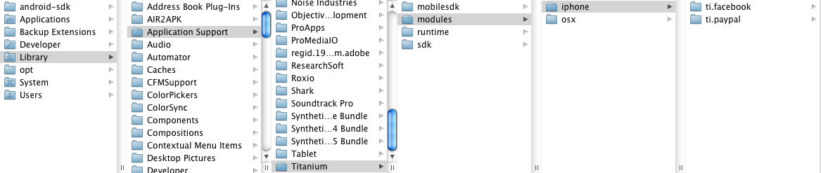
Facebook Module
Library > Application Support > Titanium > modules > iphone
This module will be rolled into version 1.6.
Notes:
Installing the facebook module is easy. The directory structure I like revolves around the root of the users computer. This is iOS only since we are
working with 1.5.1. In 1.6 this will not have to be done.

Slide 15
Titanium & Facebook (Three Parts)
Info.plist file
1 <key>CFBundleURLSchemes</key>
2 <array>
3 <string>fbYOURAPPID</string>
4 </array>
tiapp.xml file
1 <modules>
2 <module version=“0.1”>ti.facebook</module>
3 </modules>
Within your Resources Directory
1 var facebook = require(“ti.facebook”);
2 facebook.appid = “YOUR APPS ID”;
3 facebook.permissions = [“A LIST OF PERMISSIONS”];
Notes:
When using Facebook, there are three files that need some basic information.
This is the APPID and the Permissions that you’ll need

Slide 16
Facebook Permissions
http://developers.facebook.com/docs/authentication/permissions/
email
offline_access
sms
publish_stream
create_event
rsvp_event
publish_checkins
user_birthday
user_website
Notes:
There are a ton of permissions and the most important one we use is offline_access
It provides a non-expiring accessToken that can be utilized for background access.

Slide 17
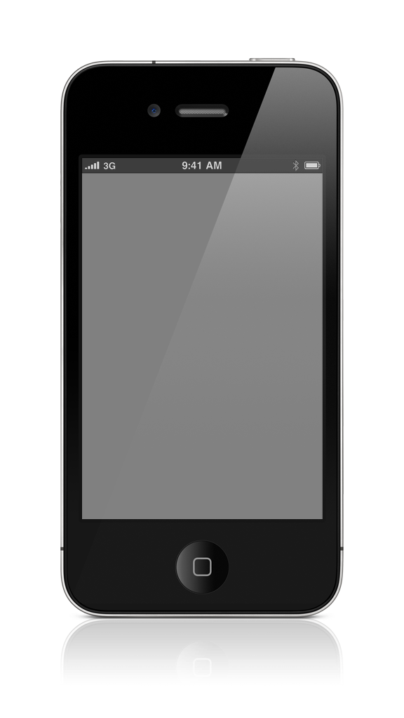
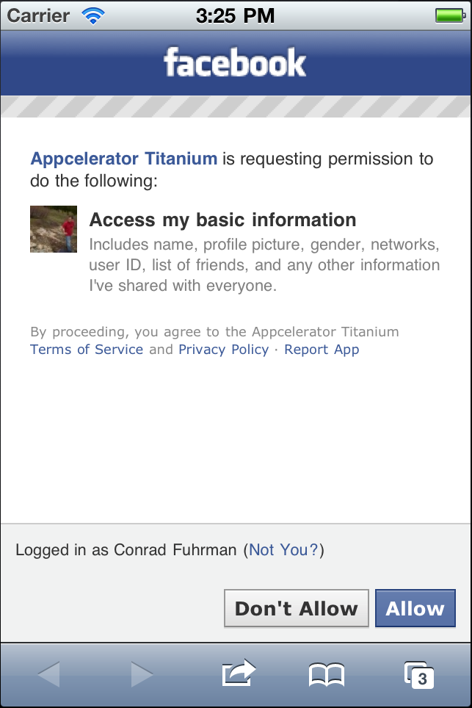
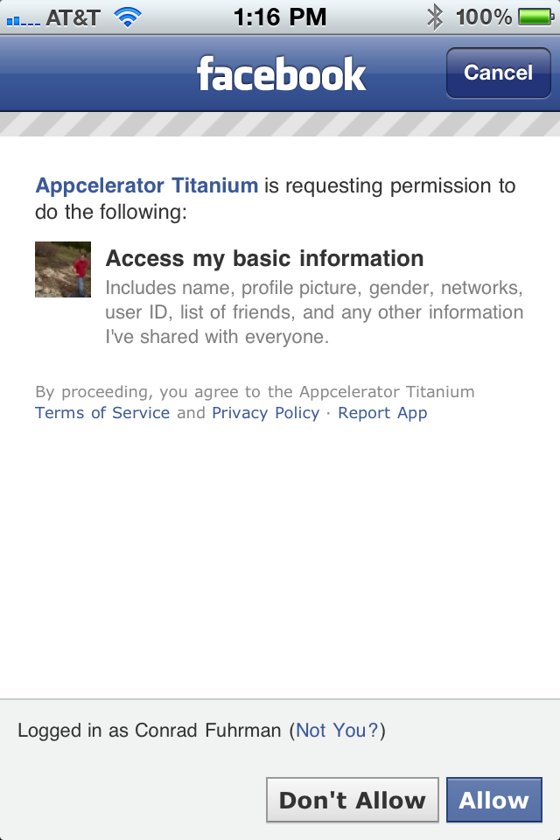
Facebook & Mobile Experience
Mobile Web
Facebook App
Notes:
If a user doesn’t have the Facebook app on their phone it will be a slightly different process
The app will use mobile web to authroize.
It is important to discuss the user experiene here and test on device at this time.

Slide 18


Demonstration
Notes:
For the demonstration we will create a two tab app that pulls data from the address book and from facebook. It will
display Facebook friends. Basic operation of the two API’s will be shown here.

Slide 19
Summary
You should now be able to pull information from the contacts and use a Facebook App to interact with a Facebook users information.

Slide 20
Q&A

