Slide 1


Titanium Studio
STD-<number>
Notes:
Module time: 15 mins (no lab)

Slide 2
Agenda
Intro / Review
Titanium-specific features
Deployment and distribution features
Debugging
Customizing and extending
STD-<number>

Slide 3
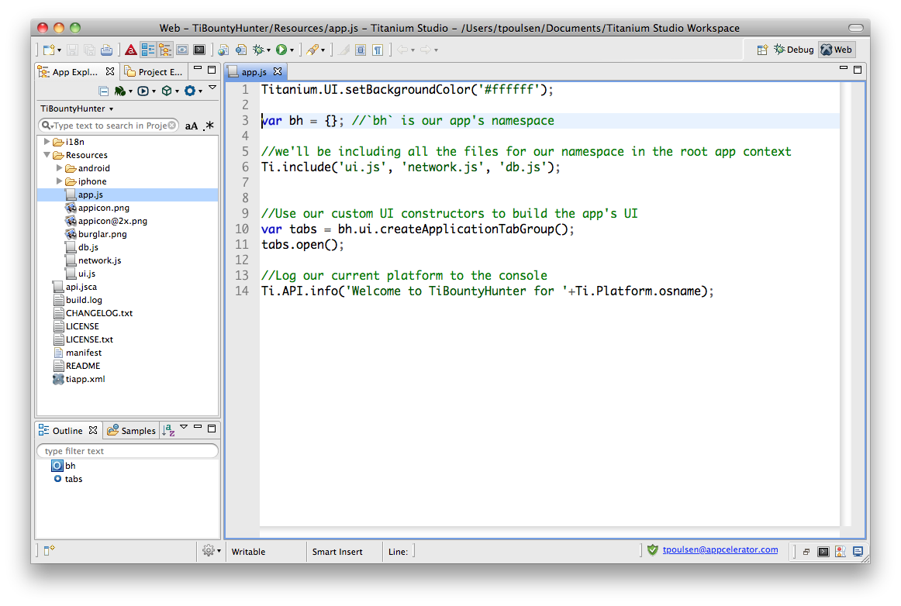
Eclipse concepts
Perspective
View
Editor
STD-<number>
Notes:
Based on Eclipse (www.eclipse.org/) – open source software development tools project
Editor = window in which you change code or project parameters
View = hierarchical selector, such as a file tree
Perspective = Editors + Views
Workspace = file location for your project

Slide 4
UI Overview
Coding features
Debug, Run, & Deploy menus
App explorer
Terminal & Console buttons
STD-<number>
Notes:
Point out the main UI features
App Explorer (view)
Code editing view & features (editor)
Debug, Run & Deploy menus
New project button
Terminal, Console, and Problems buttons

Slide 5
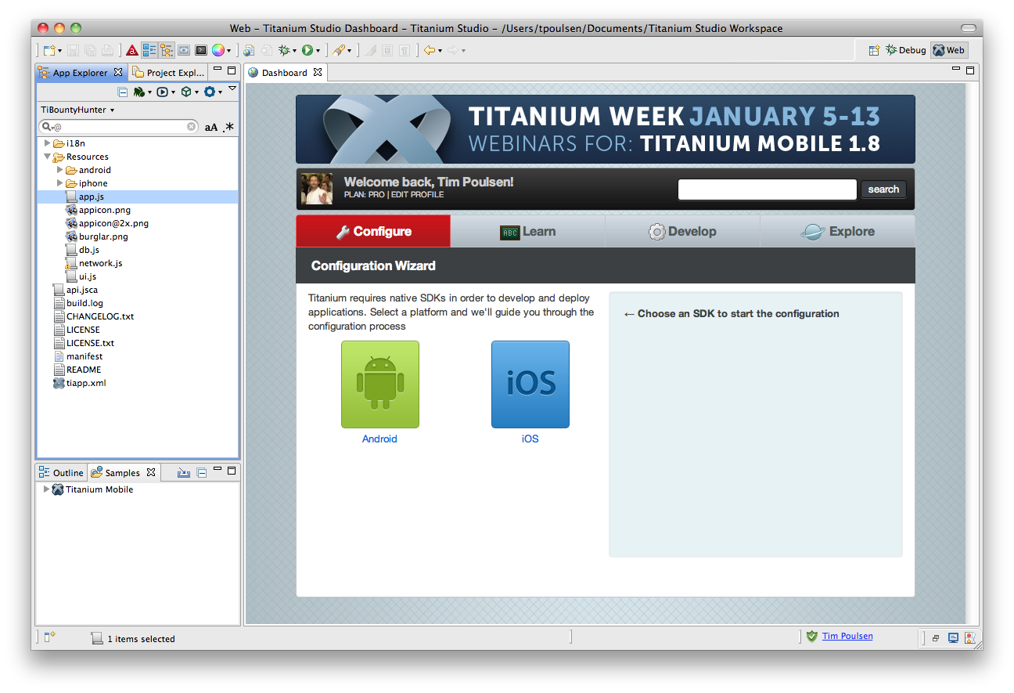
Titanium Dashboard
Dashboard
STD-<number>
Notes:
News and notes about Titanium, Appcelerator, and Aptana

Slide 6
Titanium-specific features
Project management – create project wizard, tiapp.xml editor, build cleaning
Project configuration - API level, emulator settings, more
Console output and filtering
Run and Deploy menus
Demo
STD-<number>
Notes:
Demo:
show tiapp.xml editor
build cleaning
config project – set api level & android emulator options

Slide 7
Deployment and distribution
Mobile deployment and distribution features
Local web / HTML testing (integrated/system browser)
Web/ HTML / PHP deployment (ftp, sftp, ftps)
PHP, Ruby, etc. deployment and distribution (Engine Yard, RedHat Cloud, Capistrano)
Git integration – pull/push/commit, branching
SVN & other CI system integration (add-ons)
STD-<number>

Slide 8
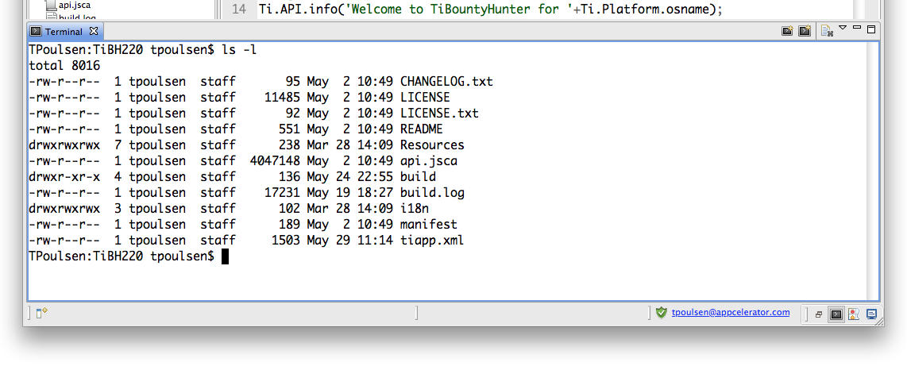
Integrated terminal
click here
STD-<number>

Slide 9
Debugging
Breakpoints, stepping through code, conditional breakpoints
Variables – examining variable state and affecting run-time variable values
Demo
STD-<number>
Notes:
Use a project like TiBountyHunter and set a break point
e.g. in the table-creation loop
Demonstrate changing a variable live
e.g. changing the name of a fugitive

Slide 10
Customizing
Themes & colors
Editor options (line wrapping, numbering, etc.)
“macros” and shortcuts
STD-<number>
Notes:
You can customize many aspects of Ti Studio …

Slide 11
TextMate compatibility
Importing TextMate themes
Importing TextMate bundles
STD-<number>
Notes:
Studio is compatible with textmate themes and bundles

Slide 12
Extending and maintaining Ti Studio
Add-ons – e.g. SVN tools
Updates and update checking
STD-<number>
Notes:
You can install support for CVS, SVN and so forth through add-ons
Studio uses and is generally compatible with Eclipse add-ons
Studio automatically checks for program and SDK updates
You can manually update the SDK (e.g. to use a CI build) by choosing Help, Install Titanium SDK from URL

Slide 13

Q&A
STD-<number>
Notes:
There is no lab. Before we move to the next module, what questions do you have?

