Slide 1

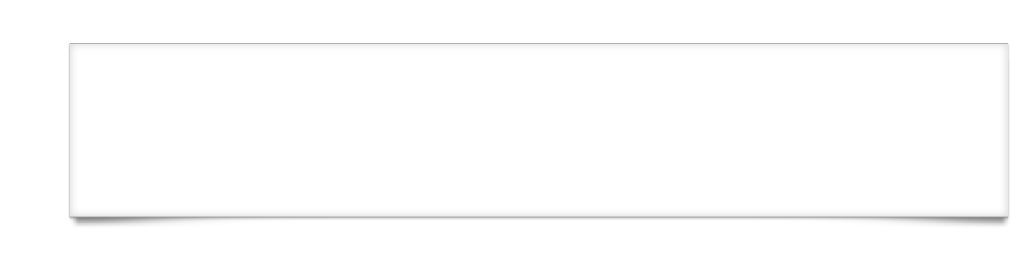


WEB-<number>
Notes:
Module time: 60 mins (Teaching: 15 mins, lab: 45 mins)

Slide 2
Agenda
Integrating the WebView component
WebView gotchas
Novel uses of the WebView
Lab Exercise
WEB-<number>

Slide 3
Integrating Web Content
HTML/CSS are embedded in much data on the web
HTML/CSS are often the only/best way to accomplish certain tasks:
Rendering HTML/CSS (duh)
Canvas (animations)
Integrating existing web-based tools
Walking HTML documents
WEB-<number>
Notes:
Many business-use cases for using HTML/CSS in your app
Might be easiest way to go
Canvas for animations
Existing libraries (graphing, jquery)
DOM manipulations and access

Slide 4
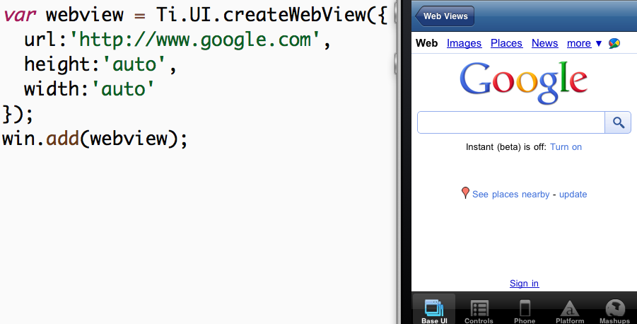
Remote Web Content
Uses might include pulling in blog content from an RSS feed (hint) or re-purposing (semi) static content from an existing site
WEB-<number>
Notes:
Static / existing web pages
Dynamic data from a CMS or web service
Embed a web view anywhere in your app (views, windows)

Slide 5
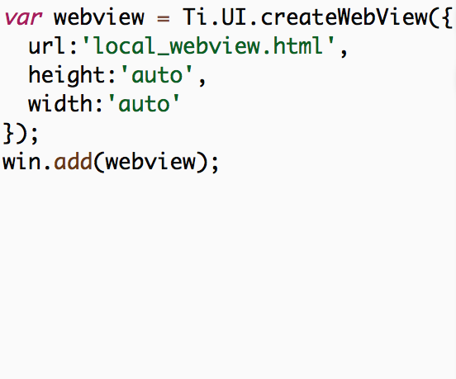
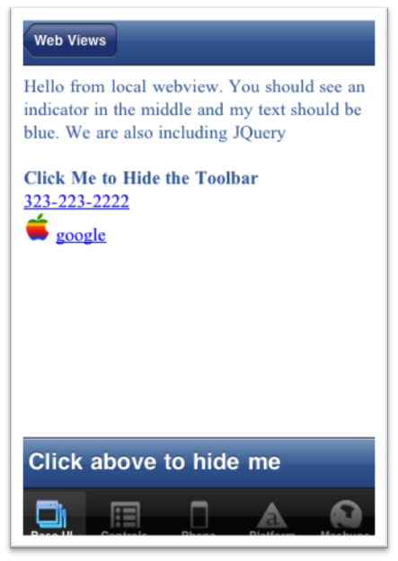
Local Web Content
Webkit can sometimes do something we can’t, or we need to re-use existing code (ours or someone else’s) – in those cases, we can ship HTML/CSS/JS with our app
WEB-<number>
Notes:
Integrated webkit has lots of power and capabilities
Easy way to embed custom UI, pre-existing content, formatted text
Point URL to local web content file
Loaded relative to Resources directory

Slide 6
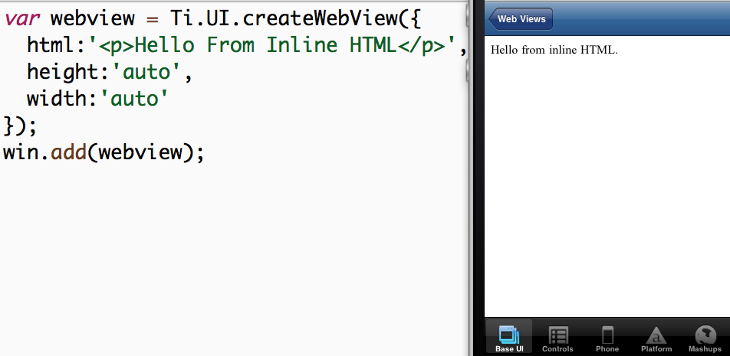
Local Web Content - Inline
Sometimes HTML markup is the best way to display small chunks of text or links (Android handles both natively)
WEB-<number>
Notes:
Use HTML property for inline content
Native Android support for HTML in labels and some other components
E.g. linkify() method will turn links and phone numbers into clickable links
See the API docs for more information

Slide 7
Communicating With The Wrapper
Remote web content has no access to Titanium APIs
Limited Titanium API access within local web pages:
Logging APIs (Ti.API.info and friends)
Application Level Events (Ti.App.fireEvent/addEventListener)
Native APIs must be accessed indirectly via application level events
WEB-<number>
Notes:
Embedded webview is its own execution context
Use custom events to communicate with rest of the app
For example, geolocation: grab data in native app, fire event passing results to webview
Remote content doesn’t have access to Ti APIs
But you can inject some JS into a remote page to give limited access

Slide 8
WebView Gotchas
Among the most expensive components to create
Should not be embedded in other scrollable views
Common misuse – inside TableViewRows (bad performance)
It is possible to implement your whole UI in HTML/CSS, but native UI is what your users expect
Can’t download/run unapproved code from a server
WEB-<number>
Notes:
Scrollable views, table views – Touch events can get messed up, bad performance

Slide 9
Novel Uses of the WebView
Display text with embedded links (think Twitter client)
Display PDF documents and more (iOS, see next slide)
Retrieve and parse HTML using the DOM (easier than in native Ti code, where you’d need to do string gymnastics)
Longer forms on iOS (next/previous buttons, auto resizing)
WEB-<number>
Notes:
iOS – view PDF (built into Safari) on Android, has to be done through 3rd party app
Parsing HTML – use jquery or other libraries to walk the DOM
Forms - auto resizing, auto-scrolling, auto “Next” button on iOS to ease data entry.

Slide 10
Embedded Documents on iOS
WebView on iOS can display embedded:
Excel
Keynote
Numbers
Pages
PDF
PowerPoint
Word
RTF
RTF Directory
WEB-<number>
Notes:
Source: http://developer.apple.com/library/ios/#qa/qa1630/_index.html

Slide 11
Q&A
WEB-<number>

Slide 12
Lab Goals
Create an RSS Reader which pulls in an XML feed and displays a blog post in a web view.
Requirements:
Pull in an RSS feed and place the results in a TableView
Create an “about” page using local HTML
Demo and Lab URL
WEB-<number>
Notes:
Demo – Lab285:
Show scrolling list of news items
Click one to show web view
Click About tab to show local HTML data
Switched RSS feed might have gone stale, use Dev blog instead:
http://developer.appcelerator.com/blog/feed

Slide 13
Lab Exercise
WEB-<number>
Notes:
Code Walkthrough – Lab285
app.js
show URL at top
xhr.onload ~line 66
xml = this.responseXML
talk through walking the XML DOM
loop through items array to build table rows
point out custom row.link property
tableview event listener
custom property (win.myurl) on window
showweb.js
creating the web view (line 2)
loads url passed in via custom window property
Scroll back to top to point out local HTML
Could load from about.html instead

