Slide 1




1-<number>
Notes:
This PPT is to introduce the whole course and take care of housekeeping tasks (agendas, etc.)

Slide 2
Introduce yourself
Briefly please:
  Name
  What’s your background?
  What’s your Titanium experience?
1-<number>
Notes:
Try to keep the introductions to 10 mins, total for the whole class

Slide 3
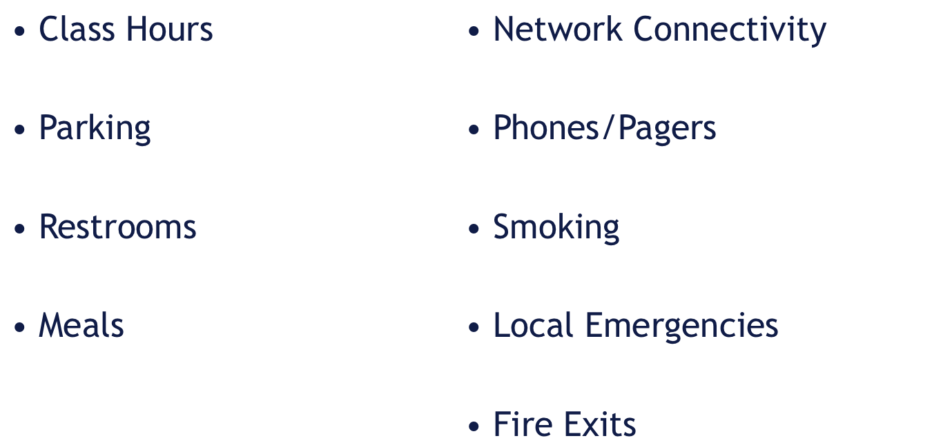
Housekeeping
1-<number>

Slide 4
Course Objectives
Understand the high-level architecture of Titanium
Apply good design principles for JavaScript code
Navigate the documentation and resources available
Master key APIs and concepts
Attempt (and pass!) a certification exam
1-<number>

Slide 5
Daily Schedule
Day One
Orientation/Recap
Native Dev Crash Course
Cross-Platform Dev
UI Fundamentals
Local Data
Remote Data
** Media/Filesystem
Q&A, Hacking
Day Two
** Media/Filesystem
Location Services
Contacts/Social APIs
Web Content
Deploy & Distribute
Study Session/Review
Certification Exam
Q&A, Hacking
1-<number>
Notes:
Depending on how fast people are completing the labs and the logisitcal flow of the class, we may cover Media/Filesystem on Day One, otherwise it may slip to Day Two.

Slide 6
Q&A
1-<number>

