Slide 1

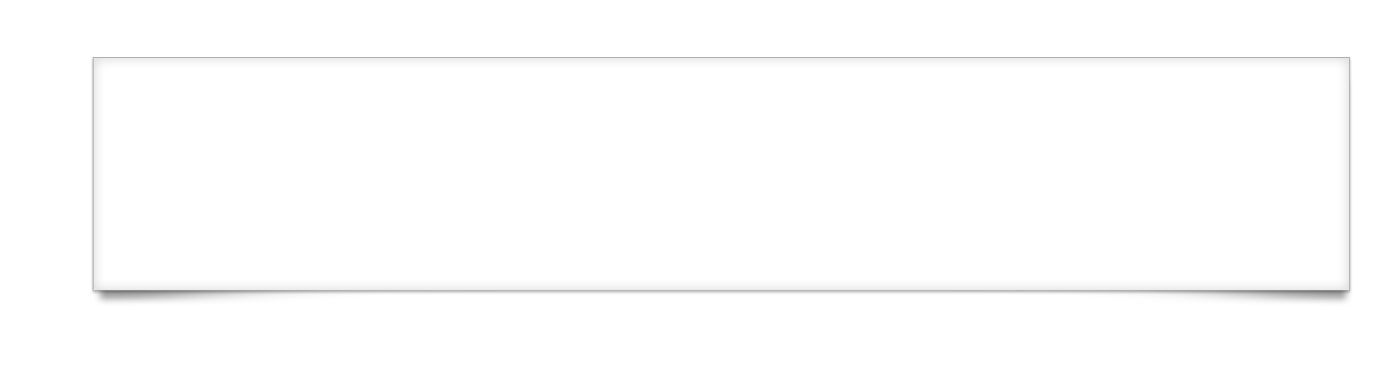


UIF-<number>
Notes:
Module time: 1 hour, 15 mins (30 mins teaching, 45 mins lab)

Slide 2
Agenda
Basic Titanium user interface structures
The Titanium View Hierarchy
Layouts and positioning
Event Handling
UIF-<number>
Notes:
View hierarchy = relationship components have to each other as you lay them out
Event handling on a component and app level

Slide 3
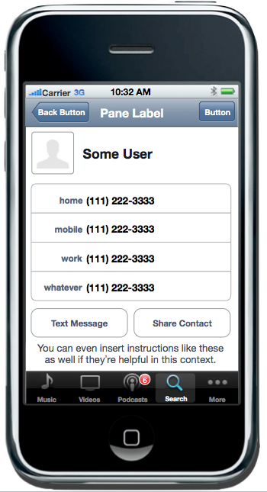
iOS User Interface Components
Status bar
Navigation bar
Rightnav
button
Leftnav
button
Table with
custom labels
Button
Notification
indicator
Tab bar
UIF-<number>
Notes:
Briefly introduce the key iOS user interface components
especially for the Android users in the class

Slide 4
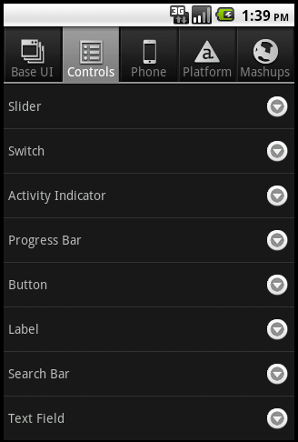
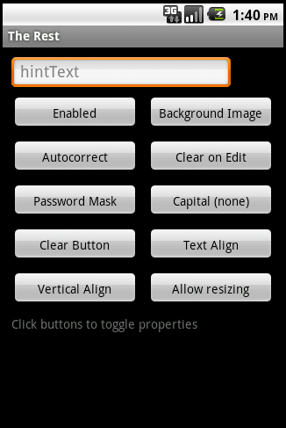
Android User Interface Components
Title bar
Notification
bar
Tab bar
Button
TableView and rows
UIF-<number>
Notes:
Briefly introduce the key Android user interface components
especially for the iOS users in the class

Slide 5
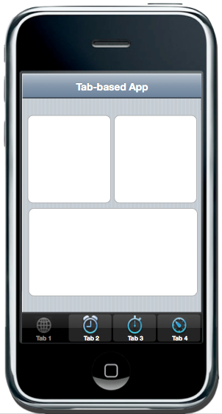
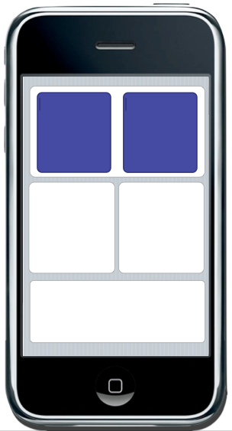
Basic Application Structure
Tab-based app
Single window
UIF-<number>
Notes:
Brief: there are two basic ways to structure an app
Tab group with multiple windows
Single window with individual views or stack of sub-windows
Key goal is to make our UI elements self-contained and self-updating to abstract the UI from the app’s logic

Slide 6
For you web developers…
A “window” is analogous to a “page”
A “view” is analogous to a “div”
Ti.UI namespace provides many specialized controls (buttons, text field, pickers, scroll views)
UI objects are composed in JavaScript similarly to DOM fragments
UIF-<number>
Notes:
UI elements composed in constructor style structure, pass parameters and get an object in return

Slide 7
View Hierarchy and Positioning
Modeled after iOS View Hierarchy
Views positioned relative to parent
Layout options:
1. Absolute
2. Vertical
3. Horizontal
Points or percentage heights/widths
UIF-<number>
Notes:
Absolute – relative to parent not screen
Vertical & horizontal – apply to parent object – we’ll see examples in upcoming slides

Slide 8
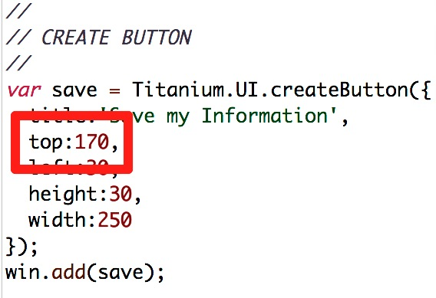
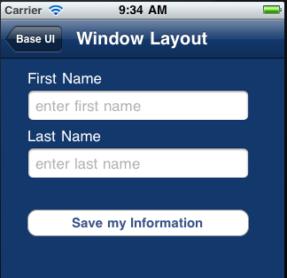

Absolute Layout
UIF-<number>
Notes:
We have here a window with a couple UI elements
The button is positioned 170 points from the parent’s top edge

Slide 9
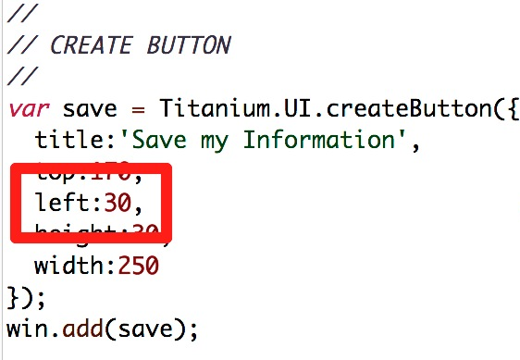

Absolute Layout
UIF-<number>
Notes:
Absolute, left 30 points from left edge

Slide 10
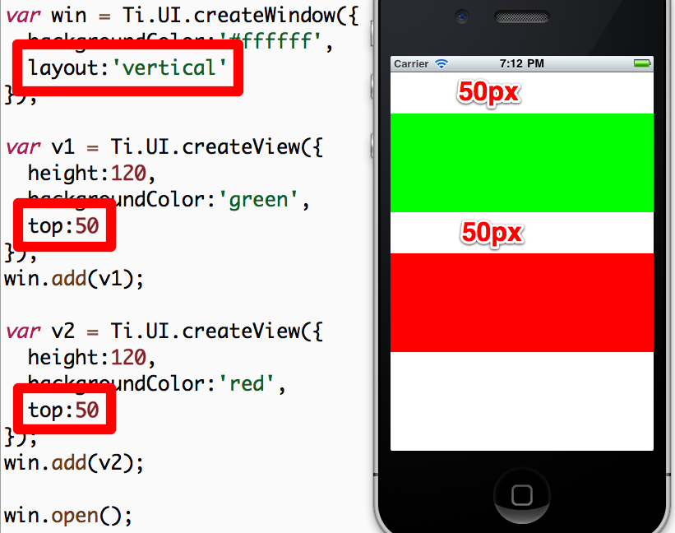
Vertical Layout
UIF-<number>
Notes:
Parent object has the Vertical layout
Child object’s positions are then in relation to each other within the parent

Slide 11
Event Handling
Similar To JavaScript in the browser
Can use addEventListener on nearly any JS object
Can programmatically fire events on objects as well
Demo: A simple event handler in the default project
UIF-<number>
Notes:
Add event listeners to objects at a component, object or app level
Programmatically fire events
Demo:
Test app from prev. module or new default app
Add event listener to the label on win1, change text of label
(Note: “tap” event is the same as “click”)
Build, click label to see event fired

Slide 12
Execution Contexts
App has one execution context by default – similar to JS thread in the browser
Can create more by:
Windows with URLs
Background Services
Each has unique symbol space – variables declared in one context unavailable in another
Demo: Execution Contexts in the default application
UIF-<number>
Notes:
Execution context is a variable space, processing thread
App.js is default context, which you get automatically
Can create others, but maybe not desirable
Demo:
In your test app, move win1 code to separate file
Update app.js to load the windows from those files
Build – error – can’t find window object
Fix with Ti.UI.currentWindow, re-build

Slide 13
More On Execution Contexts
Typically, we recommend using only a single context
Use multiples only when “clean slate” is desired
If multiple contexts are in use, it is often necessary to share data across them
For this, use application-level events
UIF-<number>
Notes:
Kitchen Sink specifically uses separate contexts because it needs / wants those clean slates

Slide 14
Application-Level Events
Useful for sending JSON-serializable data across contexts
Useful for publishing and subscribing to application events even in a single context
Critical API in component oriented applications
Demo: Cross-context messages in the default application
UIF-<number>
Notes:
Using App level events, we can de-couple our UI from our logic
UI components can listen for events and update themselves
Events can just alert or pass JSON serializable data
Demo:
Move win 2 to win2.js, using Ti.UI.currentWindow
Label2, subscribe to app:labelclicked event
receives data in event object
update label2 text & color
In win1.js, click event handler fires app:labelclicked
pass message text as second arg
Build – doesn’t work – window has to have been opened to receive events

Slide 15
Composing Your App’s UI
50% or more of your job is UI component construction
Most of the rest is event handling logic
Your app will be more maintainable if you break it down into small components
Recommendation: Use app.js to bootstrap your application and create/show/open one single UI component from your app
UIF-<number>
Notes:
Self-contained, self-updating components are easiest to maintain
Single context is recommended

Slide 16
Iterative UI Programming
UI programming can boil down to pushing pixels
Need to have the fastest possible cycles, but also need to test cross-platform from the get-go!
iOS Simulator is fast for dev, device cycle is slow
Android Emulator is S-L-O-W – keep it running!
Android devices are faster (better for dev)
UIF-<number>
Notes:
Don’t wait to test cross-platform, Android and iOS can be very different

Slide 17
Q&A
UIF-<number>

Slide 18
Lab Goals
Compose a basic two tab application
Requirements:
Display list of fugitives (dummy data)
Drill down into a detail window
Provide a window to add a fugitive
Demo and Lab URL
UIF-<number>
Notes:
Detail window – buttons don’t do anything, show labels with actual data
Add window will be empty at this point
Demo finished code: TiBH220
Hint: try to re-use as much as possible. So, one function to show detail window that accepts a busted boolean to show the details for the at-large and captured fugitives

Slide 19
Lab Exercise
UIF-<number>

Slide 20
Solution Walkthrough
UIF-<number>
Notes:
TiBH220 – ui.js file
createAddWindow() function
createDetailWindow()
The _bounty param & comment
ternary operator
createBountyTableView()
single function for both tables
boolean param
grab handle to tab
table data construction
createBountyWindow()
boolean param
Android menu
platform switch to set right nav button
createApplicationTabGroup()
single function
call createBountyWindow() twice

