Slide 1




LOC-<number>
Notes:
Module time: 60 mins (30 teaching, 30 lab)

Slide 2
Agenda
Understand the different mechanisms for persistence in Titanium Mobile
Learn the basics of the SQLite database engine
Learn how to use the Properties API to store configuration and JavaScript objects
Use persistent data to back user interface elements
LOC-<number>
Notes:
We’ll cover the differences between mechanisms and when you’d each

Slide 3
Local Data Persistence methods
SQLite Database
Properties API
Lots of structured data === Database
Configuration or less than 20 or so objects === Properties
Images, binary data – don’t use blobs if you can avoid it
LOC-<number>

Slide 4
Properties API
Lightweight Key/Value Store
Best suited for light persistence needs (configuration options, saved application state)
Coupled with JSON, can be used to store complex JavaScript objects
LOC-<number>
Notes:
Properties plus JSON is live-coded in the persistence app, with you writing out a JavaScript object to a string property and then reading it back in.

Slide 5
JSON = JavaScript Object Notation
Language-independent text-based means to represent arrays and objects (without methods)
Compact data format, efficient over slow networks
Standardized and widely supported, see json.org
Javascript
JSON
      myObj.id = 1;
      myObj.firstname=“Fred”;
      Myobj.lastname=“Flintstone”;
JSON
stringify()
      {
      “id”: 1,
      “firstname”: “Fred”,
      “lastname”: “Flintstone”
      }
JSON
parse()
LOC-<number>
Notes:
Quick intro to JSON
Skip if students are familiar with topic

Slide 6
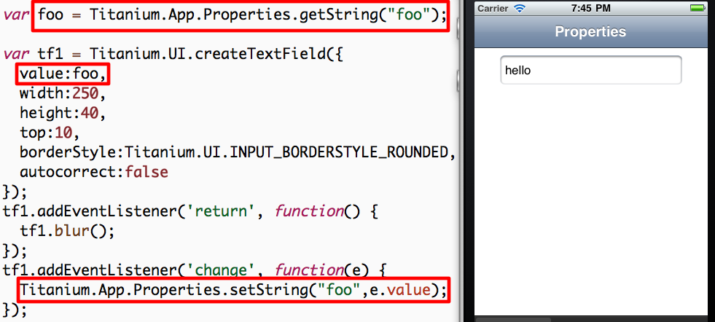
Demo: String Properties
LOC-<number>
Notes:
Demo for plain old properties uses the “Persistence” demo app
Launch in Developer and demo app
Enter data and quit
Fully quit app
Re-open to demonstrate persistence
Code review:
Open Resources/properties.js
Ti.App.Properties.getString() and mention data types
createTextField()
Change event listener, setString()

Slide 7
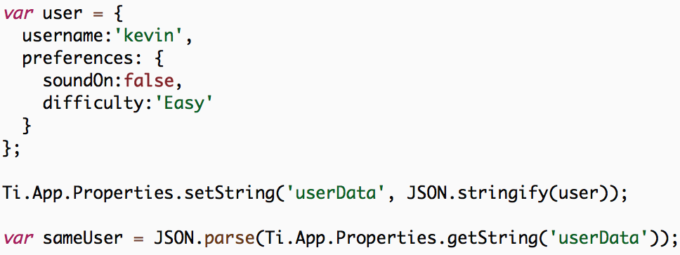
Simple Object Storage
LOC-<number>
Notes:
Ti Properties can be used to store simple objects
Example user object
Save to userData property via JSON.stringify()
Reconstitute using JSON.parse()

Slide 8
Database API
Each platform features and embedded SQLite database
Best used for large amounts of structured data
You can use a pre-populated SQLite database file using Ti.Database.install
Interact with the DB using standard SQL statements
Demo: Persistence app
LOC-<number>
Notes:
NOTE: When shipping a pre-populated database, this will NOT use the SD card on Android and will increase the size of the installable binary. This can be an issue on older Android devices. Also, any time the binary size gets bigger, you should look at alternatives, like downloading your database from the web
Demo -- Persistence app
Open app, switch to Database tab
Add an entry
Click row, alert shows row index
Click Edit, click delete button, click Delete
Don’t do the code review here, next slides

Slide 9
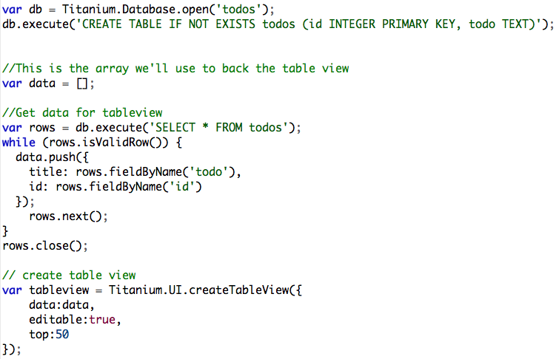
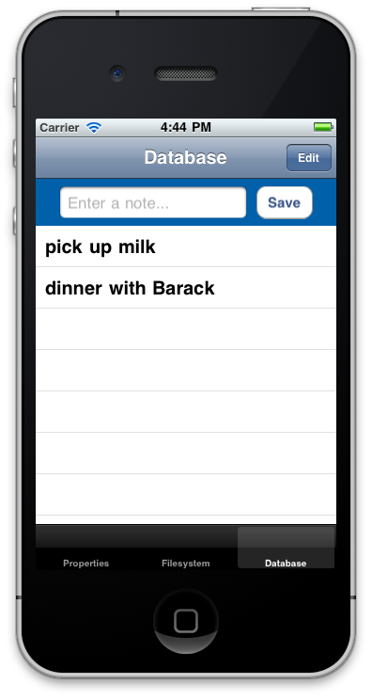
Persistence – Database demo
LOC-<number>
Notes:
Code walkthrough:
Open Resources/app.js and explain basic app structure
Open database.js
Grab reference to database with open()
Create table if it doesn’t exist
Very brief on views/buttons for entry
Retrieving data from DB and building the table row data
rows.next() critical, moves cursor to next record
rows.close() important for memory optimization
better to open and close than to leave open
Creating table, point out editable: true
Event handler on table for alert()
Event handler for delete
Event for adding new row to table
should use db.lastInsertRowID property instead

Slide 10
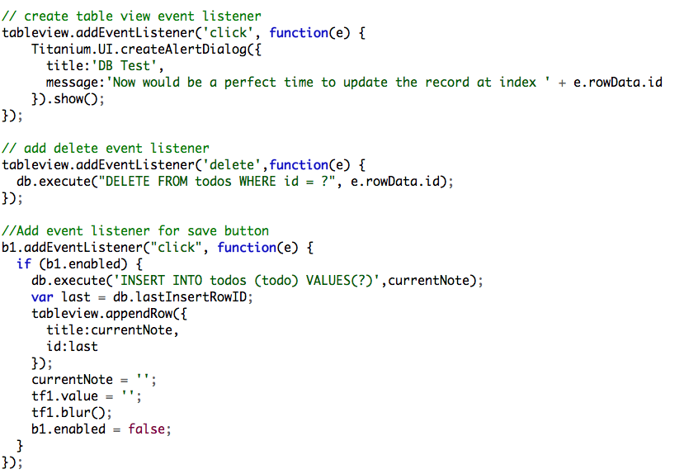
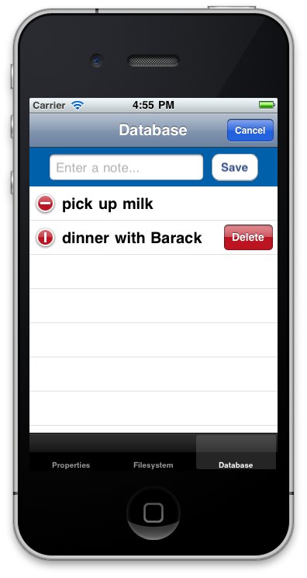
Persistence – Database demo
iOS-only
LOC-<number>
Notes:
iOS only is the table editing and delete event listener
Code walkthrough:
Open Resources/app.js and explain basic app structure
Open database.js
Grab reference to database with open()
Create table if it doesn’t exist
Very brief on views/buttons for entry
Retrieving data from DB and building the table row data
rows.next() critical, moves cursor to next record
rows.close() important for memory optimization
better to open and close than to leave open
Creating table, point out editable: true
Event handler on table for alert()
Event handler for delete
Event for adding new row to table
should use db.lastInsertRowID property instead

Slide 11
SQLite Data Types
Small number of built-in data types
Text, Integer, Real, Blob
Need to represent other data types within these primitives
Boolean - Integer 0 or 1
Date – Timestamp as text
LOC-<number>
Notes:
SQLite supports more keywords when creating fields, such as VARCHAR
But “under the hood” the various field types are mapped to the four shown here

Slide 12
Q&A
LOC-<number>

Slide 13
Lab Goals
Back our TiBountyHunter application with live data from a SQL database
Requirements:
CRUD operations on our fugitive database
Adding behavior to our detail and add windows
Update the fugitive lists on create, update or delete
Demo and Lab URL
LOC-<number>
Notes:
Sticking with our recommendation for self-contained UI components, you’ll want your tableviews to be able to update themselves when fugitives are added, deleted, or updated. You’ll want to use events to notify elements of changes and add methods to your components to update themselves with the new data.
Demo app
Add a fugitive or two
Click to show details, capture (boolean switch)
Switch to Captured tab and there’s the fugitive
Delete the scoundrel and he’s gone from the table
Show that you’ll be using the menu on Android. Demo.
You can get menu code from the KitchenSink

Slide 14
Lab Exercise
LOC-<number>

Slide 15
Solution Walkthrough
LOC-<number>
Notes:
Walk through – TiBH250
app.js
new included file
db.js
DB open, create table, and close statements
list()
add() – note application level event
delete()
bust()
ui.js
Event listener in the tableview, calls populateTable()

