Slide 1




You’re a Native App
Developer Now
Kevin Whinnery
Engineer and Platform Evangelist
Appcelerator, Inc.
kwhinnery@appcelerator.com
© 2011 Appcelerator, Inc.
Notes:
This module will cover a high level how to work in Android or iPhone development environments.
By understanding those you will more easily develop in Titanium.

Slide 2

Objective
Understand the basic native SDK tooling and its interactions with the Titanium Mobile SDK
© 2011 Appcelerator, Inc.
© 2011 Appcelerator, Inc.
Notes:
This objective requires that after the module you should be able to handle the main tools used for android tool chain:
android script, android debug bridge, emulator and android virtual manager. Android tool chain consists of more tools
but these are the most important ones to know.

Slide 3
Agenda
Overview of a generic tool chain
The Android tool chain and “Hello World!”
The iPhone tool chain and “Hello World!”
Titanium and the native SDKs
Lab Exercise
© 2011 Appcelerator, Inc.
© 2011 Appcelerator, Inc.
Notes:
Present the agenda…

Slide 4
Tool Chains – Everybody Has Them
DEFINITION
A tool chain is a set of executables/scripts that together form a work flow from code to distributed applications
© 2011 Appcelerator, Inc.
© 2011 Appcelerator, Inc.
Notes:
They are usually a set of executables/scripts that can be invoked outside an IDE (integrated development environment)
Titanium abstracts away a lot of the daunting work of the tool chain setup and maintaining the environment, however to be effective it is essential to understand the background tools of that process
Titanium executes those tools as necessary to make your life easier and more productive.

Slide 5



PROJECT MANAGER
A Generic
Tool Chain
© 2011 Appcelerator, Inc.
Notes:
creates project directories and files
Sets project parameters for the other tools
Changing parameters in those files may require full rebuilds.
What kind of data is created when using the Xcode project wizard or the android create project tool?
1 Files, folders and parameters to support the tool chain process
2 Simulation memory allocation lists to support the debugger
3 A number of documentation files.
4 No data is created, only the application.

Slide 6
PROJECT MANAGER
EDITOR
A Generic
Tool Chain
© 2011 Appcelerator, Inc.
Notes:
Editors can be very simple or have extra functionalities like
code completion, color coding, brace collapsing, syntax control and other helpers.
Pre compilation tools

Slide 7
PROJECT MANAGER
EDITOR
A Generic
Tool Chain
COMPILER
© 2011 Appcelerator, Inc.
Notes:
Compiler for the code of the project translates the code into executable code
Some examples of compilers:
GCC, Java compiler,.
Usually invoked from the IDE/Editor but can be started from command line.

Slide 8
PROJECT MANAGER
EDITOR
A Generic
Tool Chain
COMPILER
DEBUGGING
© 2011 Appcelerator, Inc.
Notes:
The debugger can be a part of the simulation environment
Usually permits stepping thru your code line by line and inspecting variables and states

Slide 9
PROJECT MANAGER
EDITOR
A Generic
Tool Chain
COMPILER
DEBUGGING
SIMULATION
© 2011 Appcelerator, Inc.
Notes:
Simulators runs your application on a mobile phone in your host system,
The simulator lets you test your application to see that it reflects your code logic
simulators are limited in hardware functionality and
what works in the simulator might not work IRL and vice versa.
You can develop applications without a host simulator and run on the device directly instead.
Why do you need a simulator to develop mobile applications?
1 You do not need one but it helps
2 Because that is the only way to inspect processes
3 The simulator is the only process than can run my application
4 Because it provides a nice user interface

Slide 10
PROJECT MANAGER
EDITOR
A Generic
Tool Chain
COMPILER
DEBUGGING
SIMULATION
PACKAGING/DISTRIBUTION AND SIGNING
© 2011 Appcelerator, Inc.
Notes:
For mobile applications, signing is usually required for distribution to markets and devices.
Signing and packaging is very different from platform to platform.

Slide 11

Android.bat script tool to create a project structure
Editor
The Android
Tool Chain
Ant build script and the java compiler
Android Debug Bridge adb.exe and the Android Virtual Device manager
Simulator emulator.exe
Zipalign and keystore
© 2011 Appcelerator, Inc.
Notes:
Project manager
Android.bat script is used to create directory and file structure for new projects.
It is also used to manage SDK packages and download as well as virtual targets.
A virtual target is a software mobile phone environment.
What tool is responsible of creating your project in Android
1 Android Debug Bridge
2 Android.bat script
3 Android Virtual Device manager
4 keystore.exe tool
Editor
Any editor of your chose can be used, but some have advantages over others.
Using the suggested Eclipse ADT plugin lets you use an editor in Eclipse.
What is the correct editor to use when developing code?
1 Emacs
2 VIM
3 Built in XCode editor
4 Any editor that can support the tool chain
Compiler & Linker
The java compiler is invoked by ant scripts in Android. You can specify debug or release modes.
The compiler will translate your java code into byte code that can run on the dalvik VM of android
Remember, Android is Linux based and uses C/C++, your applications are in Java and run on a VM in the phone.
How do you compile your code for release?
1 By clicking new in the Android virtual manager
2 By calling the release build script with ant
3 By entering emulator.exe -release
4 You can´t do that
What compiler are used to make Android applications?
1 Watcom C/C++ compiler
2 GCC, Gnu Compiler
3 No compiler is needed
4 The Java compiler
Debugger & Simulator
With the help of the Android Debug Bridge (adb.exe) you can download the application into a simulated environment.
To do this you first need to start a simulated virtual target, this is done in the android virtual device manager and needs to be started
manually prior to the application download. Your application can then be found and started in your simulated environment.
It is also possible to debug your application on a mobile phone, and skip the use of a simulator software, however it gets simpler
to use a simulator in your host computer.
What is one responsibilities of the android debug bridge?
1 It can help to install an apk file into the started emulator
2 It can precompile your java code
3 It can create copies of your project
4 It can sign your application
Signing and distribution
The keystore tool is used to create a keystore file.
This file is used to sign your application before use on devices and the android market.
You will have to use this tool during your distribution
With the zipalign tool you optimize the application (apk) for performance.
What is the zipalign tool used for?
1 It optimizes the apk file for performance
2 It collapses all zip files into one zip file.
3 It is not used in Android at all
4 It creates a keystore file.
What is the keystore tool used for
1 It is used to create a keystore file that is used in the signing process of Android market
2 It is used to create a signing process for Apples App Store
3 It is used by the editor to store keys in
4 It can manage all your key files.

Slide 12

Hello World for Android Native Tool Chain
© 2011 Appcelerator, Inc.
Notes:
Now lets demonstrate how to create, build and run your first hello world application on the emulator of Android.
This demonstration is based on the command line approach of Android development.

Slide 13
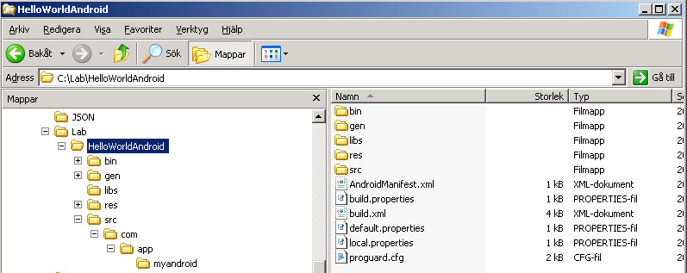
Creating the Hello World Project Structure
C:\Lab>android create project
--target 6
--name MyAndroidApp
--path ./HelloWorldAndroid
--activity MyAppActivity
--package com.app.myandroid
© 2011 Appcelerator, Inc.

Slide 14
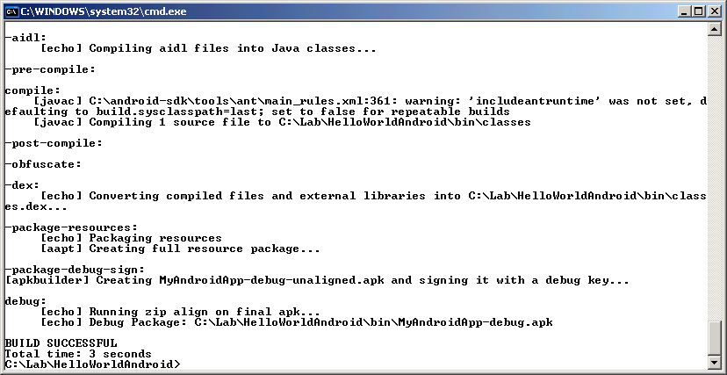
How to build your hello world application
C:\Lab>ant debug
[build successful]
© 2011 Appcelerator, Inc.
Notes:
When issuing the command ”android” stand alone it will start this android virtual device manager, by clicking new you will be able to
create a new virtual device for your needs.
What tool is used to manage your SDK versions?
1 Keystore tool
2 Android Virtual device manager
3 Windows update
4 The emulator tool
What tool is used to create a virtual target?
1 Android virtual device manager
2 The virtual elements of a project
3 The android.bat script
4 The emulator tool

Slide 15
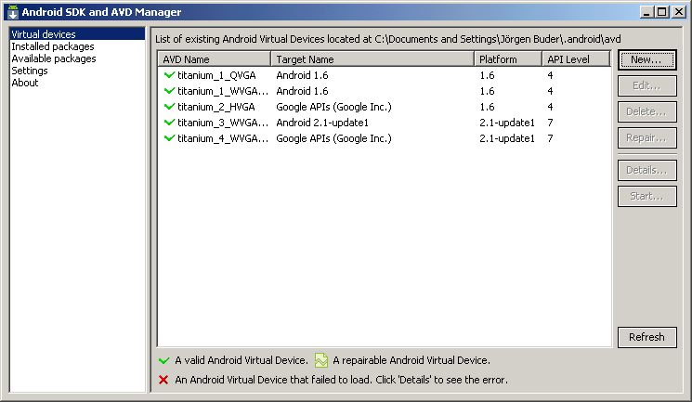
Creating a virtual device
C:\Lab>Android
[create a new virtual device]
© 2011 Appcelerator, Inc.
Notes:
When issuing the command ”android” stand alone it will start this android virtual device manager, by clicking new you will be able to
create a new virtual device for your needs.
What tool is used to manage your SDK versions?
1 Keystore tool
2 Android Virtual device manager
3 Windows update
4 The emulator tool
What tool is used to create a virtual target?
1 Android virtual device manager
2 The virtual elements of a project
3 The android.bat script
4 The emulator tool

Slide 16
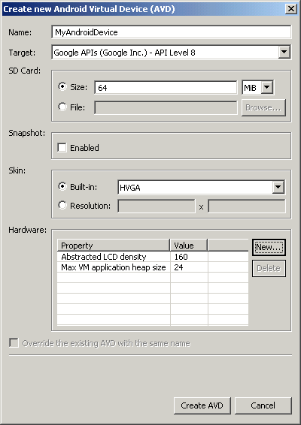
Virtual Device Parameters
[enter a name]
[choose an API level]
[pick size of SD card]
[choose a resolution]
[click create AVD]
© 2011 Appcelerator, Inc.
Notes:
Options dialog permits settings for each virtual device. It is possible to customize
hardware settings as well.
Before installation you need to start your virtual device,
in the android virtual manager, simply click start and it will show up, it takes about a minute or two.

Slide 17
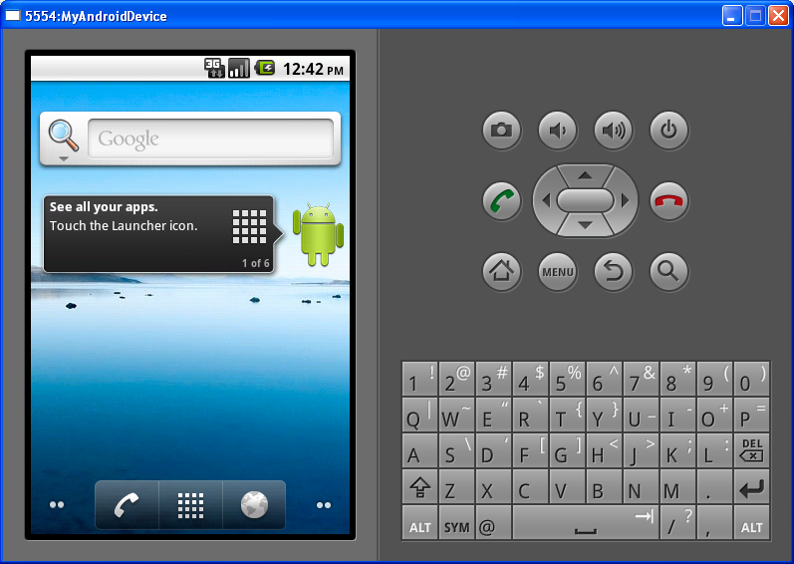
How to install your application to the target
adb install bin/MyAndroidApp-debug.apk
© 2011 Appcelerator, Inc.
Notes:
You install the apk file to the target with the help of the android debug bridge tool by specifying an install argument.
It can be installed onto an emulated device or the connected phone.
What does this command do: adb install bin/myapp.apk
1 It starts the emulator and installs my project as well us run it
2 It installs my project only if the emulator has been started
3 It installs the emulator
4 It cannot install applications at all

Slide 18
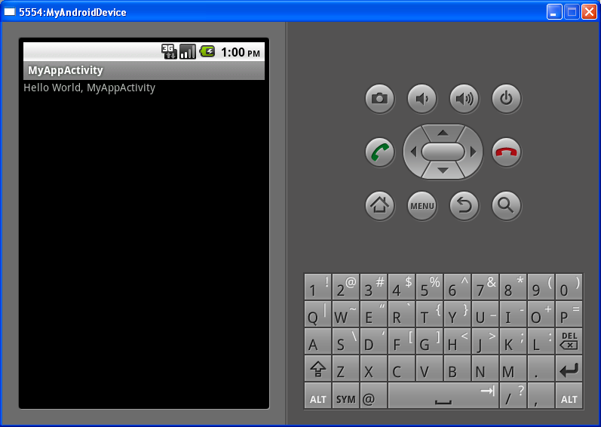
Hello World application running
© 2011 Appcelerator, Inc.
Notes:
When the application is running you can use the emulator to simulate
things on the phone as well as stimulating it´s user interface.

Slide 19
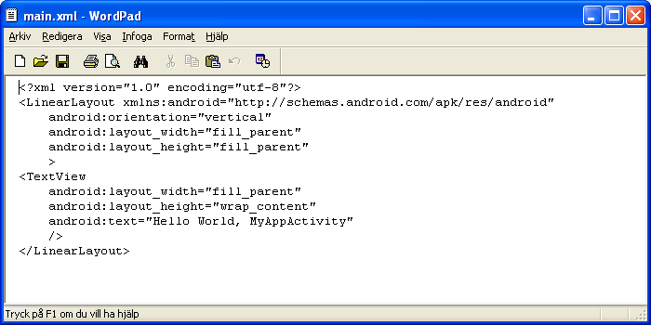
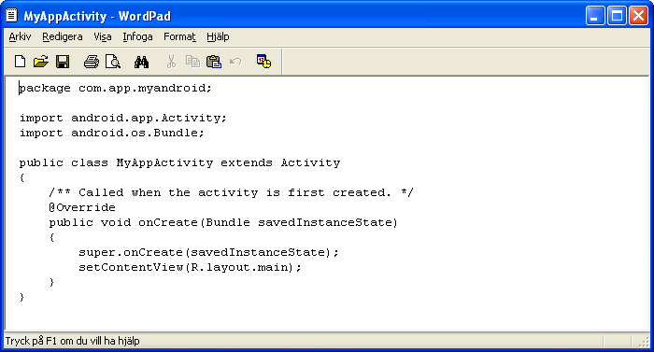
Application starting point
[a UI component in XML]
[the first function that will run]
© 2011 Appcelerator, Inc.
Notes:
View layouts are represented by xml files and properties in the XML files.
Here we can see a simple TextView specified on the view layout.
How are the view layouts represented in Android?
1 Layouts are represented with xml files which describe the view content
2 The views can only by programmatically build from Java
3 The views are drawn by hand in Photoshop
4 They are defined in the java header file.

Slide 20
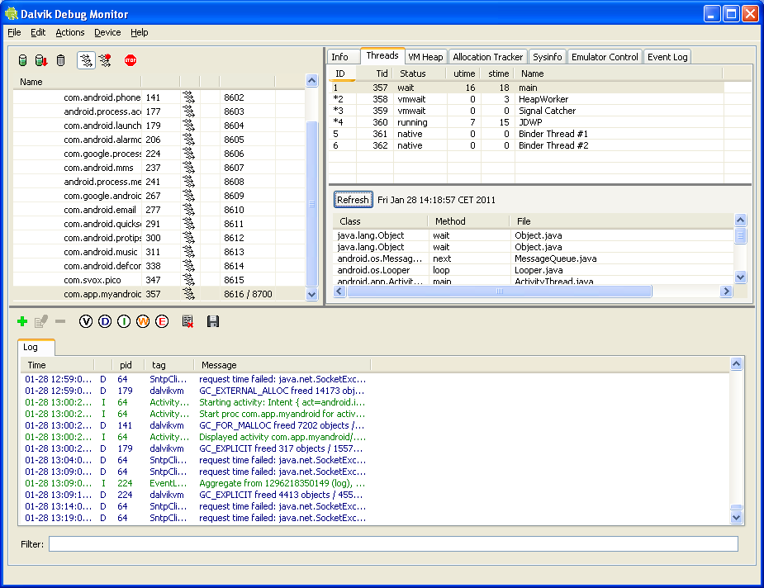
Dalvik monitor
[threads]
[processes]
[device tag]
© 2011 Appcelerator, Inc.
Notes:
With the Dalvik Monitor you can monitor threads, processes and memory in Android emulated or target devices.
It is a good tool to use in the debug process of the tool chain.
What is the name of the tool that can monitor your processes and threads on Android?
1 Debug Threads
2 Dalvik Virtual Mashine
3 Dalvik Monitor
4 It cannot be done

Slide 21

Xcode new project wizard
Editor XCode built in / other
The iPhone
Tool Chain
Objective C compiler & build system GCC
iPhone Debugger GDB
Simulator iPhone Simulator
iTunes Connect and Portal, key chain application
© 2011 Appcelerator, Inc.
Notes:
Using the iPhone tool chain is done in the IDE and at first glance it may seem that you need less steps to build your application than in Android,
how ever the difference is that in XCode the build process is linked to the debugger and simulator more tightly.
Project manager.
First you create the project and set the appropriate parameters in the crate project wizard
Then you will be presented with an IDE.
Editor.
The IDE has a built in editor with capabilities like code completion and color coding, etc
Separate editor can be used as well
Building, compiling and running the debugger in your simulator.
In XCode when you hit the build and run icon you will start the compiler and linker to create an executable
The executable is then downloaded into the iPhone simulator and is ready to use for testing.
Adding breakpoints in the code makes the simulator stop and wait for your input.
XCode uses the Gnu Debugger (GDB) as well as the Gnu Compiler (GCC)
What debugger is used for the iPhone
1 GDB, Gnu debugger
2 Any debugger can be used
3 The iPhone has no need of a debugger
4 Cicso Debugger
What compiler are used to make iPhone applications?
1 Watcom C/C++ compiler
2 GCC, Gnu Compiler
3 No compiler is needed
4 iPhone uses a linker instead of a compiler
Signing and package
Signing iPhone applications is far more complicated than on Android, you need to go through a number of
steps to create key files, device ID registrations and provisioning files from the Apple development portal.
Those are then used in your XCode environment to correctly sign your applications before uploading
with the help of iTune Connect. Tools use are the key manager in utilities folder as well as the apple portal
and XCode.

Slide 22
Hello World for iPhone Native Tool Chain
© 2011 Appcelerator, Inc.
Notes:
Creating apps for iPhone is mainly done in Xcode, included in Macintosh computers.
XCode is an IDE which wrappes all the tools you need, similar to Eclipse in Android.

Slide 23
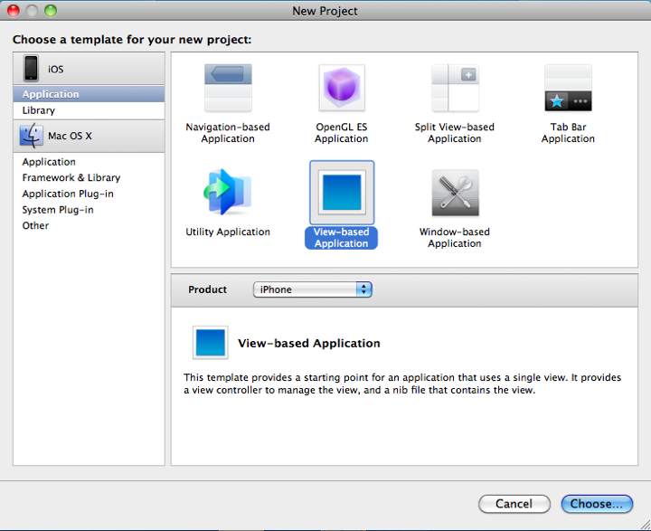
Create a new XCode project for iPhone
[project platform]
[project template]
[project product]
© 2011 Appcelerator, Inc.
Notes:
Find and boot the XCode IDE, chose to make an new XCode project.
Click ”Application” in iOS (for iPhone) and then a template, for this demonstration we will use the ”view based” application
Make sure the product is iPhone as it can be iPad as well.
Click choose and you will enter the name and location of your iphone application
What tool is used to create a project for iPhone?
1 The key manager in utilities folder
2 The iTunes Connect portal
3 The XCode Integrated environment
4 The iPhone device connected with a USB

Slide 24
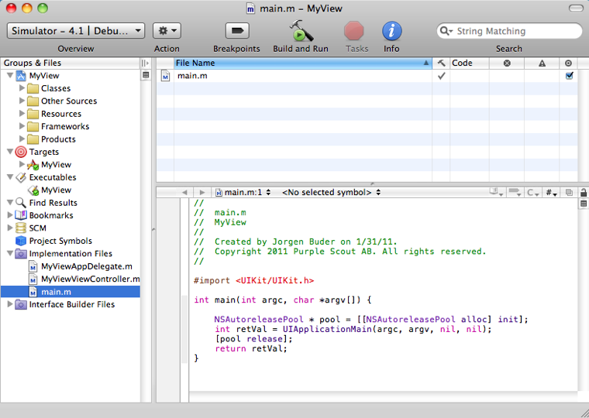
The XCode IDE tools
[build and start simulator]
[project parameters]
[editor]
[files & targets]
© 2011 Appcelerator, Inc.
Notes:
in XCode you chose your target configuration at the top left.
The left pane holds files, folders and sometimes search results and targets
The same file (main.m) can be found under more than one instance in the left pane.
Bottom right you can find the editor for your source code. The additional top right pane is used for
additional information about an instance in the left pane.
Finally in the top bar you can click the build and run and by doing that starting both the
compiler, simulator and the debugger for the chosen target and you will be presented with the iPhone
simulator running your code.
What steps are run when you hit the build and run icon in XCode?
1 Compile and start the emulator
2 Compile, link, start emulator and downloads your application as well as starts the application for you
3 Links precompiled code and then starts your iPhone device
4 Starts the emulator and then stops

Slide 25
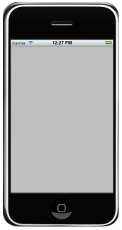
Running your application on the simulator
© 2011 Appcelerator, Inc.
Notes:
Since we didn´t add any code all we have in this application is a empty gray view, but this demonstrates how to get up and
running with the iPhone tool chain, of cause there are a number of other tools to help you develop and test your application,
but this is the minimum you would need to get started.

Slide 26
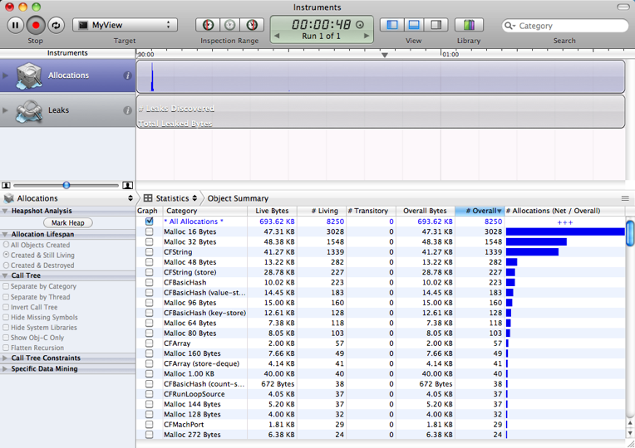
Instrumental tools to aid the test process
© 2011 Appcelerator, Inc.
Notes:
Just like the dalvik monitor in Android, you can start different instrumentation tools to find memory leaks, track threads
and processes and to find potential errors. These can be found in the run/run with performance tools menu.

Slide 27
Interactions With Titanium
© 2011 Appcelerator, Inc.

Slide 28
Titanium Developer and the SDKs
Titanium Developer is a GUI over the top of Python build scripts (mobile SDK)
Scripts interact with native tool chains
Titanium Mobile SDK requires and is dependent on these native tool chains
Will still need to use native tool chains (on occasion)
© 2011 Appcelerator, Inc.
© 2011 Appcelerator, Inc.
Notes:
Slide Flow
Titanium Developer is a Ti Desktop GUI over the top of build scripts in the mobile SDK
Demo: Navigate to the mobile SDK directory on the filesystem, show build scripts and brief explanation of what they are used for (invoking the compilers, shipping to a device)
Since the build scripts interface with command line tools like adb, the native SDKs are a hard requirement for mobile development.
Titanium Developer is today a very shallow tool. This will change with Aptana IDE integration, but for now you will need to rely on the native SDK tools for debugging – most notably adb for on-device debug logging
In some cases, if your application gets very large or uses lots of different media assets at once, you may need to start profiling your application’s memory use and experiment with ways to reduce memory consumption, but this is a very rare case since Titanium handles memory management for you.

Slide 29
Lab Exercise
Open the lab exercise documentation and work through either the Android or iPhone lab, depending on your setup.
© 2011 Appcelerator, Inc.
© 2011 Appcelerator, Inc.
Notes:
After completing the lab exercise you should now be able to create, edit, build and run a native project for iPhone and / or Android.

Slide 30
Training Resources
© 2011 Appcelerator, Inc.

Slide 31
Training Resources
module2010/lab.doc
© 2011 Appcelerator, Inc.
© 2011 Appcelerator, Inc.

Slide 32
Summary
You should now be able to create, edit, build, and deploy a basic Hello World project on iPhone or Android platform.
© 2011 Appcelerator, Inc.
© 2011 Appcelerator, Inc.

Slide 33
Q&A
© 2011 Appcelerator, Inc.

