Slide 1




Working with Media and the Filesystem
First Name, Last
Title
Appcelerator, Inc.
EMAIL
First Name, Last
Title
Appcelerator, Inc.
EMAIL
© 2011 Appcelerator, Inc.
Notes:
This module uses some of the code from persistence by Kevin

Slide 2

Objective
You will learn how to use the camera and save/load images as well as streaming sound and playing video
© 2011 Appcelerator, Inc.
© 2011 Appcelerator, Inc.

Slide 3
Agenda
Media overview
The file system
Using the camera
Using video and sound
Demonstration
Lab Exercise
Summary
© 2011 Appcelerator, Inc.
© 2011 Appcelerator, Inc.
Notes:
During the first slides, of filesystem, video and sound references will be displyed to code for better comprehension, the code is not complete
in any way, the real stuff will be demoed in the Demonstration part of this module.

Slide 4
Media overview
In the new world of mobile phones we do not talk much of calling anymore.
Instead we want more photo, video and music on demand, we want to buy and share
© 2011 Appcelerator, Inc.
© 2011 Appcelerator, Inc.
Notes:
Essentially our mobiles are no longer phones but rich media devices with a lot of sensors.
Titanium offers access to a number of media oriented functions within
Video, music and sound as well as accessing them with gallerys, music libraries and filesystems.
The drive for more media on devices makes this part extremely interesting
Review the Ti.media doc on the web

Slide 5
The file system
To make good use of the media you record or consume you need a filesystem to contain it.
Loading and saving data is very similar to how you do it in other platforms, by getting a handler to a filesystem you can then write and read to it.
© 2011 Appcelerator, Inc.
© 2011 Appcelerator, Inc.
Notes:
It is important to understand the concept between resourceDirectory and applicationDirectory
(Question to the team:
If snapping a foto, it seems a file is always saved in Android, this file is found in the gallery, but is it not saved actually to the application directroy?
Also if I create a file, any file and save it, will other apps be able to reach it? For images and video this seem to be true, but other files then?
Also the diff of recourse and app dir, lets see if I can find a good defenition for this and get it in here!!!)

Slide 6
The file system
The following code reads data and then writes it back.
// PLEASE NOTE - resourcesDirectory is read-only on the device - use
applicationDataDirectory for writes
var f = Titanium.Filesystem.getFile(Titanium.Filesystem.resourcesDirectory, 'test.json');
var resources = JSON.parse(f.read().text);
save.addEventListener("click", function(e) {
// WARNING - resourcesDirectory is not writeable on the device - use applicationDataDirectory instead
f.write(JSON.stringify(resources));
});
© 2011 Appcelerator, Inc.
© 2011 Appcelerator, Inc.
Notes:
This simple code shows how you can open a file on the device and use it
and then write it back down, This can be any type of file, like a picture, movie or music.
This file is located in the root of your project and will be send with your system when packaging
but will still be a file in the file system so that it does not take up application space(?)
Note the difference in resources and application directory.
Is there a way to detect the device or simulator environment?

Slide 7
The file system
Another example where the photo from the camera is written to a file.
Titanium.Media.showCamera({
success:function(event)
{
var cropRect = event.cropRect;
var image = event.media;
var f = Titanium.Filesystem.getFile(Titanium.Filesystem.applicationDataDirectory,'camera_photo.png');
f.write(image);
win.backgroundImage = f.nativePath;
},
© 2011 Appcelerator, Inc.
© 2011 Appcelerator, Inc.
Notes:
This is a small part of a camera object, it will on successful snapshot return here and save the image

Slide 8
Using the camera
The camera is a ”service like” process that you can call to start and that return an event object to you.
You can control the external camera service with properties and callbacks and the return values are not only the media object but can also be what type.
© 2011 Appcelerator, Inc.
© 2011 Appcelerator, Inc.
Notes:
It is important to understand that this process is external and how it is structured.
The event item contains not only the image but informaiton about the image, like for instance the type, video or photo.
You can control what kind of data you want to get back by sending arguments, for instance the type photo only

Slide 9
Using the camera
The camera can be accessed by calling the media api method Ti.Media.showCamera.
Titanium.Media.showCamera({
success:function(event)
{
var cropRect = event.cropRect;
var image = event.media;
Ti.API.debug('Our type was: '+event.mediaType);
if(event.mediaType == Ti.Media.MEDIA_TYPE_PHOTO)
{
var imageView = Ti.UI.createImageView({
width:win.width,
height:win.height,
image:event.media
});
win.add(imageView);
}
else
{
alert("got the wrong type back ="+event.mediaType);
}
},
saveToPhotoGallery:true,
allowEditing:true,
mediaTypes:[Ti.Media.MEDIA_TYPE_VIDEO,Ti.Media.MEDIA_TYPE_PHOTO]
});
© 2011 Appcelerator, Inc.
© 2011 Appcelerator, Inc.
Notes:
Finding how to use the camera can be tricky at first, but using kitchen sink and looking at the API is essential.
Above you can see how the camera is called and some properties are set that tells the function how to handle the media.
By accessing the API doc for this method you can find a set of properties that can be used to control the camera and to get
response about what the camera did. The camera is a service like external process that needs this interface.

Slide 10
Using the camera
A few important properties to consider:
success
a function that will be called when the camera is completed,
error
a function that will be called upon receiving an error,
cancel
a function that will be called if the user presses the cancel button,
autohide boolean
if the camera should auto hide after the media capture is completed (defaults to true),
saveToPhotoGallery boolean
if the media should be saved to the photo gallery upon successful capture,
© 2011 Appcelerator, Inc.
© 2011 Appcelerator, Inc.

Slide 11
Using the camera
A few more important properties to consider:
allowEditing boolean
if the media should be editable after capture in the UI interface,
mediaTypes
an array of media type constants supported by the capture device UI,
videoQuality
constant to indicate the video quality during capture,
showControls boolean
to indicate if the built-in UI controls should be displayed,
overlay
view which is added as an overlay to the camera UI (on top),
© 2011 Appcelerator, Inc.
© 2011 Appcelerator, Inc.
Notes:
Examine the Item object in the API as well to explore the return data!

Slide 12
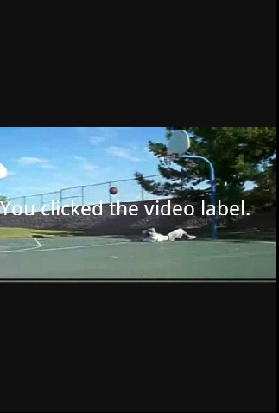
Using video
Playing a video file is as simple as ...
var activeMovie = Titanium.Media.createVideoPlayer({
contentURL:'../movie.mp4',
backgroundColor:'#111',
movieControlMode:Titanium.Media.VIDEO_CONTROL_DEFAULT,
scalingMode:Titanium.Media.VIDEO_SCALING_MODE_FILL
});
activeMovie.play();
win.addEventListener('close', function() {
activeMovie.stop();
});
© 2011 Appcelerator, Inc.
© 2011 Appcelerator, Inc.
Notes:
Setting up a video player playing a local file is done like this, with the properties you can control
scaling and controls in the view.
You can start and stop the video and we catch a window event to make sure it stops when we exit the window

Slide 13
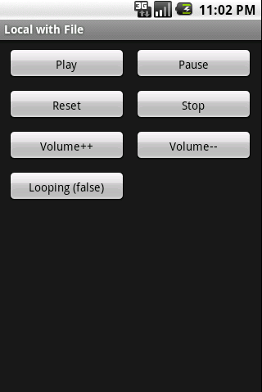
Using the sound
Playing sound from the filesystem or embedded in the application is one primary way to implement sound.
Using the filesystem can
sometimes give latency in
playback and needs to be
preloaded.
You are also able to record
sound.
© 2011 Appcelerator, Inc.
© 2011 Appcelerator, Inc.
Notes:
Sound can be played back in mainly two diffrent ways, there are the small sounds that couls make up feedback sounds or
game effects, and then there are the players.

Slide 14
Using the sound
It is also possible to play music locally or remotely, you can even stream internet radio stations to your applications.
Check out the API for sound playback for all available options. This is an example of code implementation to start the playback, pause and stop.
var url = "http://www.nch.com.au/acm/8kmp38.wav";
// load from remote url
var sound = Titanium.Media.createSound({url:url,preload:true});
sound.play();
sound.pause();
sound.stop();
© 2011 Appcelerator, Inc.
© 2011 Appcelerator, Inc.
Notes:
Check the API . .

Slide 15

Demonstrations
© 2011 Appcelerator, Inc.
Notes:
We will have a look at what the code can look like when you implement the APIs.
Use Android simulator as the camera is simulated there.
Note about the demos: The demo has been made so that you sould in fact skip the kitchen sink real hands on demo, how ever it is recomended
to demo the code and function in kitchen sink. The slides only can be used in a smaller timeframe presentation, same goes for other similar demo slides)

Slide 16

Camera capture and saving the image
The following code shows the success function of the cameraShow object. It handles the image saving
Titanium.Media.showCamera({
success:function(event)
{
var cropRect = event.cropRect;
var image = event.media;
var f = Titanium.Filesystem.getFile (Titanium.Filesystem.applicationDataDirectory,
'camera_photo.png');
f.write(image);
win.backgroundImage = f.nativePath;
},
cancel:function()
{
},
error:function(error)
{
},
allowEditing:true,
saveToPhotoGallery:false
});
© 2011 Appcelerator, Inc.
Notes:
Walkthrough in kitchen sink and demo the function.
File: examples/camera_file.js

Slide 17
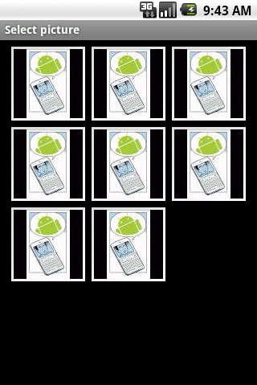
Photo Gallery and getting an object
The following code shows the success function of the openPhotoGallery object. It is a gallery picker object.
Titanium.Media.openPhotoGallery({
success:function(event)
{
var cropRect = event.cropRect;
var image = event.media;
// set image view
Ti.API.debug('Our type was: '+event.mediaType);
if(event.mediaType == Ti.Media.MEDIA_TYPE_PHOTO)
{
imageView.image = image;
}
},
allowEditing:true,
popoverView:popoverView,
arrowDirection:arrowDirection,
mediaTypes:[Ti.Media.MEDIA_TYPE_VIDEO,Ti.Media.MEDIA_TYPE_PHOTO]
});
© 2011 Appcelerator, Inc.
Notes:
Walkthrough in kitchen sink and demo the function.
File: examples/photo_gallery.js
This function is similar in structure as the showCamera was!
You will be returned with the image/video that you have chosen!
(I am afraid that the image from gallery is in fact NOT the file we saved... anyone?)

Slide 18
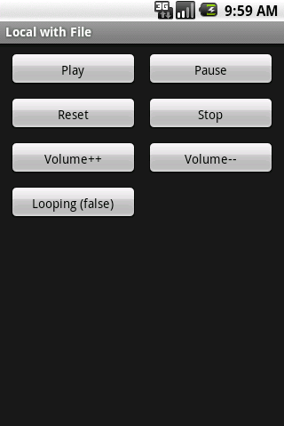
Playing a local sound file
The following code loads a sound file from your resource directory and plays it back.
var file = Titanium.Filesystem.getFile(Titanium.Filesystem.resourcesDirectory,'cricket.wav');
// load from file object
var sound = Titanium.Media.createSound({sound:file});
//
// PLAY
//
var play = Titanium.UI.createButton({
title:'Play',
});
play.addEventListener('click', function()
{
sound.play();
pb.max = sound.duration;
});
© 2011 Appcelerator, Inc.
Notes:
Walkthrough in kitchen sink and demo the function.
File: examples/sound_file.js

Slide 19
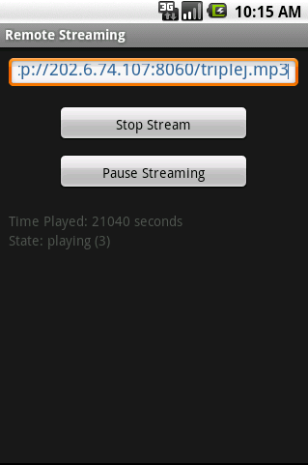
Streaming internet radio
The following code starts a streamer object in which you can set a URL and then start playing.
var streamer = Ti.Media.createAudioPlayer();
url = Titanium.UI.createTextField({
value:'http://202.6.74.107:8060/triplej.mp3'
});
streamButton.addEventListener('click',function()
{
if (streamButton.title == 'Stop Stream')
{
progressLabel.text = 'Stopped';
streamer.stop();
pauseButton.enabled = false;
pauseButton.title = 'Pause Streaming';
streamButton.title = "Start Streaming";
}
else
{
progressLabel.text = 'Starting ...';
streamer.url = url.value;
streamer.start();
pauseButton.enabled = true;
pauseButton.title = 'Pause Streaming';
streamButton.title = "Stop Stream";
}
});
© 2011 Appcelerator, Inc.
Notes:
Walkthrough in kitchen sink and demo the function.
File: examples/sound_remote.js
Note the similarity to the sound object.

Slide 20
Play a local video
The following code plays a local video sequence in a typical player controller.
var activeMovie = Titanium.Media.createVideoPlayer({
contentURL:'../movie.mp4',
backgroundColor:'#111',
movieControlMode:Titanium.Media.VIDEO_CONTROL_DEFAULT,
scalingMode:Titanium.Media.VIDEO_SCALING_MODE_FILL
});
activeMovie.play();
win.addEventListener('close', function() {
activeMovie.stop();
});
© 2011 Appcelerator, Inc.
Notes:
Walkthrough in kitchen sink and demo the function.
File: examples/movie_local.js
Note that you can add UI objects to the video as if it was a view

Slide 21
Explore
As the Titanium framework offers a rich media API, exploring the KitchenSink and the API documentation further will introduce you to more media objects.
© 2011 Appcelerator, Inc.

Slide 22
Media API summary
Audio Player
Audio Recorder
Music Player
Sound Player
Video Player
Camera Object (returns a media object)
Gallery Object (returns a media object)
Music Library Object (returns a media object)
Microphone Monitoring
Device Vibration
Different Media file types
Different Media codec types
Quality Settings
Control Settings
© 2011 Appcelerator, Inc.
Notes:
Exploring the API is essential to get your started, use it as a template for your new applications.

Slide 23
Training Resources
© 2011 Appcelerator, Inc.
Notes:
Lets implement some rich media functions...

Slide 24
Training Resources
Kitchen Sink
Lab doc
Ti Bounty Hunter code
URL github..
© 2011 Appcelerator, Inc.
© 2011 Appcelerator, Inc.

Slide 25
Summary
You should now be able to use images, videos and sound to populate your application with a great user experience, as well as being able to save and load files and understand where files are stored.
© 2011 Appcelerator, Inc.
© 2011 Appcelerator, Inc.

Slide 26
Q&A
© 2011 Appcelerator, Inc.

