Slide 1




LOC-<number>
Notes:
Module time: 60 mins (30 teaching, 30 lab)

Slide 2
Agenda
Comprender los distintos mecanismos para la persistencia en Titanium Mobile
Aprender los puntos básicos del motor de SQLite
Comprender el uso de la API Properties para almacenar la configuración y objetos JavaScript
Utilizar datos persistentes para memorizar la configuración de los elementos en la interfaz de usuario
LOC-<number>
Notes:
We’ll cover the differences between mechanisms and when you’d each

Slide 3
Métodos de persistencia para datos locales
Base de datos SQLite
API Properties
Montones de datos estructurados === Base de datos
Configuración o menos de 20 objetos parecidos === Propiedades
Imágenes, datos binarios – no use blobs siempre que se pueda
LOC-<number>

Slide 4
Properties API
Almacenamiento ligero de tipo clave/valor
Es más adecuada para persistencia ligera (opciones de configuración, estados de la aplicación)
Junto con JSON, puede ser utilizado para almacenar objetos complejos de JavaScript
LOC-<number>
Notes:
Properties plus JSON is live-coded in the persistence app, with you writing out a JavaScript object to a string property and then reading it back in.

Slide 5
JSON = JavaScript Object Notation
Independiente de lenguaje y basado en texto, creado para representar arreglos y objetos (sin métodos)
Formato de datos compacto, eficiente en conexiones lentas
Estandarizado y soportado ampliamente, ver json.org
Javascript
JSON
      myObj.id = 1;
      myObj.firstname=“Fred”;
      Myobj.lastname=“Flintstone”;
JSON
stringify()
      {
      “id”: 1,
      “firstname”: “Fred”,
      “lastname”: “Flintstone”
      }
JSON
parse()
LOC-<number>
Notes:
Quick intro to JSON
Skip if students are familiar with topic

Slide 6
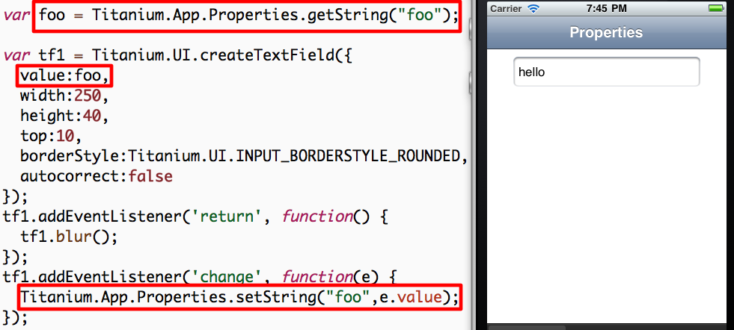
Demo: String Properties
LOC-<number>
Notes:
Demo for plain old properties uses the “Persistence” demo app
Launch in Developer and demo app
Enter data and quit
Fully quit app
Re-open to demonstrate persistence
Code review:
Open Resources/properties.js
Ti.App.Properties.getString() and mention data types
createTextField()
Change event listener, setString()

Slide 7
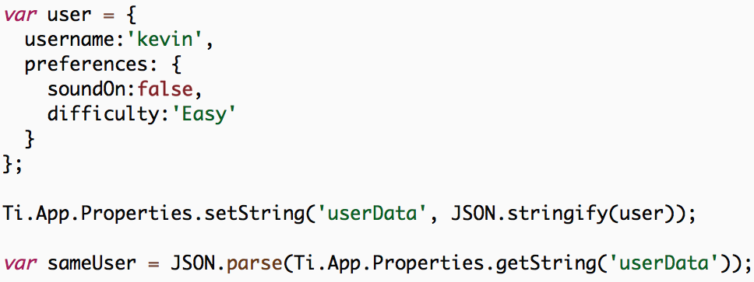
Almacenamiento simple de objetos
LOC-<number>
Notes:
Ti Properties can be used to store simple objects
Example user object
Save to userData property via JSON.stringify()
Reconstitute using JSON.parse()

Slide 8
Database API
Cada plataforma maneja e incluye una base de datos en SQLite
Mejor situado para grandes cantidades de datos
Es posible utilizar una base de datos rellenada previamente utilizando Ti.Database.install
Interacción con la BD utilizando declaraciones SQL estándar
Demo: Persistence app
LOC-<number>
Notes:
NOTE: When shipping a pre-populated database, this will NOT use the SD card on Android and will increase the size of the installable binary. This can be an issue on older Android devices. Also, any time the binary size gets bigger, you should look at alternatives, like downloading your database from the web
Demo -- Persistence app
Open app, switch to Database tab
Add an entry
Click row, alert shows row index
Click Edit, click delete button, click Delete
Don’t do the code review here, next slides

Slide 9
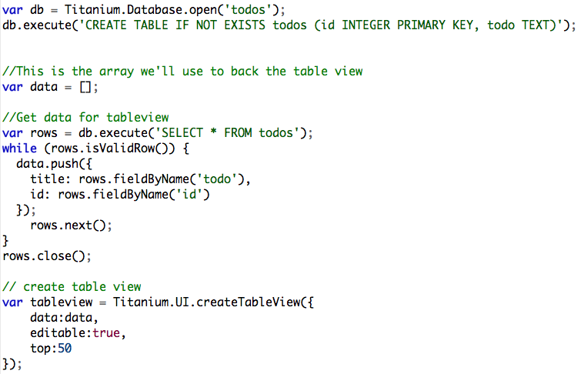
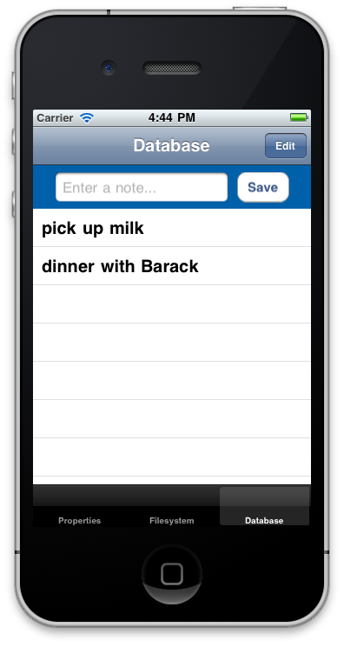
Persistence – Database demo
LOC-<number>
Notes:
Code walkthrough:
Open Resources/app.js and explain basic app structure
Open database.js
Grab reference to database with open()
Create table if it doesn’t exist
Very brief on views/buttons for entry
Retrieving data from DB and building the table row data
rows.next() critical, moves cursor to next record
rows.close() important for memory optimization
better to open and close than to leave open
Creating table, point out editable: true
Event handler on table for alert()
Event handler for delete
Event for adding new row to table
should use db.lastInsertRowID property instead

Slide 10
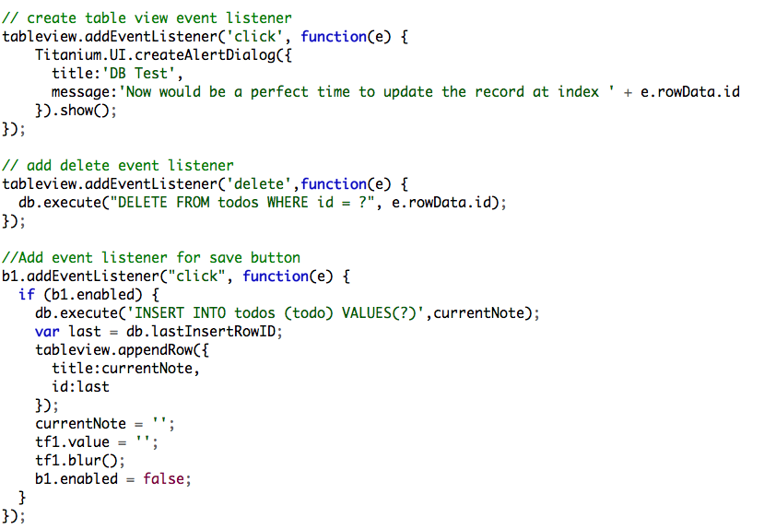
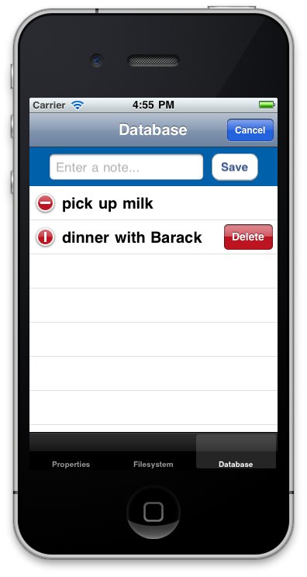
Persistence – Database demo
Solo iOS
LOC-<number>
Notes:
iOS only is the table editing and delete event listener
Code walkthrough:
Open Resources/app.js and explain basic app structure
Open database.js
Grab reference to database with open()
Create table if it doesn’t exist
Very brief on views/buttons for entry
Retrieving data from DB and building the table row data
rows.next() critical, moves cursor to next record
rows.close() important for memory optimization
better to open and close than to leave open
Creating table, point out editable: true
Event handler on table for alert()
Event handler for delete
Event for adding new row to table
should use db.lastInsertRowID property instead

Slide 11
Tipos de Datos en SQLite
Número reducido de tipos de datos preestablecidos
Texto, Entero, Real, Blob
Otros tipos de datos se deben representar mediantes estos tipos
Boolean – Entero 0 or 1
Fecha – Timestamp en forma de texto
LOC-<number>
Notes:
SQLite supports more keywords when creating fields, such as VARCHAR
But “under the hood” the various field types are mapped to the four shown here

Slide 12
Q&A
LOC-<number>

Slide 13
Objetivos de Laboratorio
Respaldar la aplicación TiBountyHunter con datos reales de una base de datos SQL
Requisitos:
Operaciones CRUD en la base de datos de fugitivos
Añadir comportamiento a las ventanas de detalle y agregar
Actualizar la lista de fugitivos al crear, actualizar o borrar
Demo y URL del Laboratorio
LOC-<number>
Notes:
Sticking with our recommendation for self-contained UI components, you’ll want your tableviews to be able to update themselves when fugitives are added, deleted, or updated. You’ll want to use events to notify elements of changes and add methods to your components to update themselves with the new data.
Demo app
Add a fugitive or two
Click to show details, capture (boolean switch)
Switch to Captured tab and there’s the fugitive
Delete the scoundrel and he’s gone from the table
Show that you’ll be using the menu on Android. Demo.
You can get menu code from the KitchenSink

Slide 14
Ejercicios de Laboratorio
LOC-<number>

Slide 15
Tutorial de Solución
LOC-<number>
Notes:
Walk through – TiBH250
app.js
new included file
db.js
DB open, create table, and close statements
list()
add() – note application level event
delete()
bust()
ui.js
Event listener in the tableview, calls populateTable()

