Slide 1


Welcome To Titanium!
Titanium Certified Developer Training Course 101
Appcelerator, Inc.
community@appcelerator.com

Slide 2
Objective
Learn the value and fundamental concepts of developing applications on the Titanium platform

Slide 3
Agenda
Titanium Overview
Hello World and Project Walkthrough
Developer Resources
Where to go from here

Slide 4


Titanium Overview

Slide 5

What Is Titanium?
Titanium allows web developers to rapidly create native mobile, desktop, and tablet applications using JavaScript, HTML, and CSS

Slide 6
Titanium Key Facts
Open Source (Apache 2.0)
Pro Services, Training, Analytics and SLA Support available from Appcelerator
Mobile Platforms: iOS, Android, and BlackBerry (beta)
Desktop Platforms: Windows, OS X, and Linux

Slide 7
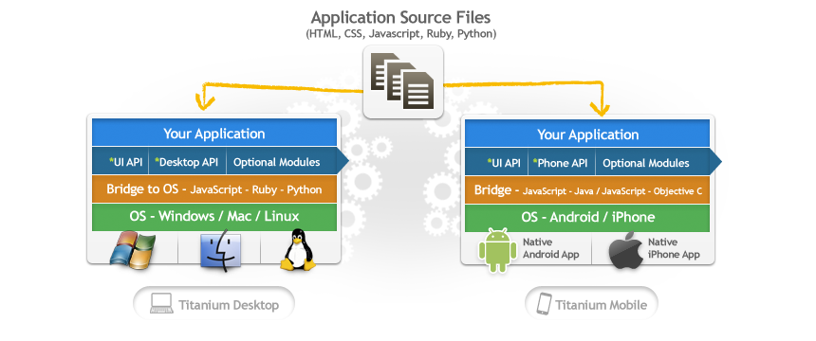
Titanium At 10,000 Feet
Desktop:
HTML 5/ CSS 3 for UI (Webkit)
JavaScript, Ruby, PHP or Python for scripting
Mobile:
JavaScript APIs for UI (Native)
JavaScript for scripting
WebView available, not required

Slide 8








Platform Capabilities
Native User Experience
Native performance + Native UI
(tables, animations, gestures…etc.)
Multimedia
Camera, video camera,
streaming/device audio/video
Location-based services
Augmented reality, geo-location, compass, native maps
Analytics
Integrated user, session, and custom analytics. Interactive web-based analysis tools, Geo-analytics
Social sharing
Authenticated access to Facebook, Twitter, Yahoo YQL.
Native email/address book
Titanium+Plus
Open source and commercial platform plug-ins for ERP systems, encrypted databases, and more
Data
Local SQLite database, light weight key/value store, Filesystem I/O, remote web services
Development tools
Create, test, and publish your application using a single unified tool set

Slide 9
Titanium Projects
Titanium Mobile
Titanium Desktop
Titanium Developer
Aptana Studio – Eclipse-based IDE
Titanium/Aptana IDE coming soon!

Slide 10
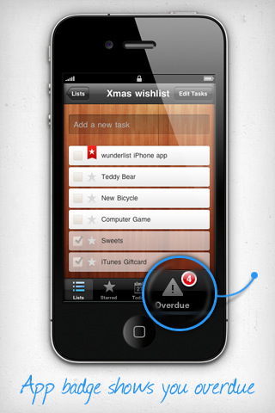
Powered By Titanium
Latest Applications:
Late Night with Jimmy Fallon
Wunderlist
GetGlue (Android)
Companies:
NBC/Universal
eBay and PayPal
Anheuser Busch
Jaguar
MTV
Many more

Slide 11
Hello World!

