Slide 1




Kevin Whinnery
Engineer and Platform Evangelist
Appcelerator, Inc.
kwhinnery@appcelerator.com
Notes:
Most students cannot read slides while listening to a presenter. Make your presentation as visually graphic as possible.

Slide 2
Agenda
Basic Titanium user interface structures
The Titanium View Hierarchy
Layouts and positioning
Event Handling
Externalizing style properties

Slide 3
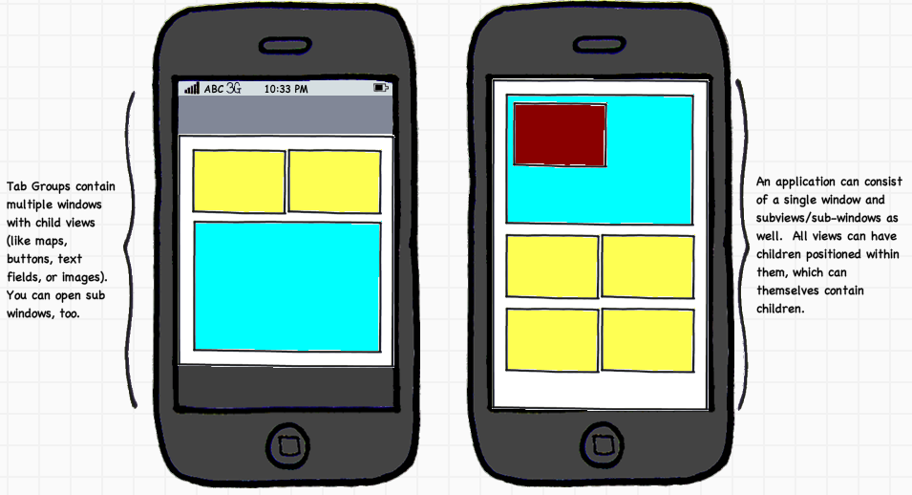
Basic Application Structure
Notes:
Basically two types of application structures – a single window (or stack of windows) with child views, or a tab group containing a single window or stack of windows.

Slide 4
For you web developers…
A “window” is analogous to a “page”
A “view” is analogous to a “div”
Ti.UI namespace provides many specialized controls (buttons, text field, pickers, maps, scroll views)
UI objects are composed in JavaScript similarly to DOM fragments

Slide 5
View Hierarchy and Positioning
Modeled after iOS View Hierarchy
Views positioned relative to parent
Layout options:
1. Absolute
2. Vertical
3. Horizontal (Android as of 1.6.0)
Percentage Heights/Widths (Android in 1.6.0)

Slide 6
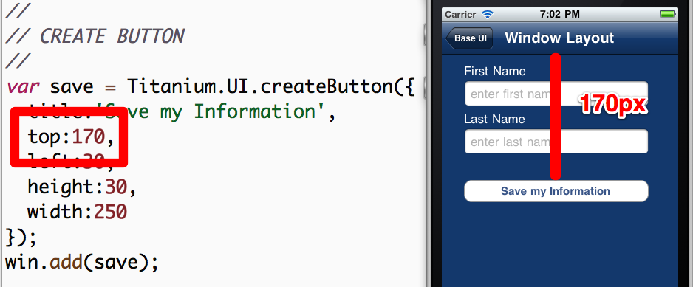
Absolute Layout

Slide 7
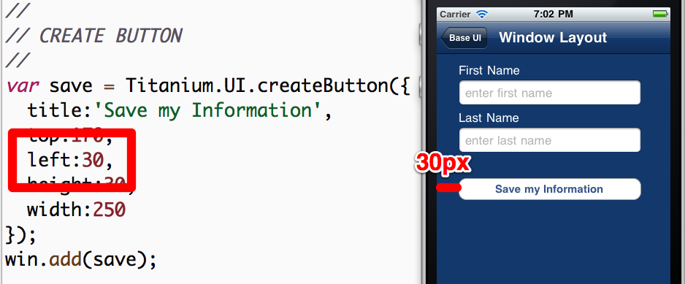
Absolute Layout

Slide 8
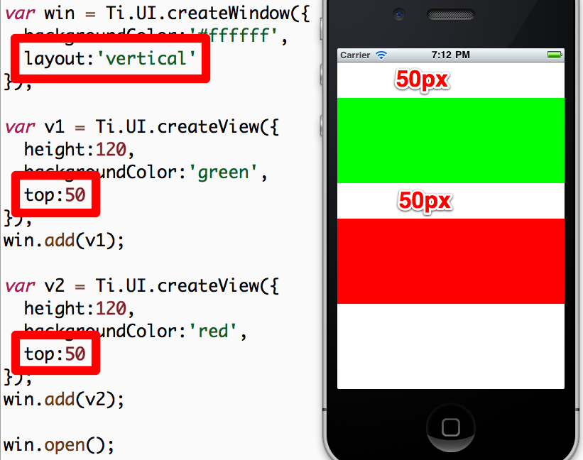
Vertical Layout

Slide 9
Event Handling
Similar To JavaScript in the browser
Can use addEventListener on nearly any JS object
Can programmatically fire events on objects as well
Demo: A simple event handler in the default project

Slide 10
Execution Contexts
App has one execution context by default – similar to JS thread in the browser
Can create more by:
Windows with URLs
Background Services
Each has unique symbol space – variables declared in one context unavailable in another
Demo: Execution Contexts in the default application

Slide 11
More On Execution Contexts
Typically, we recommend using only a single context
Use multiples only when “clean slate” is desired
If multiple contexts are in use, it is often necessary to share data across them
For this, use application-level events

Slide 12
Application-Level Events
Useful for sending JSON-serializable data across contexts
Useful for publishing and subscribing to application events even in a single context
Critical API in component oriented applications
Demo: Cross-context messages in the default application

Slide 13
Composing Your App’s UI
50% or more of your job is UI component construction
Most of the rest is event handling logic
Your app will be more maintainable if you break it down into small components
Recommendation: Use app.js to bootstrap your application and create/show/open one single UI component from your app

Slide 14
Iterative UI Programming
UI programming can boil down to pushing pixels
Need to have the fastest possible cycles, but also need to test cross-platform from the get-go!
iOS Emulator is fast for dev, device cycle is slow
Android Emulator is S-L-O-W – keep it running!
Android devices are faster (better for dev)

Slide 15

Lab Exercise

Slide 16
Lab Goals
Compose a basic two tab application
Requirements:
Display list of fugitives (dummy data)
Drill down into a detail window
Provide a window to add a fugitive
Demo and Lab URL

Slide 17
Solution Walkthrough

Slide 18
Q&A

